Slide 1
The International Society for Heart and Lung Transplantation/Heart Failure Society of America Guideline on Acute Mechanical Circulatory Support
Alexander M. Bernhardt, MD, Hannah Copeland, MD, Anita Deswal, MD, MPH, Jason Gluck, DO, Michael M. Givertz, MD Alexander M. Bernhardt, MD, Jason Gluck, DO Arthur Reshad Garan, MD, MS, Shelley Hall, MD, Awori Hayanga, MD, Ivan Knezevic, MD, Federico Pappalardo, MD, Joyce Wald, DO Cristiano Amarelli, MD, William L. Baker, PharmD, David Baran, MD, Daniel Dilling, MD, Airlie Hogan, RN, Anna L. Meyer, MD, Ivan Netuka, MD, Minoru Ono, MD, Federico Pappalardo, MD, Gustavo Parrilla, MD, Duc Thin Pham, MD, Scott Silvestry, MD, Christy Smith, MD, Koji Takeda, MD, Sunu S. Thomas, MD, MSc, Esther Vorovich, MD, MSCE Michael M. Givertz, MD Jo Ellen Rodgers, PharmD Nana Aburjania, MD, Jean M. Connors, MD, Jasmin S. Hanke, MD, Elrina Joubert-Huebner, MD, Gal Levy, MD, Ann E. Woolley, MD, MPH Hannah Copeland, MD David L.S. Morales, MD, Amanda Vest, MBBS, MPH Francisco A. Arabia, MD, MBA, Michael Carrier, MD, MBA, Christopher T. Salerno, MD, Benedikt Schrage, MD Anita Deswal, MD, MPH Savitri Fedson, MD, MA Larry A. Allen, MD, MHS, Cynthia J. Bither, CRNP, Shannon Dunlay, MD, MS, Paola Morejon, MD, Kay Kendall, MSW, LISW, Michael Kiernan, MD, Sean Pinney, MD, Stephan Schueler, MD, Peter Macdonald, MD, Diyar Saeed, MD, Evgenij Potapov, MD, Tien M.H. Ng, PharmD Alexander M. Bernhardt, MD, Hannah Copeland, MD, Anita Deswal, MD, MPH, Jason Gluck, DO, Michael M. Givertz, MD Alexander M. Bernhardt, MD, Jason Gluck, DO Arthur Reshad Garan, MD, MS, Shelley Hall, MD, Awori Hayanga, MD, Ivan Knezevic, MD, Federico Pappalardo, MD, Joyce Wald, DO Cristiano Amarelli, MD, William L. Baker, PharmD, David Baran, MD, Daniel Dilling, MD, Airlie Hogan, RN, Anna L. Meyer, MD, Ivan Netuka, MD, Minoru Ono, MD, Federico Pappalardo, MD, Gustavo Parrilla, MD, Duc Thin Pham, MD, Scott Silvestry, MD, Christy Smith, MD, Koji Takeda, MD, Sunu S. Thomas, MD, MSc, Esther Vorovich, MD, MSCE Michael M. Givertz, MD Jo Ellen Rodgers, PharmD Nana Aburjania, MD, Jean M. Connors, MD, Jasmin S. Hanke, MD, Elrina Joubert-Huebner, MD, Gal Levy, MD, Ann E. Woolley, MD, MPH Hannah Copeland, MD David L.S. Morales, MD, Amanda Vest, MBBS, MPH Francisco A. Arabia, MD, MBA, Michael Carrier, MD, MBA, Christopher T. Salerno, MD, Benedikt Schrage, MD Anita Deswal, MD, MPH Savitri Fedson, MD, MA Larry A. Allen, MD, MHS, Cynthia J. Bither, CRNP, Shannon Dunlay, MD, MS, Paola Morejon, MD, Kay Kendall, MSW, LISW, Michael Kiernan, MD, Sean Pinney, MD, Stephan Schueler, MD, Peter Macdonald, MD, Diyar Saeed, MD, Evgenij Potapov, MD, Tien M.H. Ng, PharmD Alexander M. Bernhardt, MD, Hannah Copeland, MD, Anita Deswal, MD, MPH, Jason Gluck, DO, Michael M. Givertz, MD Alexander M. Bernhardt, MD, Jason Gluck, DO Arthur Reshad Garan, MD, MS, Shelley Hall, MD, Awori Hayanga, MD, Ivan Knezevic, MD, Federico Pappalardo, MD, Joyce Wald, DO Cristiano Amarelli, MD, William L. Baker, PharmD, David Baran, MD, Daniel Dilling, MD, Airlie Hogan, RN, Anna L. Meyer, MD, Ivan Netuka, MD, Minoru Ono, MD, Federico Pappalardo, MD, Gustavo Parrilla, MD, Duc Thin Pham, MD, Scott Silvestry, MD, Christy Smith, MD, Koji Takeda, MD, Sunu S. Thomas, MD, MSc, Esther Vorovich, MD, MSCE Michael M. Givertz, MD Jo Ellen Rodgers, PharmD Nana Aburjania, MD, Jean M. Connors, MD, Jasmin S. Hanke, MD, Elrina Joubert-Huebner, MD, Gal Levy, MD, Ann E. Woolley, MD, MPH Hannah Copeland, MD David L.S. Morales, MD, Amanda Vest, MBBS, MPH Francisco A. Arabia, MD, MBA, Michael Carrier, MD, MBA, Christopher T. Salerno, MD, Benedikt Schrage, MD Anita Deswal, MD, MPH Savitri Fedson, MD, MA Larry A. Allen, MD, MHS, Cynthia J. Bither, CRNP, Shannon Dunlay, MD, MS, Paola Morejon, MD, Kay Kendall, MSW, LISW, Michael Kiernan, MD, Sean Pinney, MD, Stephan Schueler, MD, Peter Macdonald, MD, Diyar Saeed, MD, Evgenij Potapov, MD, Tien M.H. Ng, PharmD Alexander M. Bernhardt, MD, Hannah Copeland, MD, Anita Deswal, MD, MPH, Jason Gluck, DO, Michael M. Givertz, MD Alexander M. Bernhardt, MD, Jason Gluck, DO Arthur Reshad Garan, MD, MS, Shelley Hall, MD, Awori Hayanga, MD, Ivan Knezevic, MD, Federico Pappalardo, MD, Joyce Wald, DO Cristiano Amarelli, MD, William L. Baker, PharmD, David Baran, MD, Daniel Dilling, MD, Airlie Hogan, RN, Anna L. Meyer, MD, Ivan Netuka, MD, Minoru Ono, MD, Federico Pappalardo, MD, Gustavo Parrilla, MD, Duc Thin Pham, MD, Scott Silvestry, MD, Christy Smith, MD, Koji Takeda, MD, Sunu S. Thomas, MD, MSc, Esther Vorovich, MD, MSCE Michael M. Givertz, MD Jo Ellen Rodgers, PharmD Nana Aburjania, MD, Jean M. Connors, MD, Jasmin S. Hanke, MD, Elrina Joubert-Huebner, MD, Gal Levy, MD, Ann E. Woolley, MD, MPH Hannah Copeland, MD David L.S. Morales, MD, Amanda Vest, MBBS, MPH Francisco A. Arabia, MD, MBA, Michael Carrier, MD, MBA, Christopher T. Salerno, MD, Benedikt Schrage, MD Anita Deswal, MD, MPH Savitri Fedson, MD, MA Larry A. Allen, MD, MHS, Cynthia J. Bither, CRNP, Shannon Dunlay, MD, MS, Paola Morejon, MD, Kay Kendall, MSW, LISW, Michael Kiernan, MD, Sean Pinney, MD, Stephan Schueler, MD, Peter Macdonald, MD, Diyar Saeed, MD, Evgenij Potapov, MD, Tien M.H. Ng, PharmD Alexander M. Bernhardt, MD, Hannah Copeland, MD, Anita Deswal, MD, MPH, Jason Gluck, DO, Michael M. Givertz, MD Alexander M. Bernhardt, MD, Jason Gluck, DO Arthur Reshad Garan, MD, MS, Shelley Hall, MD, Awori Hayanga, MD, Ivan Knezevic, MD, Federico Pappalardo, MD, Joyce Wald, DO Cristiano Amarelli, MD, William L. Baker, PharmD, David Baran, MD, Daniel Dilling, MD, Airlie Hogan, RN, Anna L. Meyer, MD, Ivan Netuka, MD, Minoru Ono, MD, Federico Pappalardo, MD, Gustavo Parrilla, MD, Duc Thin Pham, MD, Scott Silvestry, MD, Christy Smith, MD, Koji Takeda, MD, Sunu S. Thomas, MD, MSc, Esther Vorovich, MD, MSCE Michael M. Givertz, MD Jo Ellen Rodgers, PharmD Nana Aburjania, MD, Jean M. Connors, MD, Jasmin S. Hanke, MD, Elrina Joubert-Huebner, MD, Gal Levy, MD, Ann E. Woolley, MD, MPH Hannah Copeland, MD David L.S. Morales, MD, Amanda Vest, MBBS, MPH Francisco A. Arabia, MD, MBA, Michael Carrier, MD, MBA, Christopher T. Salerno, MD, Benedikt Schrage, MD Anita Deswal, MD, MPH Savitri Fedson, MD, MA Larry A. Allen, MD, MHS, Cynthia J. Bither, CRNP, Shannon Dunlay, MD, MS, Paola Morejon, MD, Kay Kendall, MSW, LISW, Michael Kiernan, MD, Sean Pinney, MD, Stephan Schueler, MD, Peter Macdonald, MD, Diyar Saeed, MD, Evgenij Potapov, MD, Tien M.H. Ng, PharmD Alexander M. Bernhardt, MD, Hannah Copeland, MD, Anita Deswal, MD, MPH, Jason Gluck, DO, Michael M. Givertz, MD Alexander M. Bernhardt, MD, Jason Gluck, DO Arthur Reshad Garan, MD, MS, Shelley Hall, MD, Awori Hayanga, MD, Ivan Knezevic, MD, Federico Pappalardo, MD, Joyce Wald, DO Cristiano Amarelli, MD, William L. Baker, PharmD, David Baran, MD, Daniel Dilling, MD, Airlie Hogan, RN, Anna L. Meyer, MD, Ivan Netuka, MD, Minoru Ono, MD, Federico Pappalardo, MD, Gustavo Parrilla, MD, Duc Thin Pham, MD, Scott Silvestry, MD, Christy Smith, MD, Koji Takeda, MD, Sunu S. Thomas, MD, MSc, Esther Vorovich, MD, MSCE Michael M. Givertz, MD Jo Ellen Rodgers, PharmD Nana Aburjania, MD, Jean M. Connors, MD, Jasmin S. Hanke, MD, Elrina Joubert-Huebner, MD, Gal Levy, MD, Ann E. Woolley, MD, MPH Hannah Copeland, MD David L.S. Morales, MD, Amanda Vest, MBBS, MPH Francisco A. Arabia, MD, MBA, Michael Carrier, MD, MBA, Christopher T. Salerno, MD, Benedikt Schrage, MD Anita Deswal, MD, MPH Savitri Fedson, MD, MA Larry A. Allen, MD, MHS, Cynthia J. Bither, CRNP, Shannon Dunlay, MD, MS, Paola Morejon, MD, Kay Kendall, MSW, LISW, Michael Kiernan, MD, Sean Pinney, MD, Stephan Schueler, MD, Peter Macdonald, MD, Diyar Saeed, MD, Evgenij Potapov, MD, Tien M.H. Ng, PharmD Alexander M. Bernhardt, MD, Hannah Copeland, MD, Anita Deswal, MD, MPH, Jason Gluck, DO, Michael M. Givertz, MD Alexander M. Bernhardt, MD, Jason Gluck, DO Arthur Reshad Garan, MD, MS, Shelley Hall, MD, Awori Hayanga, MD, Ivan Knezevic, MD, Federico Pappalardo, MD, Joyce Wald, DO Cristiano Amarelli, MD, William L. Baker, PharmD, David Baran, MD, Daniel Dilling, MD, Airlie Hogan, RN, Anna L. Meyer, MD, Ivan Netuka, MD, Minoru Ono, MD, Federico Pappalardo, MD, Gustavo Parrilla, MD, Duc Thin Pham, MD, Scott Silvestry, MD, Christy Smith, MD, Koji Takeda, MD, Sunu S. Thomas, MD, MSc, Esther Vorovich, MD, MSCE Michael M. Givertz, MD Jo Ellen Rodgers, PharmD Nana Aburjania, MD, Jean M. Connors, MD, Jasmin S. Hanke, MD, Elrina Joubert-Huebner, MD, Gal Levy, MD, Ann E. Woolley, MD, MPH Hannah Copeland, MD David L.S. Morales, MD, Amanda Vest, MBBS, MPH Francisco A. Arabia, MD, MBA, Michael Carrier, MD, MBA, Christopher T. Salerno, MD, Benedikt Schrage, MD Anita Deswal, MD, MPH Savitri Fedson, MD, MA Larry A. Allen, MD, MHS, Cynthia J. Bither, CRNP, Shannon Dunlay, MD, MS, Paola Morejon, MD, Kay Kendall, MSW, LISW, Michael Kiernan, MD, Sean Pinney, MD, Stephan Schueler, MD, Peter Macdonald, MD, Diyar Saeed, MD, Evgenij Potapov, MD, Tien M.H. Ng, PharmD Alexander M. Bernhardt, MD, Hannah Copeland, MD, Anita Deswal, MD, MPH, Jason Gluck, DO, Michael M. Givertz, MD Alexander M. Bernhardt, MD, Jason Gluck, DO Arthur Reshad Garan, MD, MS, Shelley Hall, MD, Awori Hayanga, MD, Ivan Knezevic, MD, Federico Pappalardo, MD, Joyce Wald, DO Cristiano Amarelli, MD, William L. Baker, PharmD, David Baran, MD, Daniel Dilling, MD, Airlie Hogan, RN, Anna L. Meyer, MD, Ivan Netuka, MD, Minoru Ono, MD, Federico Pappalardo, MD, Gustavo Parrilla, MD, Duc Thin Pham, MD, Scott Silvestry, MD, Christy Smith, MD, Koji Takeda, MD, Sunu S. Thomas, MD, MSc, Esther Vorovich, MD, MSCE Michael M. Givertz, MD Jo Ellen Rodgers, PharmD Nana Aburjania, MD, Jean M. Connors, MD, Jasmin S. Hanke, MD, Elrina Joubert-Huebner, MD, Gal Levy, MD, Ann E. Woolley, MD, MPH Hannah Copeland, MD David L.S. Morales, MD, Amanda Vest, MBBS, MPH Francisco A. Arabia, MD, MBA, Michael Carrier, MD, MBA, Christopher T. Salerno, MD, Benedikt Schrage, MD Anita Deswal, MD, MPH Savitri Fedson, MD, MA Larry A. Allen, MD, MHS, Cynthia J. Bither, CRNP, Shannon Dunlay, MD, MS, Paola Morejon, MD, Kay Kendall, MSW, LISW, Michael Kiernan, MD, Sean Pinney, MD, Stephan Schueler, MD, Peter Macdonald, MD, Diyar Saeed, MD, Evgenij Potapov, MD, Tien M.H. Ng, PharmD Alexander M. Bernhardt, MD, Hannah Copeland, MD, Anita Deswal, MD, MPH, Jason Gluck, DO, Michael M. Givertz, MD Alexander M. Bernhardt, MD, Jason Gluck, DO Arthur Reshad Garan, MD, MS, Shelley Hall, MD, Awori Hayanga, MD, Ivan Knezevic, MD, Federico Pappalardo, MD, Joyce Wald, DO Cristiano Amarelli, MD, William L. Baker, PharmD, David Baran, MD, Daniel Dilling, MD, Airlie Hogan, RN, Anna L. Meyer, MD, Ivan Netuka, MD, Minoru Ono, MD, Federico Pappalardo, MD, Gustavo Parrilla, MD, Duc Thin Pham, MD, Scott Silvestry, MD, Christy Smith, MD, Koji Takeda, MD, Sunu S. Thomas, MD, MSc, Esther Vorovich, MD, MSCE Michael M. Givertz, MD Jo Ellen Rodgers, PharmD Nana Aburjania, MD, Jean M. Connors, MD, Jasmin S. Hanke, MD, Elrina Joubert-Huebner, MD, Gal Levy, MD, Ann E. Woolley, MD, MPH Hannah Copeland, MD David L.S. Morales, MD, Amanda Vest, MBBS, MPH Francisco A. Arabia, MD, MBA, Michael Carrier, MD, MBA, Christopher T. Salerno, MD, Benedikt Schrage, MD Anita Deswal, MD, MPH Savitri Fedson, MD, MA Larry A. Allen, MD, MHS, Cynthia J. Bither, CRNP, Shannon Dunlay, MD, MS, Paola Morejon, MD, Kay Kendall, MSW, LISW, Michael Kiernan, MD, Sean Pinney, MD, Stephan Schueler, MD, Peter Macdonald, MD, Diyar Saeed, MD, Evgenij Potapov, MD, Tien M.H. Ng, PharmD Alexander M. Bernhardt, MD, Hannah Copeland, MD, Anita Deswal, MD, MPH, Jason Gluck, DO, Michael M. Givertz, MD Alexander M. Bernhardt, MD, Jason Gluck, DO Arthur Reshad Garan, MD, MS, Shelley Hall, MD, Awori Hayanga, MD, Ivan Knezevic, MD, Federico Pappalardo, MD, Joyce Wald, DO Cristiano Amarelli, MD, William L. Baker, PharmD, David Baran, MD, Daniel Dilling, MD, Airlie Hogan, RN, Anna L. Meyer, MD, Ivan Netuka, MD, Minoru Ono, MD, Federico Pappalardo, MD, Gustavo Parrilla, MD, Duc Thin Pham, MD, Scott Silvestry, MD, Christy Smith, MD, Koji Takeda, MD, Sunu S. Thomas, MD, MSc, Esther Vorovich, MD, MSCE Michael M. Givertz, MD Jo Ellen Rodgers, PharmD Nana Aburjania, MD, Jean M. Connors, MD, Jasmin S. Hanke, MD, Elrina Joubert-Huebner, MD, Gal Levy, MD, Ann E. Woolley, MD, MPH Hannah Copeland, MD David L.S. Morales, MD, Amanda Vest, MBBS, MPH Francisco A. Arabia, MD, MBA, Michael Carrier, MD, MBA, Christopher T. Salerno, MD, Benedikt Schrage, MD Anita Deswal, MD, MPH Savitri Fedson, MD, MA Larry A. Allen, MD, MHS, Cynthia J. Bither, CRNP, Shannon Dunlay, MD, MS, Paola Morejon, MD, Kay Kendall, MSW, LISW, Michael Kiernan, MD, Sean Pinney, MD, Stephan Schueler, MD, Peter Macdonald, MD, Diyar Saeed, MD, Evgenij Potapov, MD, Tien M.H. Ng, PharmD Alexander M. Bernhardt, MD, Hannah Copeland, MD, Anita Deswal, MD, MPH, Jason Gluck, DO, Michael M. Givertz, MD Alexander M. Bernhardt, MD, Jason Gluck, DO Arthur Reshad Garan, MD, MS, Shelley Hall, MD, Awori Hayanga, MD, Ivan Knezevic, MD, Federico Pappalardo, MD, Joyce Wald, DO Cristiano Amarelli, MD, William L. Baker, PharmD, David Baran, MD, Daniel Dilling, MD, Airlie Hogan, RN, Anna L. Meyer, MD, Ivan Netuka, MD, Minoru Ono, MD, Federico Pappalardo, MD, Gustavo Parrilla, MD, Duc Thin Pham, MD, Scott Silvestry, MD, Christy Smith, MD, Koji Takeda, MD, Sunu S. Thomas, MD, MSc, Esther Vorovich, MD, MSCE Michael M. Givertz, MD Jo Ellen Rodgers, PharmD Nana Aburjania, MD, Jean M. Connors, MD, Jasmin S. Hanke, MD, Elrina Joubert-Huebner, MD, Gal Levy, MD, Ann E. Woolley, MD, MPH Hannah Copeland, MD David L.S. Morales, MD, Amanda Vest, MBBS, MPH Francisco A. Arabia, MD, MBA, Michael Carrier, MD, MBA, Christopher T. Salerno, MD, Benedikt Schrage, MD Anita Deswal, MD, MPH Savitri Fedson, MD, MA Larry A. Allen, MD, MHS, Cynthia J. Bither, CRNP, Shannon Dunlay, MD, MS, Paola Morejon, MD, Kay Kendall, MSW, LISW, Michael Kiernan, MD, Sean Pinney, MD, Stephan Schueler, MD, Peter Macdonald, MD, Diyar Saeed, MD, Evgenij Potapov, MD, Tien M.H. Ng, PharmD Alexander M. Bernhardt, MD, Hannah Copeland, MD, Anita Deswal, MD, MPH, Jason Gluck, DO, Michael M. Givertz, MD Alexander M. Bernhardt, MD, Jason Gluck, DO Arthur Reshad Garan, MD, MS, Shelley Hall, MD, Awori Hayanga, MD, Ivan Knezevic, MD, Federico Pappalardo, MD, Joyce Wald, DO Cristiano Amarelli, MD, William L. Baker, PharmD, David Baran, MD, Daniel Dilling, MD, Airlie Hogan, RN, Anna L. Meyer, MD, Ivan Netuka, MD, Minoru Ono, MD, Federico Pappalardo, MD, Gustavo Parrilla, MD, Duc Thin Pham, MD, Scott Silvestry, MD, Christy Smith, MD, Koji Takeda, MD, Sunu S. Thomas, MD, MSc, Esther Vorovich, MD, MSCE Michael M. Givertz, MD Jo Ellen Rodgers, PharmD Nana Aburjania, MD, Jean M. Connors, MD, Jasmin S. Hanke, MD, Elrina Joubert-Huebner, MD, Gal Levy, MD, Ann E. Woolley, MD, MPH Hannah Copeland, MD David L.S. Morales, MD, Amanda Vest, MBBS, MPH Francisco A. Arabia, MD, MBA, Michael Carrier, MD, MBA, Christopher T. Salerno, MD, Benedikt Schrage, MD Anita Deswal, MD, MPH Savitri Fedson, MD, MA Larry A. Allen, MD, MHS, Cynthia J. Bither, CRNP, Shannon Dunlay, MD, MS, Paola Morejon, MD, Kay Kendall, MSW, LISW, Michael Kiernan, MD, Sean Pinney, MD, Stephan Schueler, MD, Peter Macdonald, MD, Diyar Saeed, MD, Evgenij Potapov, MD, Tien M.H. Ng, PharmD Alexander M. Bernhardt, MD, Hannah Copeland, MD, Anita Deswal, MD, MPH, Jason Gluck, DO, Michael M. Givertz, MD Alexander M. Bernhardt, MD, Jason Gluck, DO Arthur Reshad Garan, MD, MS, Shelley Hall, MD, Awori Hayanga, MD, Ivan Knezevic, MD, Federico Pappalardo, MD, Joyce Wald, DO Cristiano Amarelli, MD, William L. Baker, PharmD, David Baran, MD, Daniel Dilling, MD, Airlie Hogan, RN, Anna L. Meyer, MD, Ivan Netuka, MD, Minoru Ono, MD, Federico Pappalardo, MD, Gustavo Parrilla, MD, Duc Thin Pham, MD, Scott Silvestry, MD, Christy Smith, MD, Koji Takeda, MD, Sunu S. Thomas, MD, MSc, Esther Vorovich, MD, MSCE Michael M. Givertz, MD Jo Ellen Rodgers, PharmD Nana Aburjania, MD, Jean M. Connors, MD, Jasmin S. Hanke, MD, Elrina Joubert-Huebner, MD, Gal Levy, MD, Ann E. Woolley, MD, MPH Hannah Copeland, MD David L.S. Morales, MD, Amanda Vest, MBBS, MPH Francisco A. Arabia, MD, MBA, Michael Carrier, MD, MBA, Christopher T. Salerno, MD, Benedikt Schrage, MD Anita Deswal, MD, MPH Savitri Fedson, MD, MA Larry A. Allen, MD, MHS, Cynthia J. Bither, CRNP, Shannon Dunlay, MD, MS, Paola Morejon, MD, Kay Kendall, MSW, LISW, Michael Kiernan, MD, Sean Pinney, MD, Stephan Schueler, MD, Peter Macdonald, MD, Diyar Saeed, MD, Evg
nij Potapov, MD, Tien M.H. Ng, PharmD
The Journal of Heart and Lung Transplantation
Volume 42 Issue 4 Pages e1-e64 (April 2023)
DOI: 10.1016/j.healun.2022.10.028
Copyright © 2023 Terms and Conditions

Slide 2
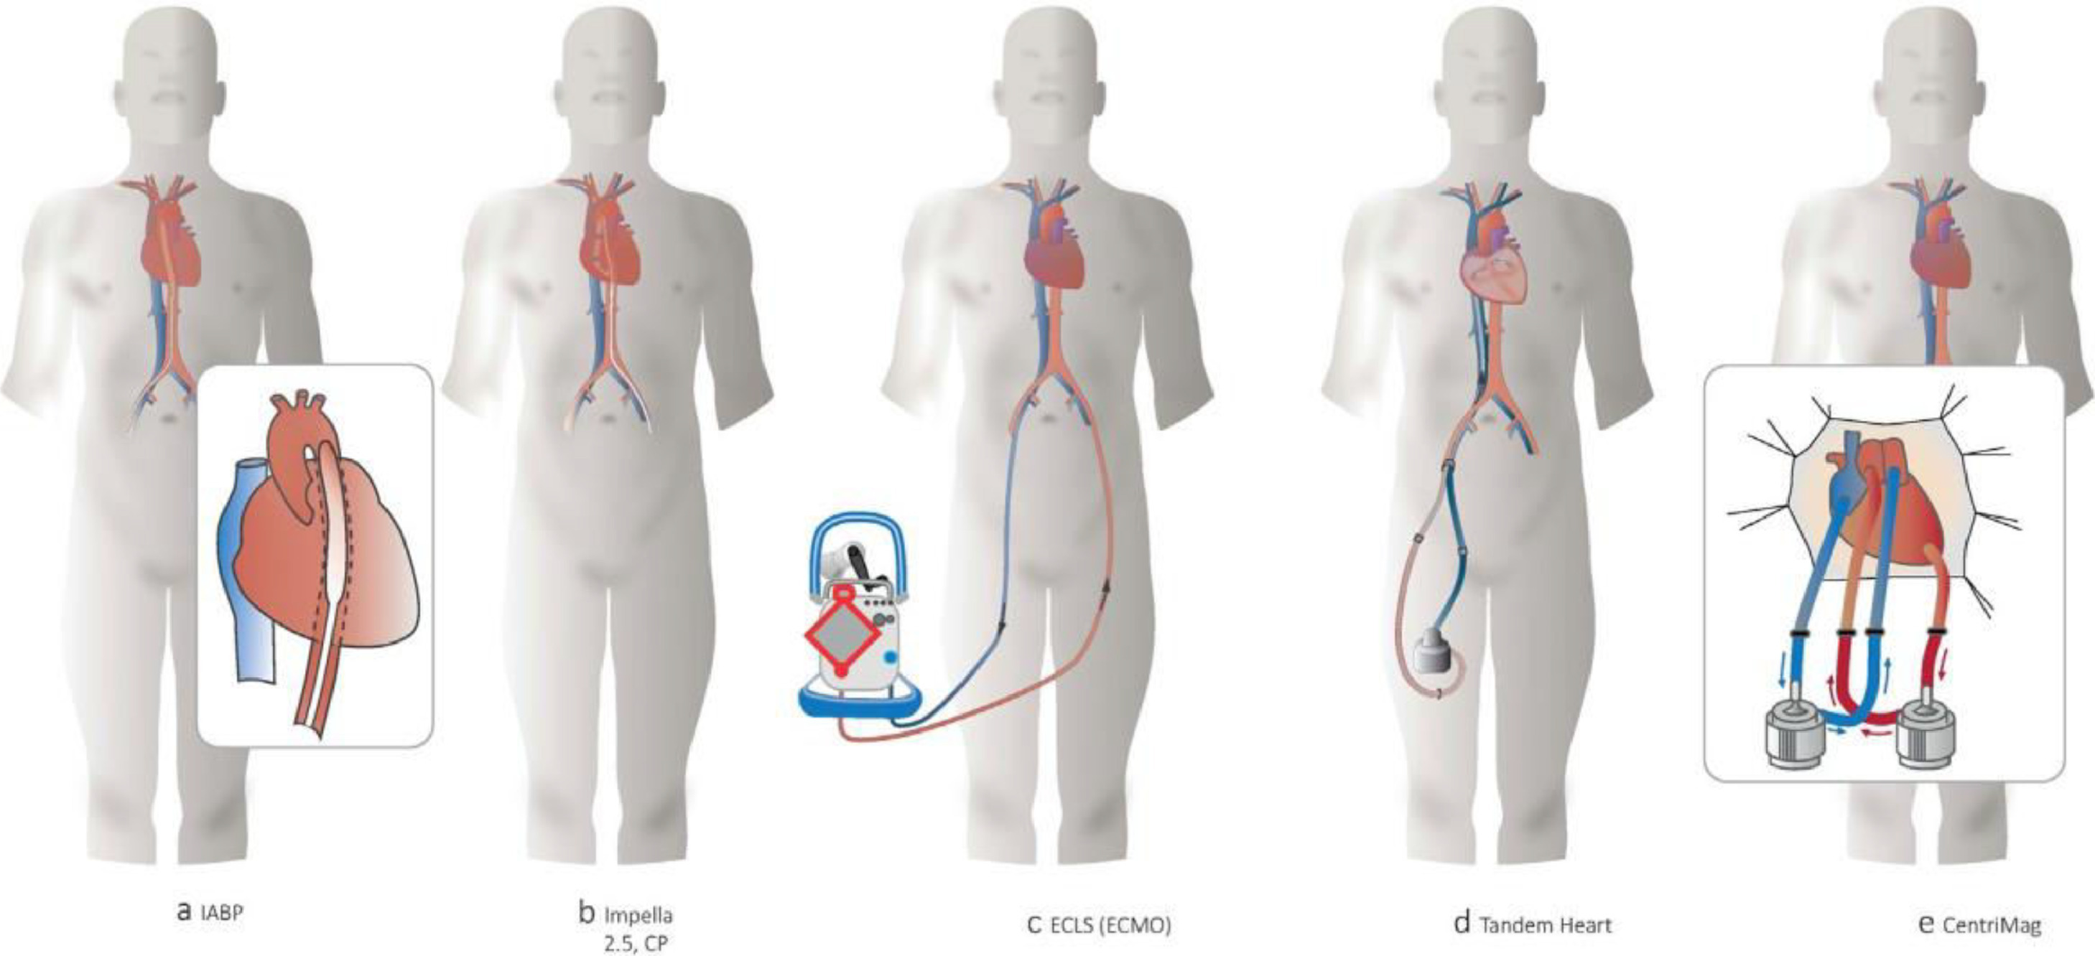
Fig. 1.1
The Journal of Heart and Lung Transplantation 2023 42e1-e64DOI: (10.1016/j.healun.2022.10.028)
Copyright © 2023 Terms and Conditions
Notes:
Overview of devices for acute mechanical circulatory support. ECLS, extracorporeal life support; ECMO, extracorporeal membrane oxygenation; IABP, intra-aortic balloon pump.

Slide 3
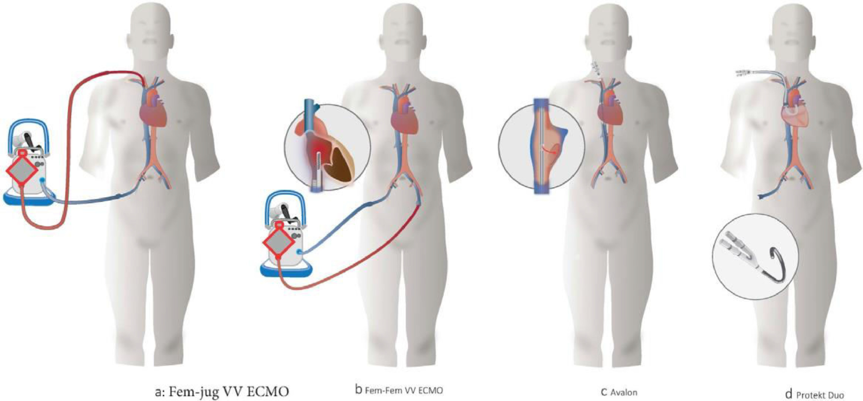
Fig. 1.2
The Journal of Heart and Lung Transplantation 2023 42e1-e64DOI: (10.1016/j.healun.2022.10.028)
Copyright © 2023 Terms and Conditions
Notes:
Different cannulations for VV ECMO. Fem-Fem, femoral-femoral; Fem-jug, femoral–jugular; ECMO, extracorporeal membrane oxygenation; VV, venovenous.

Slide 4
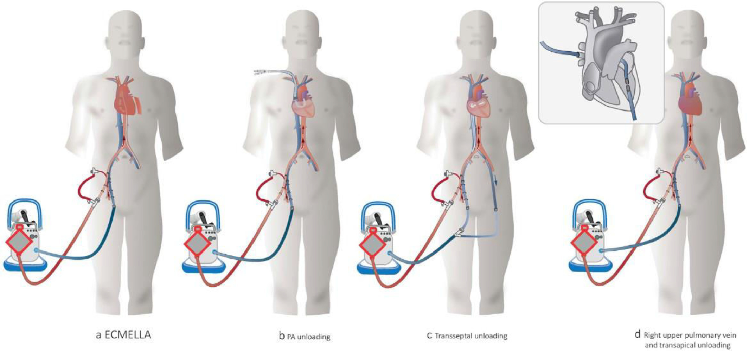
Fig. 1.3
The Journal of Heart and Lung Transplantation 2023 42e1-e64DOI: (10.1016/j.healun.2022.10.028)
Copyright © 2023 Terms and Conditions
Notes:
Different cannulations for VA-ECMO: (A) Femoral VA-ECMO: (B) Axillary VA-ECMO. (C) Thoracic, central VA-ECMO. (D) VAV ECMO. VA, venoarterial; VAV, venoarterial-venous; ECMO, extracorporeal membrane oxygenation.

Slide 5
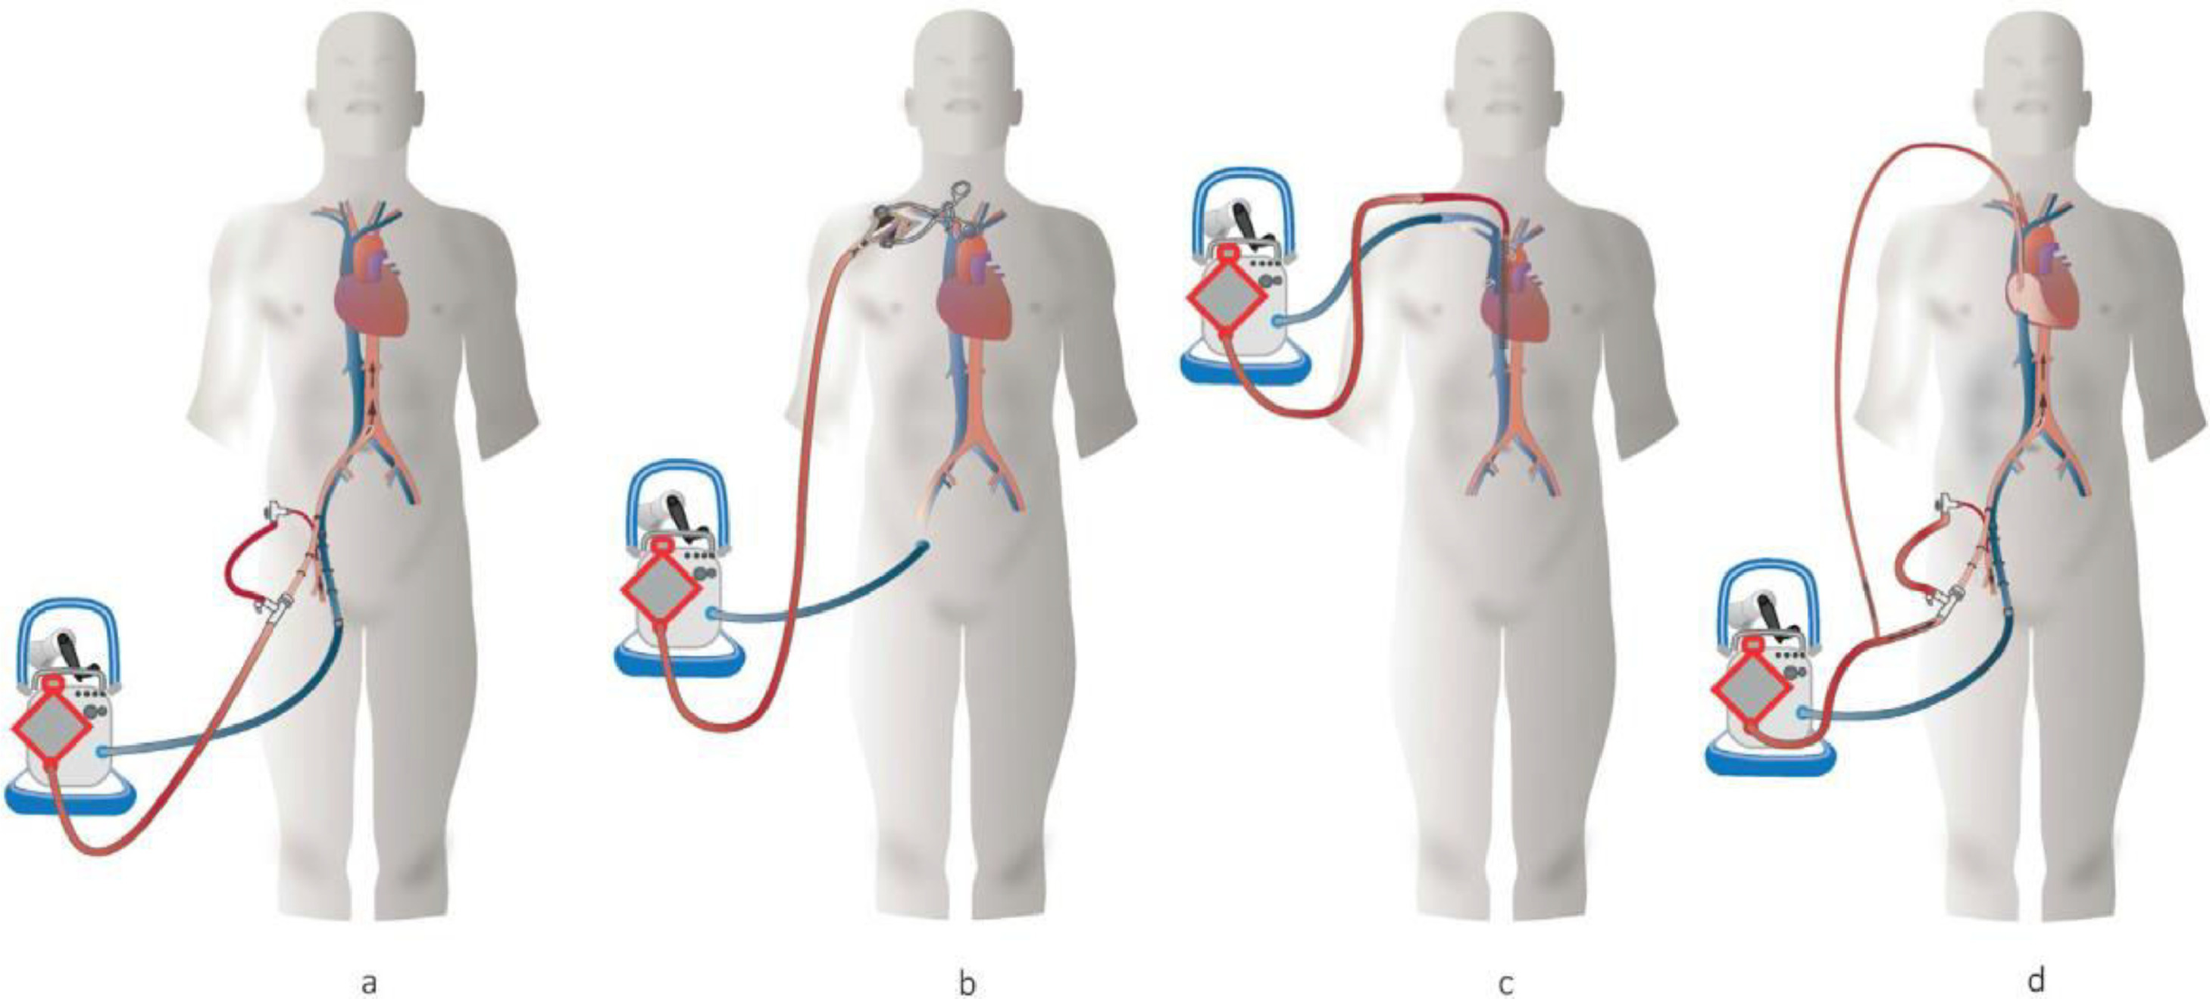
Fig. 1.4
The Journal of Heart and Lung Transplantation 2023 42e1-e64DOI: (10.1016/j.healun.2022.10.028)
Copyright © 2023 Terms and Conditions
Notes:
Overview of unloading strategies on VA-ECMO. (A) ECMELLA. Femoral VA-ECMO with an additional femorally implanted Impella device. (B) An additional PA cannula is connected to the venous VA-ECMO line. (C) An additional transseptal interatrial cannula is connected to the venous cannula. (D) An additional intracardial catheter is connected to the venous cannula. These cannula are either implanted using the apex of the left ventricle or using the right upper pulmonary vein and going through the left atrium and the mitral valve into the left ventricle. VA-ECMO, venoarterial extracorporeal membrane oxygenation; ICU, intensive care unit; PA, pulmonary artery.

Slide 6
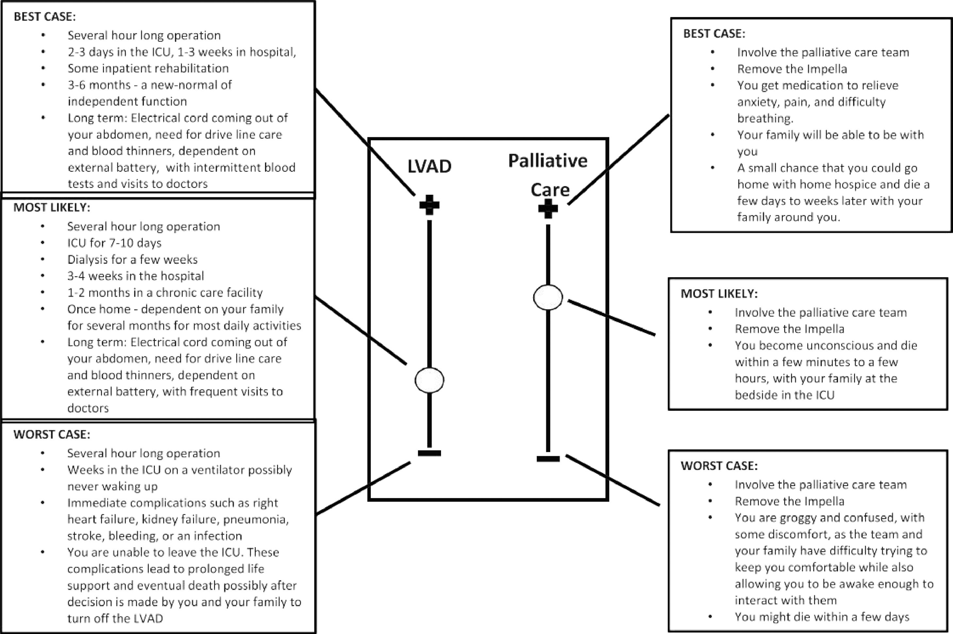
Fig. 4.1
The Journal of Heart and Lung Transplantation 2023 42e1-e64DOI: (10.1016/j.healun.2022.10.028)
Copyright © 2023 Terms and Conditions
Notes:
Best case and worst case scenarios to be used in dialog between patient, family, and clinicians during medical decision-making. The best case/worst case handwritten graphic is tailored to the specific patient and their current situation, highlighting reasonable medical options side by side and then the expected range of outcomes based on currently available data and clinician experience. The best and worst outcomes are drawn initially at the same level but can be adjusted to reflect the patient's stated values of each outcome after discussion with the patient.^{483,484,543} (adapted from⁴⁸⁴). The example presented here could represent a 78-year-old patient with chronic heart failure and significant comorbidity progressing to cardiogenic shock who has been stabilized on acute MCS with a decision to be made regarding transition to long-term durable LVAD support or to a comfort measures approach. For an explanatory video, see: https://www.youtube.com/watch?v=FnS3K44sbu0. LVAD, left ventricular assist device; MCS, mechanical circulatory support.

