Slide 1
Assessing and managing frailty in advanced heart failure: An International Society for Heart and Lung Transplantation consensus statement
Quin E. Denfeld, PhD, RN, Sunita R. Jha, PhD, Erik Fung, MD, PhD, Tiny Jaarsma, PhD, RN, Mathew S. Maurer, MD, Gordon R. Reeves, MD, MPT, Jonathan Afilalo, MD, MSc, Nadine Beerli, PhD, Lavanya Bellumkonda, MD, Sabina De Geest, PhD, RN, Eiran Z. Gorodeski, MD, MPH, Emer Joyce, MD, PhD, Jon Kobashigawa, MD, Oliver Mauthner, PhD, Julee McDonagh, PhD, RN, Izabella Uchmanowicz, PhD, RN, Victoria Vaughan Dickson, PhD, RN, JoAnn Lindenfeld, MD, Peter Macdonald, MD, PhD
The Journal of Heart and Lung Transplantation
Volume 43 Issue 1 Pages 1-27 (January 2024)
DOI: 10.1016/j.healun.2023.09.013
Copyright © 2023 International Society for the Heart and Lung Transplantation Terms and Conditions

Slide 2
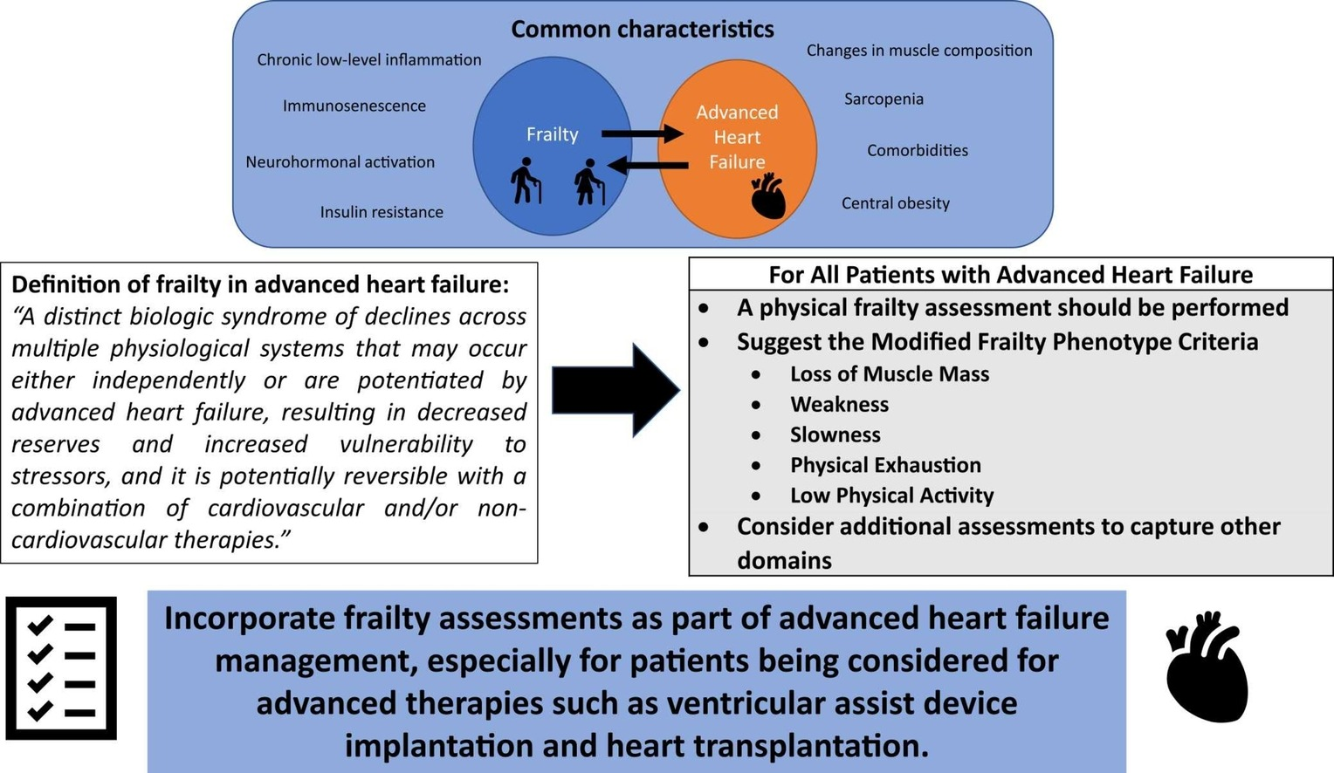
The Journal of Heart and Lung Transplantation 2024 431-27DOI: (10.1016/j.healun.2023.09.013)
Copyright © 2023 International Society for the Heart and Lung Transplantation Terms and Conditions

Slide 3
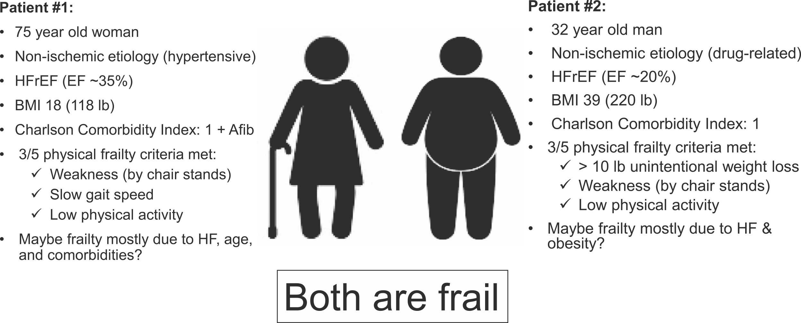
Figure 1
The Journal of Heart and Lung Transplantation 2024 431-27DOI: (10.1016/j.healun.2023.09.013)
Copyright © 2023 International Society for the Heart and Lung Transplantation Terms and Conditions
Notes:
Comparison of 2 frailty phenotypes in heart failure. Frailty affects many adults with heart failure across the lifespan, spectrum of heart failure severity, and weight range, presenting difficulties with management of frailty. BMI, body mass index; HFpEF, heart failure with preserved ejection fraction; HFrEF, heart failure with reduced ejection fraction.

Slide 4
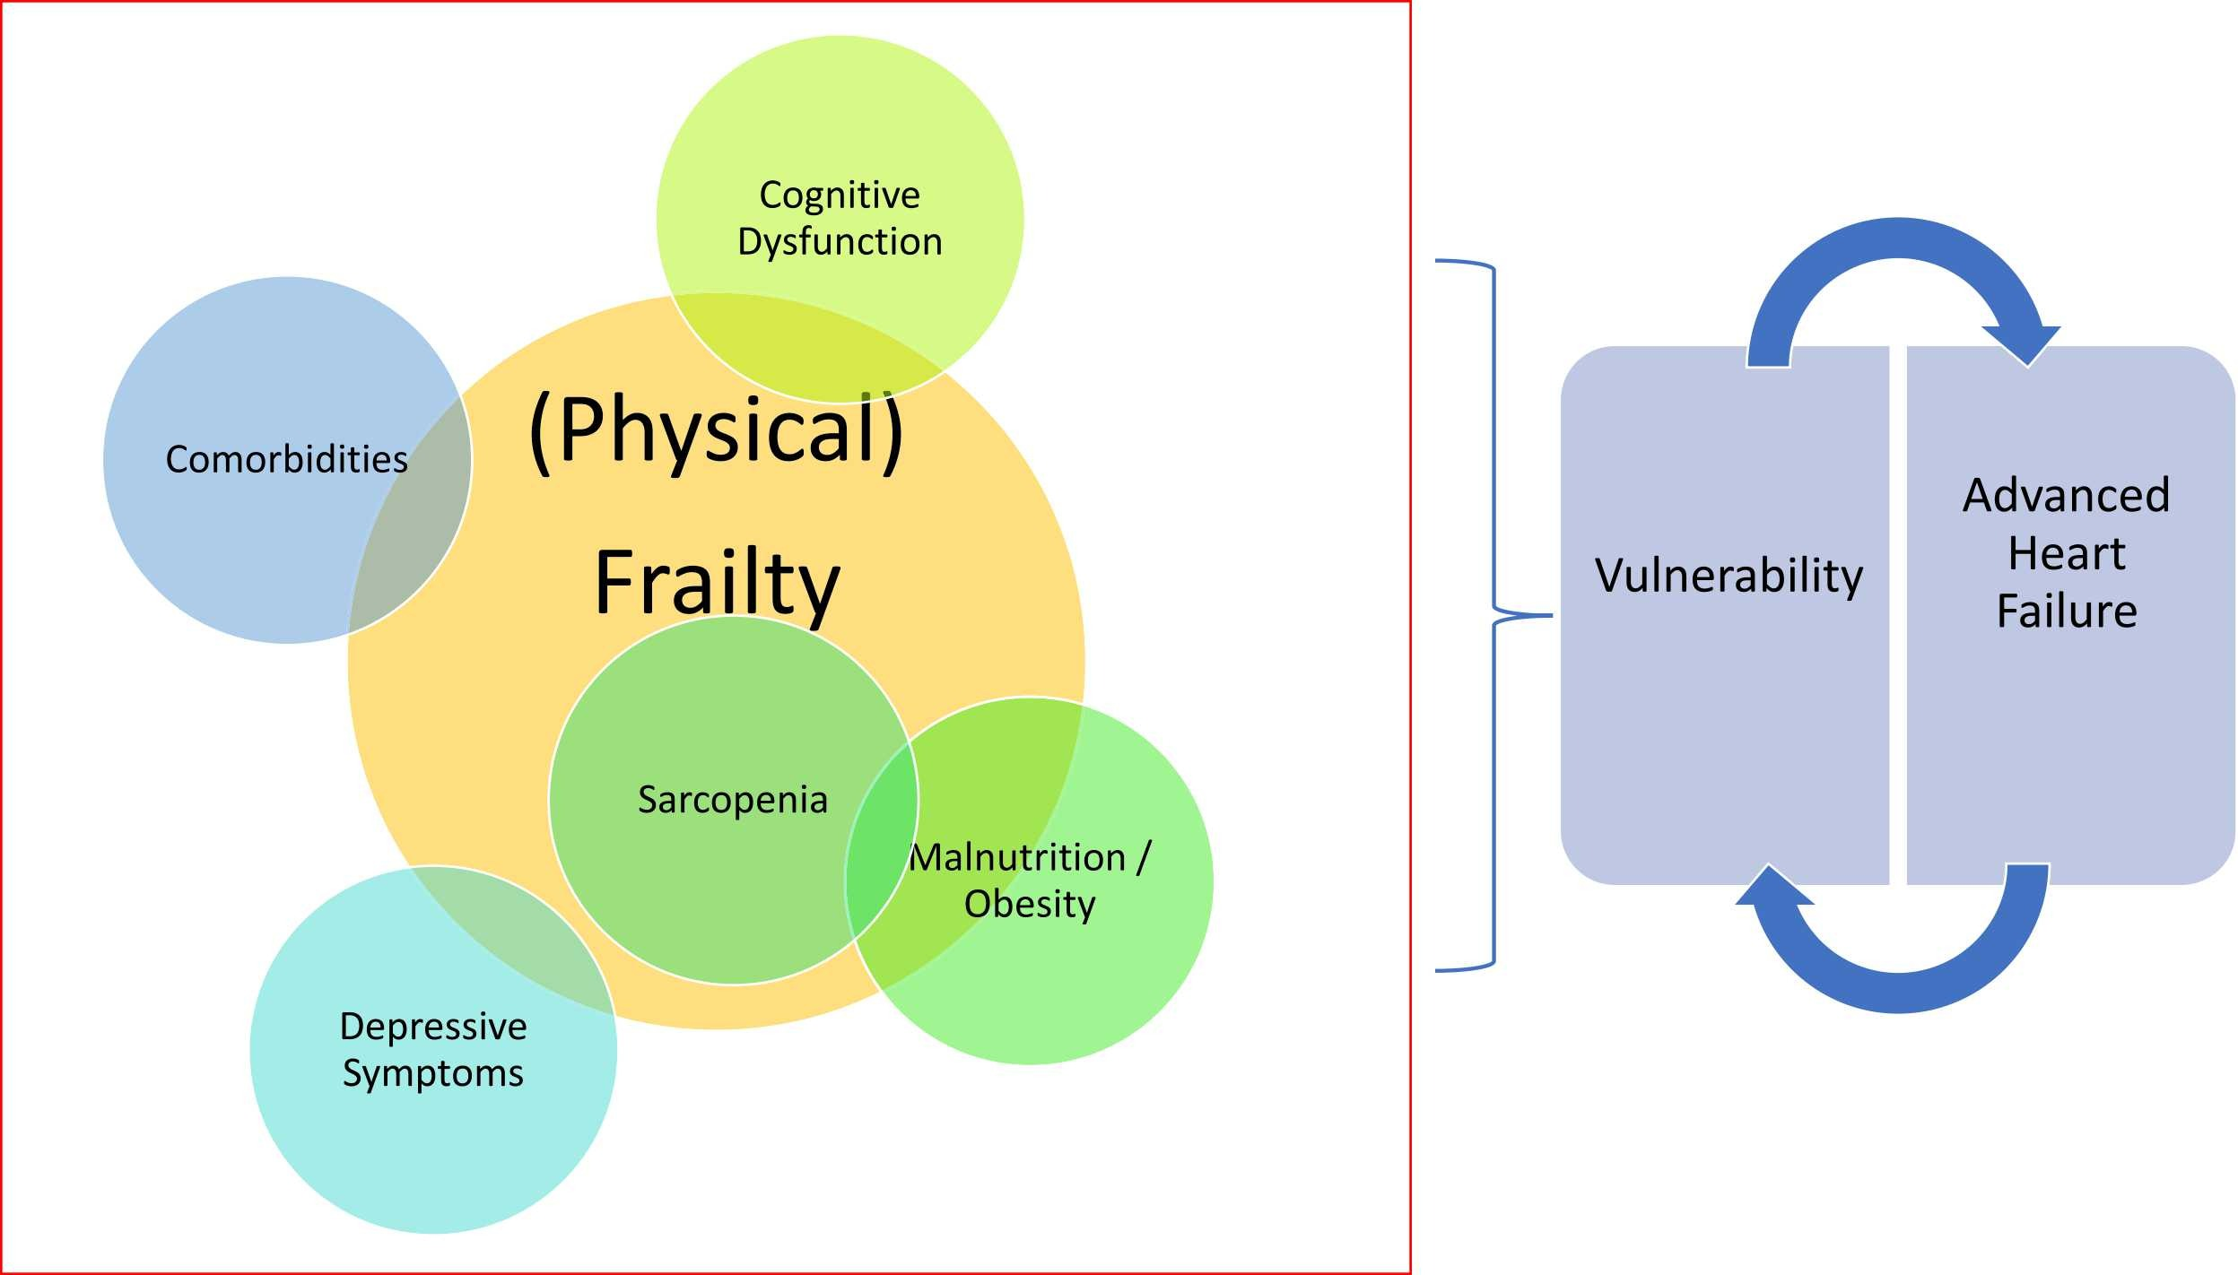
Figure 2
The Journal of Heart and Lung Transplantation 2024 431-27DOI: (10.1016/j.healun.2023.09.013)
Copyright © 2023 International Society for the Heart and Lung Transplantation Terms and Conditions
Notes:
Relationship between the different domains of frailty and related concepts. Most studies of frailty in advanced HF focus on the physical aspects of frailty such as handgrip strength, gait speed, physical exhaustion (named “(Physical) Frailty” in the figure); however, other studies include related concepts such as “Cognitive Dysfunction,” “Malnutrition/Obesity,” “Sarcopenia,” “Depression,” and “Comorbidities” under the broader umbrella of frailty. For example, the Fried Frailty Phenotype Criteria include physical performance measures and sometimes including sarcopenia measures. Cognitive frailty would include physical frailty plus cognitive dysfunction assessments. The Deficit Index could include all of these domains or selected ones.

Slide 5
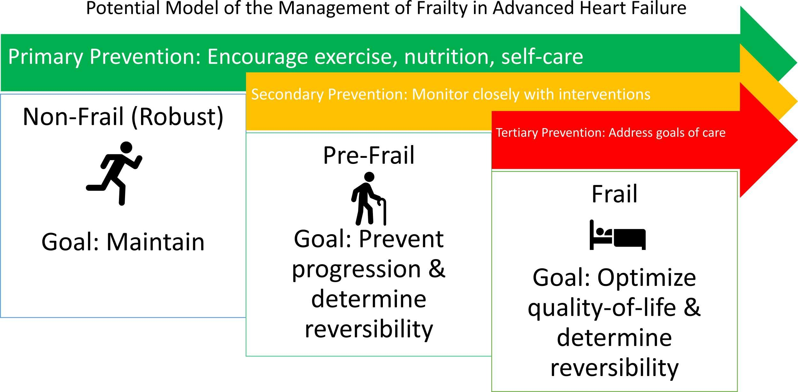
Figure 3
The Journal of Heart and Lung Transplantation 2024 431-27DOI: (10.1016/j.healun.2023.09.013)
Copyright © 2023 International Society for the Heart and Lung Transplantation Terms and Conditions
Notes:
Potential overall model of the management of frailty in advanced heart failure. Ultimately, we hope further studies will demonstrate how to maintain nonfrailty (robustness) in advanced HF patients, how to prevent progression to frailty, and how to reverse frailty.

