Slide 1
Consensus statements from the International Society for Heart and Lung Transplantation consensus conference: Heart failure–related cardiogenic shock
David A. Baran, MD, Filio Billia, MD, PhD, Varinder Randhawa, MD, PhD, Jennifer A. Cowger, MD, MS, Christopher M. Barnett, MD, MPH, Sharon Chih, MBBS, PhD, Stephan Ensminger, MD, DPhil, Jaime Hernandez-Montfort, MD, MSc, Shashank S. Sinha, MD, MSc, Esther Vorovich, MD, MSCE, Alastair Proudfoot, MD, PhD, Hoong Sern Lim, MD, Vanessa Blumer, MD, Douglas L. Jennings, PharmD, A. Reshad Garan, MD, Maria Florencia Renedo, MD, Thomas C. Hanff, MD MSCE, Manreet K. Kanwar, MD
The Journal of Heart and Lung Transplantation
DOI: 10.1016/j.healun.2023.10.007
Copyright © 2023 International Society for the Heart and Lung Transplantation Terms and Conditions

Slide 2
Figure 1
The Journal of Heart and Lung Transplantation DOI: (10.1016/j.healun.2023.10.007)
Copyright © 2023 International Society for the Heart and Lung Transplantation Terms and Conditions
Notes:
Task force 1: focus on centers: models of HF-CS care. CICU, cardiac intensive care unit; HF-CS, heart failure cardiogenic shock; ICU, intensive care unit; MCS, mechanical circulatory support.

Slide 3
Figure 2
The Journal of Heart and Lung Transplantation DOI: (10.1016/j.healun.2023.10.007)
Copyright © 2023 International Society for the Heart and Lung Transplantation Terms and Conditions
Notes:
Task force 2: focus on Pt presentation with HF-CS. HF-CS, heart failure cardiogenic shock; ICU, intensive care unit.

Slide 4
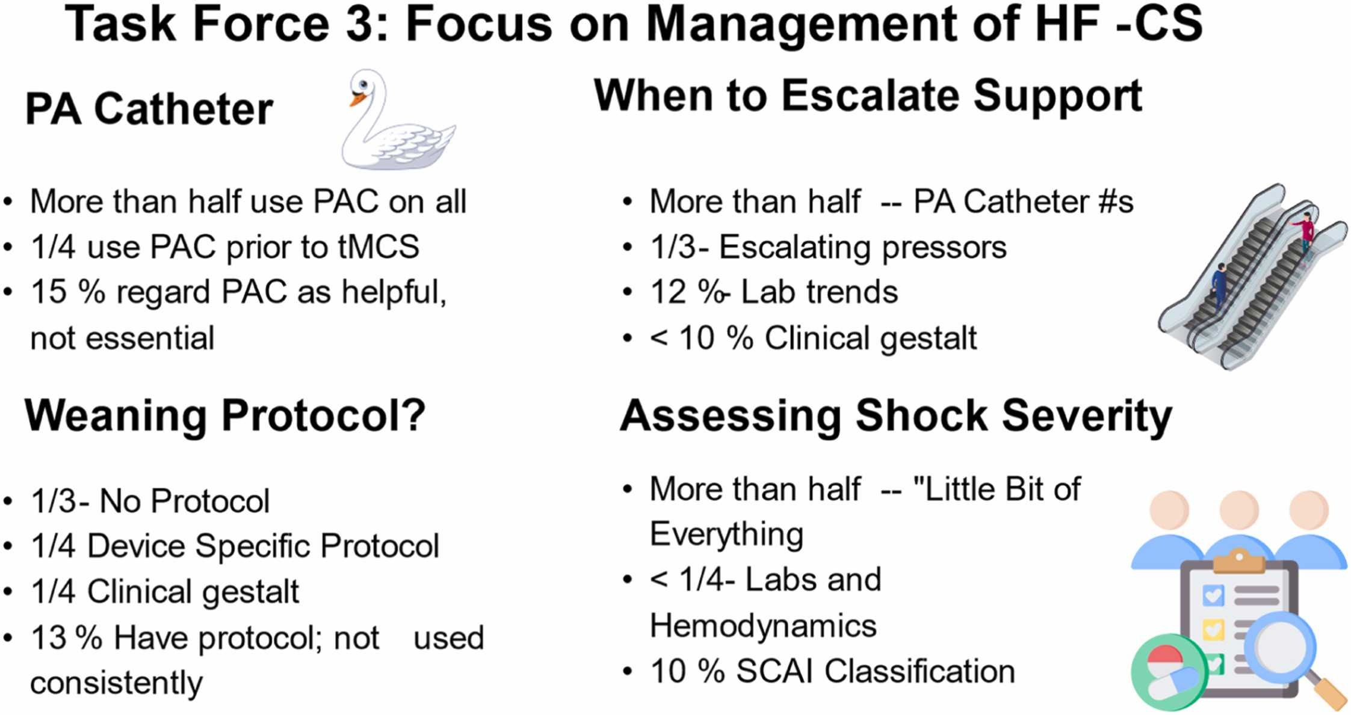
Figure 3
The Journal of Heart and Lung Transplantation DOI: (10.1016/j.healun.2023.10.007)
Copyright © 2023 International Society for the Heart and Lung Transplantation Terms and Conditions
Notes:
Task force 3: focus on management of HF-CS. HF-CS, heart failure cardiogenic shock.

Slide 5
Figure 4
The Journal of Heart and Lung Transplantation DOI: (10.1016/j.healun.2023.10.007)
Copyright © 2023 International Society for the Heart and Lung Transplantation Terms and Conditions
Notes:
Circles of cardiogenic shock care. MCS, Mechanical circulatory support; OR, Operating room; VAD, ventricular assist device.

Slide 6
Figure 5
The Journal of Heart and Lung Transplantation DOI: (10.1016/j.healun.2023.10.007)
Copyright © 2023 International Society for the Heart and Lung Transplantation Terms and Conditions
Notes:
Pyramid of shock transfer information exchange. CXR, chest x-ray; DNR, Do not resuscitate; EKG, electrocardiogram; H+ P, history and physical; PAC, pulmonary artery catheter; VS, vital signs.

