Slide 1
The International Society for Heart and Lung Transplantation (ISHLT) guidelines for the care of heart transplant recipients
Angela Velleca, MHDS, RN, Michael A Shullo, PharmD, Kumud Dhital, BMBCh, PhD, Estela Azeka, MD, Monica Colvin, MD, Eugene DePasquale, MD, Marta Farrero, MD, PhD, Luis García-Guereta, MD, Gina Jamero, NP, Kiran Khush, MD, Jacob Lavee, MD, Stephanie Pouch, MD, Jignesh Patel, MD, PhD, CJ Michaud, PharmD, Michael A Shullo, PharmD, Stephan Schubert, MD, Annalisa Angelini, MD, Lilibeth Carlos, MPharm, Sonia Mirabet, MD, Jignesh Patel, MD, PhD, Michael Pham, MD, Simon Urschel, MD, Kyung-Hee Kim, MD, Shelly Miyamoto, MD, Sharon Chih, MD, Kevin Daly, MD, Paolo Grossi, MD, Douglas L Jennings, PharmD, In-cheol Kim, MD, Hoong Sern Lim, MD, Tara Miller, MS, Luciano Potena, MD, Angela Velleca, MHDS, RN, Howard Eisen, MD, Lavanya Bellumkonda, MD, Lara Danziger-Isakov, MD, Fabienne Dobbels, PhD, Michelle Harkess, RN, Daniel Kim, MD, Haifa Lyster, FRPharmS, Yael Peled, MD, Zdenka Reinhardt, MD
The Journal of Heart and Lung Transplantation
Volume 42 Issue 5 Pages e1-e141 (May 2023)
DOI: 10.1016/j.healun.2022.10.015
Copyright © 2022 International Society for Heart and Lung Transplantation Terms and Conditions

Slide 2
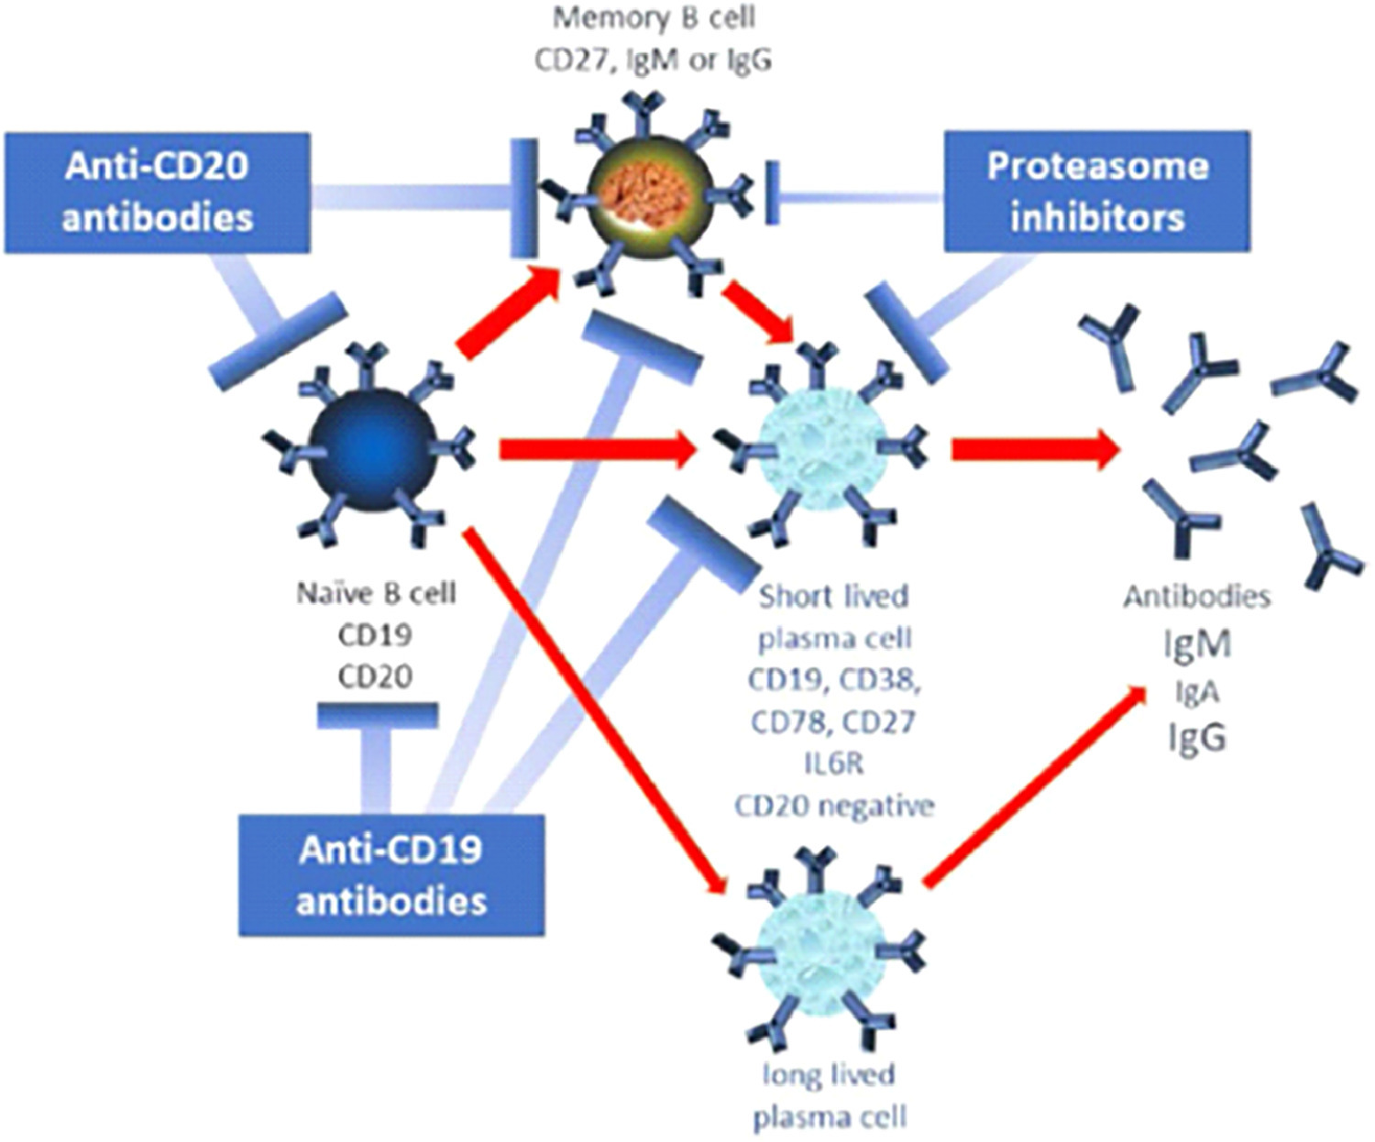
Figure 1
The Journal of Heart and Lung Transplantation 2023 42e1-e141DOI: (10.1016/j.healun.2022.10.015)
Copyright © 2022 International Society for Heart and Lung Transplantation Terms and Conditions
Notes:
Established effects of some targeted interventions. Blue bars symbolize depleting or reducing effect. Anti-CD20 antibodies show strong effect on naïve, effector, and memory B cells but no effect on plasma cells, which are not expressing CD20. Proteasome inhibitors show strong effect on PC and moderate effect on memory B cells. Anti-CD19 cells target PC but are currently not available as an effective clinical therapeutic for transplant. Effect of all of these therapies on LLPC is unclear but appears to be limited. (IL: interleukin, LLPC: long lives plasma cell, PC: plasma cell). Transplantation 103(5):p 890–898, May 2019.

