Slide 1
SCAI SHOCK Stage Classification Expert Consensus Update: A Review and Incorporation of Validation Studies
Srihari S. Naidu, MD, FSCAI, David A. Baran, MD, FSCAI, Jacob C. Jentzer, MD, Steven M. Hollenberg, MD, Sean van Diepen, MD, MSc, Mir B. Basir, DO, FSCAI, Cindy L. Grines, MD, MSCAI, Deborah B. Diercks, MD, MSc, FACEP, Shelley Hall, MD, Navin K. Kapur, MD, FSCAI, William Kent, MD, MSc, Sunil V. Rao, MD, FSCAI, Marc D. Samsky, MD, Holger Thiele, MD, FESC, Alexander G. Truesdell, MD, FSCAI, Timothy D. Henry, MD, MSCAI
Journal of the Society for Cardiovascular Angiography & Interventions
Volume 1 Issue 1 (January 2022)
DOI: 10.1016/j.jscai.2021.100008
Copyright © 2021 The Authors Terms and Conditions

Slide 2
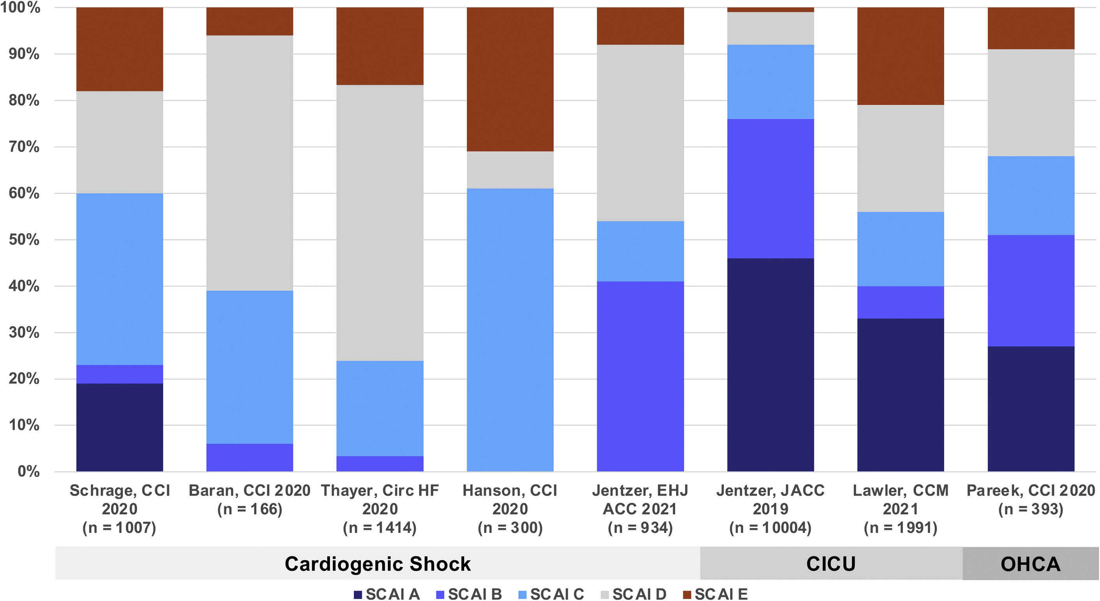
Fig. 1
Journal of the Society for Cardiovascular Angiography & Interventions 2022 1DOI: (10.1016/j.jscai.2021.100008)
Copyright © 2021 The Authors Terms and Conditions
Notes:
Distribution of SCAI SHOCK stages in each study. CICU, cardiac intensive care unit; OHCA, out-of-hospital cardiac arrest; SCAI, Society for Cardiovascular Angiography and Interventions.

Slide 3
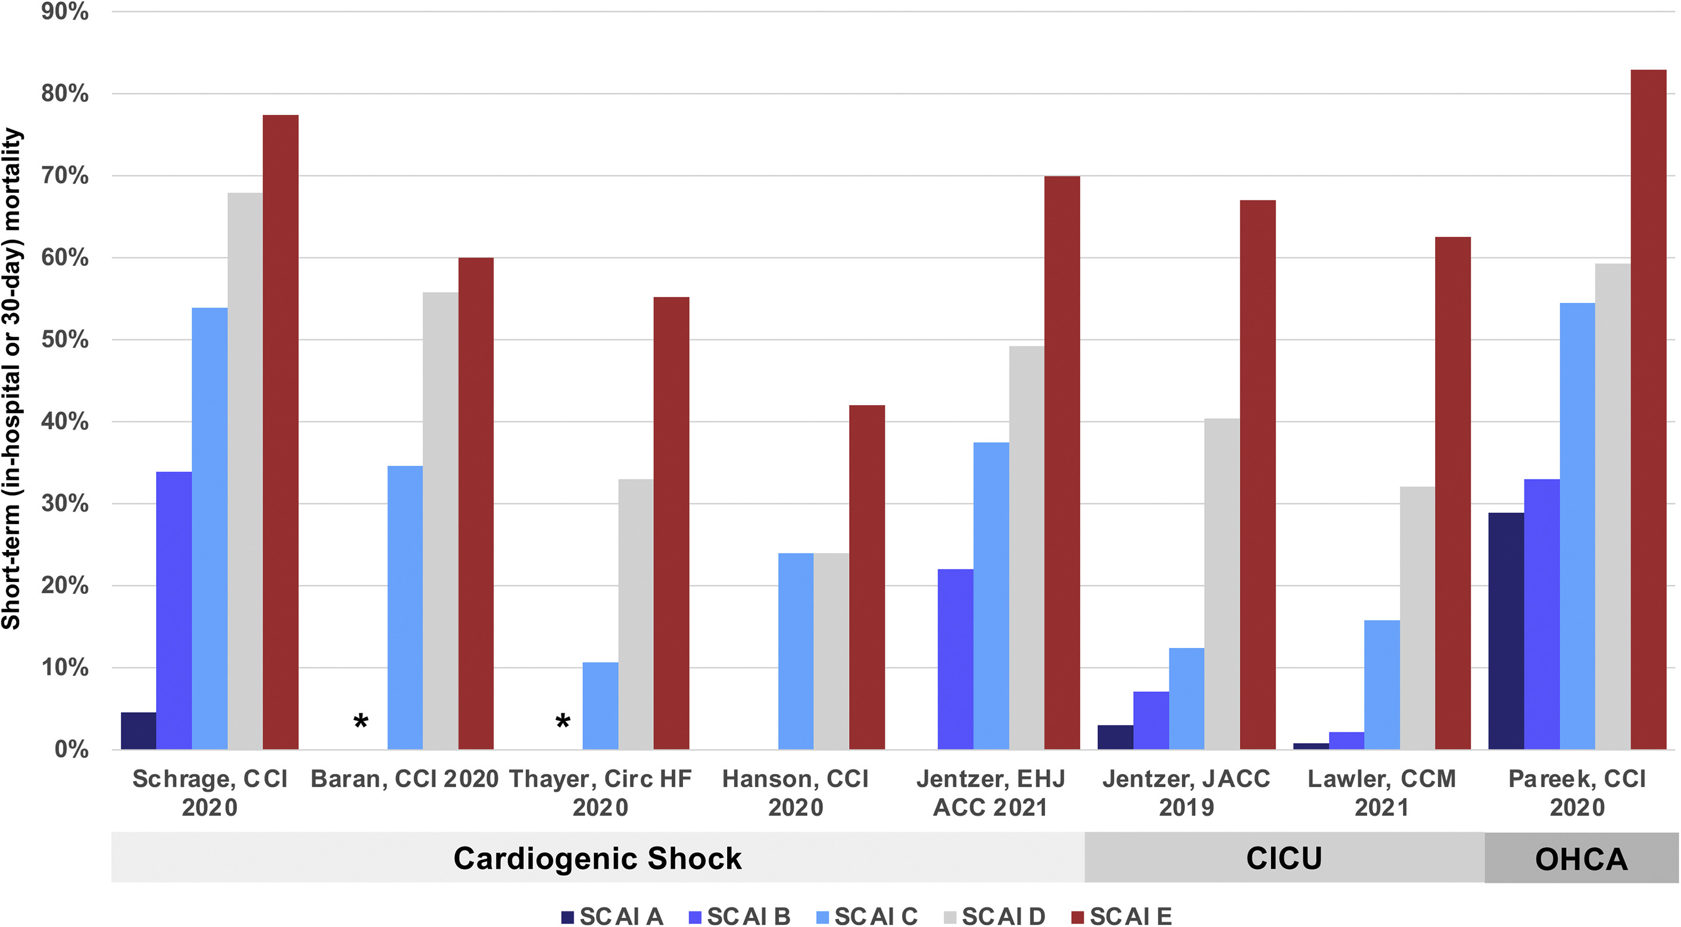
Fig. 2
Journal of the Society for Cardiovascular Angiography & Interventions 2022 1DOI: (10.1016/j.jscai.2021.100008)
Copyright © 2021 The Authors Terms and Conditions
Notes:
Short-term mortality as a function of SCAI SHOCK stages in each study. ∗denotes that no deaths were observed in patients with SCAI stage B in these studies. CICU, cardiac intensive care unit; OHCA, out-of-hospital cardiac arrest; SCAI, Society for Cardiovascular Angiography and Interventions.

Slide 4
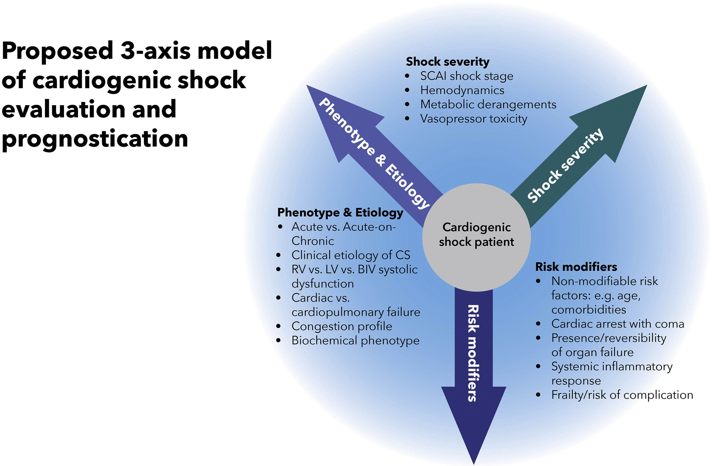
Fig. 3
Journal of the Society for Cardiovascular Angiography & Interventions 2022 1DOI: (10.1016/j.jscai.2021.100008)
Copyright © 2021 The Authors Terms and Conditions
Notes:
The proposed 3-axis conceptual model of cardiogenic shock evaluation and prognostication.

Slide 5
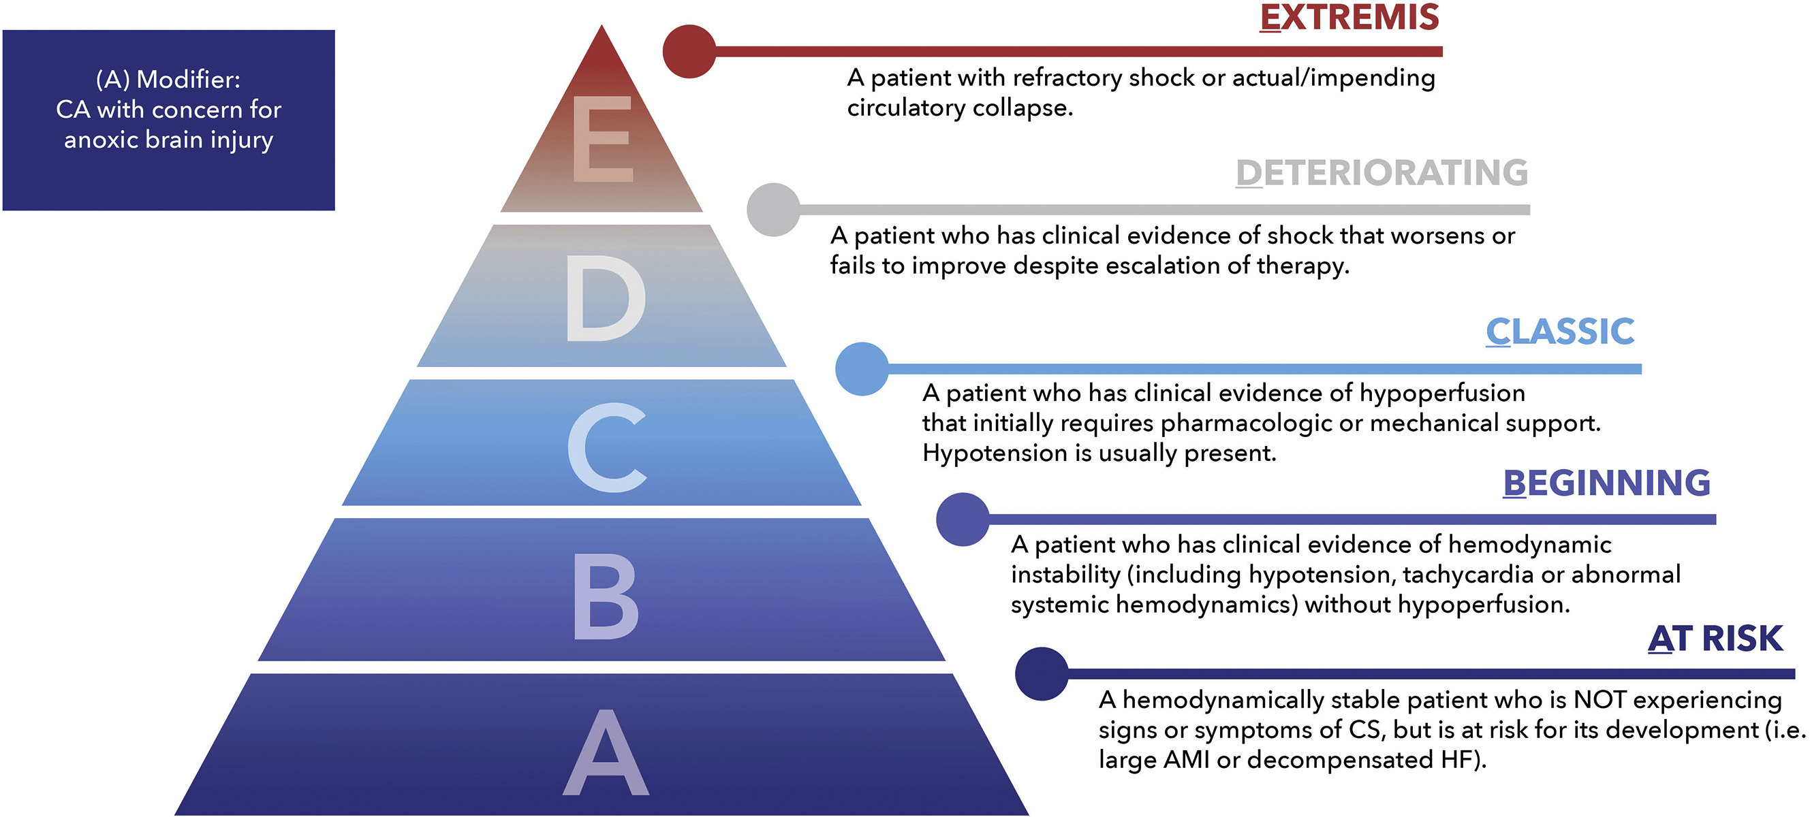
Fig. 4
Journal of the Society for Cardiovascular Angiography & Interventions 2022 1DOI: (10.1016/j.jscai.2021.100008)
Copyright © 2021 The Authors Terms and Conditions
Notes:
Updated SCAI SHOCK classification pyramid. AMI, acute myocardial infarction; CS, cardiogenic shock; HF, heart failure; SCAI, Society for Cardiovascular Angiography and Interventions.

Slide 6
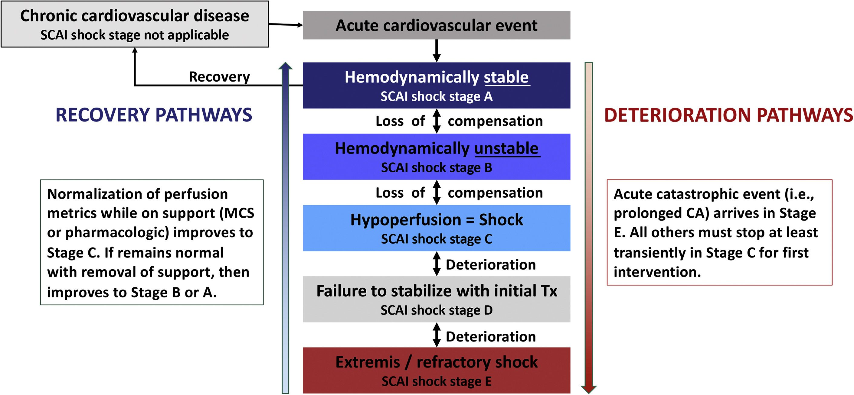
Fig. 5
Journal of the Society for Cardiovascular Angiography & Interventions 2022 1DOI: (10.1016/j.jscai.2021.100008)
Copyright © 2021 The Authors Terms and Conditions
Notes:
Cardiogenic shock is a dynamic process. CA, cardiac arrest; MCS, mechanical circulatory support; SCAI, Society for Cardiovascular Angiography and Interventions.

