Slide 1
Reproductive health after thoracic transplantation: An ISHLT expert consensus statement
Michelle M. Kittleson, MD, PhD (Chair), Ersilia M. DeFilippis, MD (Co-Chair), Catriona J. Bhagra, MRCP, MD, Jillian P. Casale, PharmD, Matthew Cauldwell, MD, Lisa A. Coscia, RN, BSN, CCTC, Rohan D'Souza, MD, Nicole Gaffney, MD, Vicky Gerovasili, MD, Patricia Ging, MSc, Kristin Horsley, PhD, Francesca Macera, MD, Joan M. Mastrobattista, MD, Miranda A. Paraskeva, MD, Lynn R. Punnoose, MD, Kismet D. Rasmusson, DNP, FNP, Quitterie Reynaud, MD, PhD, Heather J. Ross, MD, Mitesh V. Thakrar, MD, Mary Norine Walsh, MD
The Journal of Heart and Lung Transplantation
Volume 42 Issue 3 Pages e1-e42 (March 2023)
DOI: 10.1016/j.healun.2022.10.009
Copyright © 2022 International Society for Heart and Lung Transplantation Terms and Conditions

Slide 2
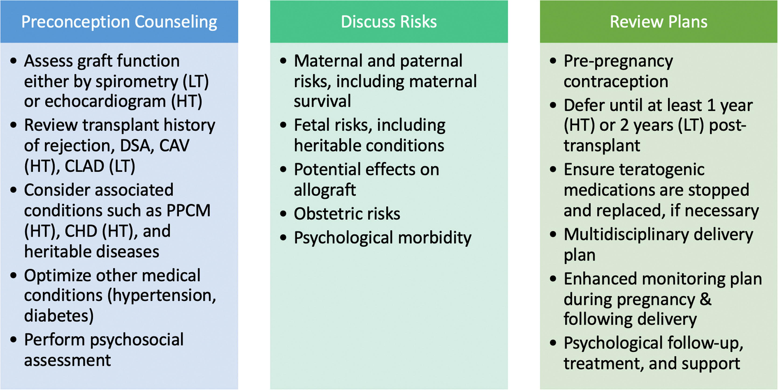
Figure 1
The Journal of Heart and Lung Transplantation 2023 42e1-e42DOI: (10.1016/j.healun.2022.10.009)
Copyright © 2022 International Society for Heart and Lung Transplantation Terms and Conditions
Notes:
Approach to preconception counseling in lung and heart transplant recipients. CAV, cardiac allograft vasculopathy; CHD, congenital heart disease; CLAD, chronic lung allograft dysfunction; DSA, donor-specific antibodies; HT, heart transplant; LT, lung transplant; PPCM, peripartum cardiomyopathy.

Slide 3
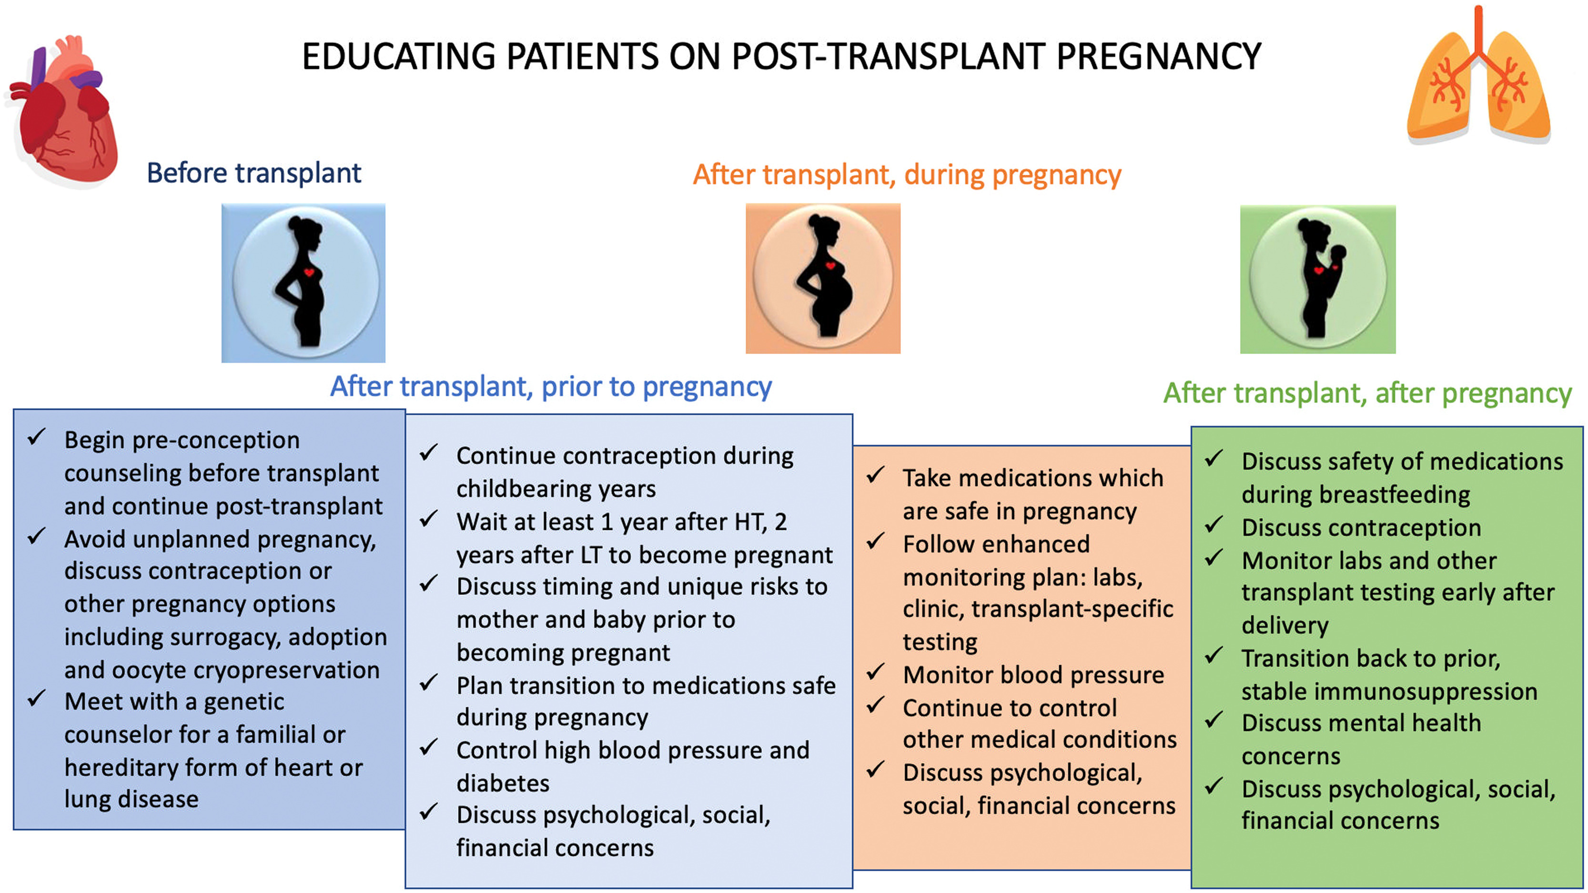
Figure 2
The Journal of Heart and Lung Transplantation 2023 42e1-e42DOI: (10.1016/j.healun.2022.10.009)
Copyright © 2022 International Society for Heart and Lung Transplantation Terms and Conditions
Notes:
Educating patients on post-transplant pregnancy. HT, heart transplant; LT, lung transplant.

Slide 4
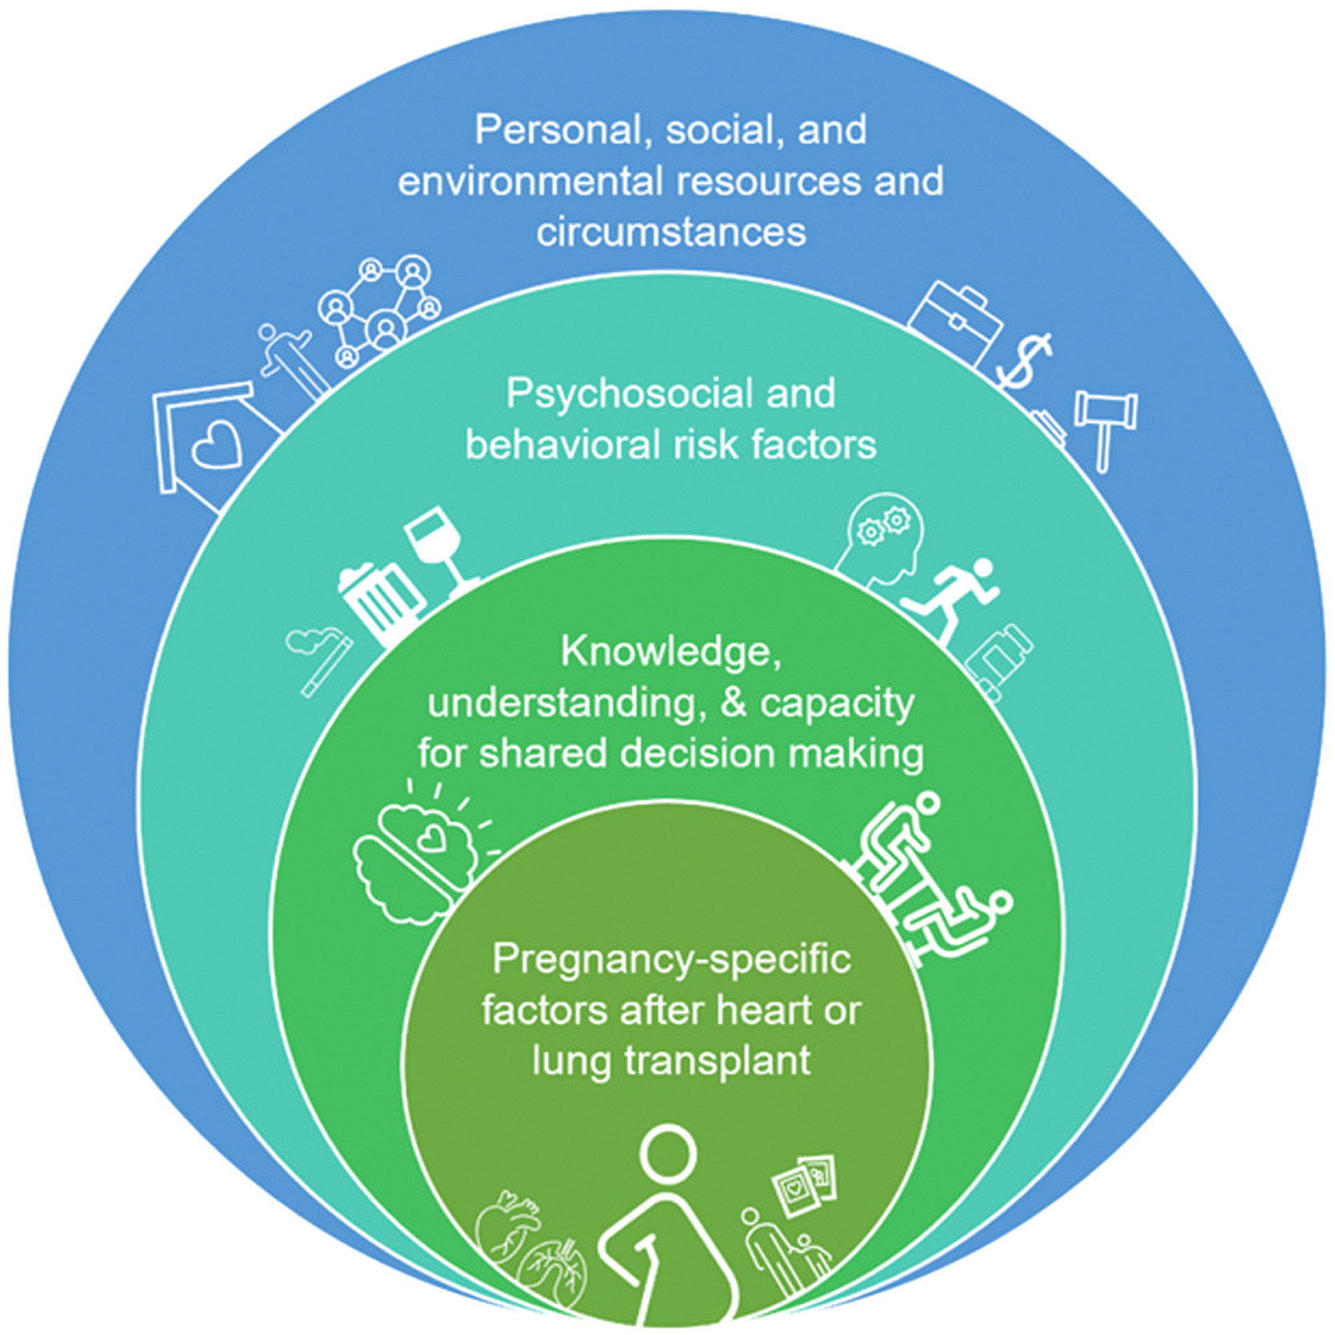
Figure 3
The Journal of Heart and Lung Transplantation 2023 42e1-e42DOI: (10.1016/j.healun.2022.10.009)
Copyright © 2022 International Society for Heart and Lung Transplantation Terms and Conditions
Notes:
Components of a comprehensive psychosocial evaluation. Psychosocial evaluation is a key part of both transplant and pregnancy care. Important components of a comprehensive psychosocial evaluation include 1) factors specific to patients’ personal, social, and environmental resources and circumstances, 2) psychosocial risk factors for poor pregnancy outcomes, including treatment and medication adherence, health behaviors, mental health, and substance use history, 3) factors related to patient's knowledge, understanding, cognitive abilities, and capacity to engage in shared decision-making during preconception and pregnancy, and 4) factors specific to heart and lung transplant recipients who may be contemplating pregnancy, including lifespan, need for re-transplantation, and the impact of adverse outcomes.

Slide 5
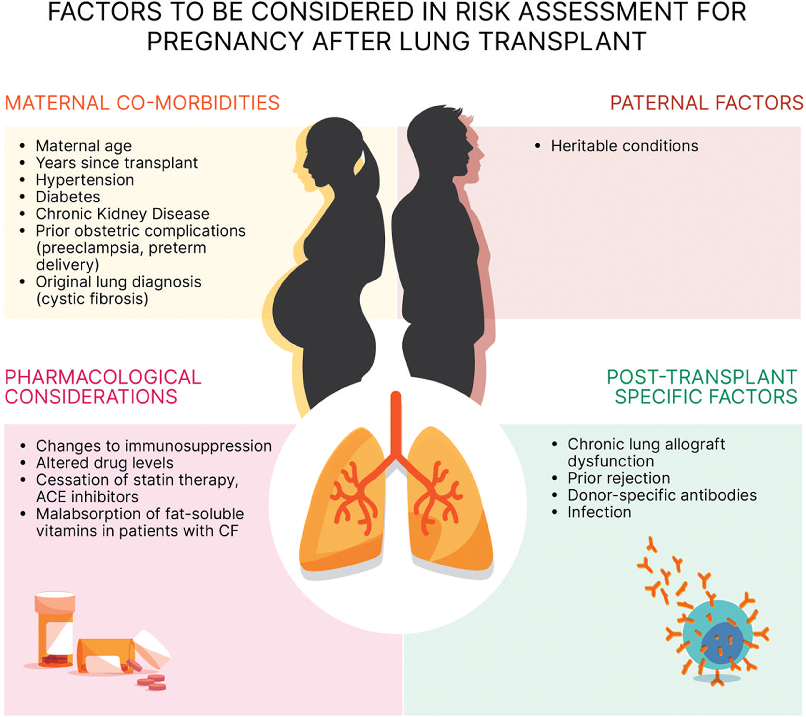
Figure 4
The Journal of Heart and Lung Transplantation 2023 42e1-e42DOI: (10.1016/j.healun.2022.10.009)
Copyright © 2022 International Society for Heart and Lung Transplantation Terms and Conditions
Notes:
Factors to be considered in risk assessment for pregnancy after lung transplant. CF, cystic fibrosis; ACE, angiotensin-converting enzyme.

Slide 6
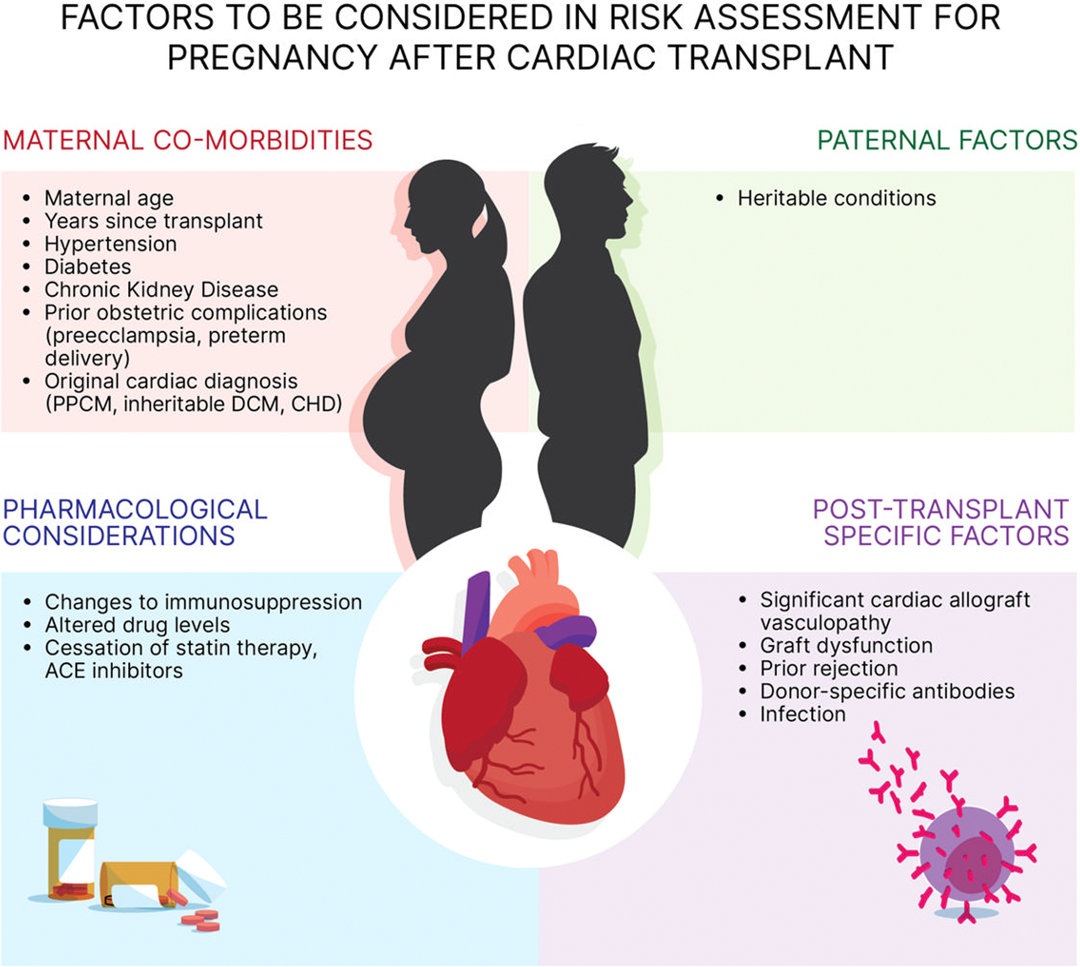
Figure 5
The Journal of Heart and Lung Transplantation 2023 42e1-e42DOI: (10.1016/j.healun.2022.10.009)
Copyright © 2022 International Society for Heart and Lung Transplantation Terms and Conditions
Notes:
Factors to be considered in risk assessment for pregnancy after heart transplantation. ACE, angiotensin-converting enzyme; CHD, congenital heart disease; DCM, dilated cardiomyopathy; PPCM, peripartum cardiomyopathy.

Slide 7
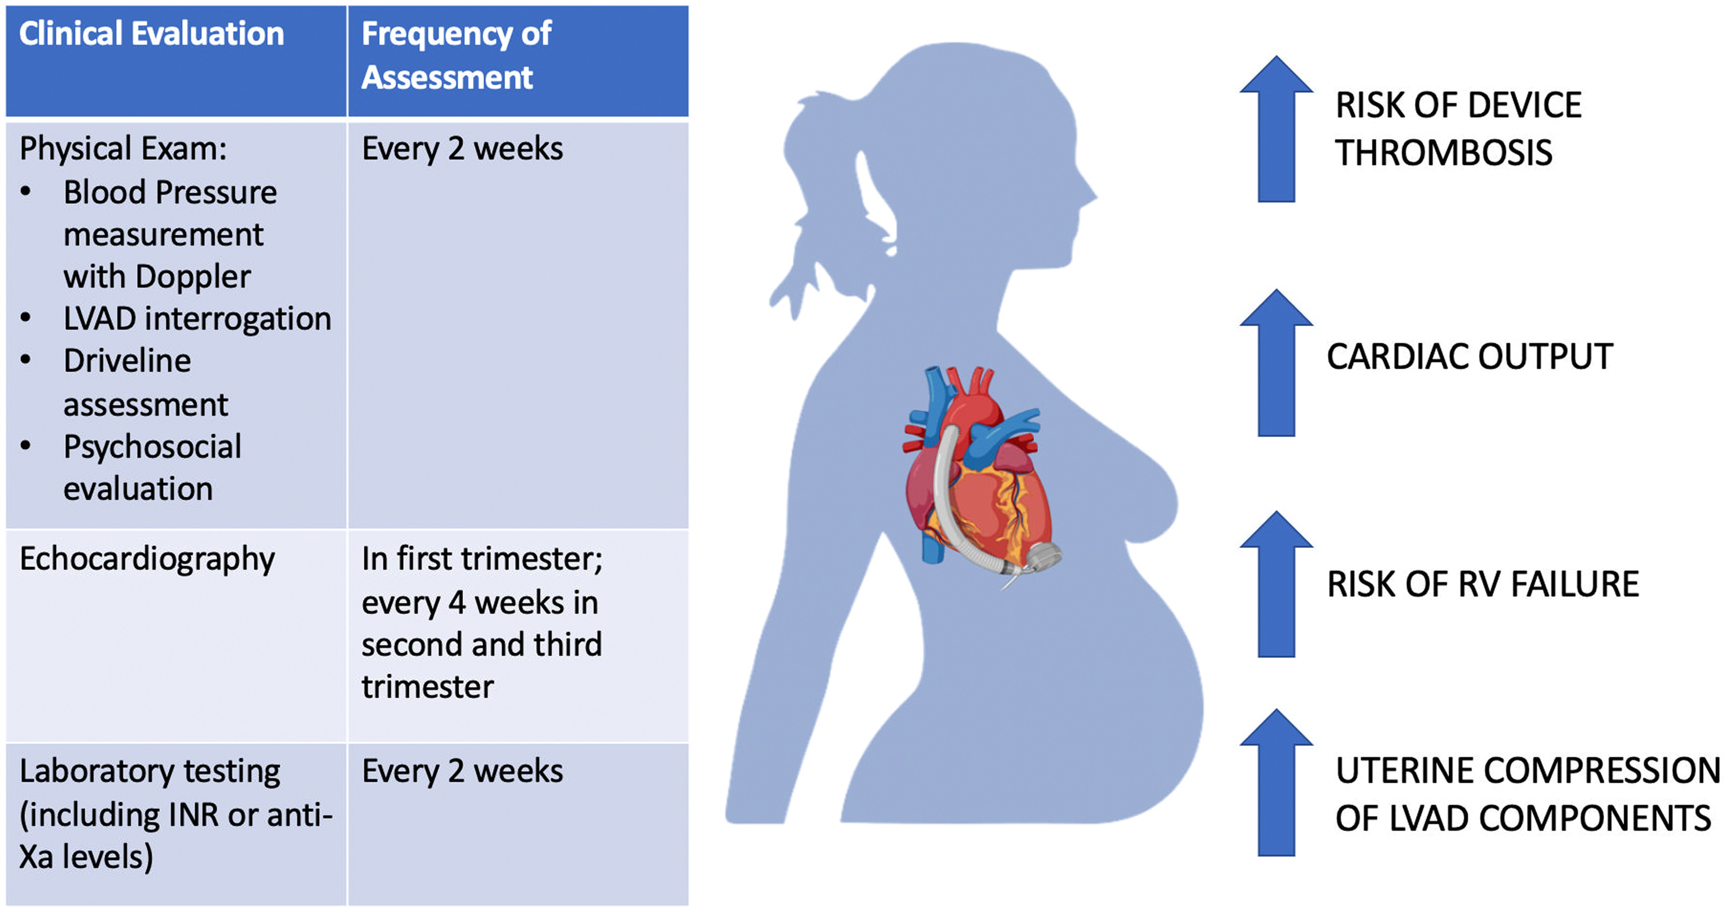
Figure 6
The Journal of Heart and Lung Transplantation 2023 42e1-e42DOI: (10.1016/j.healun.2022.10.009)
Copyright © 2022 International Society for Heart and Lung Transplantation Terms and Conditions
Notes:
Pregnancy in patients on LVAD support. LVAD, left ventricular assist device.

Slide 8
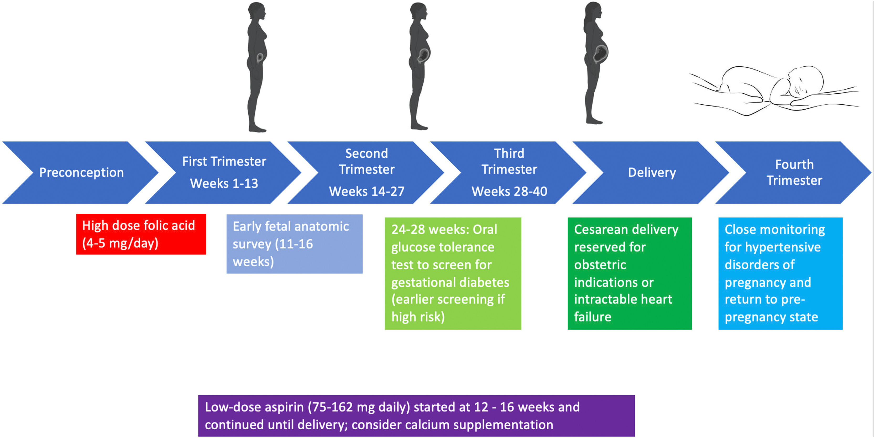
Figure 7
The Journal of Heart and Lung Transplantation 2023 42e1-e42DOI: (10.1016/j.healun.2022.10.009)
Copyright © 2022 International Society for Heart and Lung Transplantation Terms and Conditions
Notes:
Obstetric management.

