Slide 1
ISHLT consensus document on lung transplantation in patients with connective tissue disease: Part I: Epidemiology, assessment of extrapulmonary conditions, candidate evaluation, selection criteria, and pathology statements
Maria M. Crespo, MD, Erika D. Lease, MD, Amparo Sole, MD, PhD, Nora Sandorfi, MD, Laurie D. Snyder, MD, Gerald J. Berry, MD, Jérôme Le Pavec, MD, PhD, Aida E. Venado, MD, Jose M. Cifrian, MD, Hilary Goldberg, MD, Daniel F. Dilling, MD, Cynthia Gries, MD, Arun Nair, MD, Keith Willie, MD, MSPH, Keith C. Meyer, MD, Rupal J. Shah, MD, Sofya Tokman, MD, Are Holm, MD, Caroline M. Patterson, MD, Tanya McWilliams, MD, Osnat Shtraichman, MD, Brad Bemiss, MD, Juan Salgado, MD, Carol Farver, MD, Heather Strah, MD, Katharina Wassilew, MD, DSmed, Vaidehi Kaza, MD, MPH, Molly Howsare, DO, Michelle Murray, MD, Sangeeta Bhorade, MD, Marie Budev, DO
The Journal of Heart and Lung Transplantation
Volume 40 Issue 11 Pages 1251-1266 (November 2021)
DOI: 10.1016/j.healun.2021.07.014
Copyright © 2021 International Society for Heart and Lung Transplantation Terms and Conditions

Slide 2
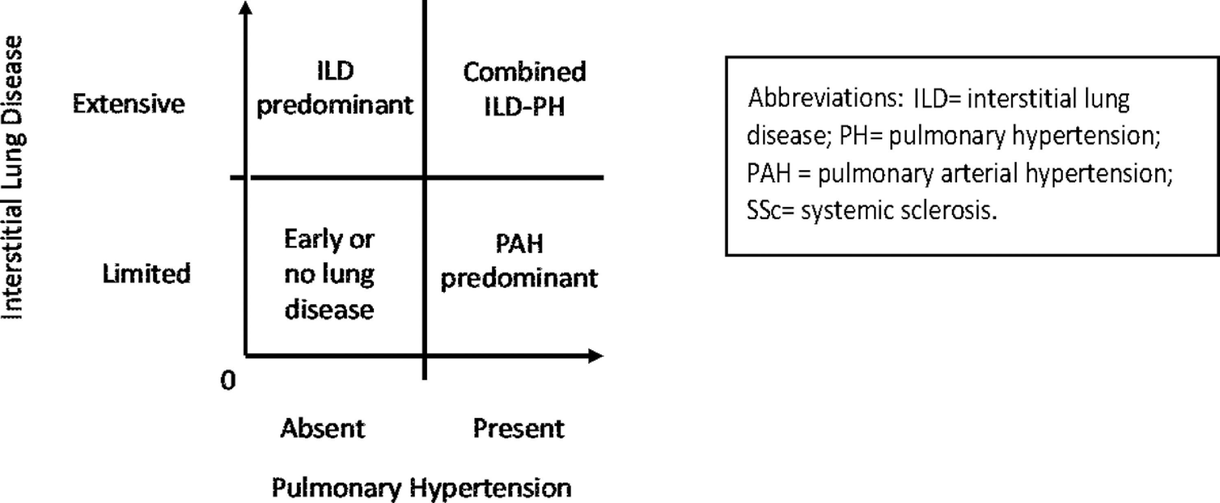
Figure 1
The Journal of Heart and Lung Transplantation 2021 401251-1266DOI: (10.1016/j.healun.2021.07.014)
Copyright © 2021 International Society for Heart and Lung Transplantation Terms and Conditions
Notes:
Systemic Sclerosis (SSc) pulmonary phenotypes: Extent of interstitial lung disease (ILD) and hemodynamic Porfiles.

