Slide 1

Evaluation and management of patients with chronic thromboembolic pulmonary hypertension - consensus statement from the ISHLT
Marc de Perrot, MD, Deepa Gopalan, MD, David Jenkins, MD, Irene M. Lang, MD, Elie Fadel, MD, Marion Delcroix, MD, Raymond Benza, MD, Gustavo A. Heresi, MD, Manreet Kanwar, MD, John T. Granton, MD, Micheal McInnis, MD, Frederikus A. Klok, MD, Kim M. Kerr, MD, Joanna Pepke-Zaba, MD, Mark Toshner, MD, Anastasia Bykova, RN, NP, Andrea M. D’Armini, MD, Ivan M. Robbins, MD, Michael Madani, MD, David McGiffin, MD, Christoph B. Wiedenroth, MD, Sebastian Mafeld, MD, Isabelle Opitz, MD, Olaf Mercier, MD, Patricia A. Uber, PharmD, Robert P. Frantz, MD, William R. Auger, MD
The Journal of Heart and Lung Transplantation
Volume 40 Issue 11 Pages 1301-1326 (November 2021)
DOI: 10.1016/j.healun.2021.07.020
Copyright © 2021 International Society for Heart and Lung Transplantation Terms and Conditions

Slide 2
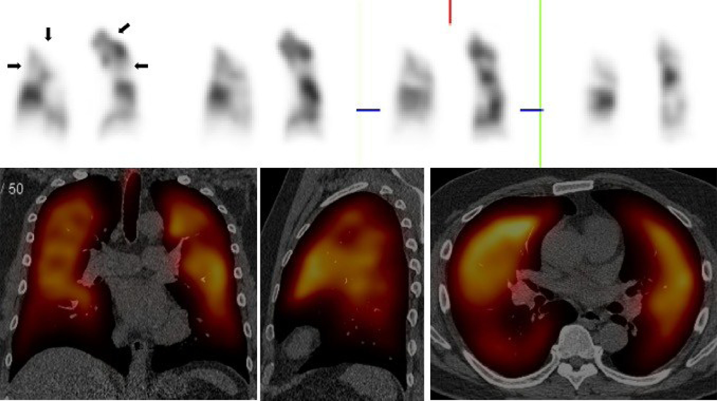
Figure 1
The Journal of Heart and Lung Transplantation 2021 401301-1326DOI: (10.1016/j.healun.2021.07.020)
Copyright © 2021 International Society for Heart and Lung Transplantation Terms and Conditions
Notes:
VQ-SPECT CT in a 38 year old male with CTEPH. Coronal perfusion views from the SPECT series (Top) demonstrates multiple segmental perfusion defects in both lungs (black arrows). Coronal, sagittal and axial reconstructions (Bottom) delineates the perfusion component overlaid on the axial low dose CT. The addition of CT to SPECT improves the specificity of the VQ by promoting the identification of lung diseases. CTEPH, Chronic thromboembolic pulmonary hypertension. VQ, ventilation-perfusion.

Slide 3
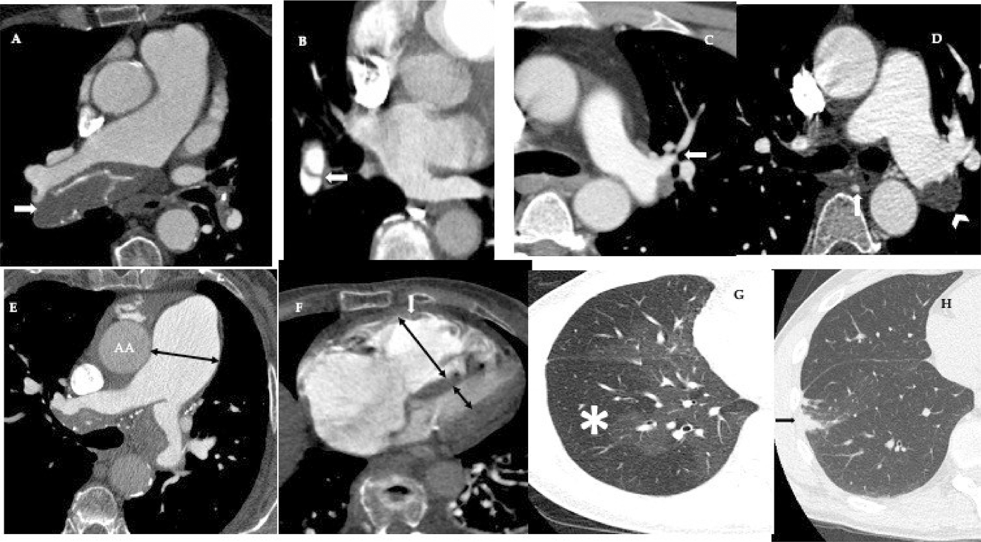
Figure 2
The Journal of Heart and Lung Transplantation 2021 401301-1326DOI: (10.1016/j.healun.2021.07.020)
Copyright © 2021 International Society for Heart and Lung Transplantation Terms and Conditions
Notes:
Signs of CTEPH on CTPA. (A) Eccentric calcific thrombus (arrow) in distal right main pulmonary artery. (B) Magnified view of the right lower lobe demonstrates a slit (arrow) in the segmental artery. Multiple slits are termed a web. (C) Stenosis (arrow) in left upper lobe artery (D) Dilated and tortuous bronchial artery collaterals (arrow) & occlusive thrombus (chevron) in the left interlobar artery. (E) Dilatation of the main pulmonary artery measuring 37 mm, larger than the accompanying ascending aorta (AA). (F) Dilated right ventricle (long double-ended arrow) relative to the left ventricle (short double-ended arrow). Also note hypertrophy of the right ventricular wall (white arrow). (G) Mosaic attenuation. The hypodense lung (*) corresponds to areas of decreased perfusion. (H) Curvilinear subpleural band opacities (arrow) corresponding to chronic pulmonary infarct. CTEPH, Chronic thromboembolic pulmonary hypertension; CTPA, Computed tomography pulmonary angiography.

Slide 4
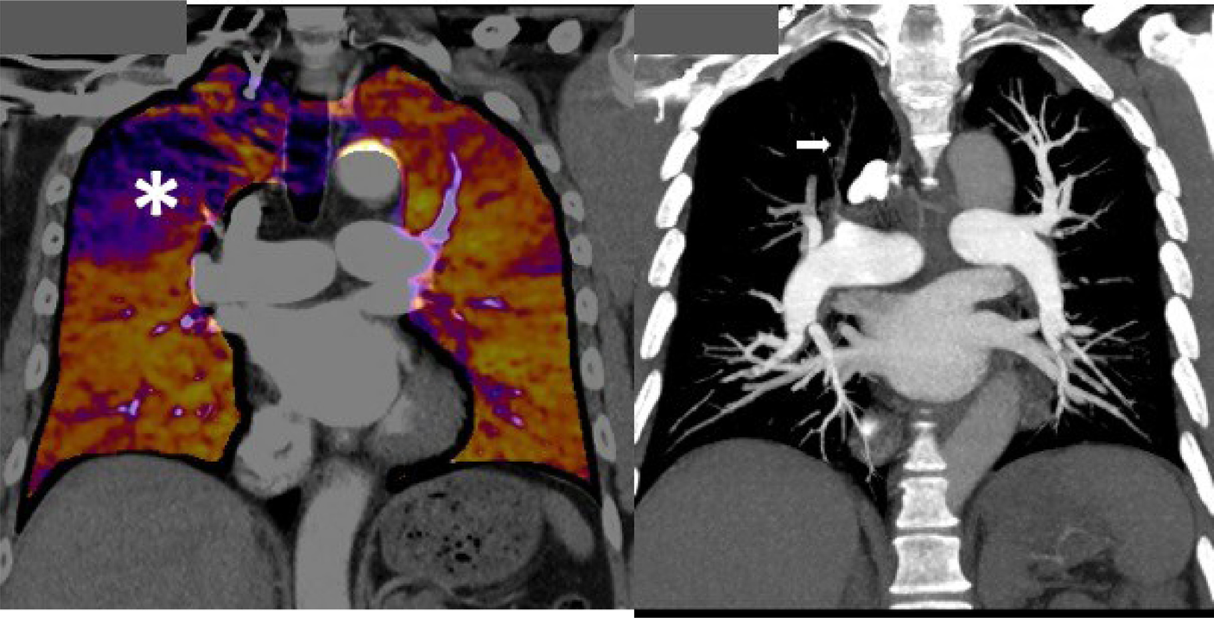
Figure 3
The Journal of Heart and Lung Transplantation 2021 401301-1326DOI: (10.1016/j.healun.2021.07.020)
Copyright © 2021 International Society for Heart and Lung Transplantation Terms and Conditions
Notes:
Coronal views of a dual Energy CTPA in a 55 year old with CTEPH. There is a large perfusion defect (*) in the anterior segment of the right upper lobe (Left) with corresponding occlusion (arrow) of the anterior right upper lobe pulmonary artery (Right). CTEPH, Chronic thromboembolic pulmonary hypertension; CTPA, Computed tomography pulmonary angiography.

Slide 5
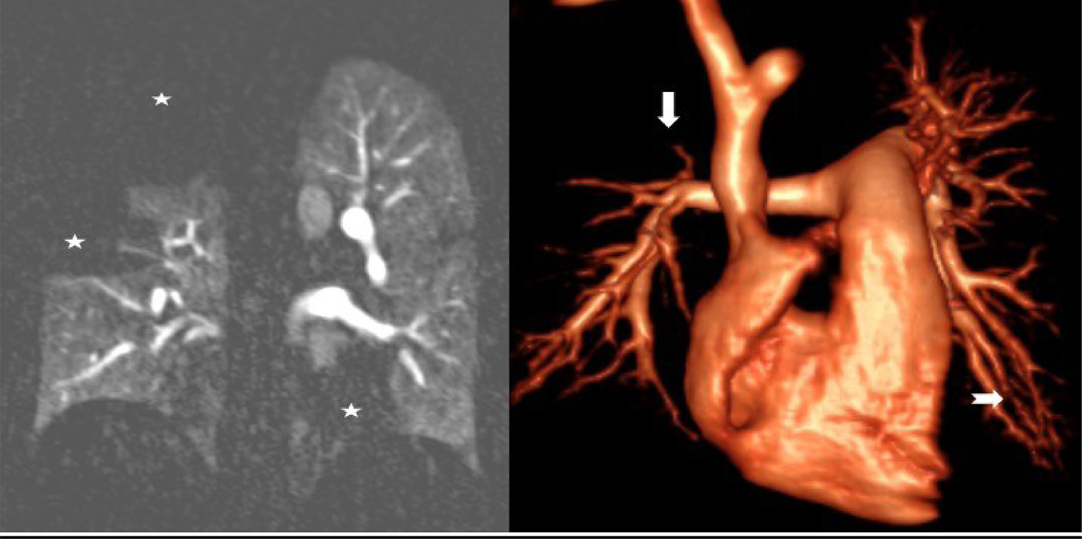
Figure 4
The Journal of Heart and Lung Transplantation 2021 401301-1326DOI: (10.1016/j.healun.2021.07.020)
Copyright © 2021 International Society for Heart and Lung Transplantation Terms and Conditions
Notes:
MR of the pulmonary circulation in CTEPH. Coronal perfusion (left panel) dataset reveals lobar perfusion defect in the right upper and segmental perfusion defects in the right middle and left lower lobes (white star). On the angiography volume rendered technique (right panel), note the corresponding lobar occlusion in right upper and segmental disease in the right middle and left lower lobes (white arrow). CTEPH, Chronic thromboembolic pulmonary hypertension.

Slide 6
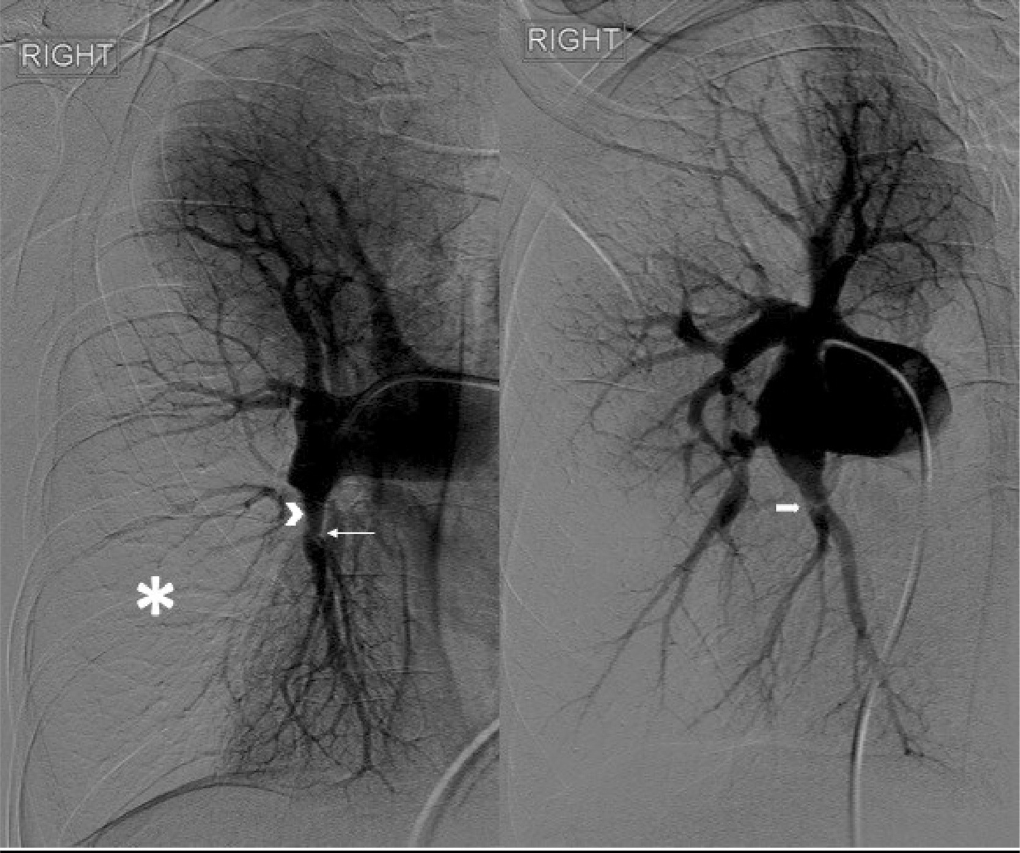
Figure 5
The Journal of Heart and Lung Transplantation 2021 401301-1326DOI: (10.1016/j.healun.2021.07.020)
Copyright © 2021 International Society for Heart and Lung Transplantation Terms and Conditions
Notes:
Catheter pulmonary angiography in a 57 year old female with CTEPH. Frontal (left) and Oblique (right) views demonstrates constellation of signs including intimal thrombus (chevron) in right lower lobe pulmonary artery, segmental stenosis with post-stenotic dilatation (thin arrow), proximal web (block arrow) that is only appreciable on the oblique view, abruptly truncated vasculature with loss of perfusion (*) in the parenchymal phase. CTEPH, Chronic thromboembolic pulmonary hypertension.

Slide 7
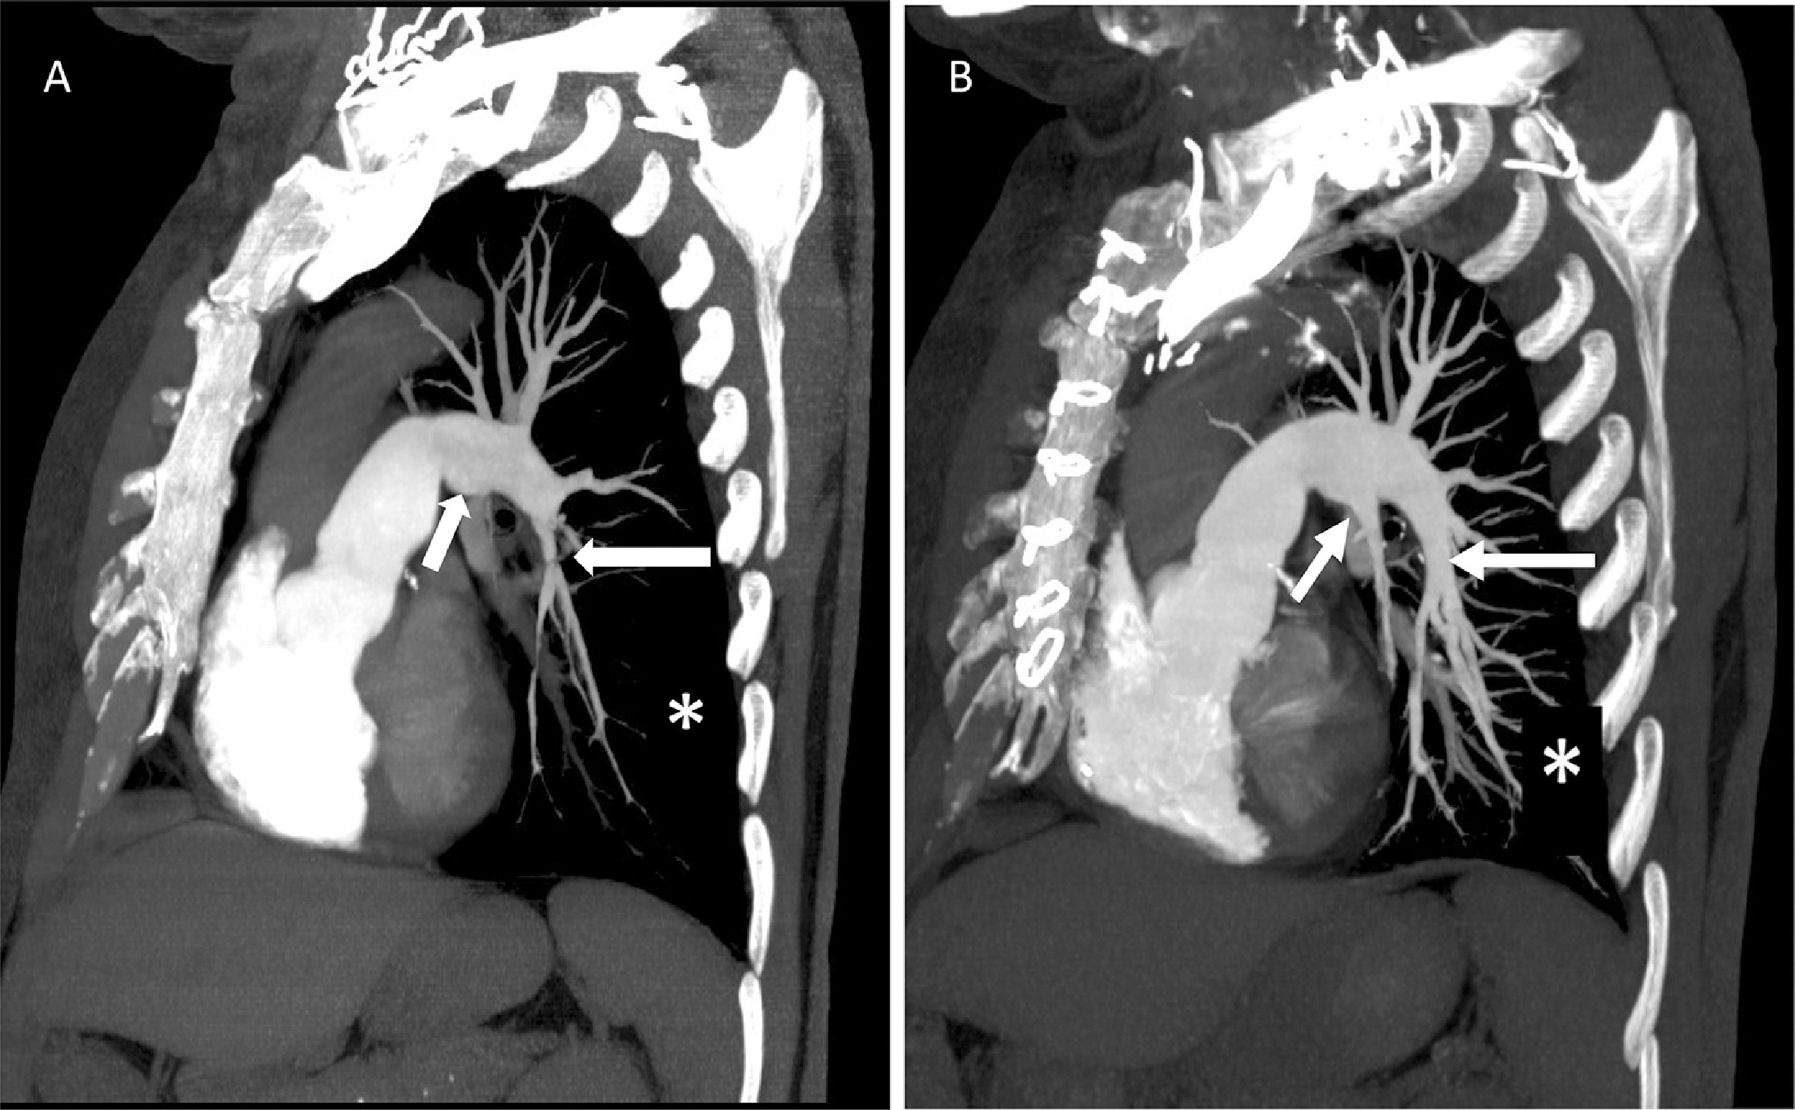
Figure 6
The Journal of Heart and Lung Transplantation 2021 401301-1326DOI: (10.1016/j.healun.2021.07.020)
Copyright © 2021 International Society for Heart and Lung Transplantation Terms and Conditions
Notes:
Coronal oblique CTPA MIP reformat of the left pulmonary arteries in a 56 year old man with CTEPH. A. Preoperative CTPA demonstrates a stenosis of the left lower lobe basal trunk (long arrow) due to webs and a complete occlusion of the lingular PA (short arrow). Note the paucity of vessels at the subsegmental level in the lung periphery (asterisk). B. Postoperative CTPA in the same patient demonstrates improved patency of the left lower lobe basal trunk (long arrow), reconstitution of the lingular pulmonary artery (short arrow) and a marked increase in vasculature at the subsegmental level (asterisk). MIP – Maximum intensity projection; CTPA – Computed tomography pulmonary angiogram.

Slide 8
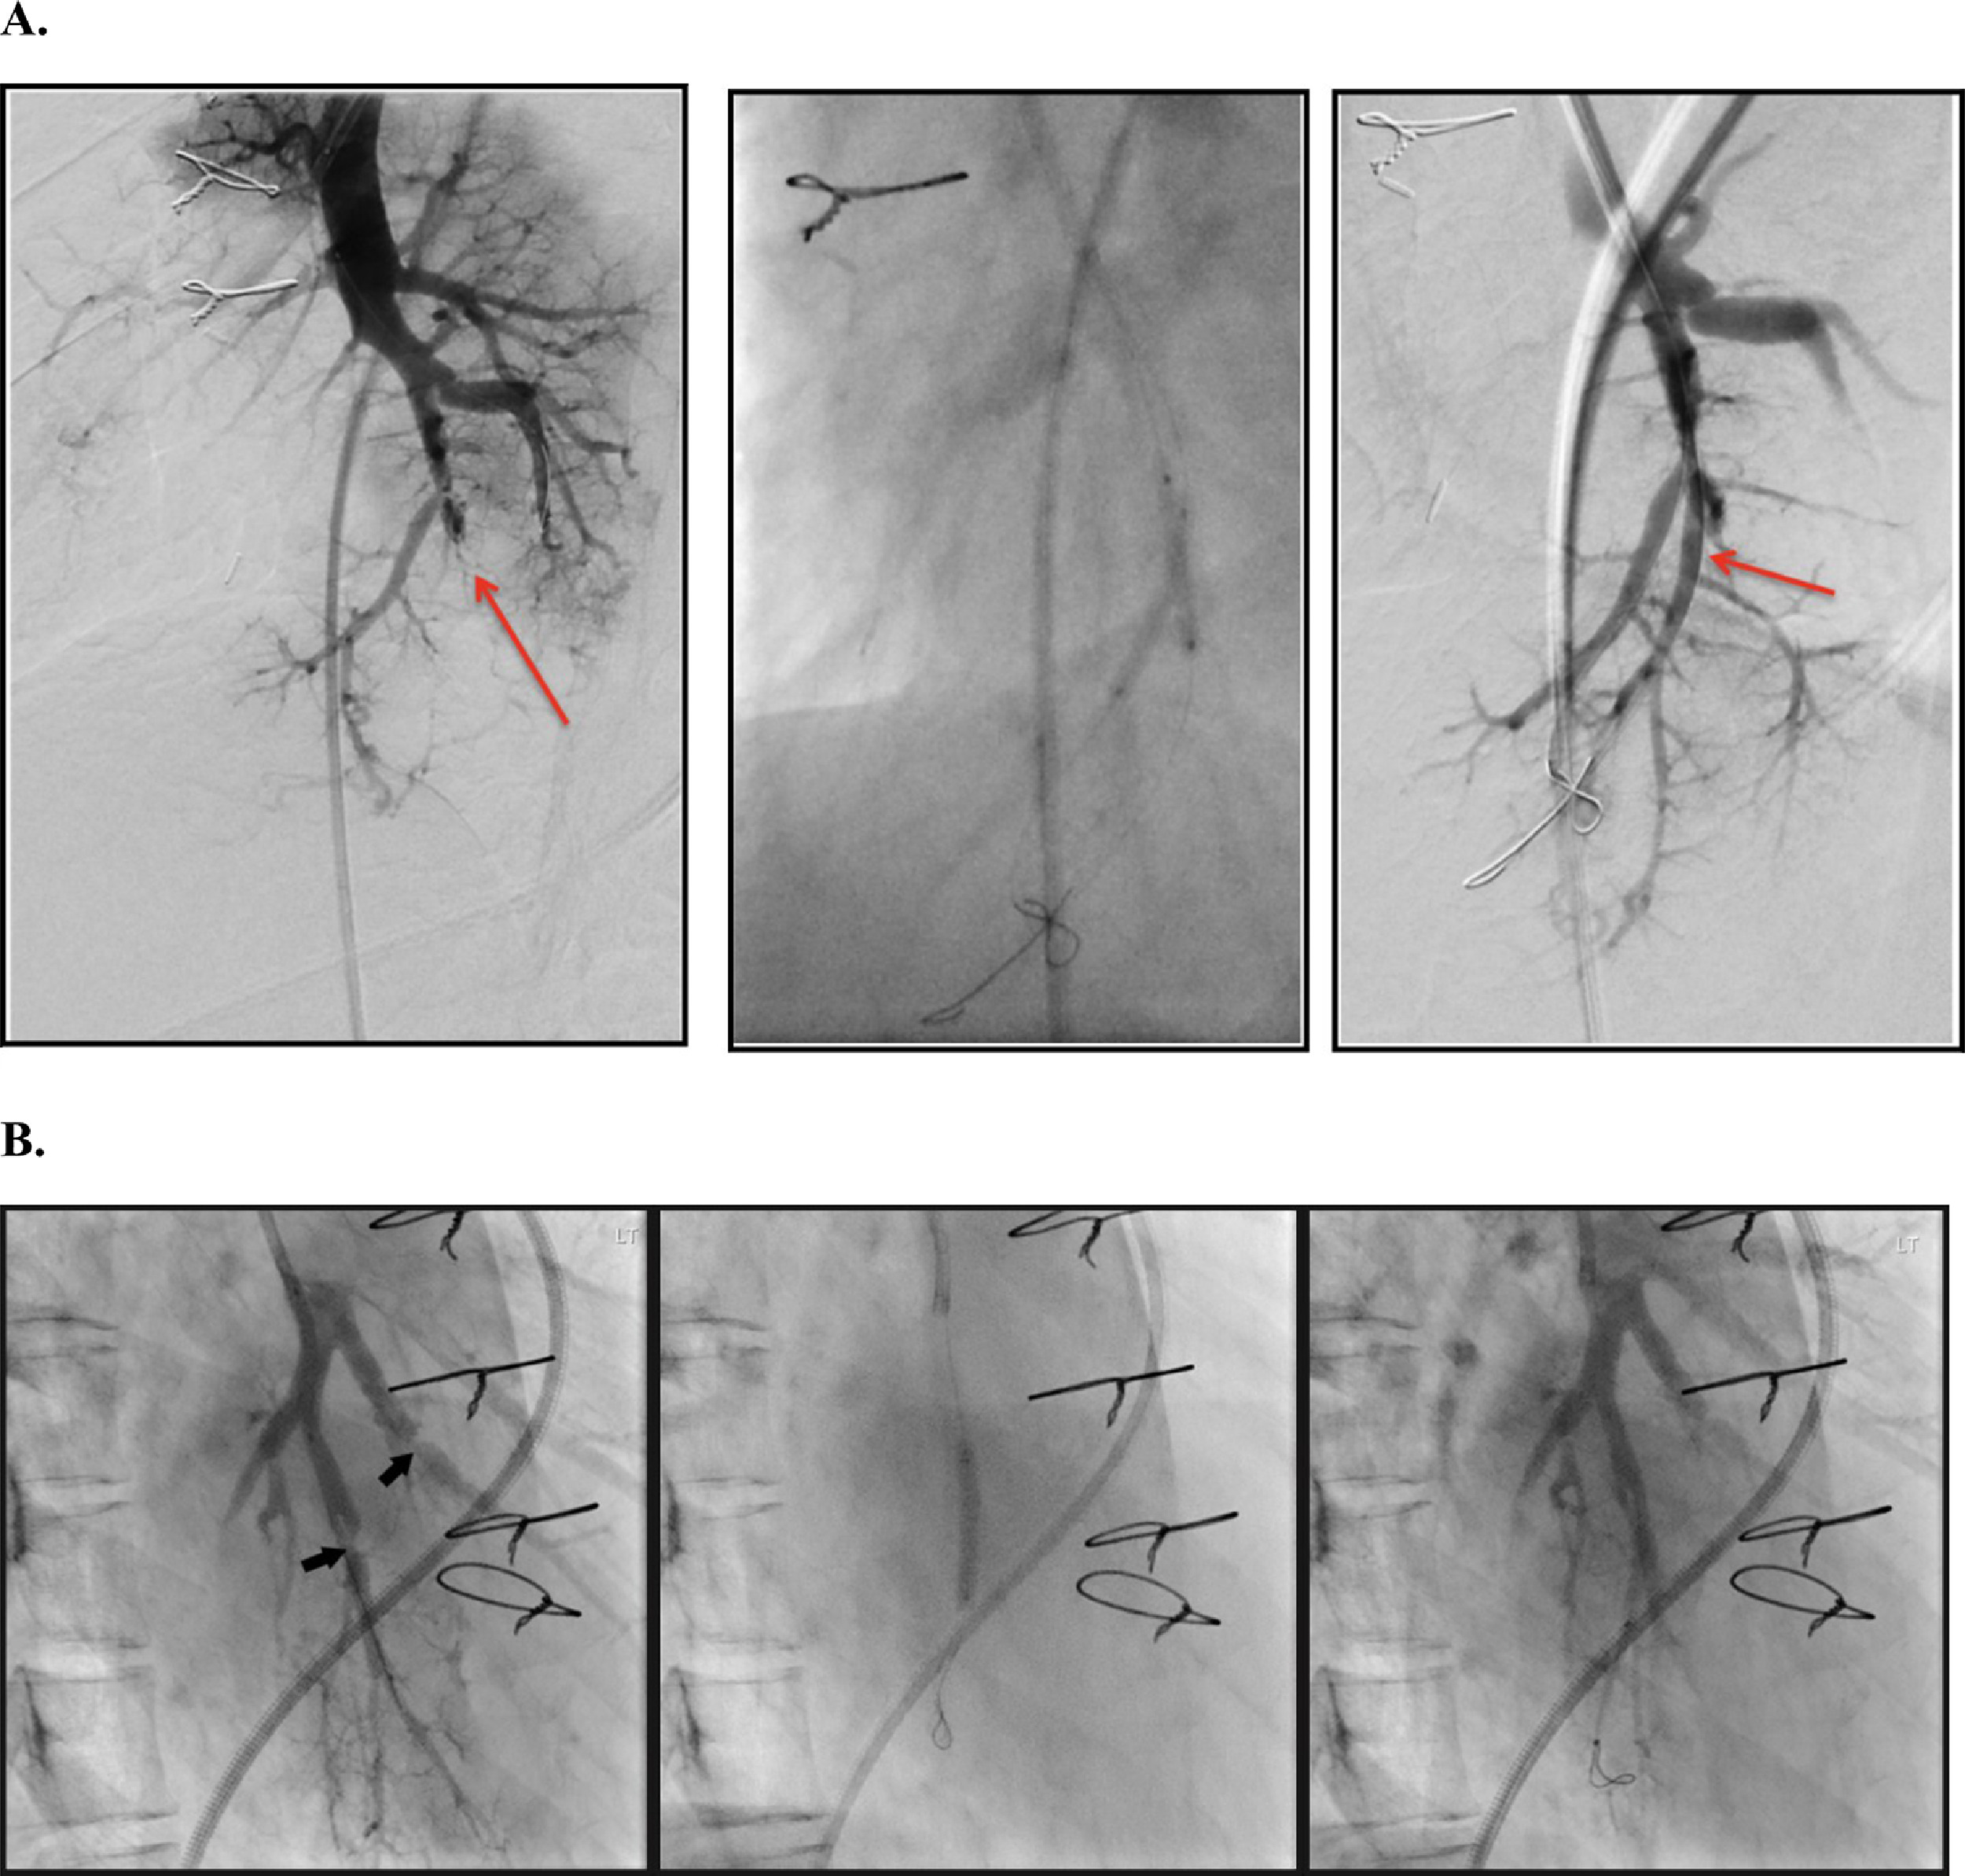
Figure 7
The Journal of Heart and Lung Transplantation 2021 401301-1326DOI: (10.1016/j.healun.2021.07.020)
Copyright © 2021 International Society for Heart and Lung Transplantation Terms and Conditions
Notes:
Two patients (A and B) post endarterectomy with residual left lower lobe distal segmental severe stenosis (arrows). Challenging area to reach surgically. Balloon pulmonary angioplasty to 3mm with improvement in angiographic result.

