Slide 1
Utilization of hepatitis C virus–infected organ donors in cardiothoracic transplantation: An ISHLT expert consensus statement
Saima Aslam, MD, MS, Paolo Grossi, MD, PhD, Kelly H. Schlendorf, MD, MHS, Are M. Holm, MD, PhD, Ann E. Woolley, MD, MPH, Emily Blumberg, MD, Mandeep R. Mehra, MD, MSc Saima Aslam, MD, MS, Mandeep R. Mehra, MD, MSc, Emily Blumberg, MD, Paolo Grossi, MD, PhD, Are M. Holm, MD, PhD, Kelly H. Schlendorf, MD, MHS, Ann E. Woolley, MD, MPH, Fernanda P. Silveira, MD, Jeffrey Teuteberg, MD, Maria Crespo, MD, Haifa Lyster, PharmD, Laura Lourenco, PharmD, Sara Machado, MD, Michael Shullo, Pharm D, Matthew Hartwig, MD, Miranda Peraskeva, MD, Cameron Wolfe, MD, Kiran Khush, MD, Michael Ison, MD, Shelley Hall, MD, Joshua Mooney, MD, Steve Ivulich, PharmD, Marcelo Cypel, MD, Victor Pretorius, MBBS, Patricia Uber, PharmD, Evan Kransdorf, MD, PhD, Adam Cochrane, PharmD, MPH, Alan Glanville, MD, Jennifer Gray, PharmD Saima Aslam, MD, MS, Paolo Grossi, MD, PhD, Kelly H. Schlendorf, MD, MHS, Are M. Holm, MD, PhD, Ann E. Woolley, MD, MPH, Emily Blumberg, MD, Mandeep R. Mehra, MD, MSc Saima Aslam, MD, MS, Mandeep R. Mehra, MD, MSc, Emily Blumberg, MD, Paolo Grossi, MD, PhD, Are M. Holm, MD, PhD, Kelly H. Schlendorf, MD, MHS, Ann E. Woolley, MD, MPH, Fernanda P. Silveira, MD, Jeffrey Teuteberg, MD, Maria Crespo, MD, Haifa Lyster, PharmD, Laura Lourenco, PharmD, Sara Machado, MD, Michael Shullo, Pharm D, Matthew Hartwig, MD, Miranda Peraskeva, MD, Cameron Wolfe, MD, Kiran Khush, MD, Michael Ison, MD, Shelley Hall, MD, Joshua Mooney, MD, Steve Ivulich, PharmD, Marcelo Cypel, MD, Victor Pretorius, MBBS, Patricia Uber, PharmD, Evan Kransdorf, MD, PhD, Adam Cochrane, PharmD, MPH, Alan Glanville, MD, Jennifer Gray, PharmD
The Journal of Heart and Lung Transplantation
Volume 39 Issue 5 Pages 418-432 (May 2020)
DOI: 10.1016/j.healun.2020.03.004
Copyright © 2020 International Society for Heart and Lung Transplantation Terms and Conditions

Slide 2
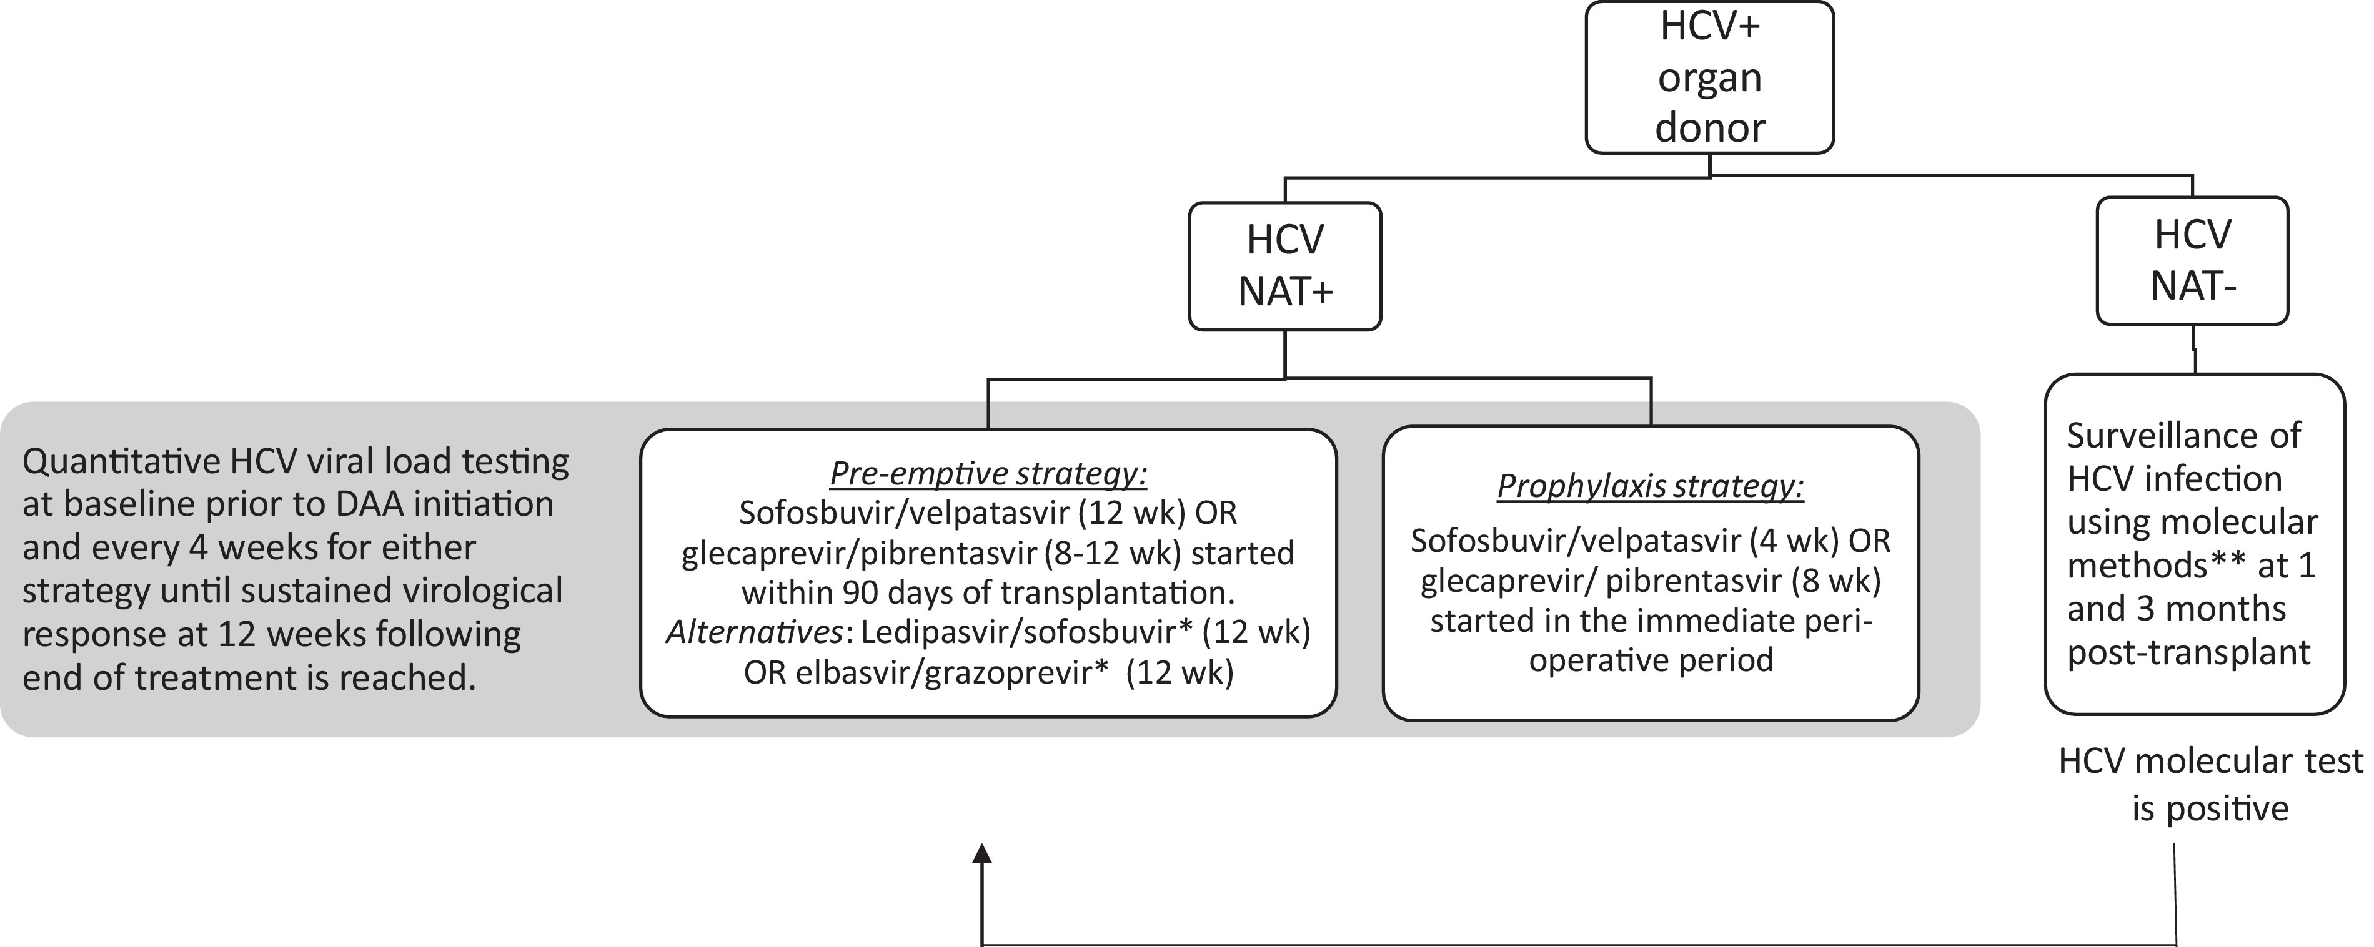
Figure 1
The Journal of Heart and Lung Transplantation 2020 39418-432DOI: (10.1016/j.healun.2020.03.004)
Copyright © 2020 International Society for Heart and Lung Transplantation Terms and Conditions
Notes:
Algorithm depicting flow of events when utilizing HCV-positive organs for cardiothoracic transplantation into HCV-negative recipients. *Based on appropriate genotype as per manufacturer recommendations. **Molecular methods include NAT and quantitative RNA PCR and/or viral load. DAA, direct-acting antiviral; HCV, hepatitis C virus; NAT, nucleic acid test; PCR, polymerase chain reaction; wk, week.

