Slide 1
Donor heart and lung procurement: A consensus statement
Hannah Copeland, MD, J.W. Awori Hayanga, MD, MPH, Arne Neyrinck, MD, PhD, Peter MacDonald, MD, Goran Dellgren, MD, PhD, Alejandro Bertolotti, MD, Tam Khuu, PharmD, Fay Burrows, Bpharm, Jack G. Copeland, MD, Danyel Gooch, BSN, RN, Amy Hackmann, MD, David Hormuth, MD, Christa Kirk, MD, Virginia Linacre, MD, Haifa Lyster, PharmD, Silvana Marasco, MD, David McGiffin, MD, Priya Nair, MD, Axel Rahmel, MD, Michael Sasevich, MD, Martin Schweiger, MD, Aleem Siddique, MD, Timothy J. Snyder, C.P.T.C. CCEMTP, William Stansfield, MD, Steven Tsui, MD, Yishay Orr, MD, Patricia Uber, PharmD, Rajimyer Venkateswaran, MD, Jasleen Kukreja, MD, Michael Mulligan, MD
The Journal of Heart and Lung Transplantation
Volume 39 Issue 6 Pages 501-517 (June 2020)
DOI: 10.1016/j.healun.2020.03.020
Copyright © 2020 Terms and Conditions

Slide 2
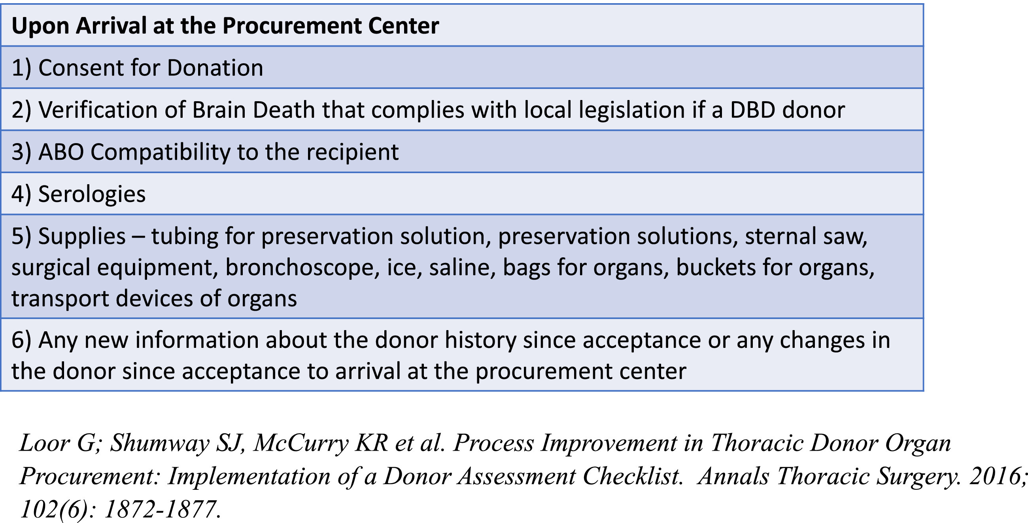
Figure 1
The Journal of Heart and Lung Transplantation 2020 39501-517DOI: (10.1016/j.healun.2020.03.020)
Copyright © 2020 Terms and Conditions
Notes:
Donor procurement checklist.

Slide 3
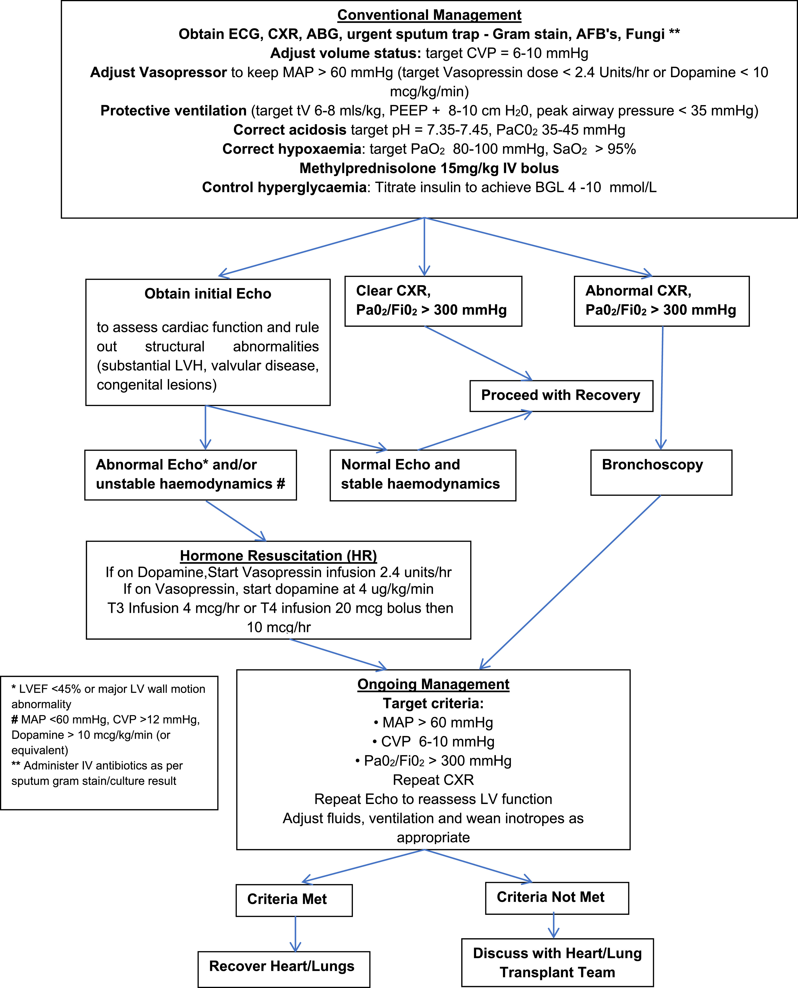
Figure 2
The Journal of Heart and Lung Transplantation 2020 39501-517DOI: (10.1016/j.healun.2020.03.020)
Copyright © 2020 Terms and Conditions
Notes:
Donor heart and lung management algorithm. ABG; arterial blood gas; CVP, central venous pressure; CXR, chest x ray; ECG, electrocardiogram; LV, left ventricle; LVEF, left ventricular ejection fraction; LVH, left ventricular hypertrophy; MAP, mean arterial pressure; PEEP, positive-end expiratory pressure.

Slide 4
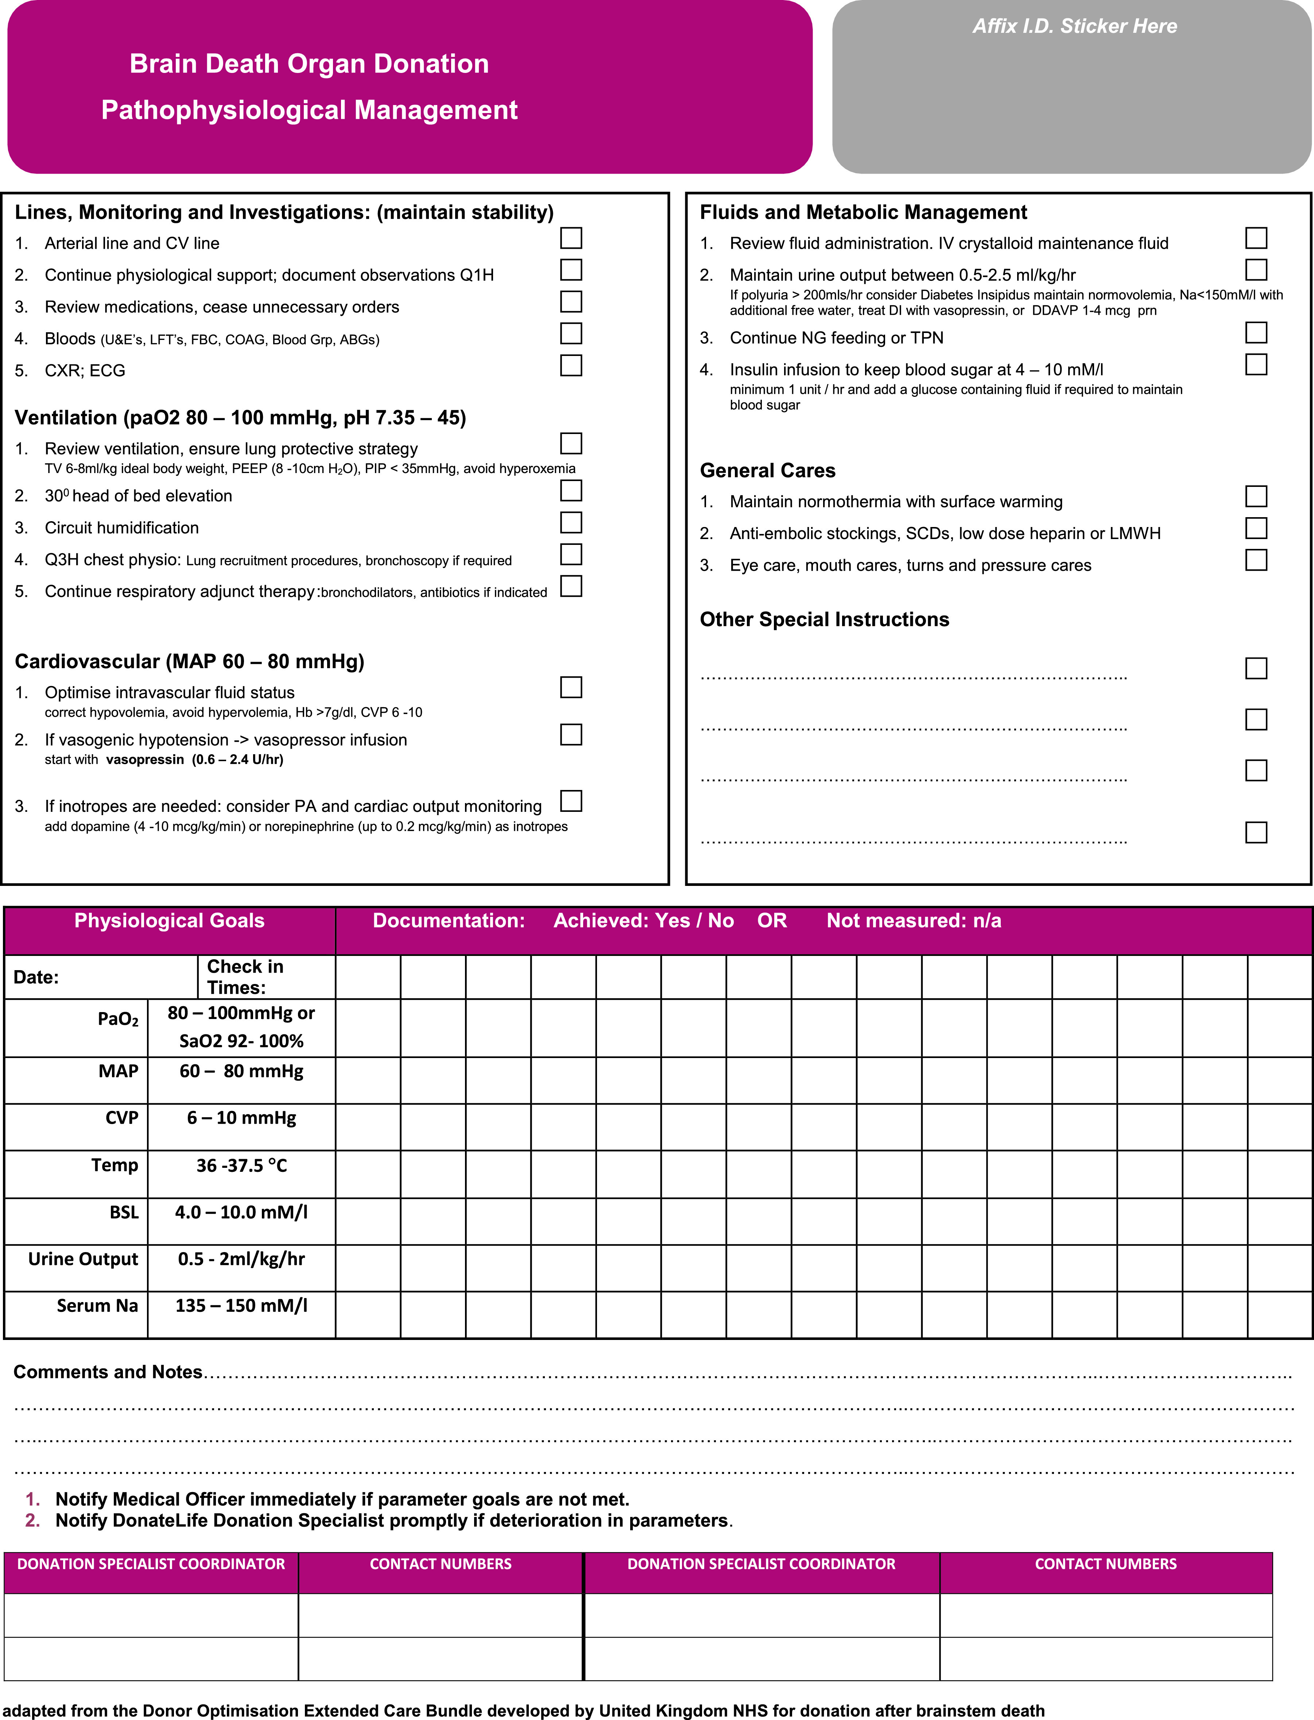
Figure 3
The Journal of Heart and Lung Transplantation 2020 39501-517DOI: (10.1016/j.healun.2020.03.020)
Copyright © 2020 Terms and Conditions
Notes:
Brain death donor management pathophysiological management.

Slide 5
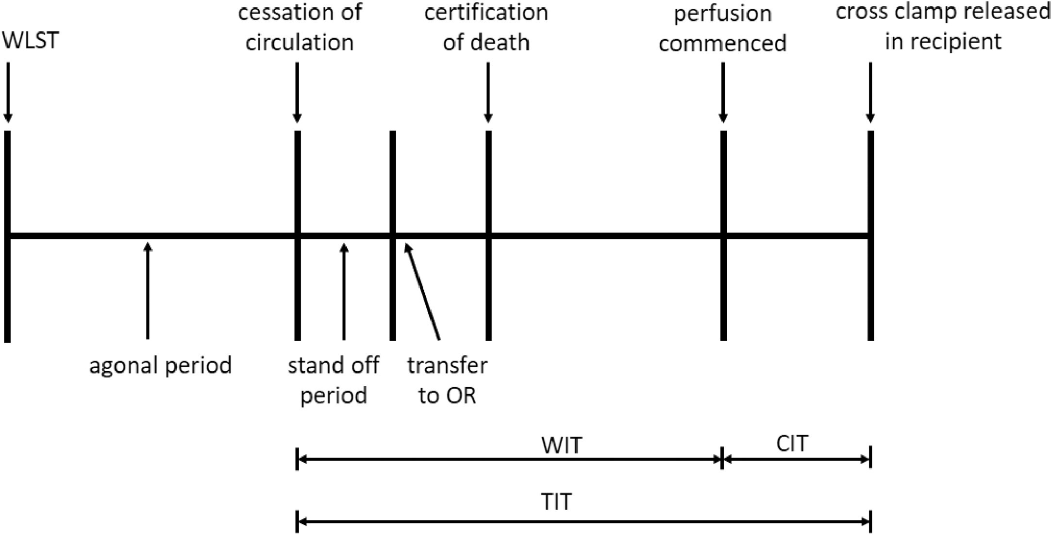
Figure 4
The Journal of Heart and Lung Transplantation 2020 39501-517DOI: (10.1016/j.healun.2020.03.020)
Copyright © 2020 Terms and Conditions
Notes:
DCD lung procurement procedure. CIT, cold ischemic time; DCD, donation after circulatory death; OR, operating room; TIT, total ischemic time; WIT, warm ischemic time.

