Slide 1
2019 updated consensus statement on the diagnosis and treatment of pediatric pulmonary hypertension: The European Pediatric Pulmonary Vascular Disease Network (EPPVDN), endorsed by AEPC, ESPR and ISHLT
Georg Hansmann, MD, PhD (Chair), Martin Koestenberger, MD (Co-Chair), Tero-Pekka Alastalo, MD, PhD, Christian Apitz, MD, Eric D. Austin, MD, MSc, Damien Bonnet, MD, PhD, Werner Budts, MD, PhD, Michele D'Alto, MD, PhD, Michael A. Gatzoulis, MD, PhD, Babar S. Hasan, MD, Rainer Kozlik-Feldmann, MD, R. Krishna Kumar, MD, Astrid E. Lammers, MD, MD(Res), Heiner Latus, MD, Ina Michel-Behnke, MD, PhD, Oliver Miera, MD, Nicholas W. Morrell, MD, Guido Pieles, MD, DPhil, Daniel Quandt, MD, Hannes Sallmon, MD, Dietmar Schranz, MD, Karin Tran-Lundmark, MD, PhD, Robert M.R. Tulloh, DM FRCPCH, Gregor Warnecke, MD, Håkan Wåhlander, MD, PhD, Sven C. Weber, MD, Peter Zartner, MD
The Journal of Heart and Lung Transplantation
Volume 38 Issue 9 Pages 879-901 (September 2019)
DOI: 10.1016/j.healun.2019.06.022
Copyright © 2019 Terms and Conditions

Slide 2
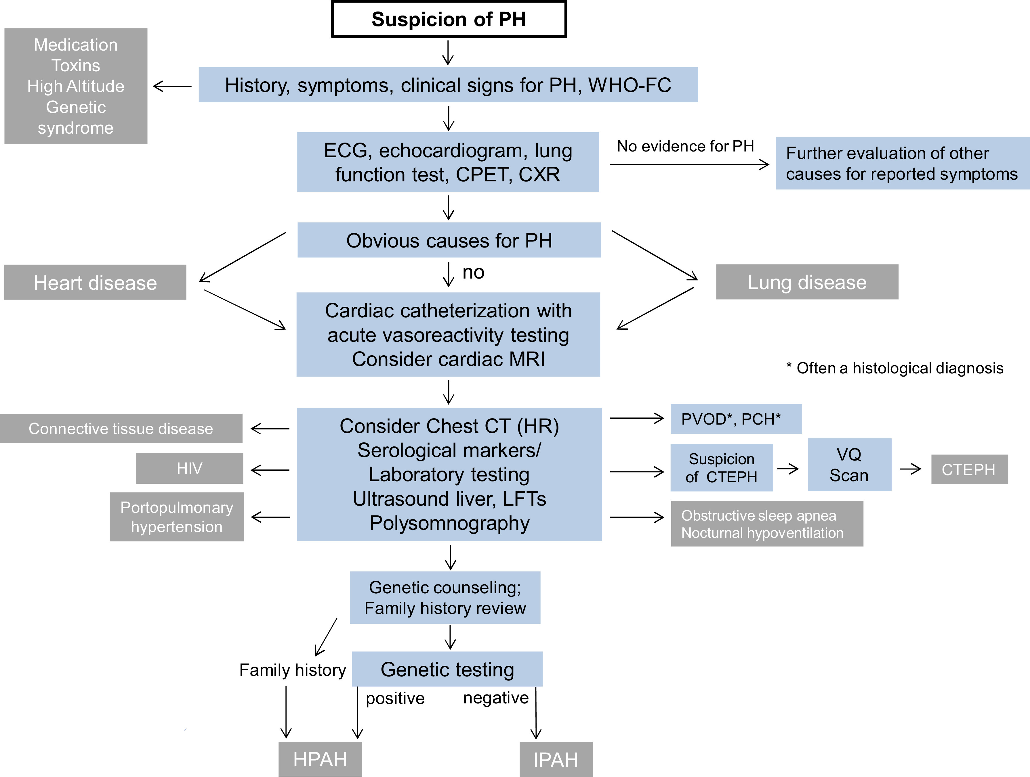
Figure 1
The Journal of Heart and Lung Transplantation 2019 38879-901DOI: (10.1016/j.healun.2019.06.022)
Copyright © 2019 Terms and Conditions
Notes:
Diagnostic algorithm for a child or young adult with suspected PH. Screening for pediatric PH is performed by ECG and echocardiography. If these investigations suggest the presence of PH/PHVD, chest X-ray and/or chest CT should be considered, followed by additional investigations. If PH/PHVD is severe, and the patient presents severely ill in overt heart failure and/or pulmonary vascular crisis, cardiac catheterization may be postponed and pharmacotherapy including intravenous prostanoids started immediately. CPET, cardiopulmonary exercise testing; CT, computed tomography; CTEPH, chronic thromboembolic pulmonary hypertension; CXR, chest X-ray; ECG, electrocardiogram; FC, functional class; HIV, human immunodeficiency virus; HPAH, heritable pulmonary arterial hypertension; HR, high resolution; IPAH, idiopathic pulmonary arterial hypertension; LFT, liver function test; MRI, magnetic resonance imaging; PCH, pulmonary capillary hemangiomatosis; PH, pulmonary hypertension; PHVD, pulmonary hypertensive vascular disease; PVOD, pulmonary veno-occlusive disease; VQ, ventilation/perfusion; WHO, World Health Organization. Modified from Lammers et al., 2016.⁶

Slide 3
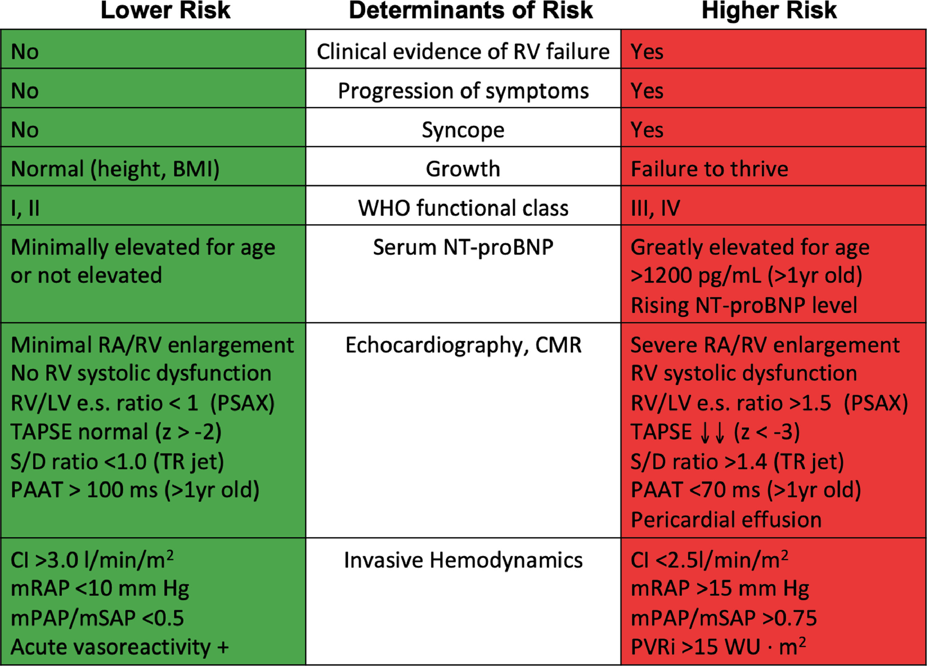
Figure 2
The Journal of Heart and Lung Transplantation 2019 38879-901DOI: (10.1016/j.healun.2019.06.022)
Copyright © 2019 Terms and Conditions
Notes:
Determinants of risk in pediatric PH and suspected PHVD. Variables are listed that distinguish between lower risk and higher risk, while the intermediate risk group is broad and not specifically defined. Overall, these determinants have only level of evidence C because of sparse or lacking pediatric data. Healthcare providers may include here PVR/SVR ratio, the 6 minute walk distance, and VO2max obtained during cardiopulmonary exercise testing as risk variables; however, it is unclear where exactly the cut-off values should be set. One must also note that most of these variables have been validated mostly for IPAH, and the cut-off levels used above may not necessarily apply to other forms of PAH. Furthermore, the use of approved therapies and their influence on the variables should be considered in the evaluation of the risk. See also supplementary Figure S1 for the EPPVDN risk score sheet (PH risk stratification). BMI, body mass index; BNP, brain natriuretic peptide; CI, cardiac index; CMR, cardiovascular magnetic resonance imaging; e.s., end-systolic; IPAH, idiopathic pulmonary arterial hypertension; mPAP, mean pulmonary artery pressure; mRAP, mean right atrial pressure; mSAP, mean systemic artery pressure; NT-proBNP, N terminal pro BNP; PAAT, pulmonary artery acceleration time by transthoracic Doppler echocardiography; PAH, pulmonary arterial hypertension; PH, pulmonary hypertension; PHVD, pulmonary hypertensive vascular disease; PSAX, parasternal short axis view by transthoracic echocardiography; PVR, pulmonary vascular resistance; PVRi, pulmonary vascular resistance index; RA, right atrium; RV, right ventricle; S/D ratio, systolic/diastolic duration ratio by Doppler echocardiography; SVR, systemic vascular resistance; SVRi, systemic vascular resistance index; TAPSE, tricuspid annular plane systolic excursion; TR, tricuspid regurgitation; VO2max, maximum rate of oxygen consumption; WHO, world health organization; WU, Wood unit. Modified from Hansmann et al., 2016.¹⁴

Slide 4
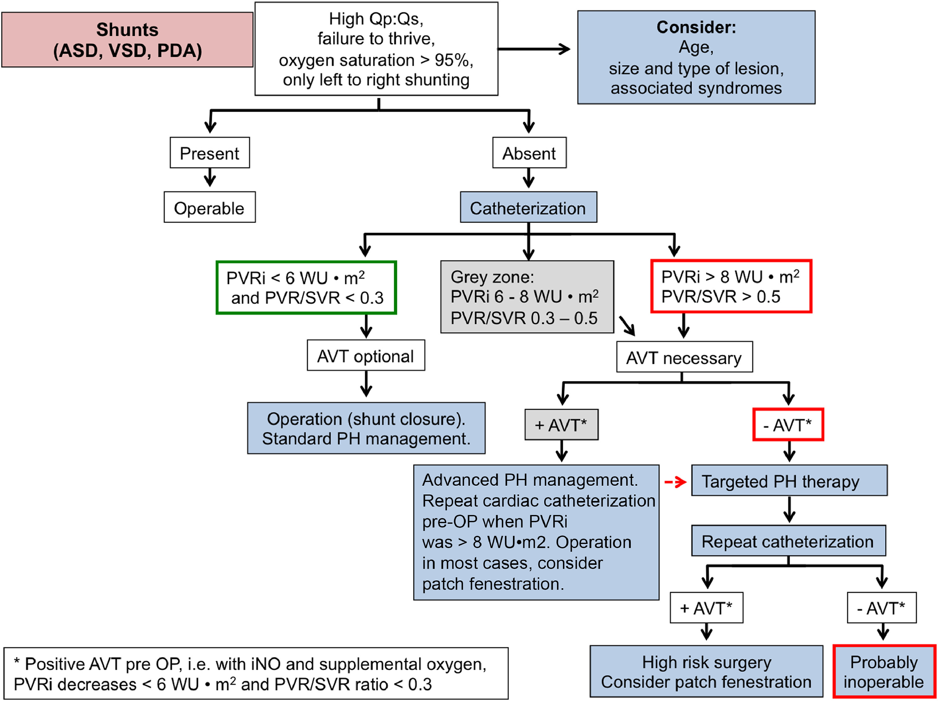
Figure 3
The Journal of Heart and Lung Transplantation 2019 38879-901DOI: (10.1016/j.healun.2019.06.022)
Copyright © 2019 Terms and Conditions
Notes:
Algorithm for the management of patients with CHD associated with PAH/PHVD and congenital shunt lesions. The indication for invasive diagnostics and eligibility for surgery/operability by comprehensive right and left heart catheterization includes basic evaluation and AVT, the latter especially in the gray zone of forecast uncertainty. Red frames indicate likely inoperable. Green frames indicate operability (pursue complete shunt closure). Of note: This algorithm does not cover the difficult treatment of children and young adults with isolated or predominantly post-capillary PH because of post-capillary obstructive lesions, for example, in the setting of pulmonary vein stenosis, mitral stenosis or other small left-sided structures (Supplementary Table S8 online), or cardiomyopathy with elevated left ventricular end-diastolic filling pressures. AVT, acute vasoreactivity testing; ASD, atrial septal defect; CHD, congenital heart disease; iNO, inhaled nitric oxide; PAH, pulmonary arterial hypertension; PDA, patent ductus arteriosus; PH, pulmonary hypertension; PHVD, pulmonary hypertensive vascular disease; pre-OP, preoperatively; PVR, pulmonary vascular resistance; PVRi, pulmonary vascular resistance index; Qp, pulmonary blood flow; Qs, systemic blood flow; SVR, systemic vascular resistance; VSD, ventricular septal defect; WU, Wood unit. Modified from Lopes and Barst and the Pulmonary Vascular Research Institute PAH-CHD taskforce (Pulmonary Vascular Research Institute website; published on September 26, 2013) and Kozlik-Feldmann et al., 2016.²²

Slide 5
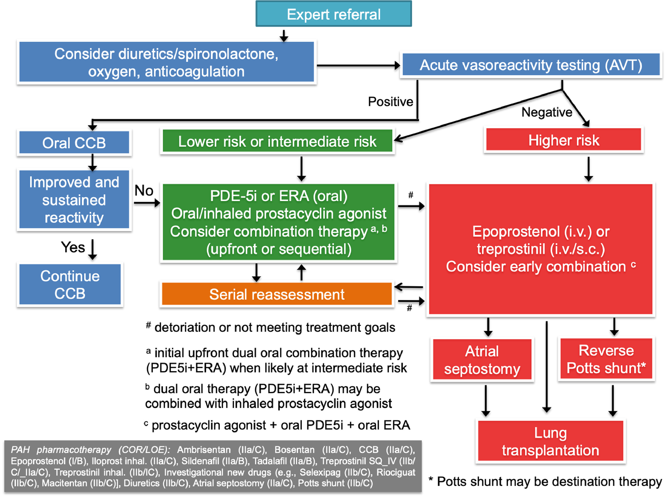
Figure 4
The Journal of Heart and Lung Transplantation 2019 38879-901DOI: (10.1016/j.healun.2019.06.022)
Copyright © 2019 Terms and Conditions
Notes:
Treatment algorithm for pediatric PAH. This algorithm applies to IPAH and HPAH (previously called familial PAH). Solid clinical data on the therapy of other forms of PH are limited, but the algorithm may apply to adult patients with DPAH. Initial monotherapy may be considered only when patient is at low risk (residual role for monotherapy). Monotherapy (e.g., with PDE-5i) in PAH-CHD after shunt closure and monotherapy (mostly with PDE-5i) in BPD-PH and CLD-PH is commonly used (residual role for monotherapy). We recommend initial upfront dual oral combination therapy (PDE-5i + ERA) when the patient is likely at intermediate risk. Dual oral therapy may be combined with inhaled, intravenous, or subcutaneous prostacyclin agonist (prostacyclin analogue), depending on risk stratification and clinical condition. Patients should be referred to a lung transplantation center for LuTx evaluation when they remain in an intermediate- or high-risk category despite maximal PAH therapy. In experienced centers, the 1-year survival rates after LuTx now exceed 90%. A pre-transplant rehabilitation program may be considered. Aside from sildenafil and bosentan (>1 year of age), all other agents are considered off-label drugs in children with PH in Europe. Sildenafil dosing recommendations should follow EMA-approved dosing for children. Bosentan received the following dual grading: COR I, LOE B for children with PAH and ES, and COR IIa, LOE C for children with PAH without ES. AVT, acute vasoreactivity testing; CCB, calcium channel blocker; COR, class of recommendation; DPAH, drug-induced pulmonary arterial hypertension; EMA, European Medicines Agency; ERA, endothelin receptor antagonist; ES, Eisenmenger syndrome; HPAH, heritable pulmonary arterial hypertension; inh., inhalation; IPAH, idiopathic pulmonary arterial hypertension; i.v., intravenously; LOE, level of evidence; PDE-5i, phosphodiesterase 5 inhibitor; s.c., subcutaneously.

