Slide 1
Chronic lung allograft dysfunction: Definition, diagnostic criteria, and approaches to treatment―A consensus report from the Pulmonary Council of the ISHLT
Geert M. Verleden, MD, PhD, Allan R. Glanville, MBBS, MD, Erika D. Lease, MD, Andrew J. Fisher, BMedSci, BMBS, Fiorella Calabrese, MD, Paul A. Corris, Christopher R. Ensor, PharmD, Jens Gottlieb, Ramsey R. Hachem, Vibha Lama, Tereza Martinu, MD, Desley A.H. Neil, BMedSc, MBBS, Lianne G. Singer, MD, FRCPC, Greg Snell, MD, Robin Vos, MD, PhD
The Journal of Heart and Lung Transplantation
Volume 38 Issue 5 Pages 493-503 (May 2019)
DOI: 10.1016/j.healun.2019.03.009
Copyright © 2019 International Society for Heart and Lung Transplantation Terms and Conditions

Slide 2
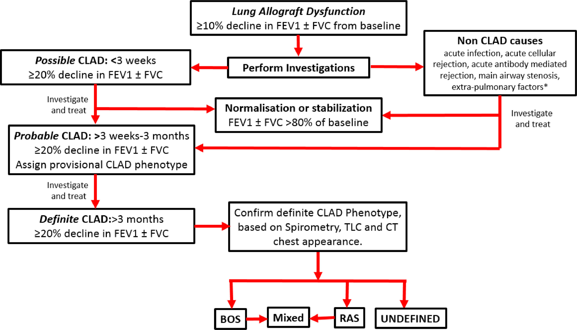
Figure 1
The Journal of Heart and Lung Transplantation 2019 38493-503DOI: (10.1016/j.healun.2019.03.009)
Copyright © 2019 International Society for Heart and Lung Transplantation Terms and Conditions
Notes:
Flowchart of evolution of CLAD. The date of onset of CLAD is defined as the date at which the first value of FEV1 ± FVC ≤80% of baseline was recorded, provided subsequent values remain at ≤80% of baseline. Undefined indicates patients who do not fit in the current definitions of BOS, RAS, and mixed phenotypes (see Table 3). Asterisk (*) indicates non-CLAD causes, as described in Table 1. BOS, bronchiolitis obliterans syndrome; CLAD, chronic lung allograft dysfunction; CT, computerized tomography; FEV1, forced expiratory volume in 1 second; FVC, forced vital capacity; RAS, restrictive allograft syndrome; TLC, total lung capacity.

Slide 3
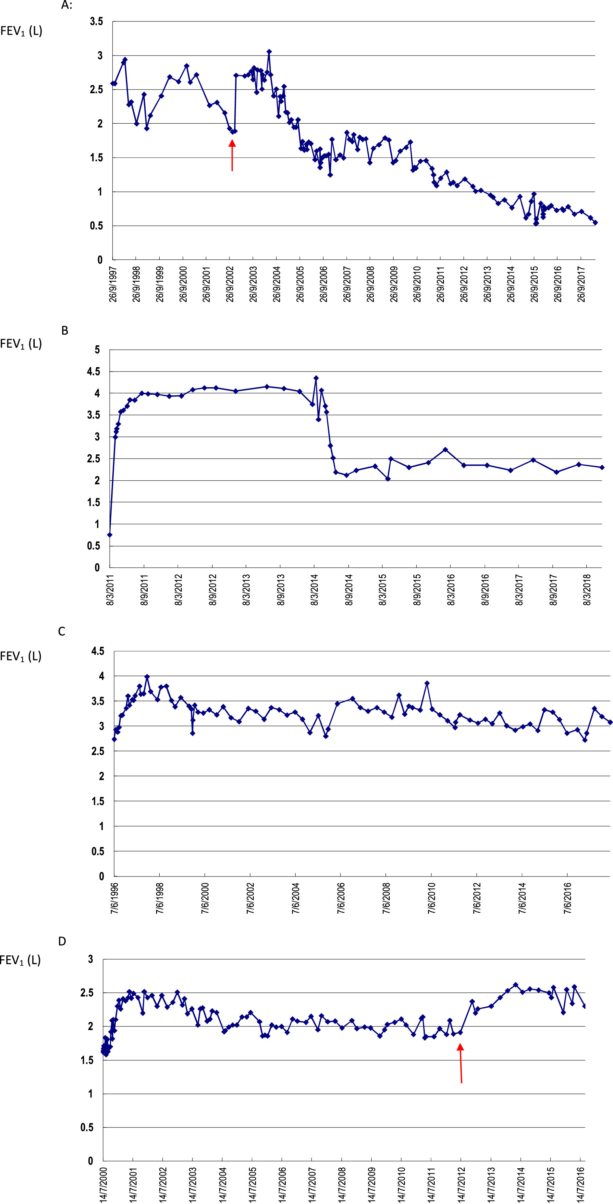
Figure 2
The Journal of Heart and Lung Transplantation 2019 38493-503DOI: (10.1016/j.healun.2019.03.009)
Copyright © 2019 International Society for Heart and Lung Transplantation Terms and Conditions
Notes:
Case studies. (A) In 1997, this patient underwent a heart‒lung transplant for complex Eisenmenger syndrome, and had several biopsy-proven acute cellular rejection episodes, which were treated with courses of intravenous steroids and intravenous anti-thymocyte globulins, and a shift from cyclosporine to tacrolimus and azathioprine to mycophenolate mofetil. Her FEV1 decreased gradually from 2.92 liters to 1.88 liters, and she was diagnosed with CLAD Stage 2 (FEV1 decline to 64% of baseline), phenotype BOS (obstructive and no CT opacities). At that time (in 2002), azithromycin was added (red arrow) and FEV1 normalized within 2 months. CLAD could no longer be sustained, so it is unlikely that her FEV1 decline before azithromycin was due to development of BO (BOS). Later, she had another gradual decline in FEV1, which was considered CLAD (initial BOS phenotype), but subsequently demonstrated a mixed phenotype with TLC decline (12%) and persistent pleuroparenchymal opacities on chest CT scan. (B) In 2011, this patient underwent a re-do bilateral lung transplant because of end-stage BOS. In 2014, after late biopsy-proven acute rejection, he developed rapidly declining obstructive spirometry, diagnosed as CLAD Stage 3, phenotype BOS. After initiation of extracorporeal photophoresis, FEV1 increased from 2.12 liters to a maximum of 2.70 liters, after which it remained stable at around 2.35 liters. This patient showed partial reversibility (+27%), with a subsequent new decline, although the patient has remained in CLAD Stage 2, phenotype BOS, illustrating that a reversible (possibly inflammatory) part of CLAD (BOS) was effectively treated, even though BO itself is not reversible. (C) In 1996, the patient underwent a bilateral lung transplantation for pulmonary arterial hypertension. The best post-operative FEV1 was 3.9 liters (100% predicted). Current FEV1 is 3.1 liters (98% predicted). Although there was an FEV1 decline of 0.8 liter (corresponding to a 20.5% decline), this is not considered CLAD, as the percent predicted has remained almost identical; thus, this may be considered a natural FEV1 decline over the course of 22 years. (D) In 2000, this patient underwent bilateral lung transplant for idiopathic pulmonary fibrosis. Her weight increased by 25 kg over the next 5 years, but then remained stable. At the same time, her FEV1 and FVC decreased by 20% compared with baseline. This was initially considered CLAD Stage 1, with restrictive pulmonary function (TLC decline 11%), but there were no opacities on chest CT scan (hence not qualifying for RAS). After she underwent a gastric bypass procedure (red arrow), resulting in a weight loss of 30 kg, pulmonary function again normalized. The patient did not have CLAD because her restrictive pulmonary function decline was due to weight gain, and CLAD score was restored to 0 with substantial weight loss. CLAD, chronic lung allograft dysfunction; CT, computerized tomography; FEV1, forced expiratory volume in 1 second; FVC, forced vital capacity; RAS, restrictive allograft syndrome; TLC, total lung capacity.

