Slide 1
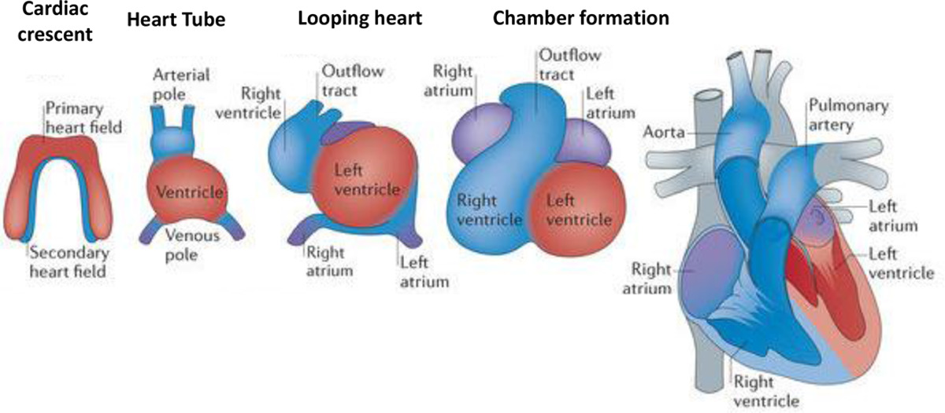
© 2018 American Heart Association, Inc.
Marvin A. Konstam. Circulation. Evaluation and Management of Right-Sided Heart Failure: A Scientific Statement From the American Heart Association, Volume: 137, Issue: 20, Pages: e578-e622, DOI: (10.1161/CIR.0000000000000560)

Slide 2
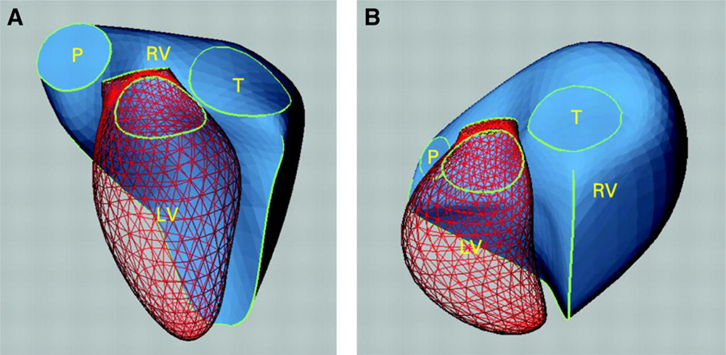
© 2018 American Heart Association, Inc.
Marvin A. Konstam. Circulation. Evaluation and Management of Right-Sided Heart Failure: A Scientific Statement From the American Heart Association, Volume: 137, Issue: 20, Pages: e578-e622, DOI: (10.1161/CIR.0000000000000560)

Slide 3
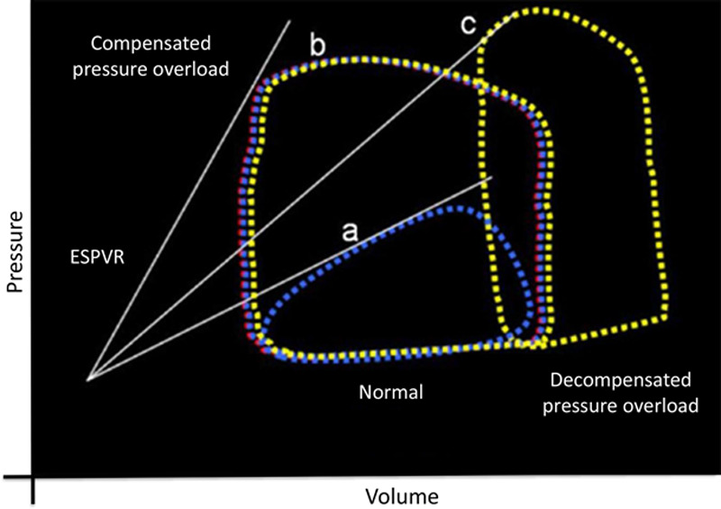
© 2018 American Heart Association, Inc.
Marvin A. Konstam. Circulation. Evaluation and Management of Right-Sided Heart Failure: A Scientific Statement From the American Heart Association, Volume: 137, Issue: 20, Pages: e578-e622, DOI: (10.1161/CIR.0000000000000560)

Slide 4
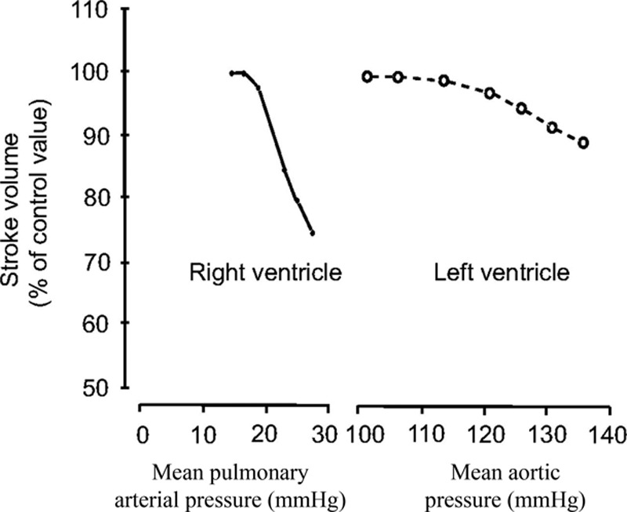
© 2018 American Heart Association, Inc.
Marvin A. Konstam. Circulation. Evaluation and Management of Right-Sided Heart Failure: A Scientific Statement From the American Heart Association, Volume: 137, Issue: 20, Pages: e578-e622, DOI: (10.1161/CIR.0000000000000560)

Slide 5
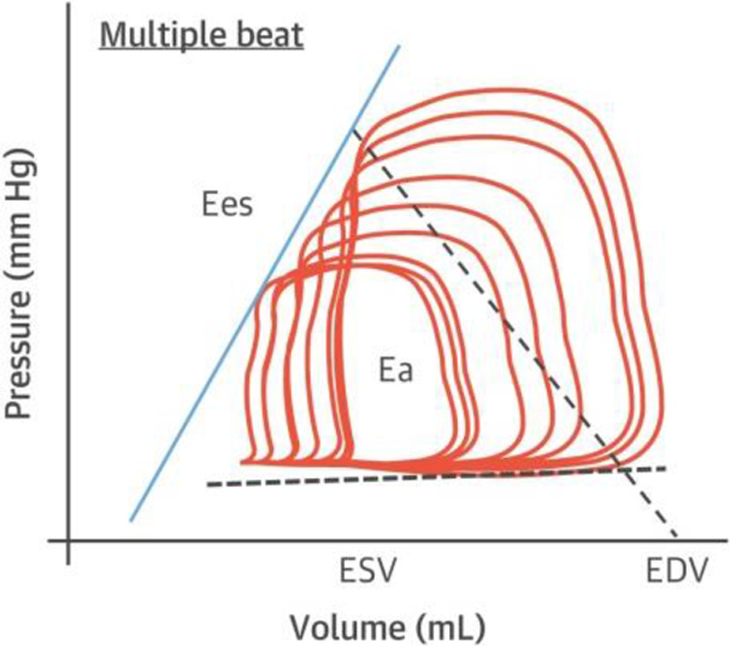
© 2018 American Heart Association, Inc.
Marvin A. Konstam. Circulation. Evaluation and Management of Right-Sided Heart Failure: A Scientific Statement From the American Heart Association, Volume: 137, Issue: 20, Pages: e578-e622, DOI: (10.1161/CIR.0000000000000560)

Slide 6
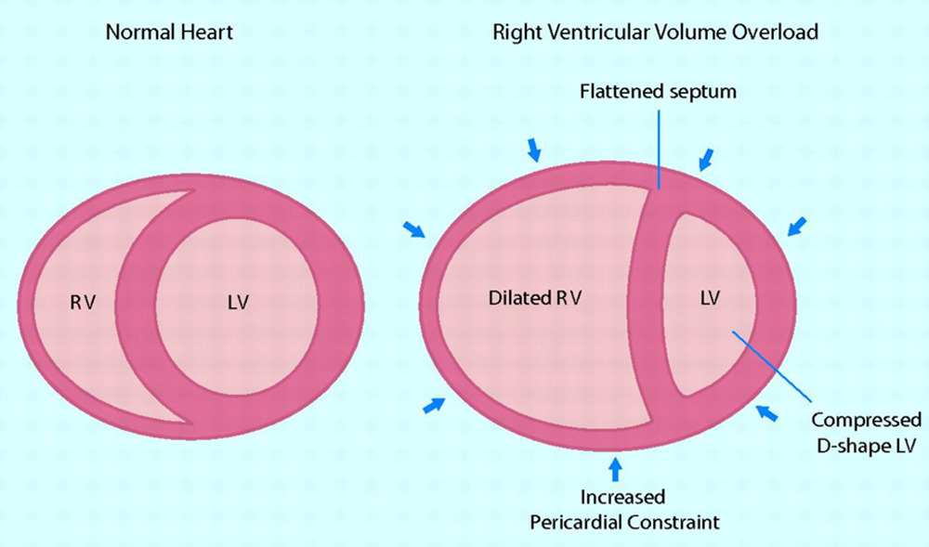
© 2018 American Heart Association, Inc.
Marvin A. Konstam. Circulation. Evaluation and Management of Right-Sided Heart Failure: A Scientific Statement From the American Heart Association, Volume: 137, Issue: 20, Pages: e578-e622, DOI: (10.1161/CIR.0000000000000560)

Slide 7
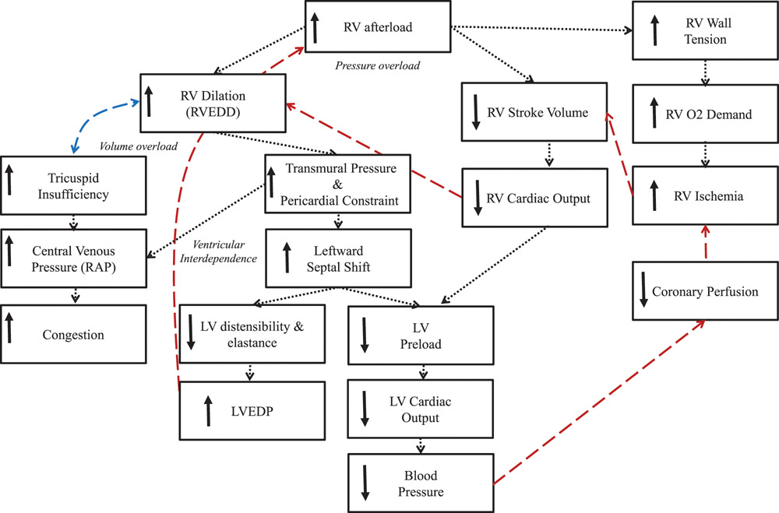
© 2018 American Heart Association, Inc.
Marvin A. Konstam. Circulation. Evaluation and Management of Right-Sided Heart Failure: A Scientific Statement From the American Heart Association, Volume: 137, Issue: 20, Pages: e578-e622, DOI: (10.1161/CIR.0000000000000560)

Slide 8
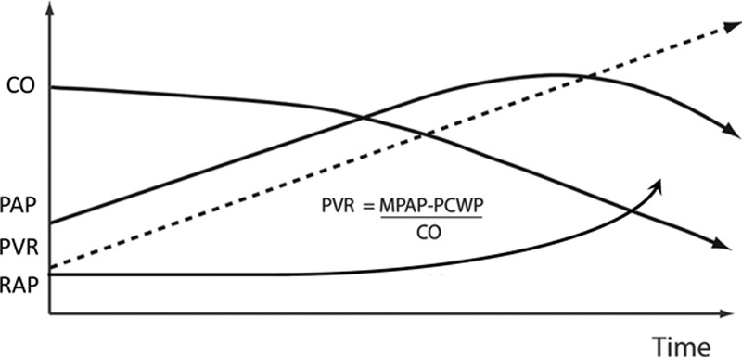
© 2018 American Heart Association, Inc.
Marvin A. Konstam. Circulation. Evaluation and Management of Right-Sided Heart Failure: A Scientific Statement From the American Heart Association, Volume: 137, Issue: 20, Pages: e578-e622, DOI: (10.1161/CIR.0000000000000560)

Slide 9
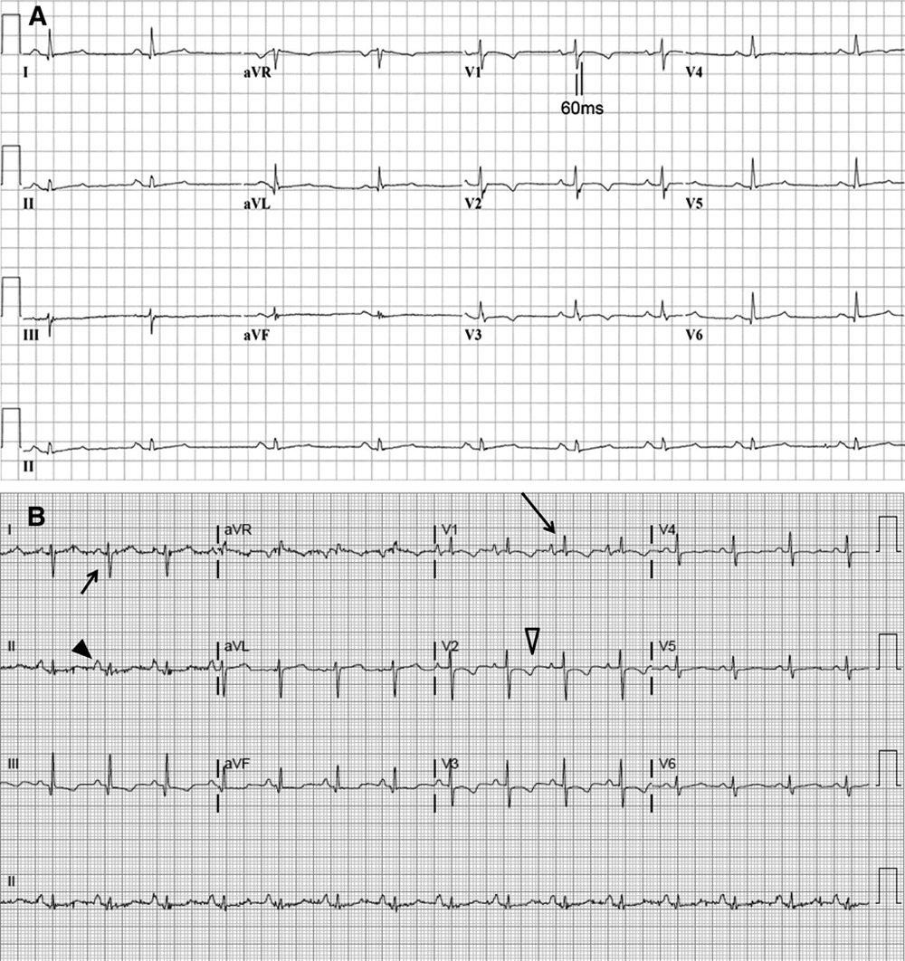
© 2018 American Heart Association, Inc.
Marvin A. Konstam. Circulation. Evaluation and Management of Right-Sided Heart Failure: A Scientific Statement From the American Heart Association, Volume: 137, Issue: 20, Pages: e578-e622, DOI: (10.1161/CIR.0000000000000560)

Slide 10
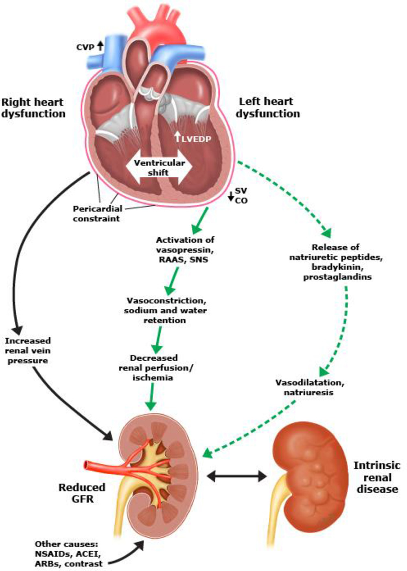
© 2018 American Heart Association, Inc.
Marvin A. Konstam. Circulation. Evaluation and Management of Right-Sided Heart Failure: A Scientific Statement From the American Heart Association, Volume: 137, Issue: 20, Pages: e578-e622, DOI: (10.1161/CIR.0000000000000560)

Slide 11
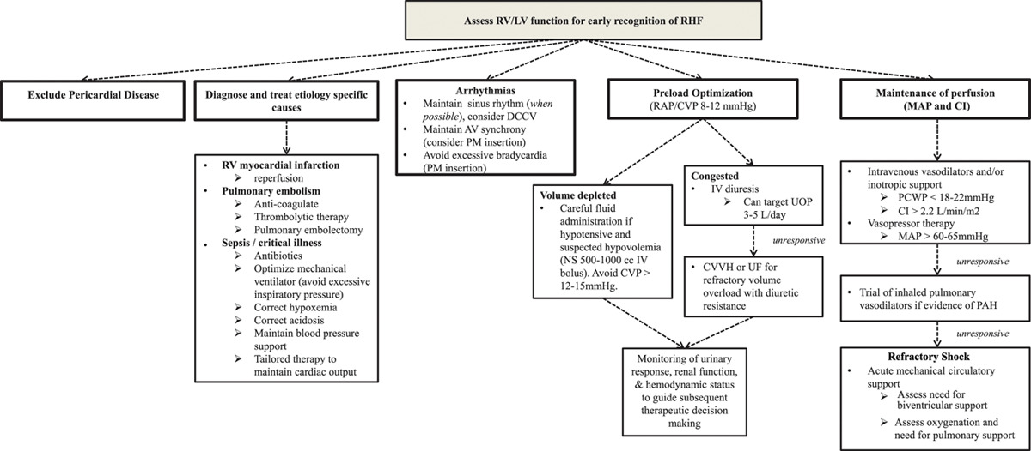
© 2018 American Heart Association, Inc.
Marvin A. Konstam. Circulation. Evaluation and Management of Right-Sided Heart Failure: A Scientific Statement From the American Heart Association, Volume: 137, Issue: 20, Pages: e578-e622, DOI: (10.1161/CIR.0000000000000560)

Slide 12
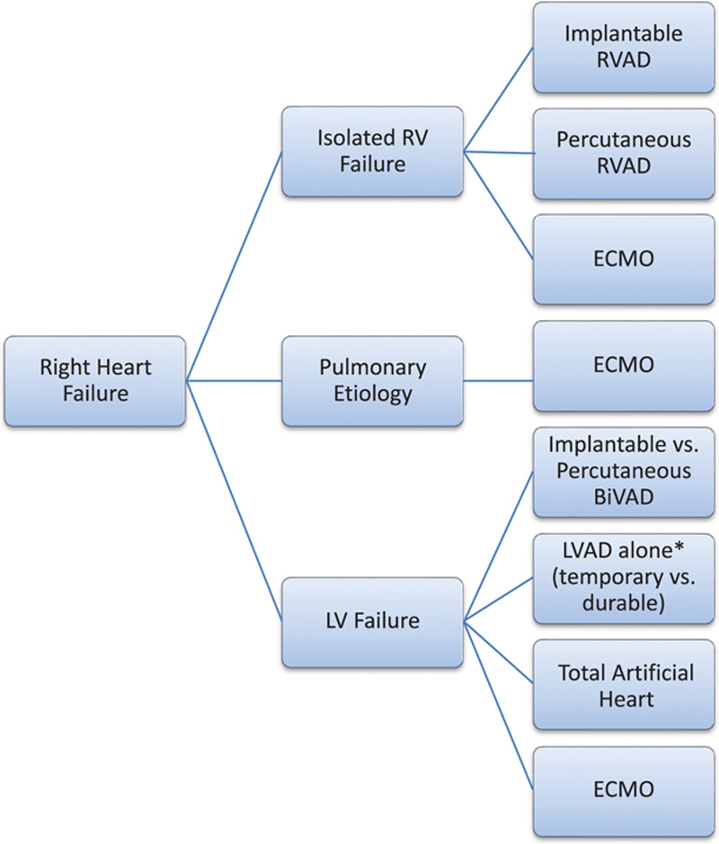
© 2018 American Heart Association, Inc.
Marvin A. Konstam. Circulation. Evaluation and Management of Right-Sided Heart Failure: A Scientific Statement From the American Heart Association, Volume: 137, Issue: 20, Pages: e578-e622, DOI: (10.1161/CIR.0000000000000560)

Slide 13
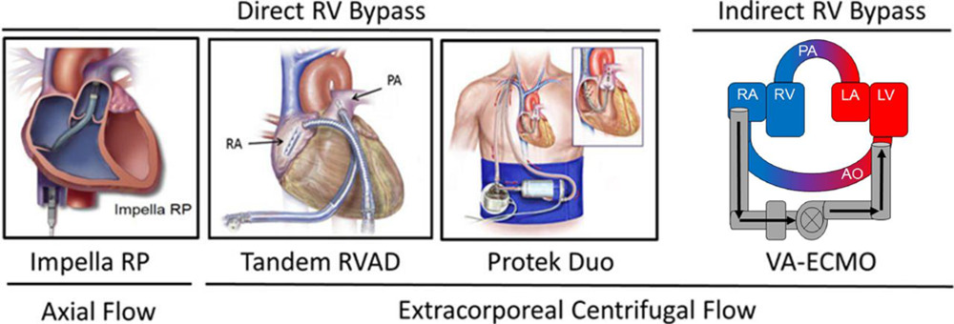
© 2018 American Heart Association, Inc.
Marvin A. Konstam. Circulation. Evaluation and Management of Right-Sided Heart Failure: A Scientific Statement From the American Heart Association, Volume: 137, Issue: 20, Pages: e578-e622, DOI: (10.1161/CIR.0000000000000560)

Slide 14
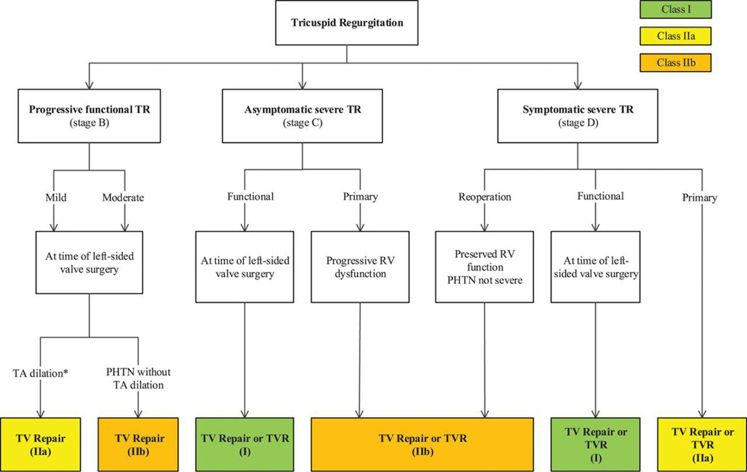
© 2018 American Heart Association, Inc.
Marvin A. Konstam. Circulation. Evaluation and Management of Right-Sided Heart Failure: A Scientific Statement From the American Heart Association, Volume: 137, Issue: 20, Pages: e578-e622, DOI: (10.1161/CIR.0000000000000560)

