Slide 1
The management of antibodies in heart transplantation: An ISHLT consensus document
Jon Kobashigawa, MD, Monica Colvin, MD, Luciano Potena, MD, PhD, Duska Dragun, MD, Maria G. Crespo-Leiro, MD, PhD, Juan F. Delgado, MD, Michael Olymbios, MBBS, Jayan Parameshwar, MD, Jignesh Patel, MD, PhD, Elaine Reed, PhD, Nancy Reinsmoen, PhD, D(ABHI), E. Rene Rodriguez, MD, Heather Ross, MD, Randall C. Starling, MD, MPH, Dolly Tyan, PhD, Simon Urschel, MD, Andreas Zuckermann, MD
The Journal of Heart and Lung Transplantation
Volume 37 Issue 5 Pages 537-547 (May 2018)
DOI: 10.1016/j.healun.2018.01.1291
Copyright © 2018 International Society for the Heart and Lung Transplantation Terms and Conditions

Slide 2
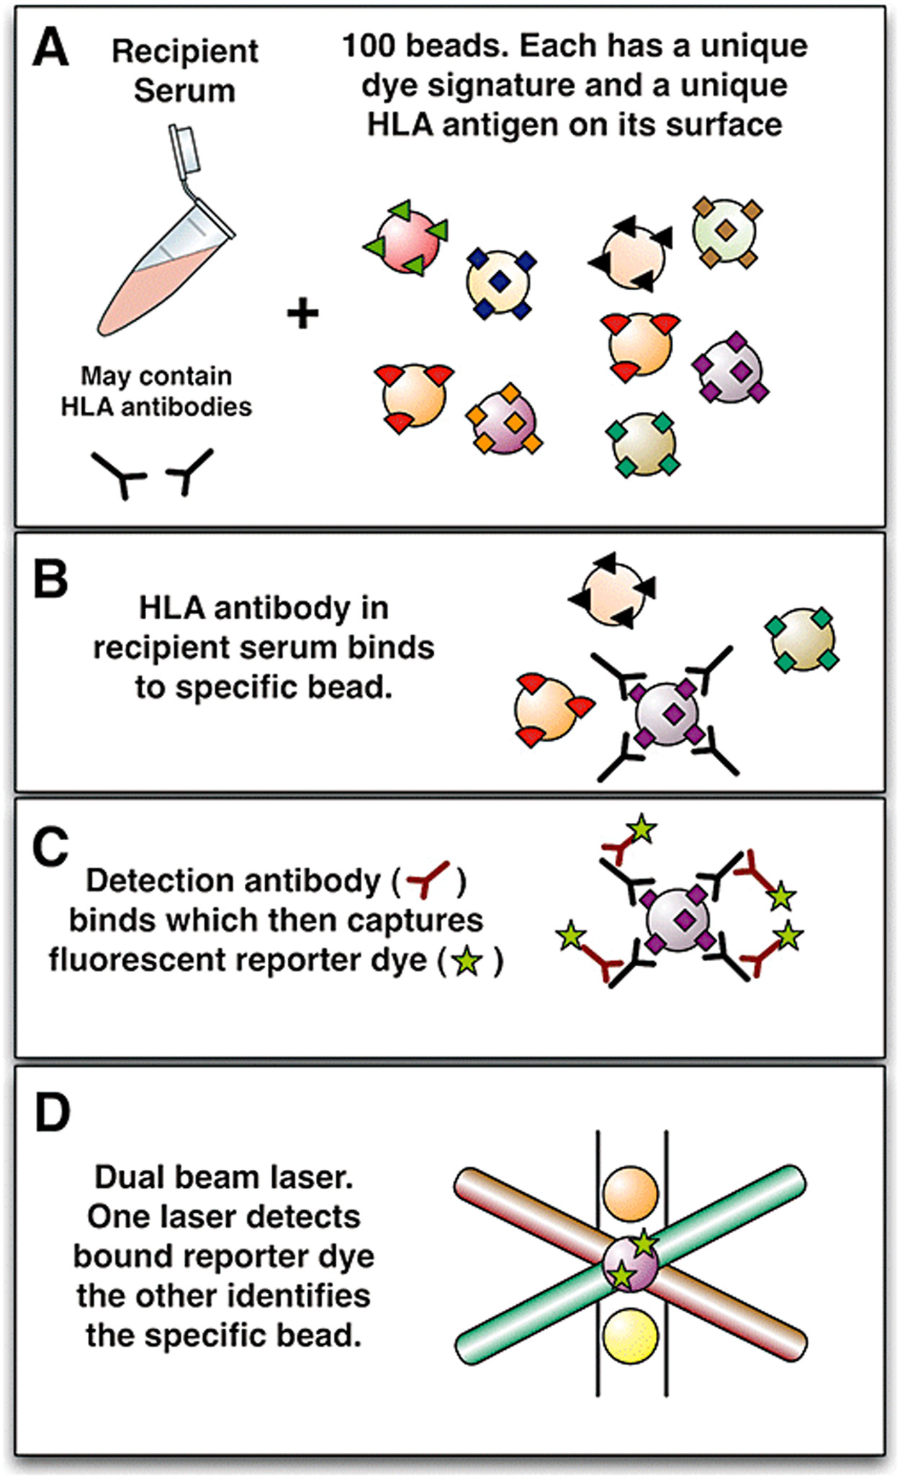
Figure 1
The Journal of Heart and Lung Transplantation 2018 37537-547DOI: (10.1016/j.healun.2018.01.1291)
Copyright © 2018 International Society for the Heart and Lung Transplantation Terms and Conditions
Notes:
Single-antigen bead assay. Recipient serum potentially containing anti‐HLA antibodies is added to a mixture of synthetic beads. Each bead is coated with a set of antigens (screening beads) or for more precise detail, with a single antigen (single-antigen beads). A unique dye signature (up to 100) specifies the identity of each bead (A). If anti‐HLA antibodies are present these will bind to the appropriate bead (B) and a detection antibody can subsequently bind and capture a reporter dye (C). Each unique bead can then be interrogated for the presence of the reporter dye on its surface using a dual beam laser (D). A profile of antibodies can thus be identified in the recipient and compared with the known HLA identity of any potential donor, allowing a prediction of the crossmatch result. Reprinted with permission from: Mulley WR, Kanellis J. Understanding crossmatch testing in organ transplantation: a case-based guide for the general nephrologist. Nephrology 2011;16(2):125-33.

