Slide 1
ISHLT Consensus Statement on adult and pediatric airway complications after lung transplantation: Definitions, grading system, and therapeutics
Maria M. Crespo, MD, Daniel P. McCarthy, MD, Peter M. Hopkins, MD, Stephen C. Clark, MD, Marie Budev, DO, Christian A. Bermudez, MD, Christian Benden, MD, Pirooz Eghtesady, MD, Erika D. Lease, MD, Lorriana Leard, MD, Jonathan D’Cunha, MD, Christopher H. Wigfield, MD, Marcelo Cypel, MD, Joshua M. Diamond, MD, James J. Yun, MD, Lonny Yarmus, DO, Michael Machuzak, MD, Walter Klepetko, MD, Geert Verleden, MD, Konrad Hoetzenecker, MD, Göran Dellgren, MD, Michael Mulligan, MD
The Journal of Heart and Lung Transplantation
Volume 37 Issue 5 Pages 548-563 (May 2018)
DOI: 10.1016/j.healun.2018.01.1309
Copyright © 2018 International Society for the Heart and Lung Transplantation Terms and Conditions

Slide 2
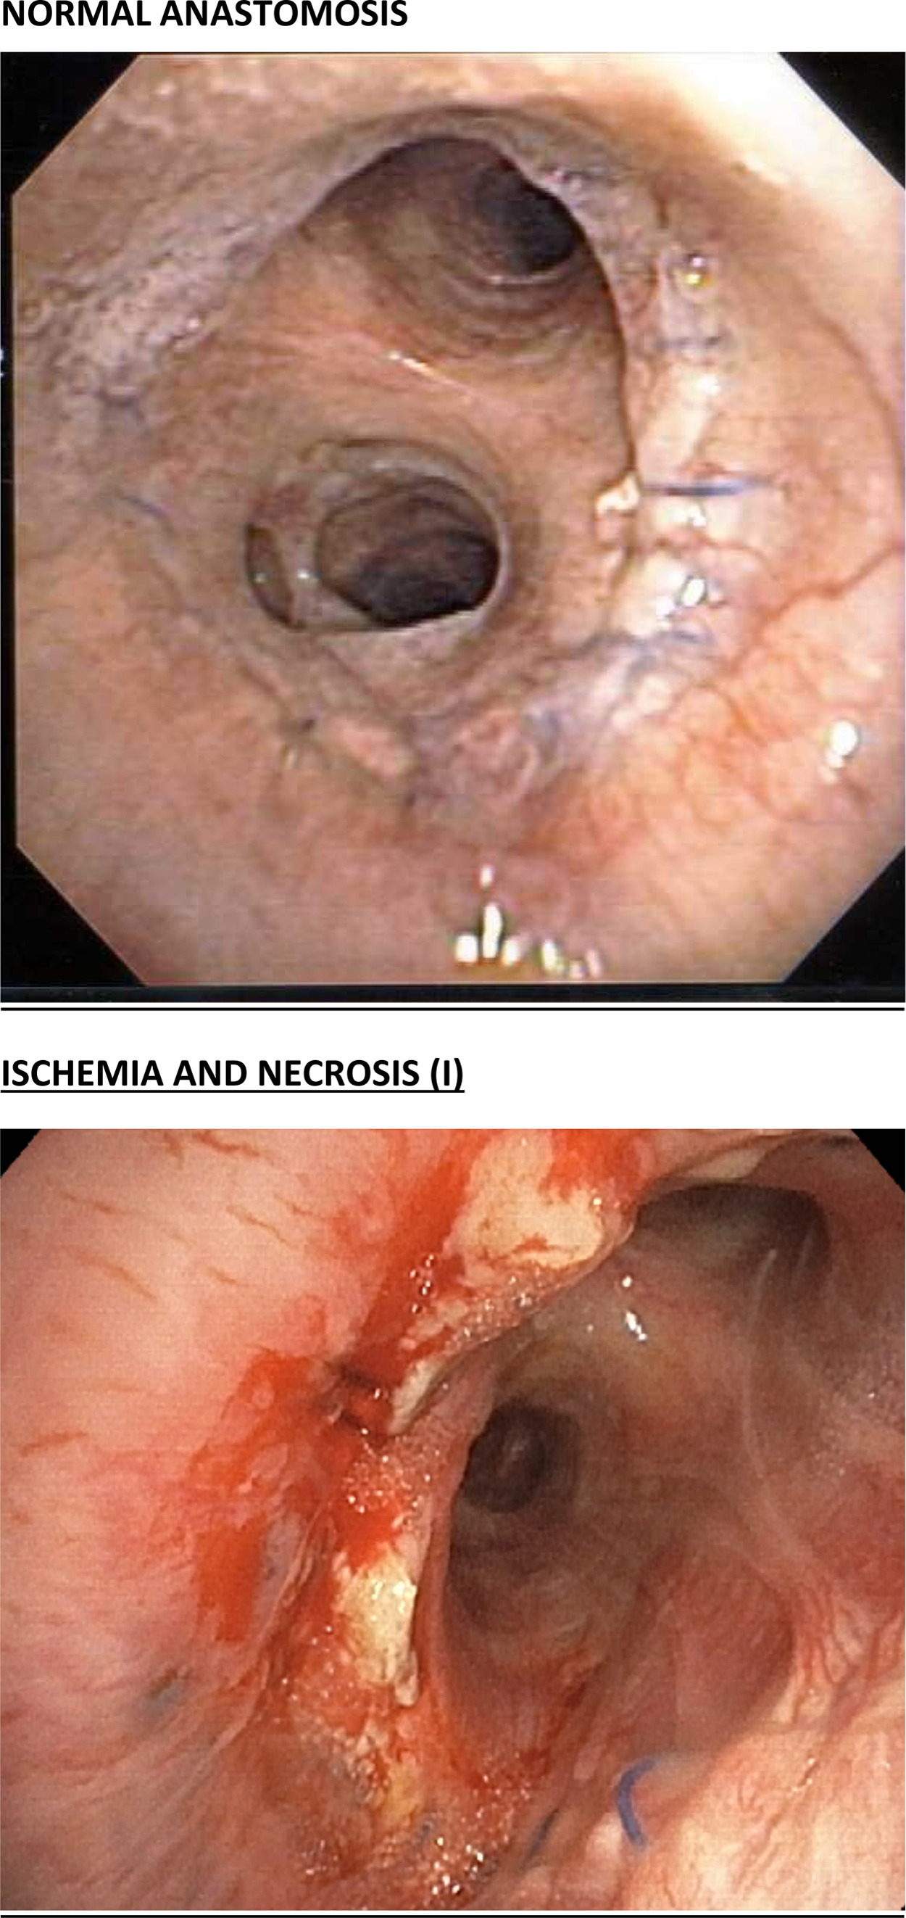
Figure 1
The Journal of Heart and Lung Transplantation 2018 37548-563DOI: (10.1016/j.healun.2018.01.1309)
Copyright © 2018 International Society for the Heart and Lung Transplantation Terms and Conditions
Notes:
Location a: The airway ischemia and/or necrosis location is perianastomotic within 1 cm of the anastomosis, Extent a: Airway ischemia affects <50% of the anastomotic circumferential.

Slide 3
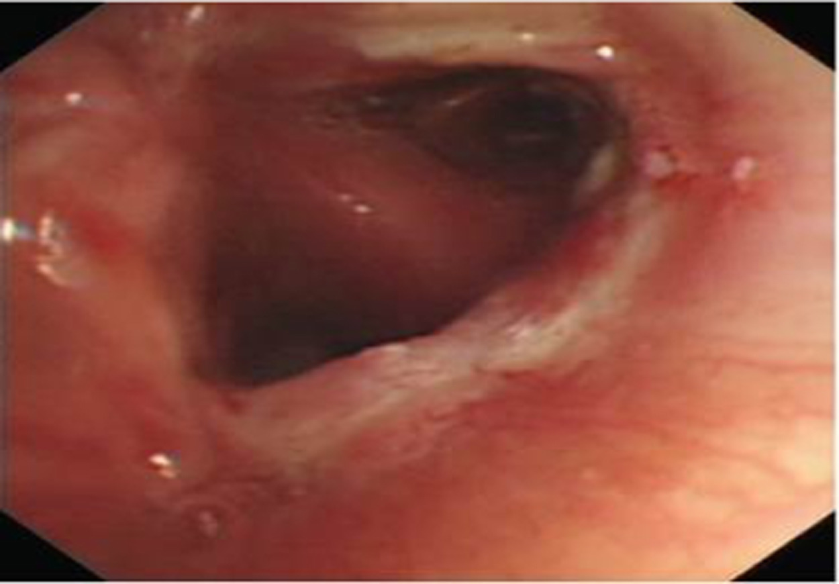
Figure 2
The Journal of Heart and Lung Transplantation 2018 37548-563DOI: (10.1016/j.healun.2018.01.1309)
Copyright © 2018 International Society for the Heart and Lung Transplantation Terms and Conditions
Notes:
Location a: The airway ischemia and/or necrosis location is perianastomotic within 1 cm of the anastomosis, Extent b: Airway ischemia affects 50-100% of the anastomotic circumferential.

Slide 4
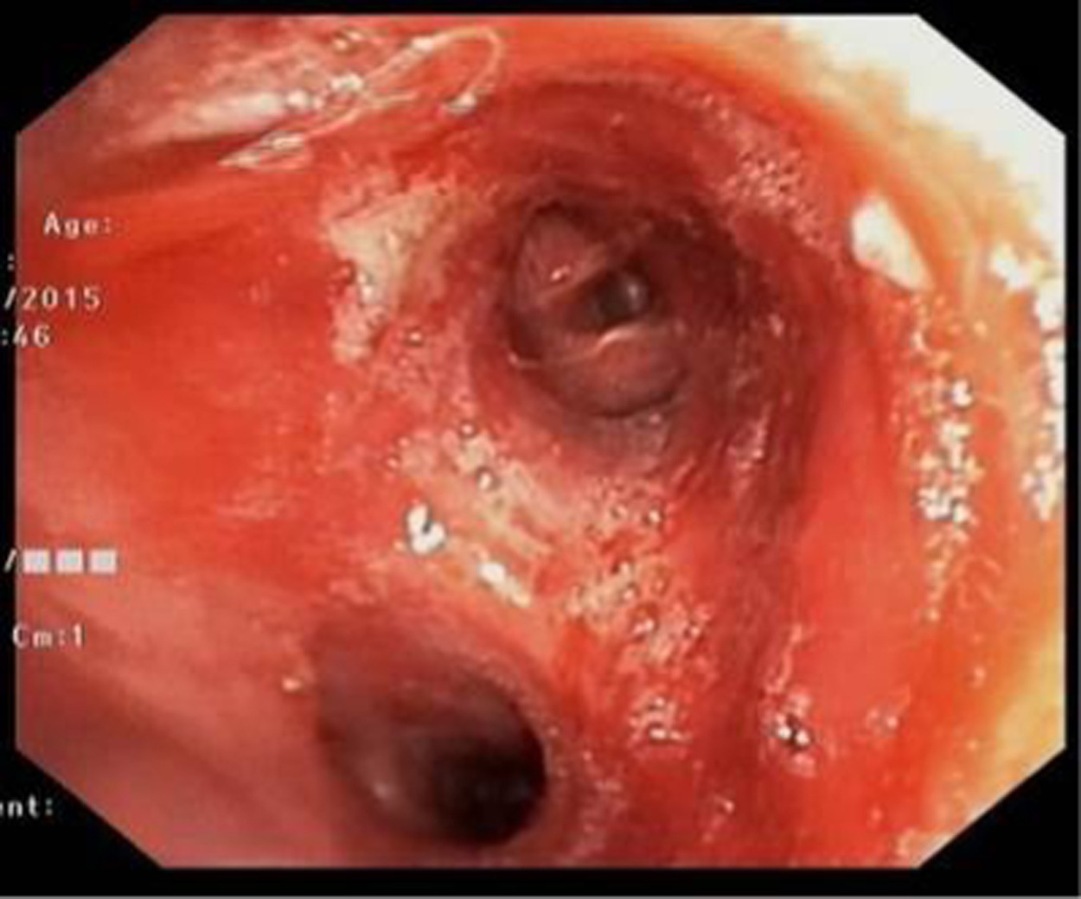
Figure 3
The Journal of Heart and Lung Transplantation 2018 37548-563DOI: (10.1016/j.healun.2018.01.1309)
Copyright © 2018 International Society for the Heart and Lung Transplantation Terms and Conditions
Notes:
Location b: The airway ischemia and/or necrosis extends >1 cm from the anastomosis to major airways, Extent b: Airway ischemia affects 50-100% of the anastomotic circumferential.

Slide 5
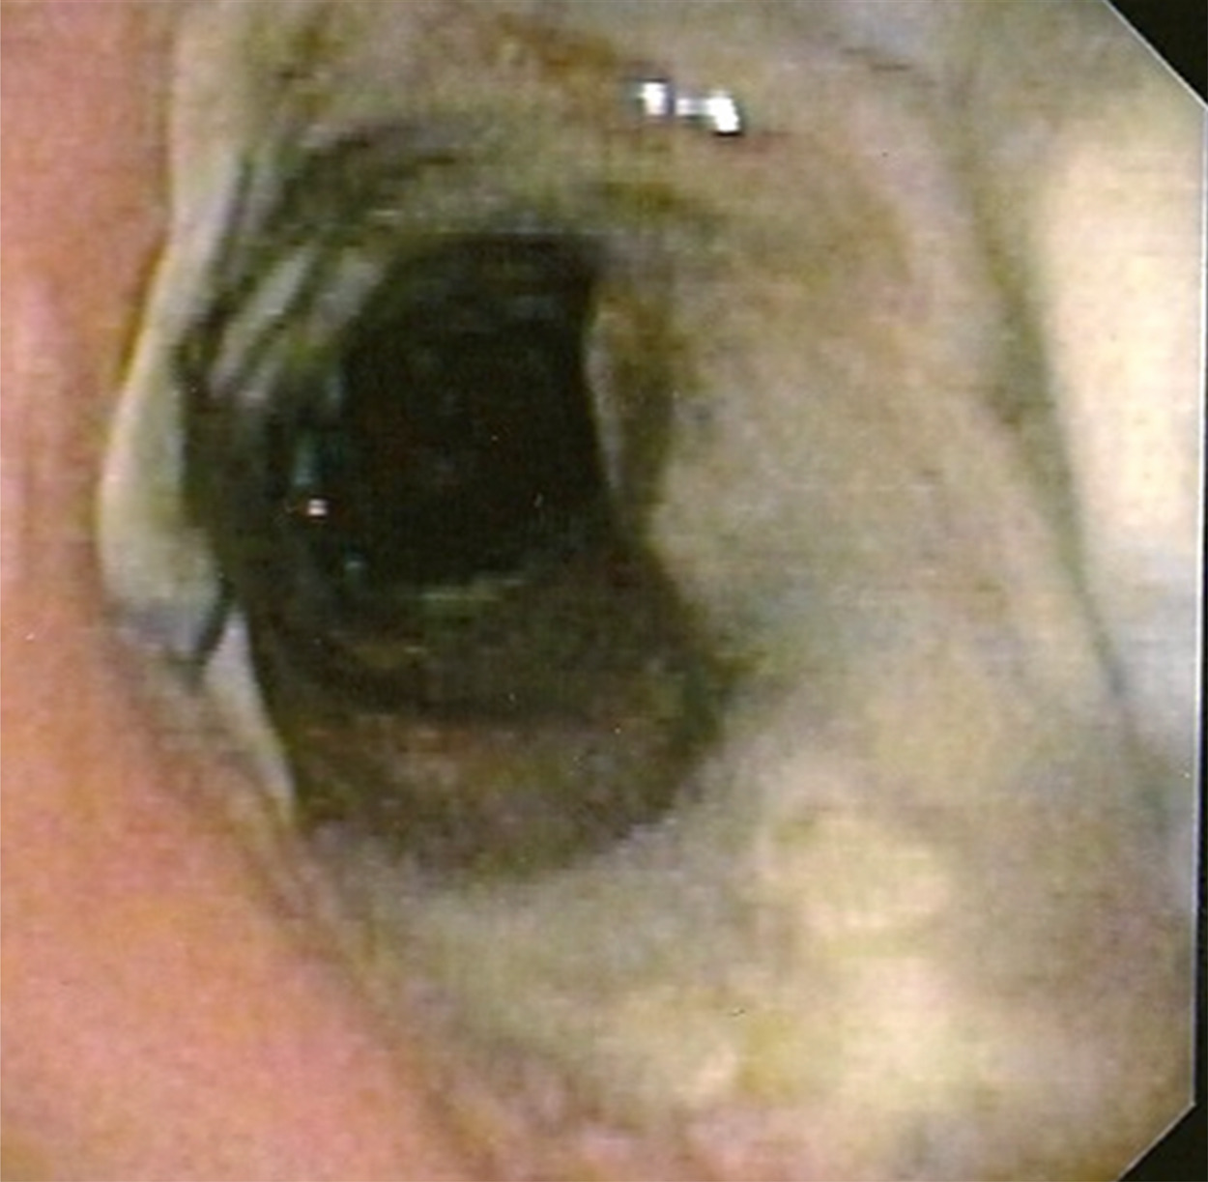
Figure 4
The Journal of Heart and Lung Transplantation 2018 37548-563DOI: (10.1016/j.healun.2018.01.1309)
Copyright © 2018 International Society for the Heart and Lung Transplantation Terms and Conditions
Notes:
Location c: The airway ischemia and/or necrosis extends > 1cm from the anastomosis into the lobar or segmental airways, Extent b: Airway ischemia affects 50-100% of the anastomotic circumferential.

Slide 6
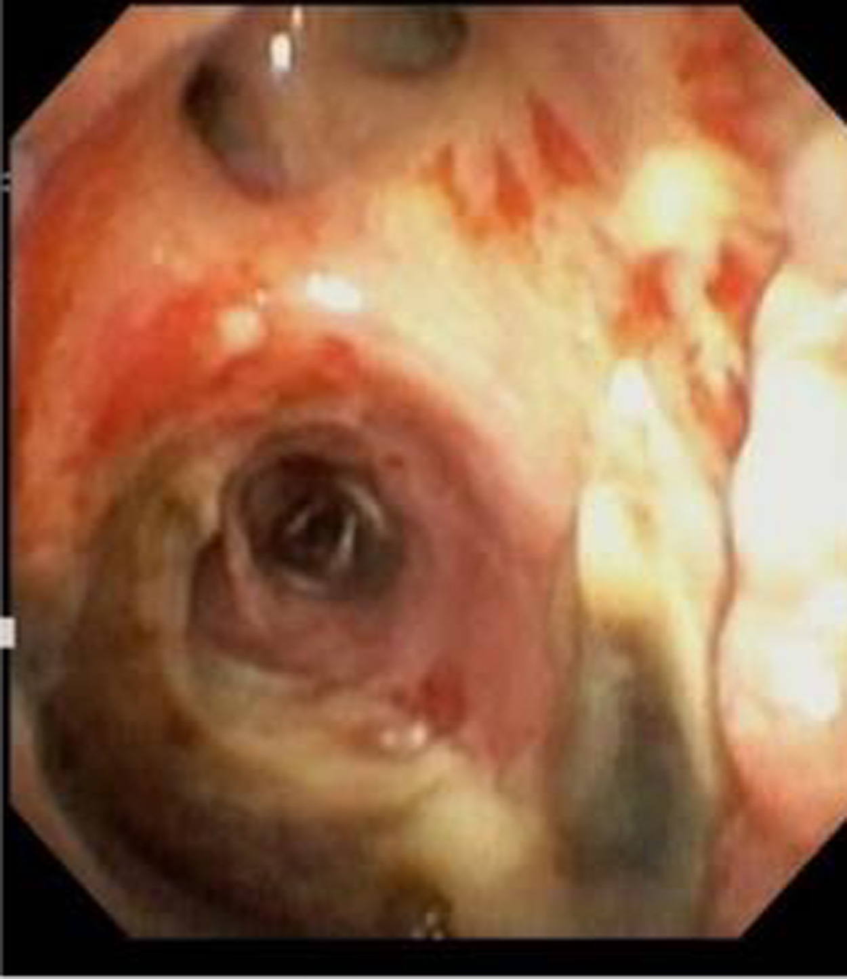
Figure 5
The Journal of Heart and Lung Transplantation 2018 37548-563DOI: (10.1016/j.healun.2018.01.1309)
Copyright © 2018 International Society for the Heart and Lung Transplantation Terms and Conditions
Notes:
Location a: The airway ischemia and/or necrosis location is perianastomotic within 1 cm of the anastomosis Extent c. Airway necrosis affecting <50% of the anastomotic circumferential.

Slide 7
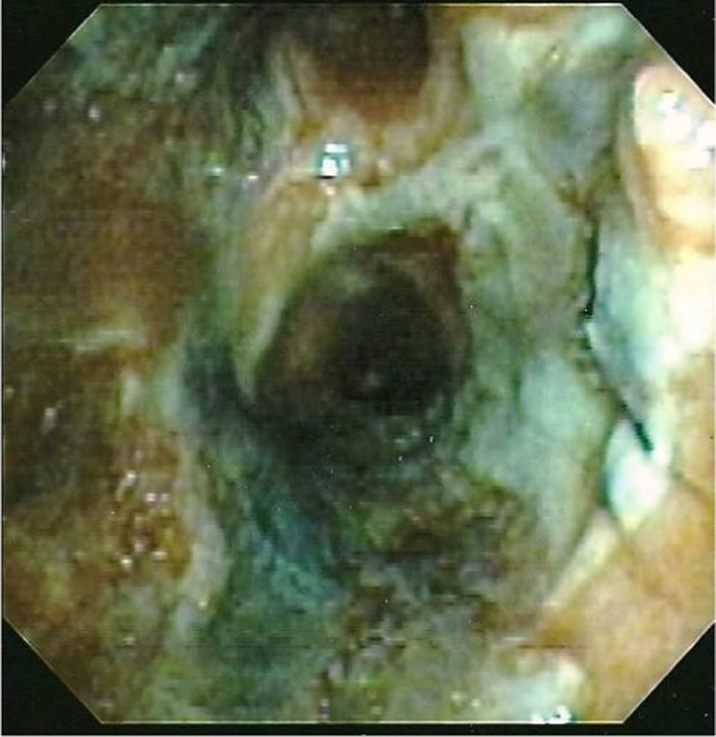
Figure 6
The Journal of Heart and Lung Transplantation 2018 37548-563DOI: (10.1016/j.healun.2018.01.1309)
Copyright © 2018 International Society for the Heart and Lung Transplantation Terms and Conditions
Notes:
Location b: The airway ischemia/necrosis location is >1 cm from the anastomosis to major airways including Bronchus Intermedius Extent d: Airway necrosis affecting 50-100% of the anastomotic circumferential.

Slide 8
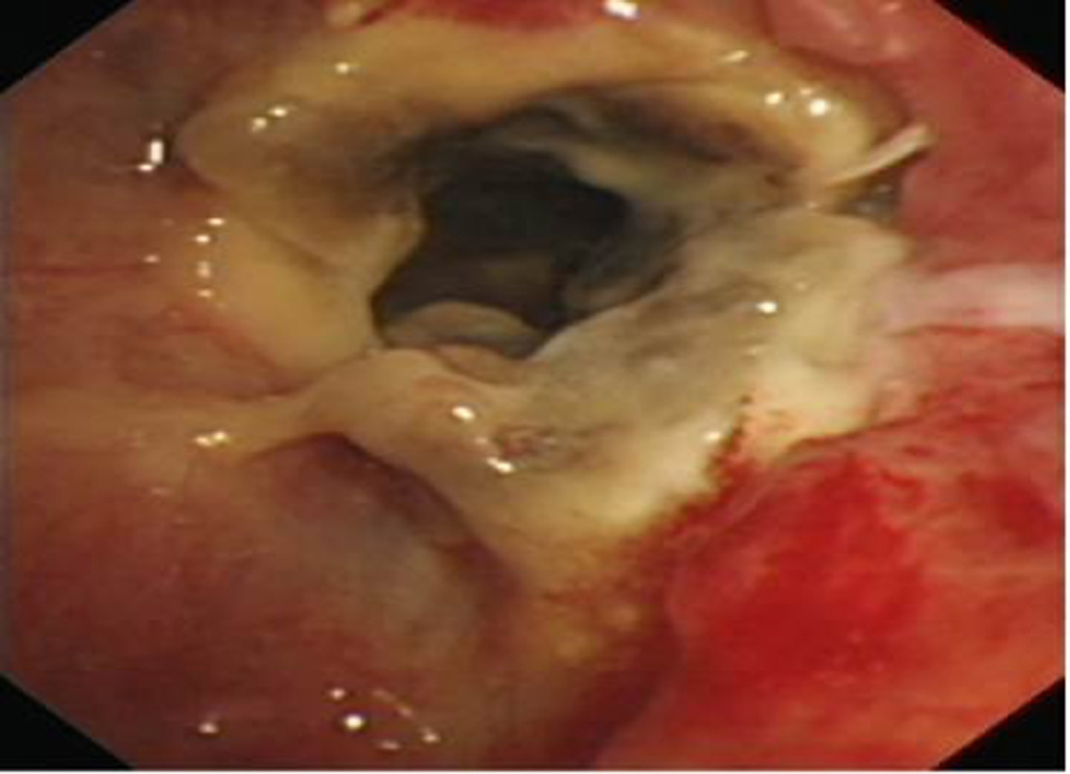
Figure 7
The Journal of Heart and Lung Transplantation 2018 37548-563DOI: (10.1016/j.healun.2018.01.1309)
Copyright © 2018 International Society for the Heart and Lung Transplantation Terms and Conditions
Notes:
Location b: The airway ischemia/necrosis location is >1 cm from the anastomosis to major airways including Bronchus Intermedius Extent d: Airway necrosis affecting 50-100% of the anastomotic circumferential.

Slide 9
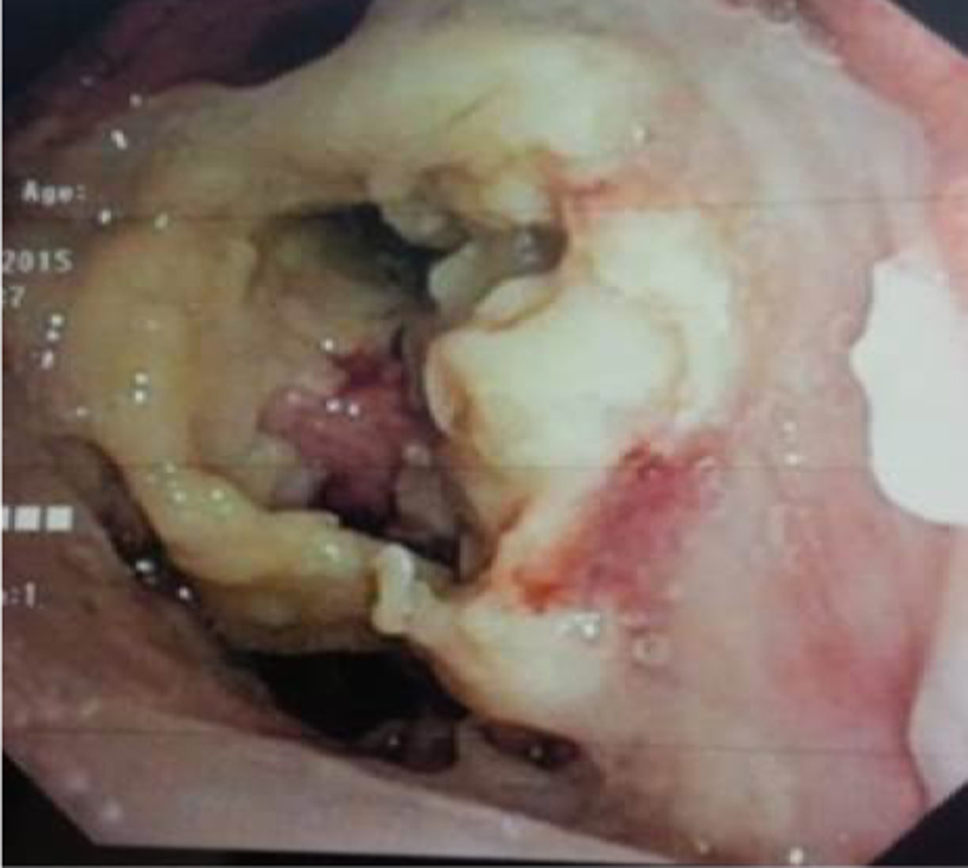
Figure 8
The Journal of Heart and Lung Transplantation 2018 37548-563DOI: (10.1016/j.healun.2018.01.1309)
Copyright © 2018 International Society for the Heart and Lung Transplantation Terms and Conditions
Notes:
Location c: The airway ischemia/necrosis location is >1 cm from the anastomosis into lobar or segmental airways Extent d: Airway necrosis affecting 50-100% of the anastomotic circumferential.

Slide 10
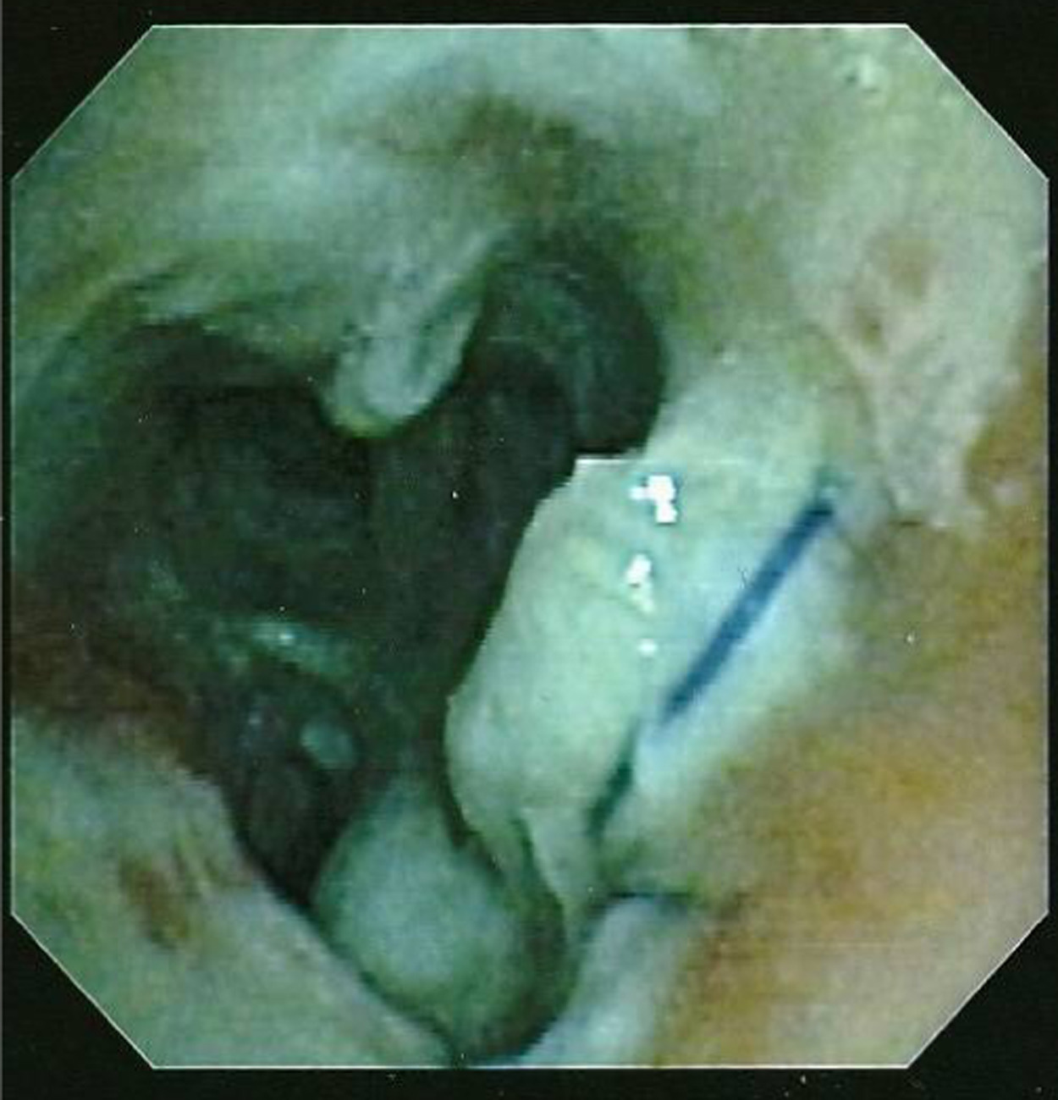
Figure 9
The Journal of Heart and Lung Transplantation 2018 37548-563DOI: (10.1016/j.healun.2018.01.1309)
Copyright © 2018 International Society for the Heart and Lung Transplantation Terms and Conditions
Notes:
Location c: The airway ischemia/necrosis location is >1 cm from the anastomosis into lobar or segmental airways Extent d: Airway necrosis affecting 50-100% of the anastomotic circumferential.

Slide 11
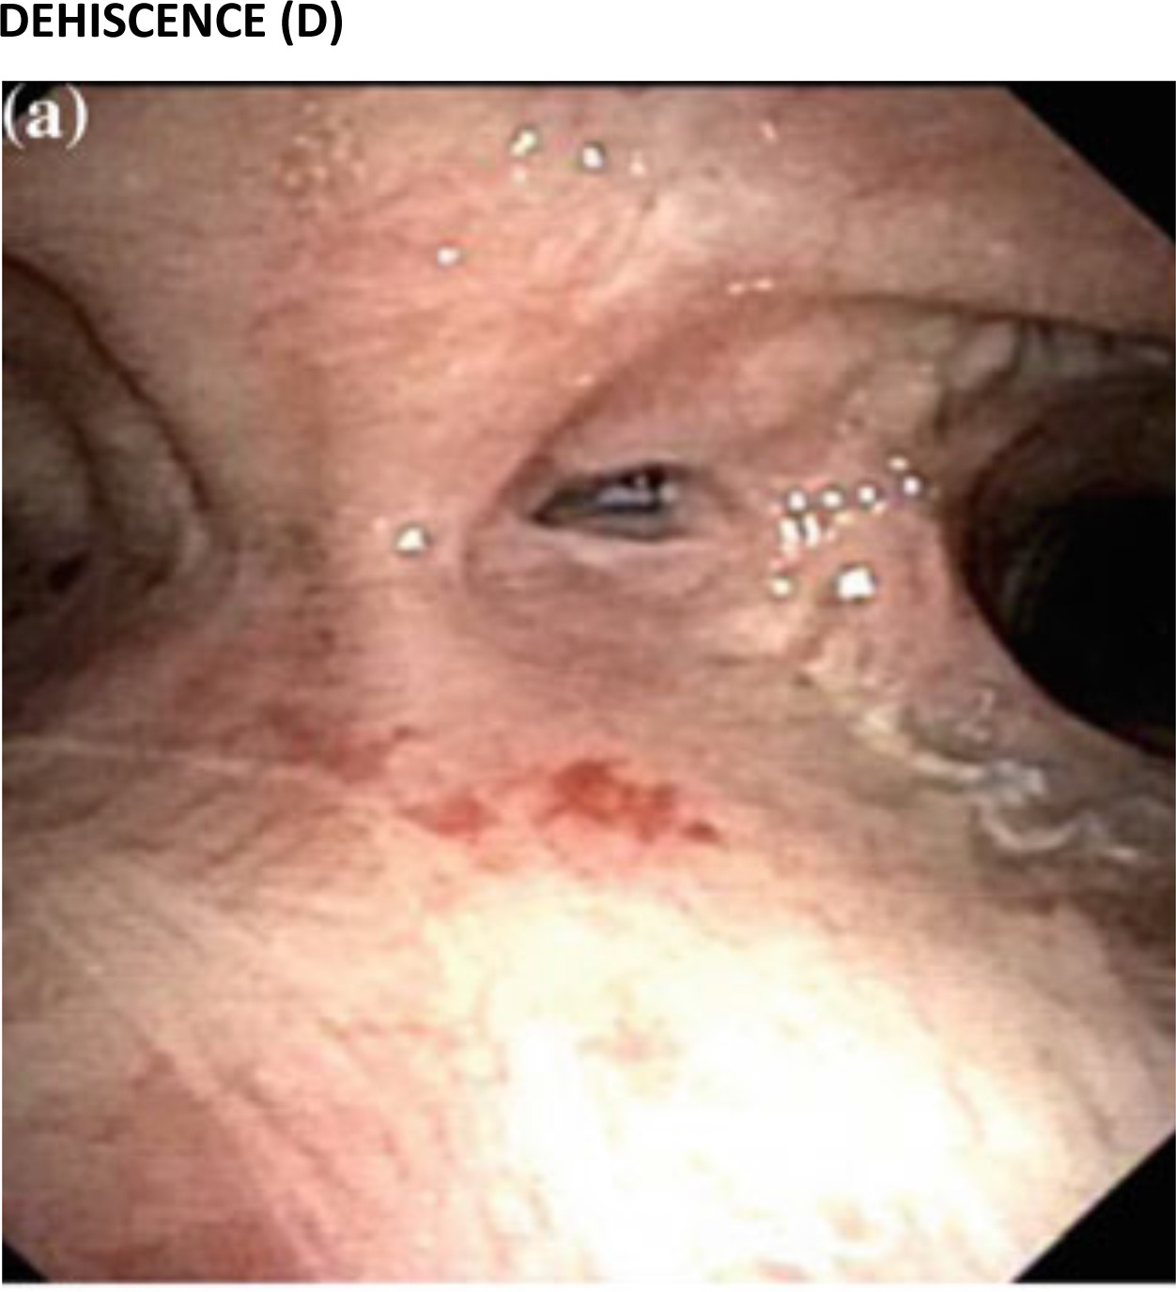
Figure 10
The Journal of Heart and Lung Transplantation 2018 37548-563DOI: (10.1016/j.healun.2018.01.1309)
Copyright © 2018 International Society for the Heart and Lung Transplantation Terms and Conditions
Notes:
Location a: The anastomosis dehiscence is at the cartilaginous wall, Extent a: The extension of the dehiscence is 0-25% of the anastomotic circumference.

Slide 12
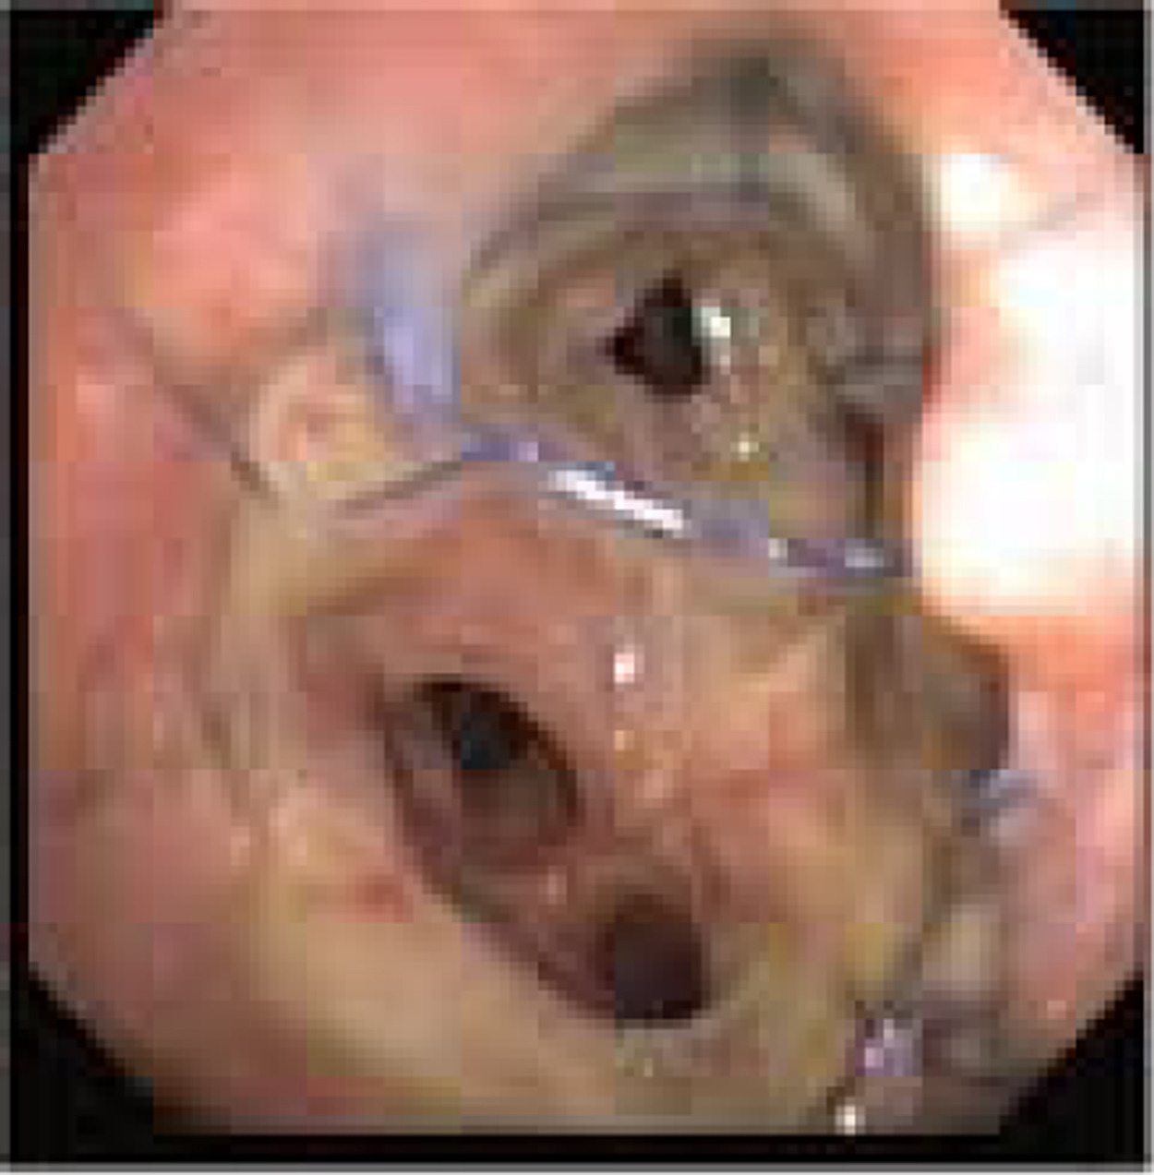
Figure 11
The Journal of Heart and Lung Transplantation 2018 37548-563DOI: (10.1016/j.healun.2018.01.1309)
Copyright © 2018 International Society for the Heart and Lung Transplantation Terms and Conditions
Notes:
Location a: The anastomosis dehiscence is at the cartilaginous wall, Extent b: The extension of the dehiscence is > 25-50% of the anastomotic circumference.

Slide 13
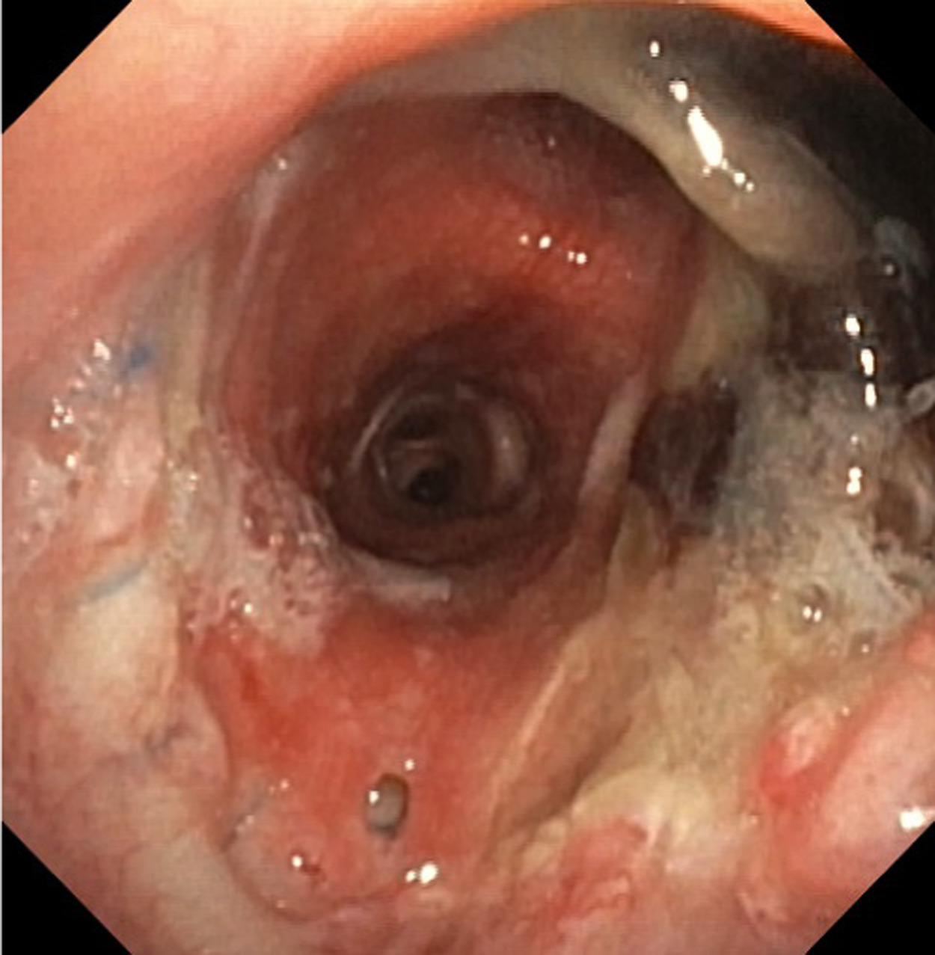
Figure 12
The Journal of Heart and Lung Transplantation 2018 37548-563DOI: (10.1016/j.healun.2018.01.1309)
Copyright © 2018 International Society for the Heart and Lung Transplantation Terms and Conditions
Notes:
Location b: The anastomosis dehiscence is at the membranous wall, Extent a: The extension of the dehiscence is 0-25% of the anastomotic circumference.

Slide 14
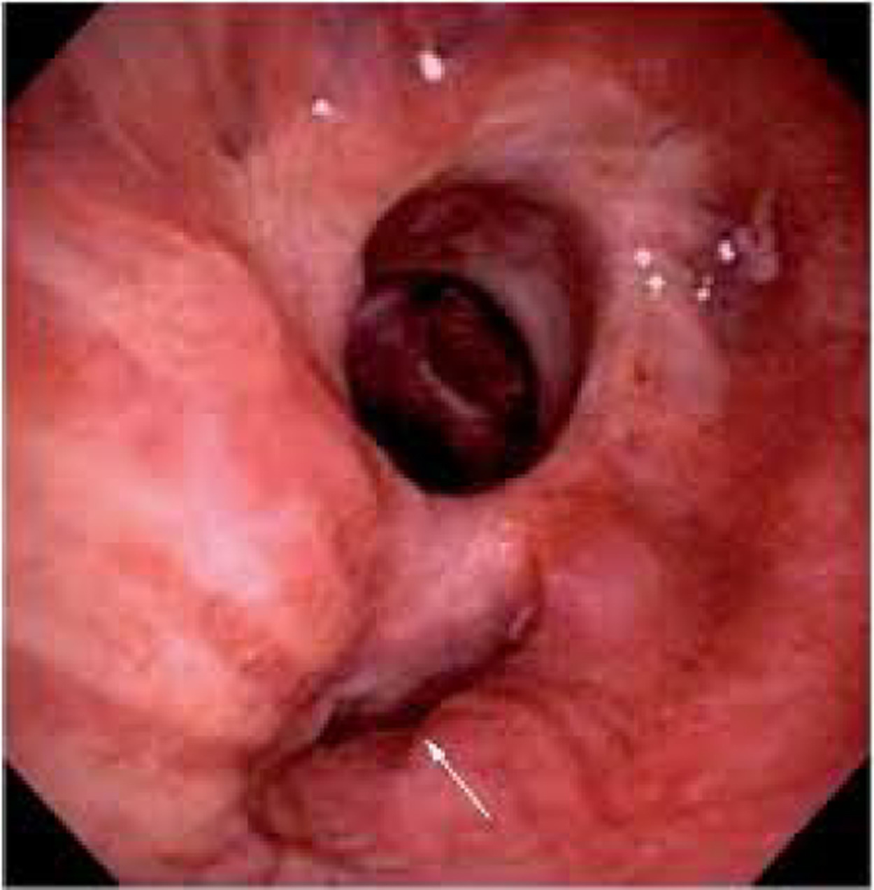
Figure 13
The Journal of Heart and Lung Transplantation 2018 37548-563DOI: (10.1016/j.healun.2018.01.1309)
Copyright © 2018 International Society for the Heart and Lung Transplantation Terms and Conditions
Notes:
Location b: The anastomosis dehiscence is at the membranous wall, Extent b: The extension of the dehiscence is >25-50% of the anastomotic circumference.

Slide 15
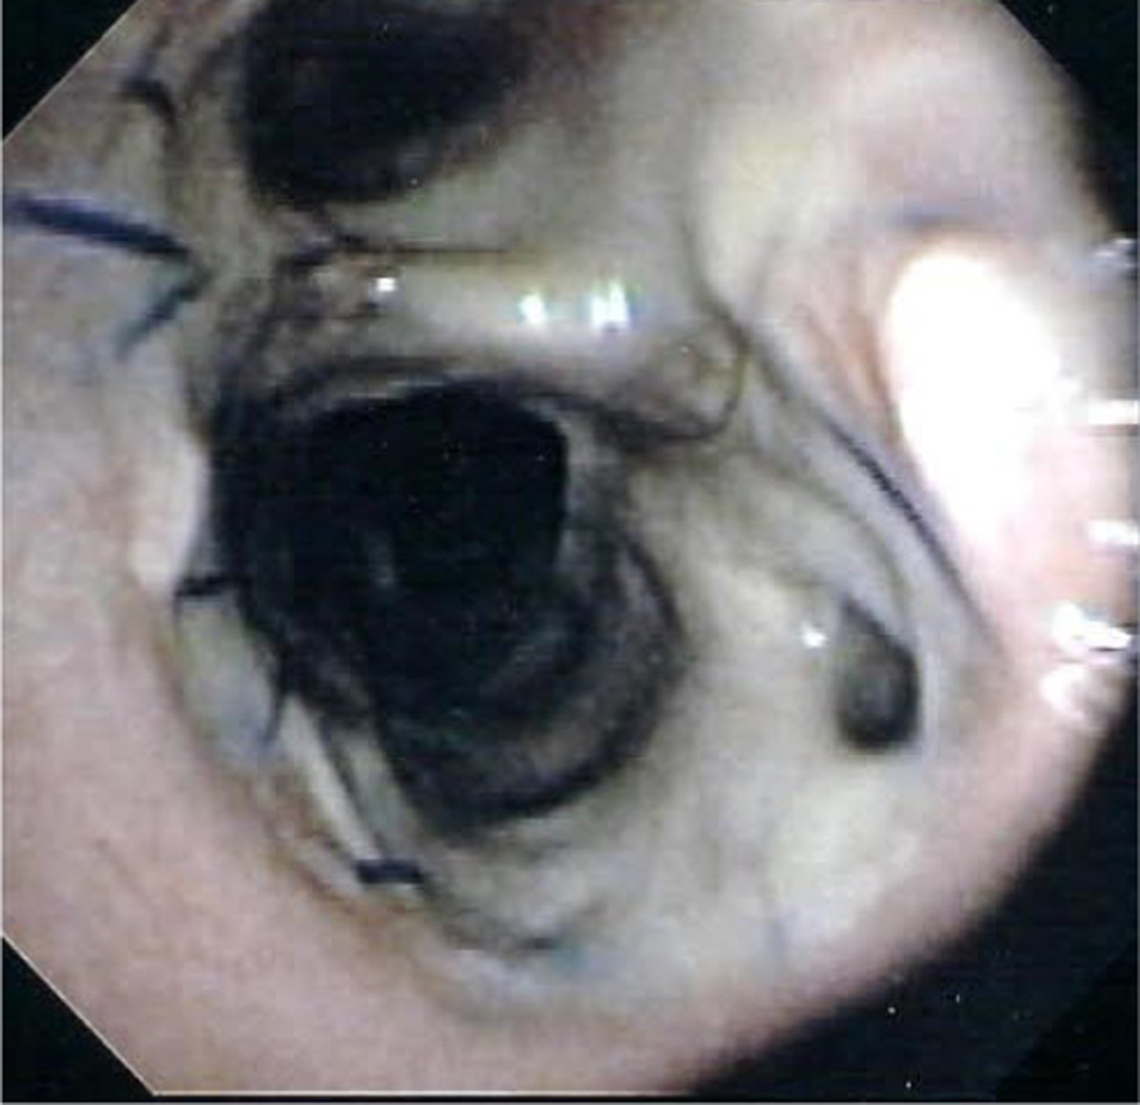
Figure 14
The Journal of Heart and Lung Transplantation 2018 37548-563DOI: (10.1016/j.healun.2018.01.1309)
Copyright © 2018 International Society for the Heart and Lung Transplantation Terms and Conditions
Notes:
Location b: The anastomosis dehiscence is at the membranous wall Extent b: The extension of the dehiscence is >25-50% of the anastomotic circumference.

Slide 16
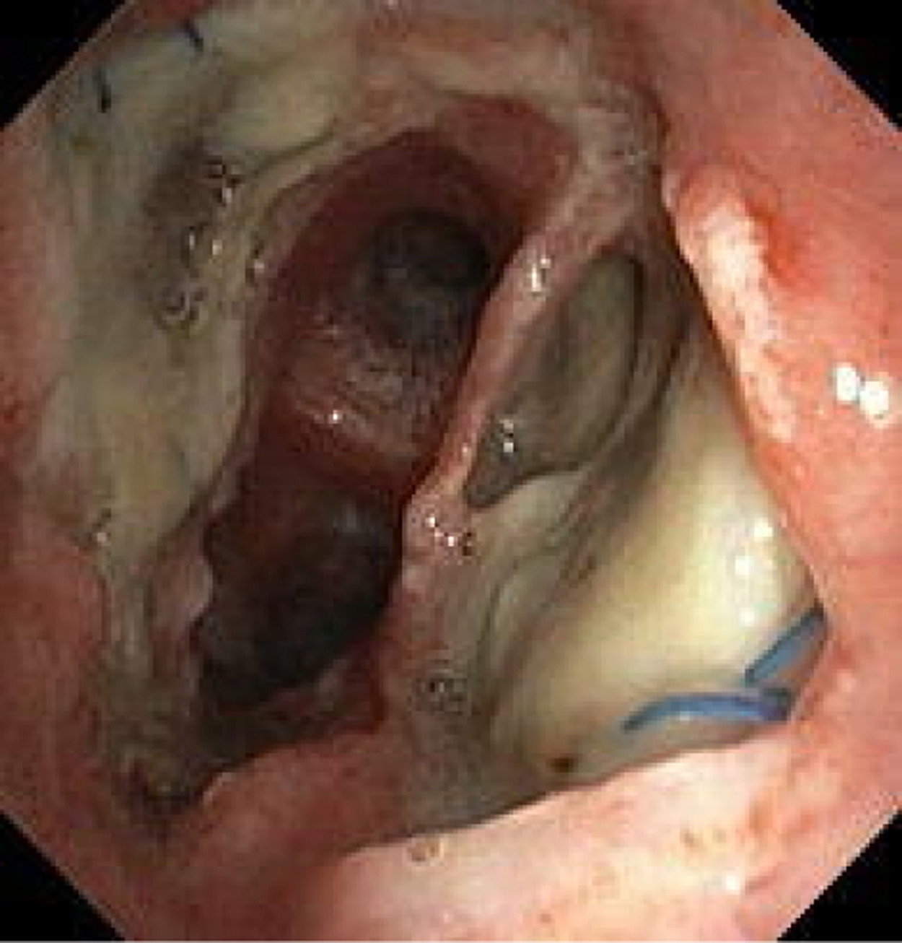
Figure 15
The Journal of Heart and Lung Transplantation 2018 37548-563DOI: (10.1016/j.healun.2018.01.1309)
Copyright © 2018 International Society for the Heart and Lung Transplantation Terms and Conditions
Notes:
Location b: The anastomosis dehiscence is at the membranous wall, Extent d: The extension of the dehiscence is >50-75% of the anastomotic circumference.

Slide 17
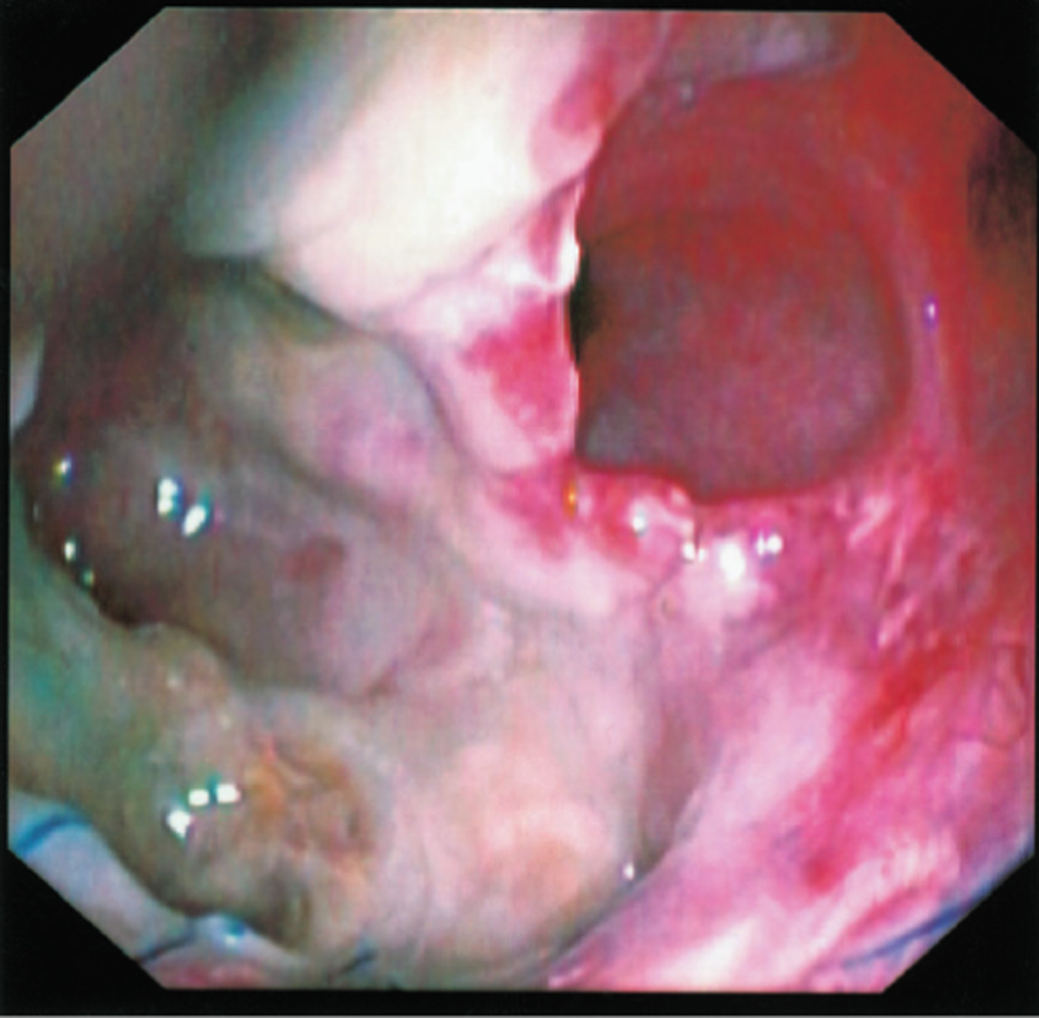
Figure 16
The Journal of Heart and Lung Transplantation 2018 37548-563DOI: (10.1016/j.healun.2018.01.1309)
Copyright © 2018 International Society for the Heart and Lung Transplantation Terms and Conditions
Notes:
Location c: The anastomosis dehiscence involves the membranous and cartilaginous wall, Extent d: The extension of the dehiscence is >75% of the anastomotic circumference.

Slide 18
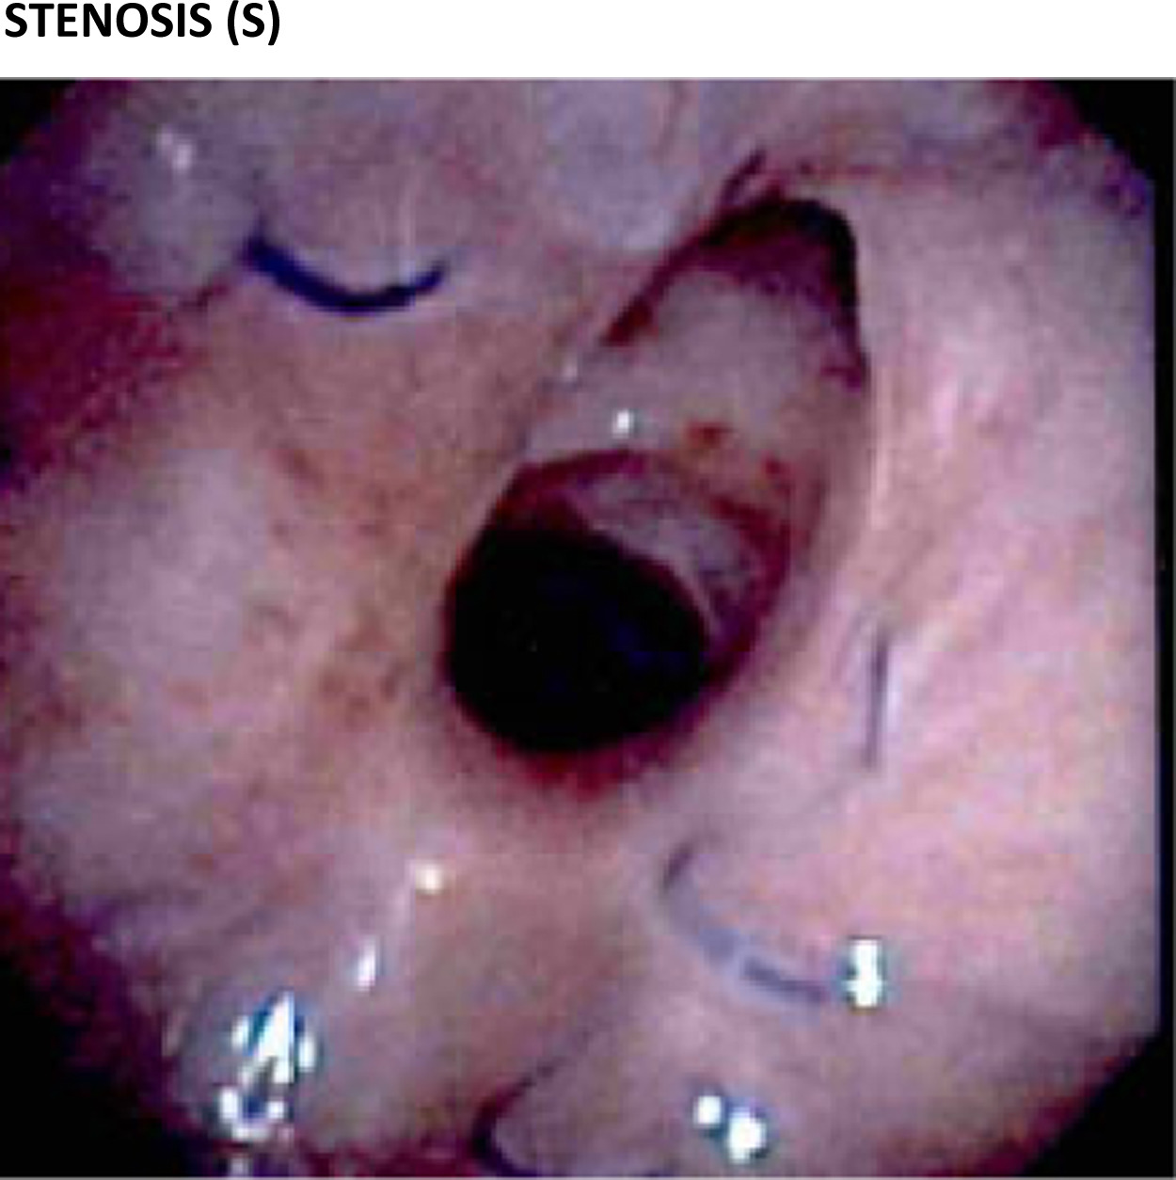
Figure 17
The Journal of Heart and Lung Transplantation 2018 37548-563DOI: (10.1016/j.healun.2018.01.1309)
Copyright © 2018 International Society for the Heart and Lung Transplantation Terms and Conditions
Notes:
Location a: The stenosis is at the anastomotic site, Extend a: There is a 0-25% reduction in cross-sectional area.

Slide 19
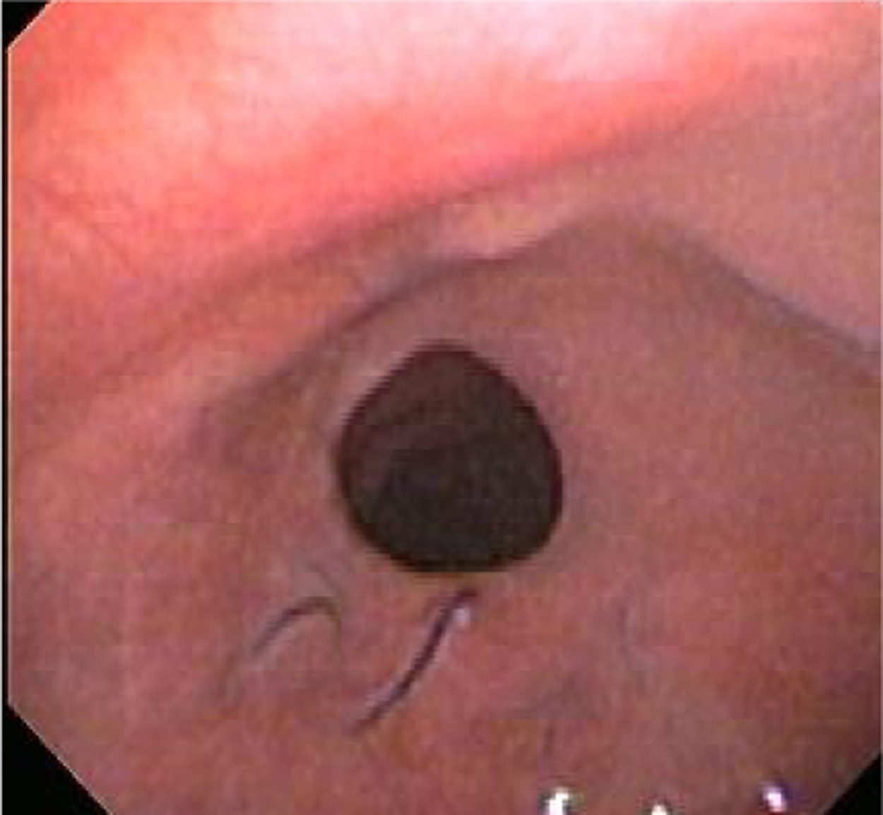
Figure 18
The Journal of Heart and Lung Transplantation 2018 37548-563DOI: (10.1016/j.healun.2018.01.1309)
Copyright © 2018 International Society for the Heart and Lung Transplantation Terms and Conditions
Notes:
Location a: The stenosis is at the anastomotic site, Extent b: There is a >25-50% reduction in cross-sectional area.

Slide 20
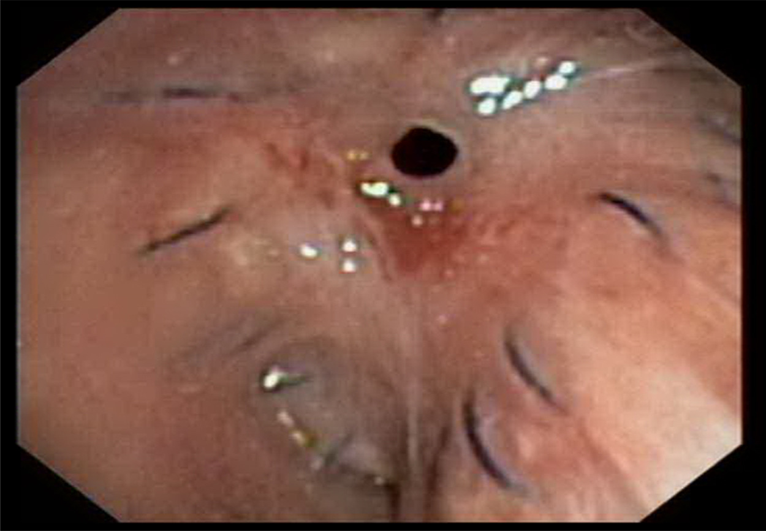
Figure 19
The Journal of Heart and Lung Transplantation 2018 37548-563DOI: (10.1016/j.healun.2018.01.1309)
Copyright © 2018 International Society for the Heart and Lung Transplantation Terms and Conditions
Notes:
Location a: The stenosis is at the anastomotic site, Extent c: There is a >50 but <100% reduction in cross-sectional area.

Slide 21
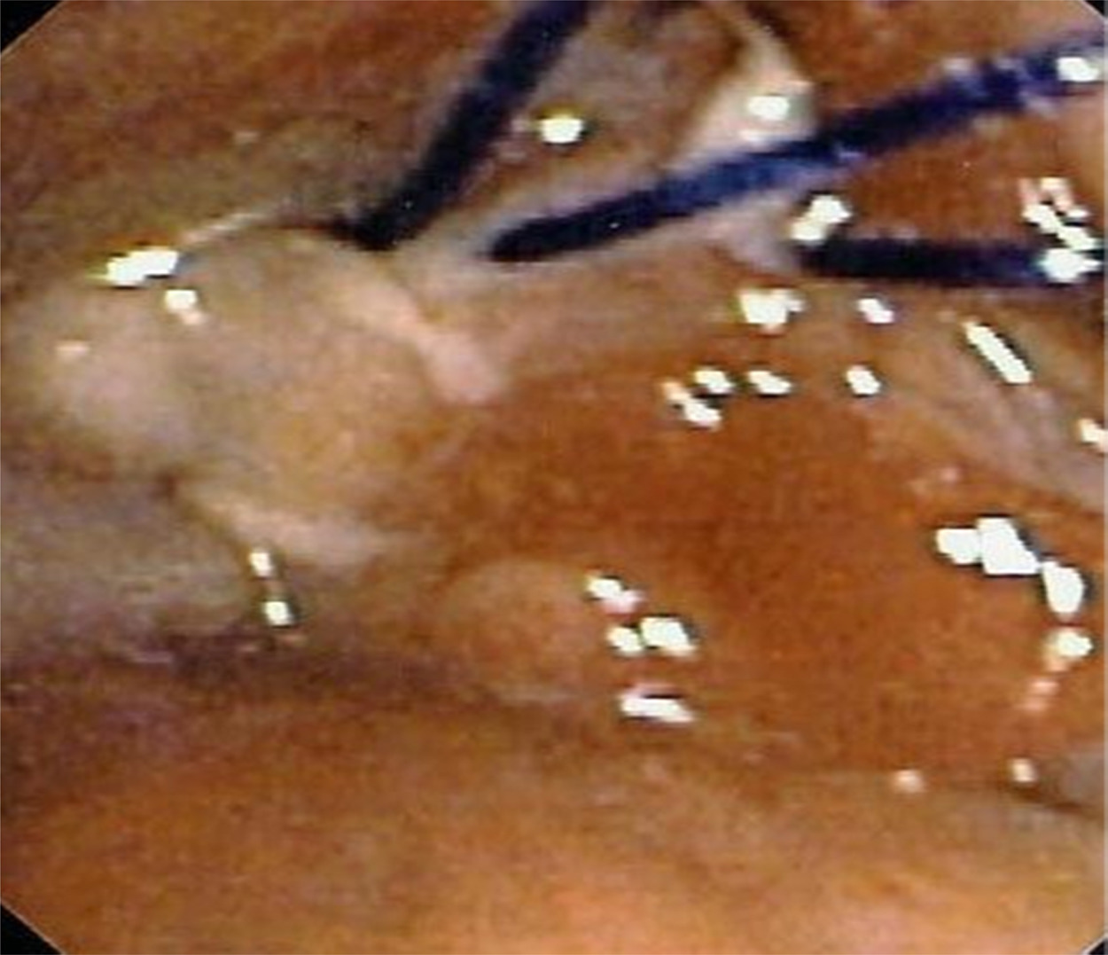
Figure 20
The Journal of Heart and Lung Transplantation 2018 37548-563DOI: (10.1016/j.healun.2018.01.1309)
Copyright © 2018 International Society for the Heart and Lung Transplantation Terms and Conditions
Notes:
Location a: The stenosis is at the anastomotic site Extent d: There is 100% reduction in cross-sectional area.

Slide 22
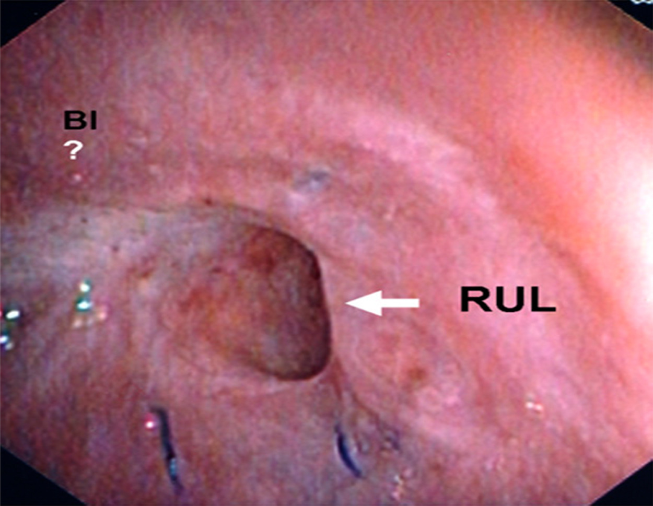
Figure 21
The Journal of Heart and Lung Transplantation 2018 37548-563DOI: (10.1016/j.healun.2018.01.1309)
Copyright © 2018 International Society for the Heart and Lung Transplantation Terms and Conditions
Notes:
Location b: The stenosis is at the anastomotic and lobar/segmental site (Bronchus intermedius), Extent d: There is 100% reduction in cross-sectional area.

Slide 23
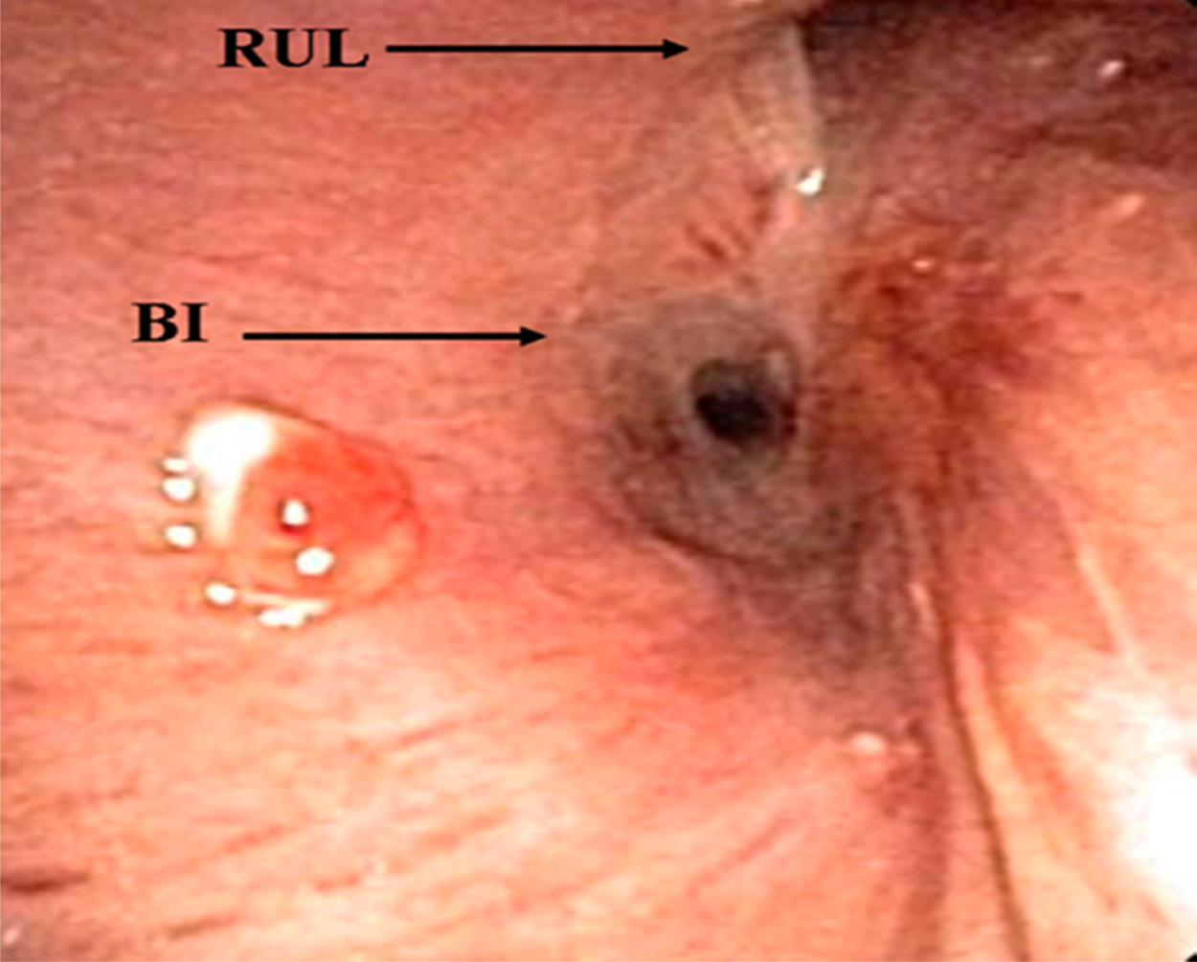
Figure 22
The Journal of Heart and Lung Transplantation 2018 37548-563DOI: (10.1016/j.healun.2018.01.1309)
Copyright © 2018 International Society for the Heart and Lung Transplantation Terms and Conditions
Notes:
Location b: The stenosis is at the anastomotic and lobar/segmental site (Bronchus intermedius), Extent c: There is a >50 but <100% reduction in cross-sectional area.

Slide 24
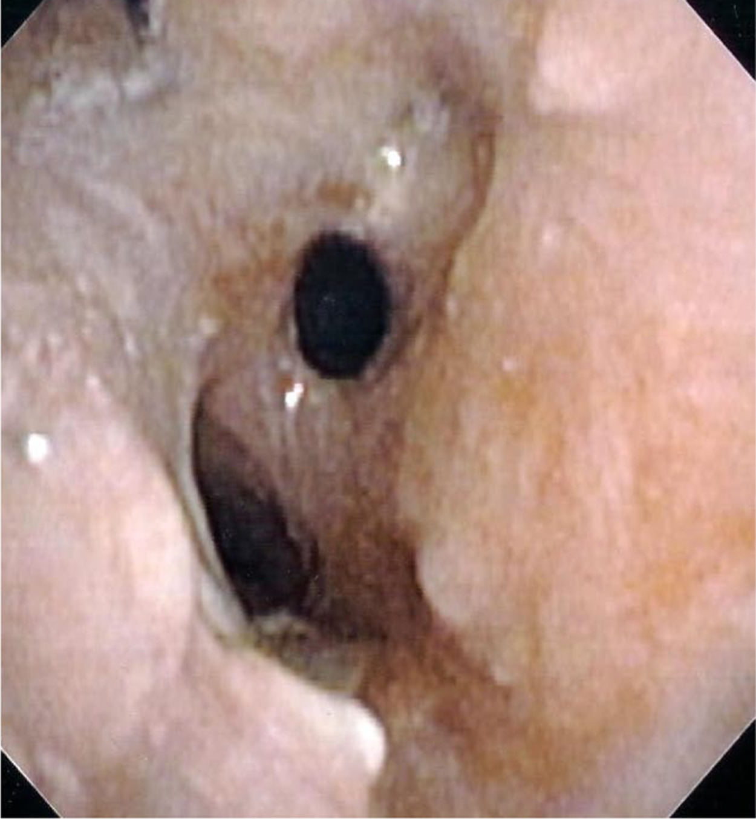
Figure 23
The Journal of Heart and Lung Transplantation 2018 37548-563DOI: (10.1016/j.healun.2018.01.1309)
Copyright © 2018 International Society for the Heart and Lung Transplantation Terms and Conditions
Notes:
Location c: The stenosis is at the lobar/segmental site only, Extent b: There is a >25-50% reduction in cross-sectional area.

Slide 25
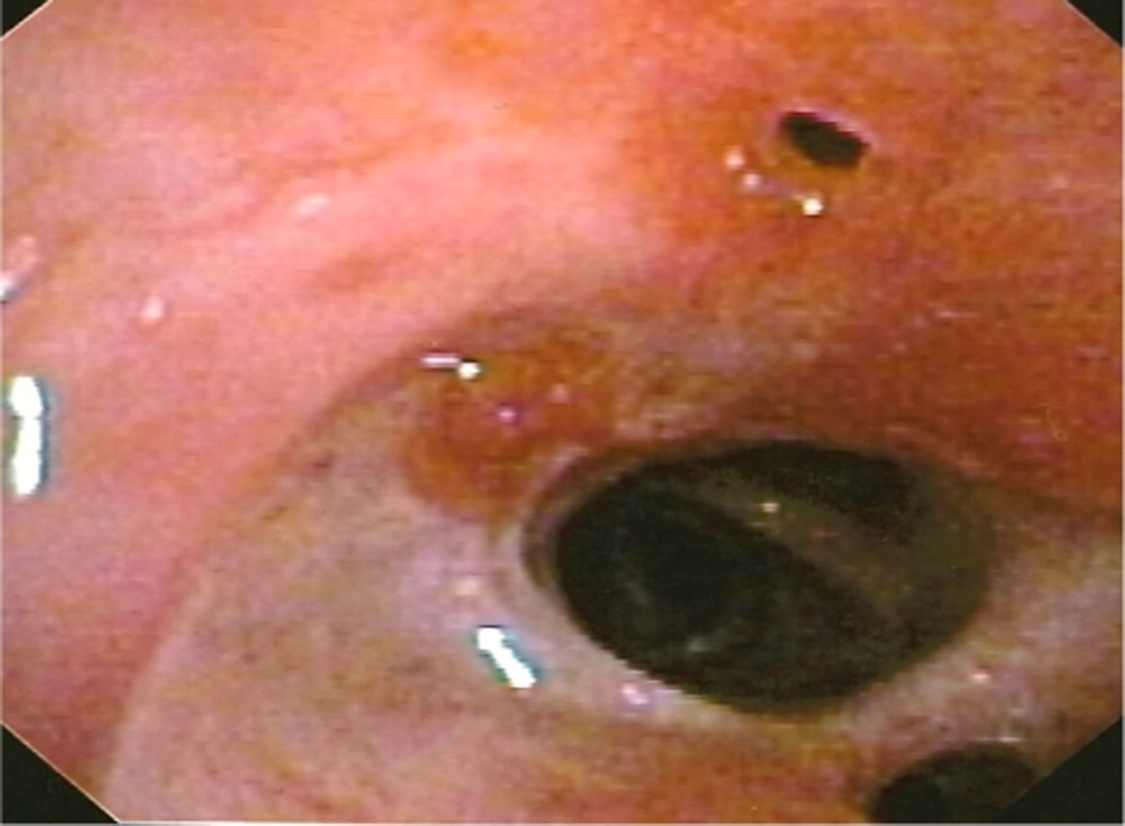
Figure 24
The Journal of Heart and Lung Transplantation 2018 37548-563DOI: (10.1016/j.healun.2018.01.1309)
Copyright © 2018 International Society for the Heart and Lung Transplantation Terms and Conditions
Notes:
Location c: The stenosis is at the lobar/segmental site only (RML stenosis), Extent c: There is a >50 but <100% reduction in cross-sectional area.

Slide 26
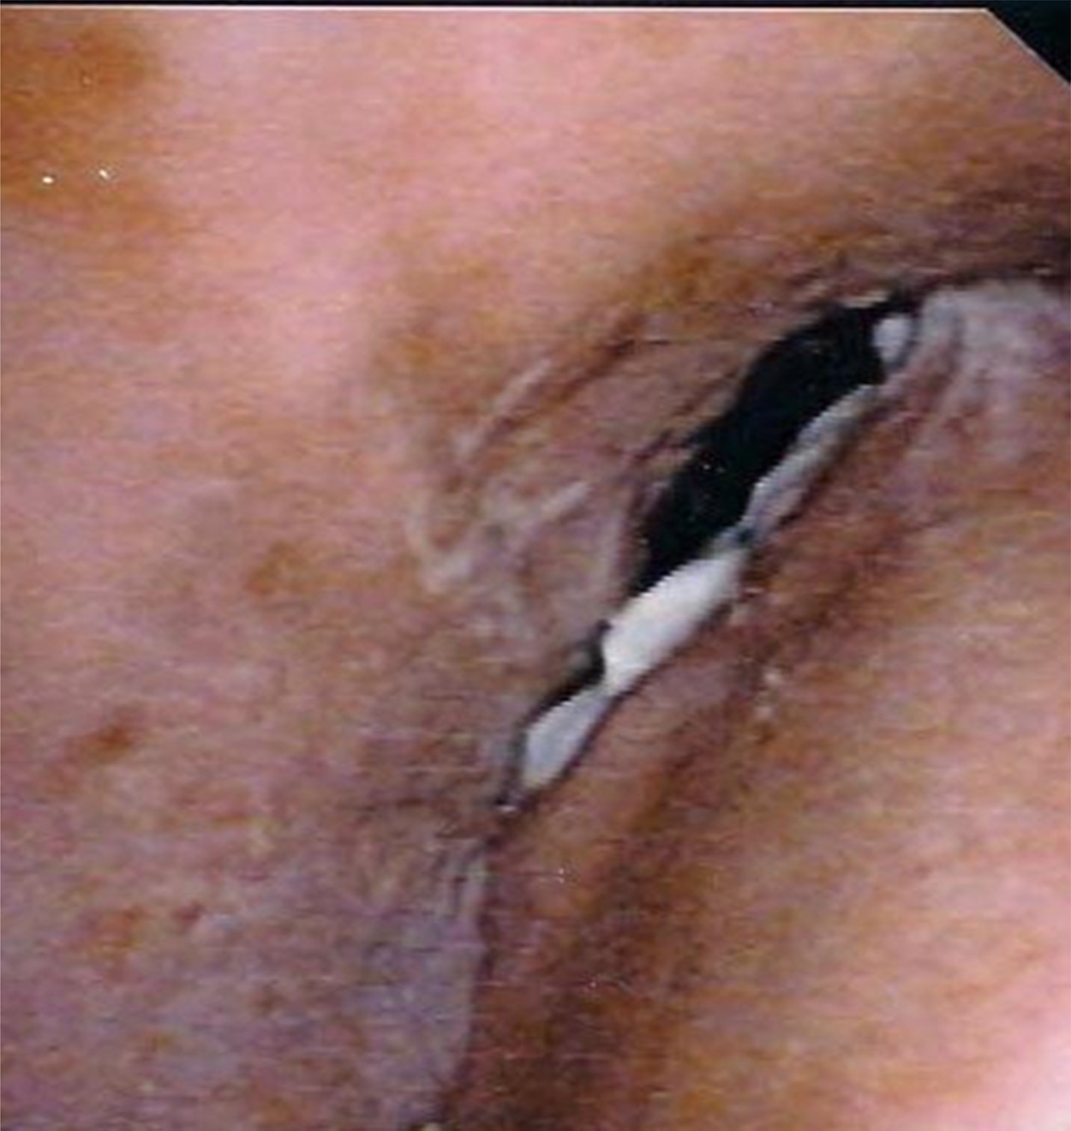
Figure 25
The Journal of Heart and Lung Transplantation 2018 37548-563DOI: (10.1016/j.healun.2018.01.1309)
Copyright © 2018 International Society for the Heart and Lung Transplantation Terms and Conditions
Notes:
Ma: The malacia is perianastomotic-within 1 cm of the anastomosis.

Slide 27
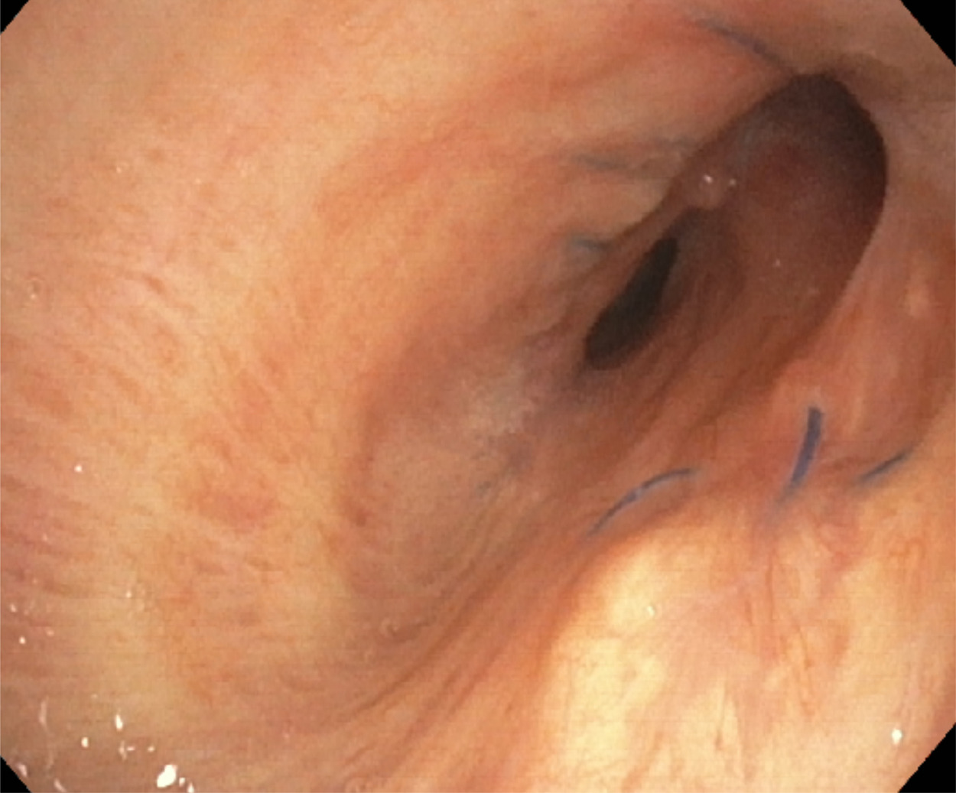
Figure 26
The Journal of Heart and Lung Transplantation 2018 37548-563DOI: (10.1016/j.healun.2018.01.1309)
Copyright © 2018 International Society for the Heart and Lung Transplantation Terms and Conditions
Notes:
Mb: The malacia is diffuse, involving the anastomosis and extending beyond 1 cm.

Slide 28
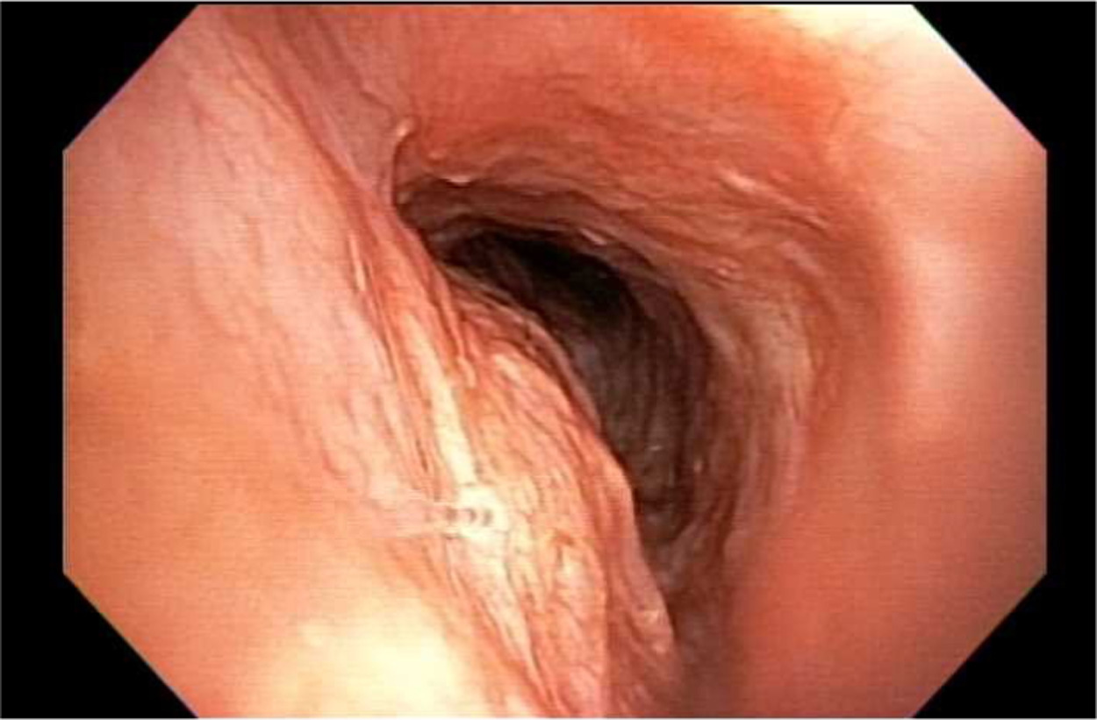
Figure 27
The Journal of Heart and Lung Transplantation 2018 37548-563DOI: (10.1016/j.healun.2018.01.1309)
Copyright © 2018 International Society for the Heart and Lung Transplantation Terms and Conditions
Notes:
Mb: The malacia is diffuse, involving the anastomosis and extending beyond 1 cm, OTHER ENDOBRONCHIAL PATHOLOGY: presenting as necrosis and stricture in the airway.

Slide 29
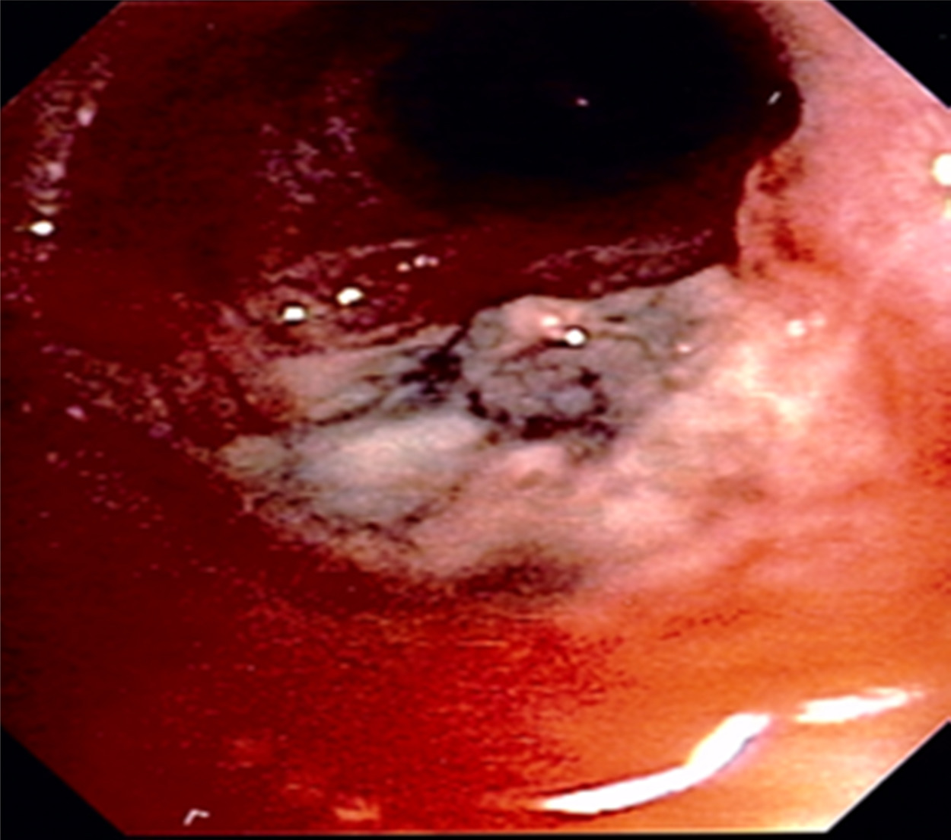
Figure 28
The Journal of Heart and Lung Transplantation 2018 37548-563DOI: (10.1016/j.healun.2018.01.1309)
Copyright © 2018 International Society for the Heart and Lung Transplantation Terms and Conditions
Notes:
Endobronchial Aspergillosis at the right anastomosis.

Slide 30
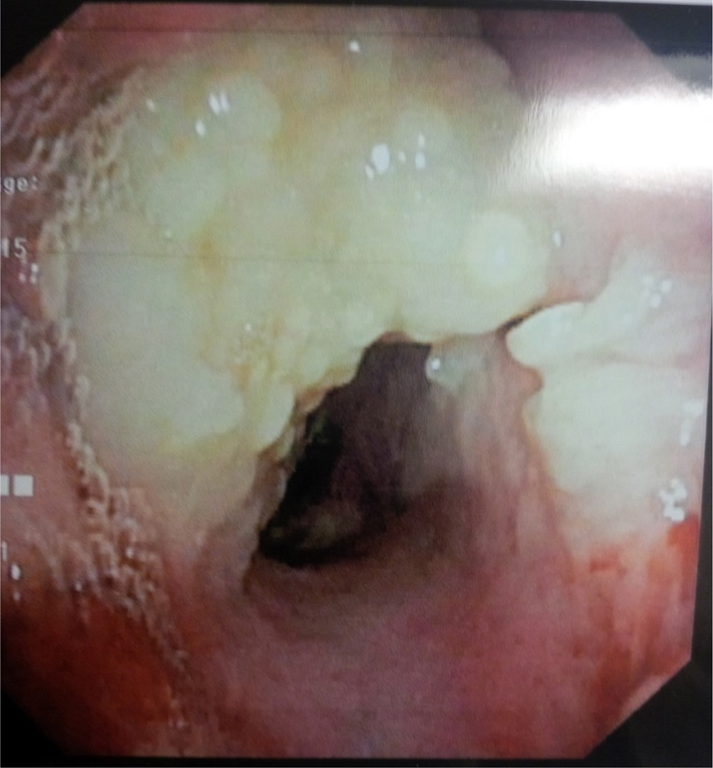
Figure 29
The Journal of Heart and Lung Transplantation 2018 37548-563DOI: (10.1016/j.healun.2018.01.1309)
Copyright © 2018 International Society for the Heart and Lung Transplantation Terms and Conditions
Notes:
Endobronchial post-transplant lymphoproliferative disorder (PTLD) involving the left anastomosis.

