Slide 1
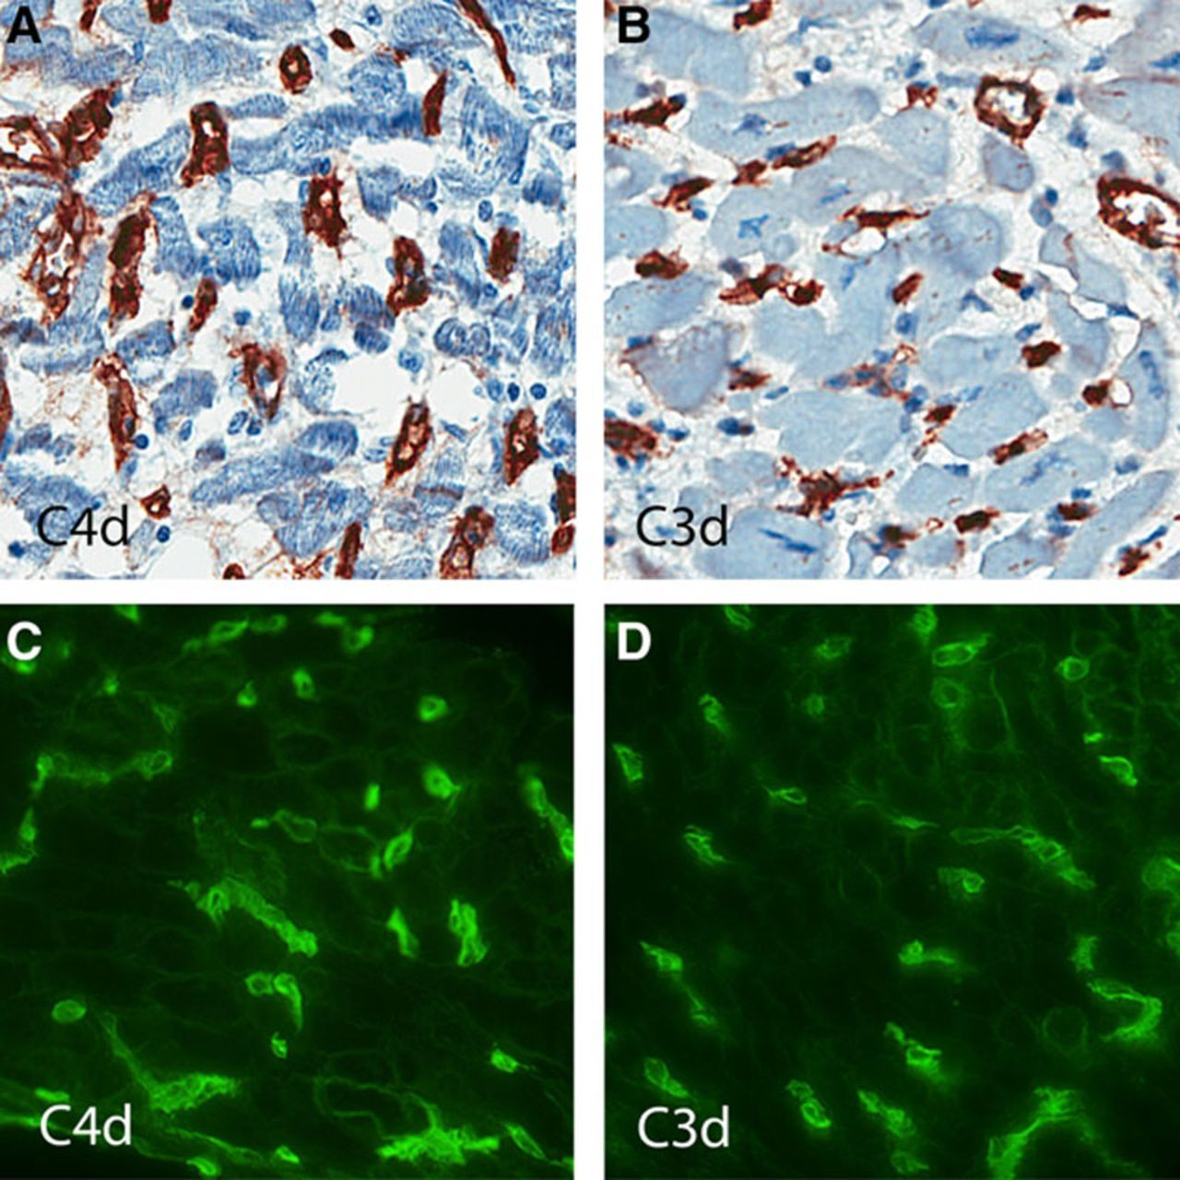
© 2015 American Heart Association, Inc.
Monica M. Colvin. Circulation. Antibody-Mediated Rejection in Cardiac Transplantation: Emerging Knowledge in Diagnosis and Management, Volume: 131, Issue: 18, Pages: 1608-1639, DOI: (10.1161/CIR.0000000000000093)

Slide 2
© 2015 American Heart Association, Inc.
Monica M. Colvin. Circulation. Antibody-Mediated Rejection in Cardiac Transplantation: Emerging Knowledge in Diagnosis and Management, Volume: 131, Issue: 18, Pages: 1608-1639, DOI: (10.1161/CIR.0000000000000093)

Slide 3
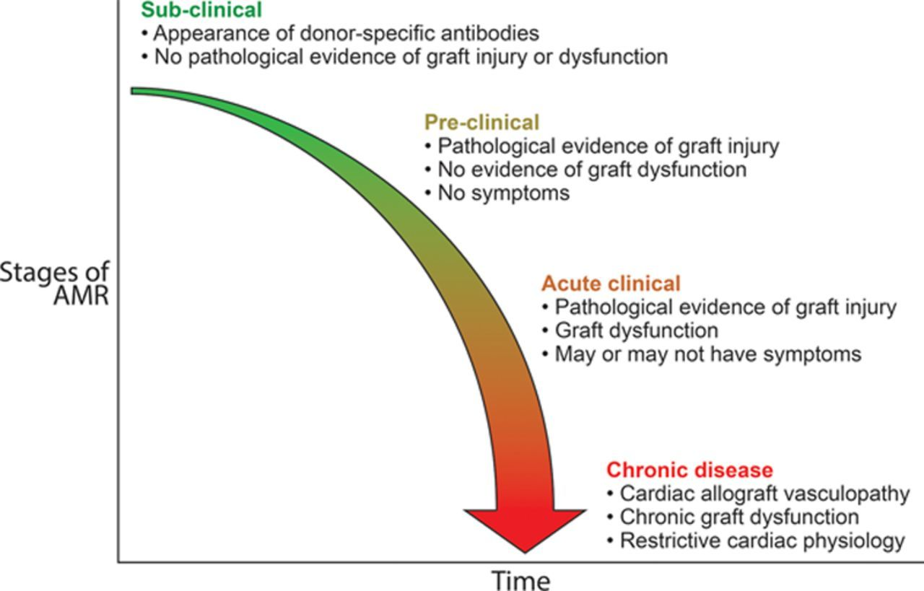
© 2015 American Heart Association, Inc.
Monica M. Colvin. Circulation. Antibody-Mediated Rejection in Cardiac Transplantation: Emerging Knowledge in Diagnosis and Management, Volume: 131, Issue: 18, Pages: 1608-1639, DOI: (10.1161/CIR.0000000000000093)

Slide 4
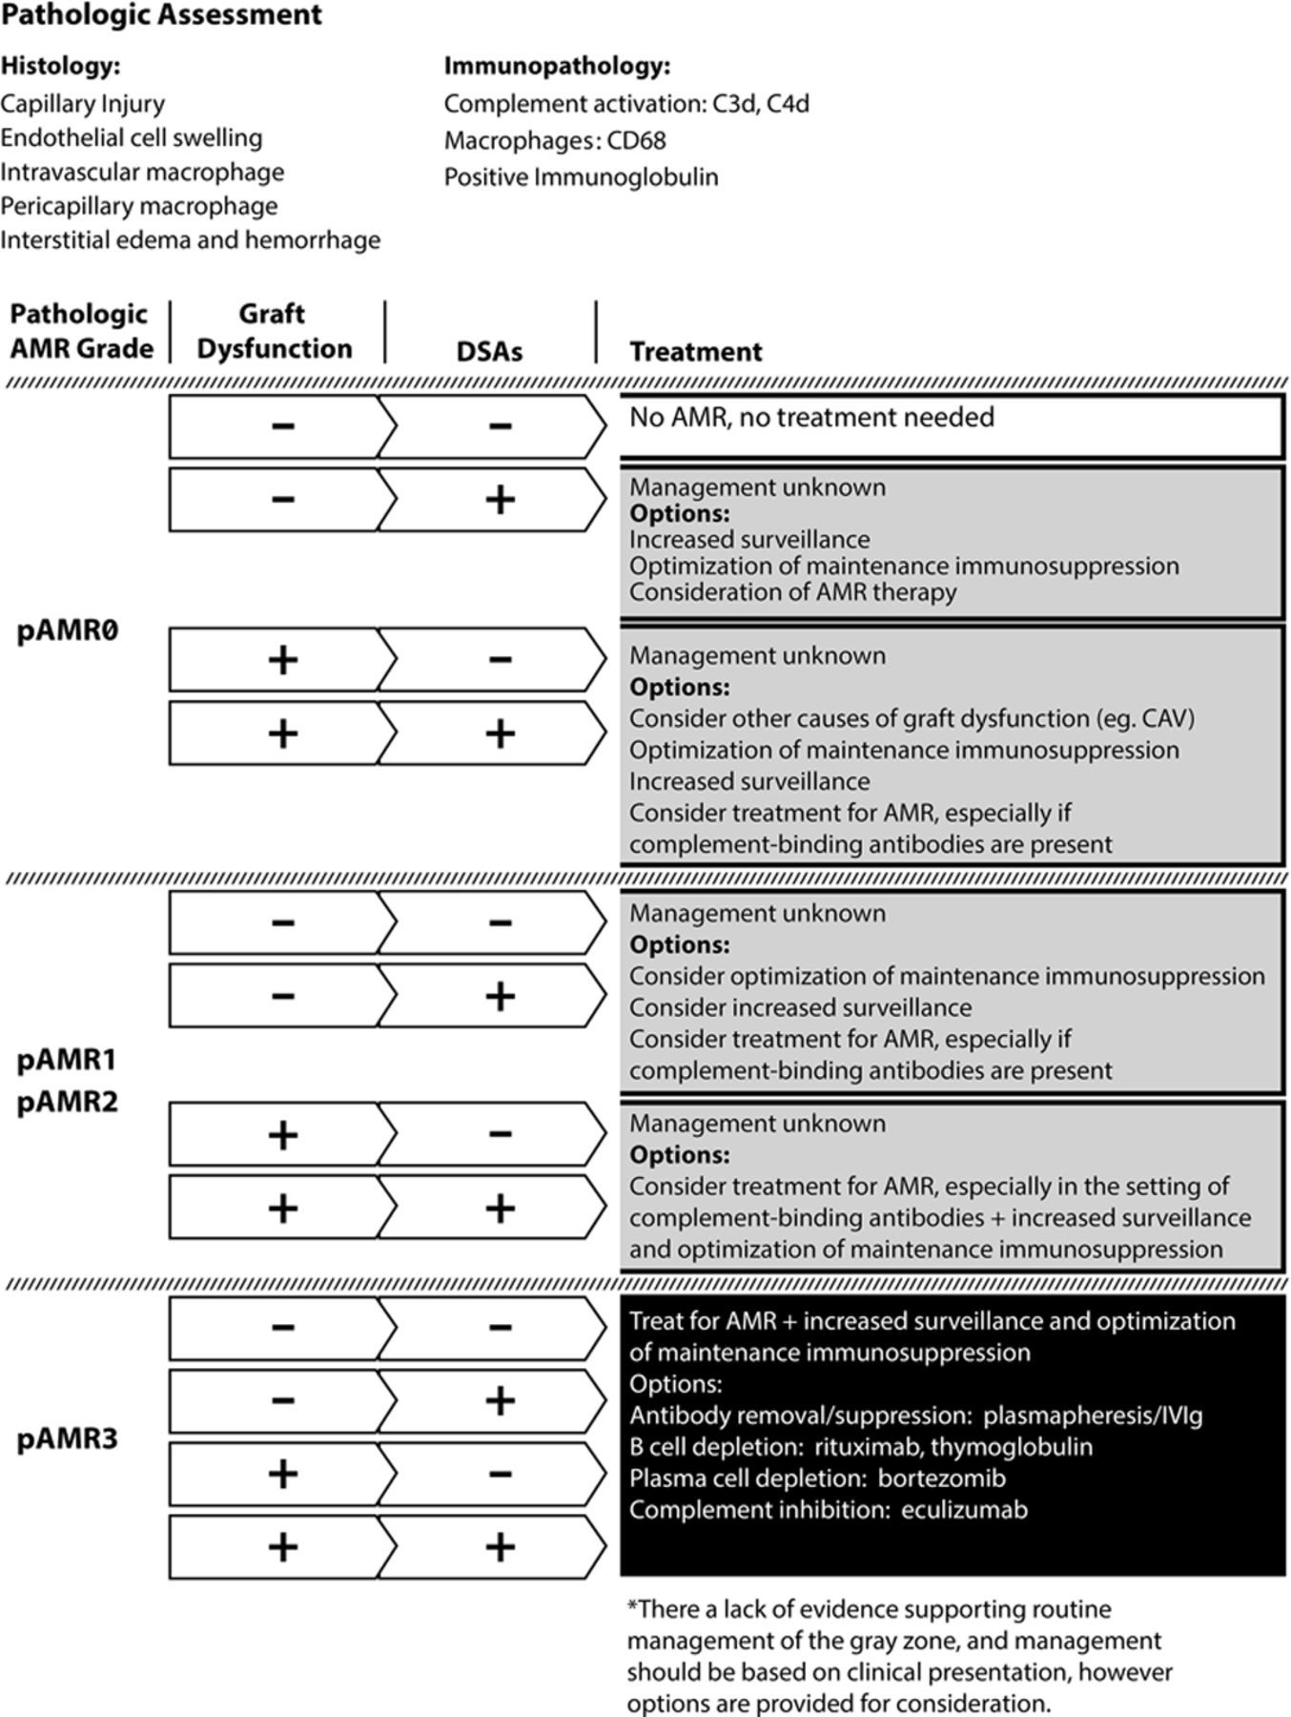
© 2015 American Heart Association, Inc.
Monica M. Colvin. Circulation. Antibody-Mediated Rejection in Cardiac Transplantation: Emerging Knowledge in Diagnosis and Management, Volume: 131, Issue: 18, Pages: 1608-1639, DOI: (10.1161/CIR.0000000000000093)

