Slide 1
The 2013 International Society for Heart and Lung Transplantation Guidelines for mechanical circulatory support: Executive summary
David Feldman, MD, PhD, Salpy V. Pamboukian, MD, MSPH, Jeffrey J. Teuteberg, MD, Emma Birks, MD, Katherine Lietz, MD, Stephanie A. Moore, MD, Jeffrey A. Morgan, MD, Francisco Arabia, MD, Mary E. Bauman, MScN, NP, Hoger W. Buchholz, MD, Mario Deng, MD, Marc L. Dickstein, MD, Aly El-Banayosy, MD, Tonya Elliot, RN, MSN, Daniel J. Goldstein, MD, Kathleen L. Grady, PhD, APN, Kylie Jones, RN, Katarzyna Hryniewicz, MD, Ranjit John, MD, Annemarie Kaan, MCN, RN, Shimon Kusne, MD, Matthias Loebe, MD, PhD, M. Patricia Massicotte, MHSc, MD, Nader Moazami, MD, Paul Mohacsi, MD, Martha Mooney, MD, Thomas Nelson, MD, Francis Pagani, MD, William Perry, RN, Evgenij V. Potapov, MD, J. Eduardo Rame, MD, MPhil, Stuart D. Russell, MD, Erik N. Sorensen, PhD, Benjamin Sun, MD, Martin Strueber, MD, Abeel A. Mangi, MD, Michael G. Petty, PhD,RN, Joseph Rogers, MD
The Journal of Heart and Lung Transplantation
Volume 32 Issue 2 Pages 157-187 (February 2013)
DOI: 10.1016/j.healun.2012.09.013
Copyright © 2013 International Society for Heart and Lung Transplantation Terms and Conditions

Slide 2
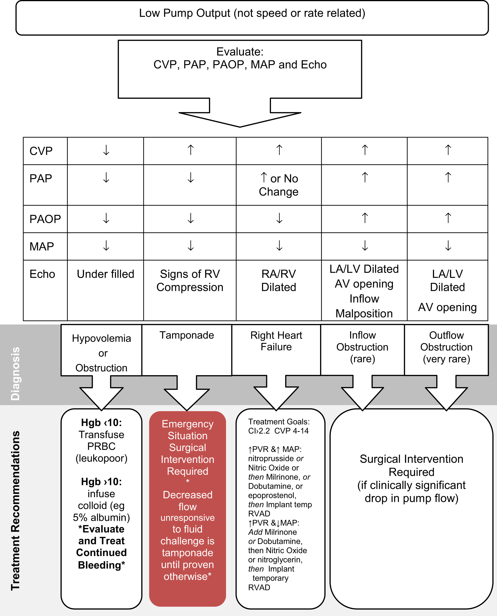
Figure 1
The Journal of Heart and Lung Transplantation 2013 32157-187DOI: (10.1016/j.healun.2012.09.013)
Copyright © 2013 International Society for Heart and Lung Transplantation Terms and Conditions
Notes:
Treatment algorithm for low pump output. AV, arteriovenous; CI, cardiac index; CVP, central venous pressure; Hgb, hemoglobin; LA, left atrium; LV, left ventricle; MAP, mean arterial pressure; PAOP, pulmonary artery occlusion pressure; PAP, pulmonary artery pressure; PRBC, packed red blood cells; PVR, peripheral vascular resistance; RA, right atrium; RV, right ventricular; RVAD, right ventricular assist device.

Slide 3
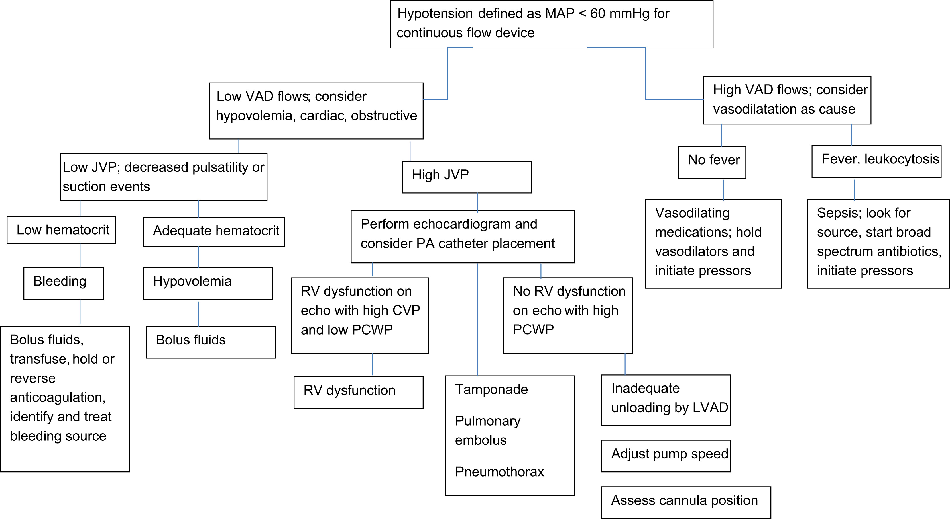
Figure 2
The Journal of Heart and Lung Transplantation 2013 32157-187DOI: (10.1016/j.healun.2012.09.013)
Copyright © 2013 International Society for Heart and Lung Transplantation Terms and Conditions
Notes:
Algorithm for assessment of hypotension after implant. CVP, central venous pressure; JVP, jugular venous pressure; LVAD, left ventricular assist device; MAP, mean arterial pressure; PA, pulmonary artery; PCWP, pulmonary capillary wedge pressure; RV, right ventricular; VAD, left ventricular assist device.

