Slide 1
A 2010 working formulation for the standardization of definitions of infections in cardiothoracic transplant recipients
Shahid Husain, MD, MS, Martha L. Mooney, MD, MS, FACP, Lara Danziger-Isakov, MD, MPH, Frauke Mattner, MD, PhD, Nina Singh, MD, Robin Avery, MD, FIDSA, Michael Ison, MD, MS, Atul Humar, MD, MSc, Robert F. Padera, MD, PhD, Leo P. Lawler, MD, FRCR, Andy Fisher, PhD, FRCP, Richard J. Drew, MD, Kate F. Gould, MBBS, MRCP, FRCP, Amparo Sole, MD, PhD, Sean Studer, MD, MSc, Patricia Munoz, MD, Lianne G. Singer, MD, FRCPC, Margaret Hannan, MD, FRCP, FRCPath
The Journal of Heart and Lung Transplantation
Volume 30 Issue 4 Pages 361-374 (April 2011)
DOI: 10.1016/j.healun.2011.01.701
Copyright © 2011 Terms and Conditions

Slide 2
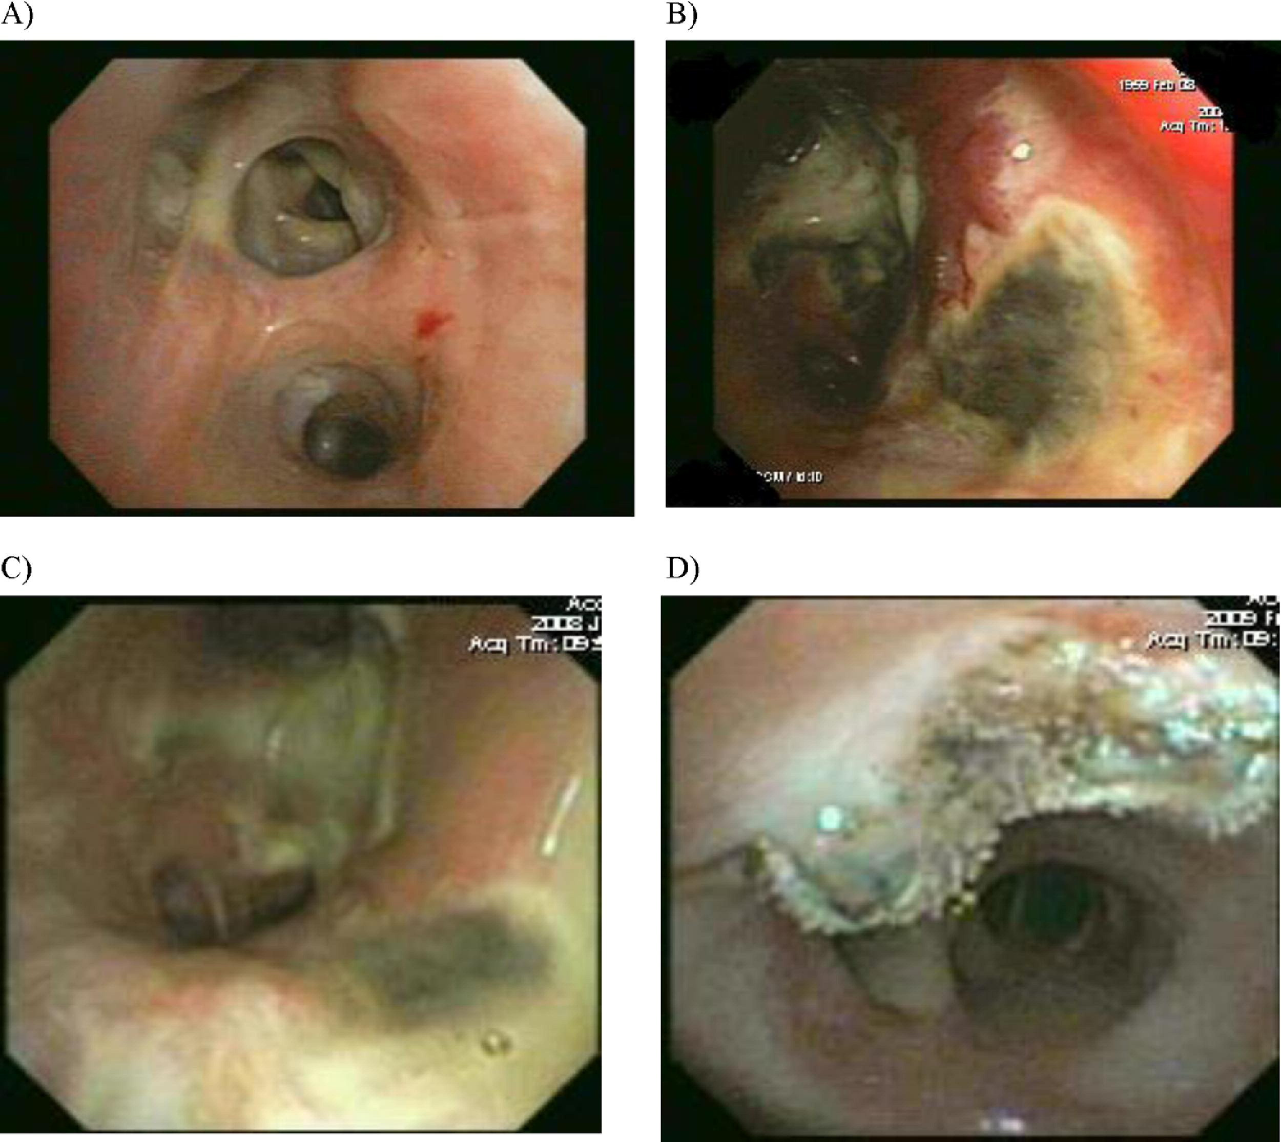
Figure 1
The Journal of Heart and Lung Transplantation 2011 30361-374DOI: (10.1016/j.healun.2011.01.701)
Copyright © 2011 Terms and Conditions
Notes:
Presentations of tracheobronchitis (TrB) and bronchial anastomatic infection (BAI) in lung transplant recipients. (A) Normal bronchoscopy. (B) Bacterial tracheobronchitis. (C) Fungal tracheobronchitis. (D) Bronchial anastomotic infection.

Slide 3
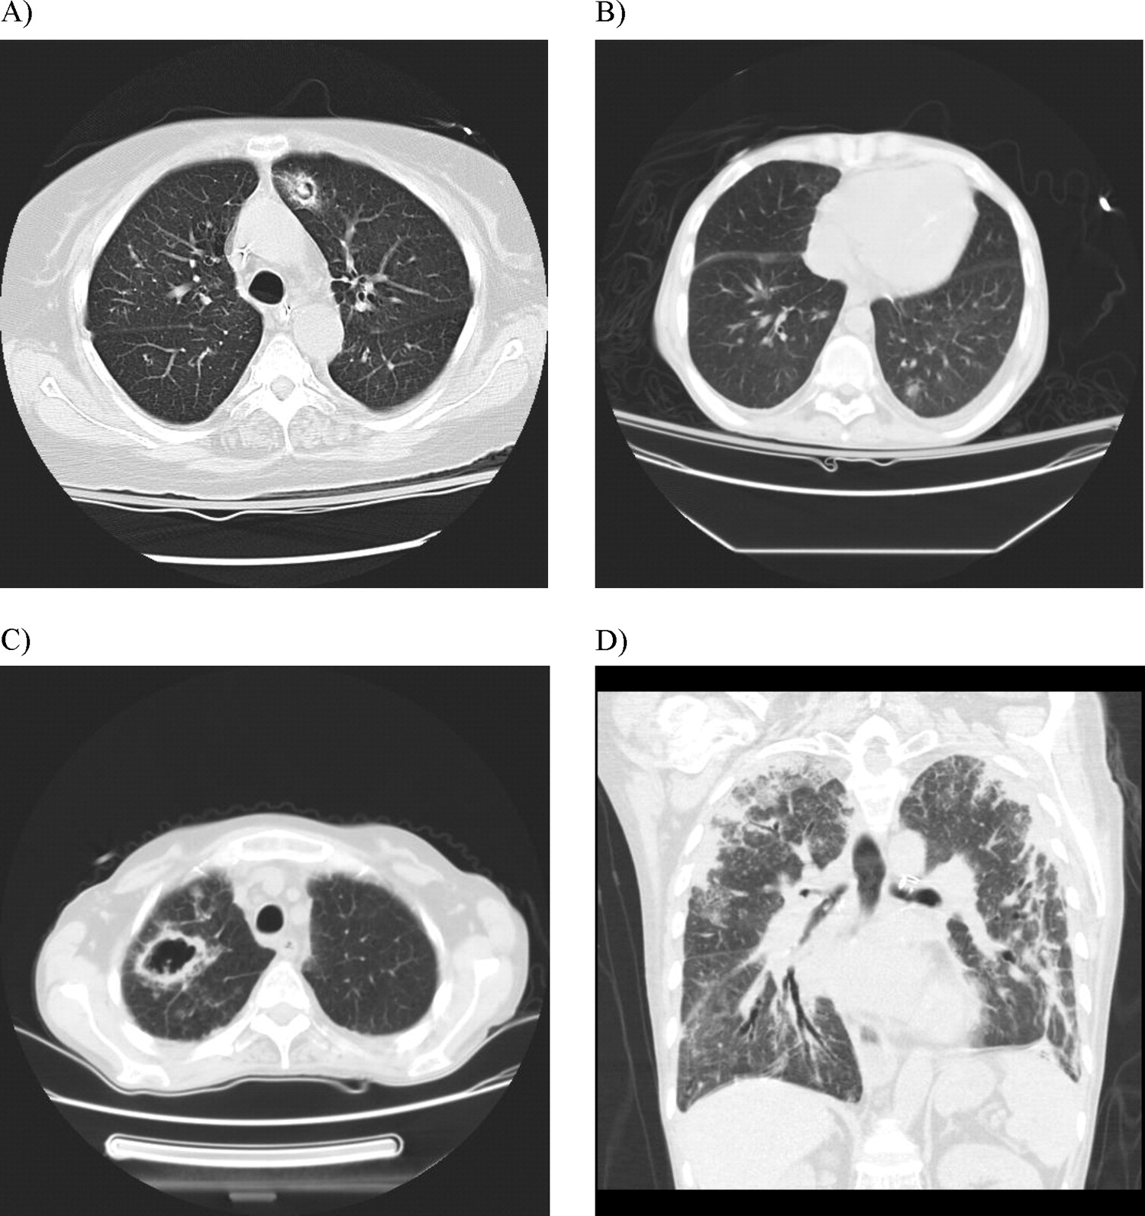
Figure 2
The Journal of Heart and Lung Transplantation 2011 30361-374DOI: (10.1016/j.healun.2011.01.701)
Copyright © 2011 Terms and Conditions
Notes:
Common radiologic manifestations of proven invasive aspergillosis in lung transplant recipients. (A) Fungal ball. (B) Solitary pulmonary nodule. (C) Cavitary lesion. (D) Multiple consolidation.

