Slide 1
The International Society of Heart and Lung Transplantation Guidelines for the care of heart transplant recipients
Maria Rosa Costanzo, MD, Maria Rosa Costanzo, MD, Anne Dipchand, MD, Randall Starling, MD, Allen Anderson, MD, Michael Chan, MD, Shashank Desai, MD, Savitri Fedson, MD, Patrick Fisher, MD, Gonzalo Gonzales-Stawinski, MD, Luigi Martinelli, MD, David McGiffin, MD, Francesco Parisi, MD, Jon Smith, MD, David Taylor, MD, Bruno Meiser, MD, Steven Webber, MD, David Baran, MD, Michael Carboni, MD, Thomas Dengler, MD, David Feldman, MD, Maria Frigerio, MD, Abdallah Kfoury, MD, Daniel Kim, MD, Jon Kobashigawa, MD, Michael Shullo, PharmD, Josef Stehlik, MD, Jeffrey Teuteberg, MD, Patricia Uber, PharmD, Andreas Zuckermann, MD, Sharon Hunt, MD, Michael Burch, Geetha Bhat, MD, Charles Canter, MD, Richard Chinnock, MD, Marisa Crespo-Leiro, MD, Reynolds Delgado, MD, Fabienne Dobbels, PhD, Kathleen Grady, PhD, Kao W, MD, Jaqueline Lamour, MD, Gareth Parry, MD, Jignesh Patel, MD, Daniela Pini, MD, Sean Pinney, MD, Jeffrey Towbin, MD, Gene Wolfel, MD, Diego Delgado, MD, Howard Eisen, MD, Lee Goldberg, MD, Jeff Hosenpud, MD, Maryl Johnson, MD, Anne Keogh, MD, Clive Lewis, MD, John O'Connell, MD, Joseph Rogers, MD, Heather Ross, MD, Stuart Russell, MD, Johan Vanhaecke, MD
The Journal of Heart and Lung Transplantation
Volume 29 Issue 8 Pages 914-956 (August 2010)
DOI: 10.1016/j.healun.2010.05.034
Copyright © 2010 International Society for Heart and Lung Transplantation Terms and Conditions

Slide 2
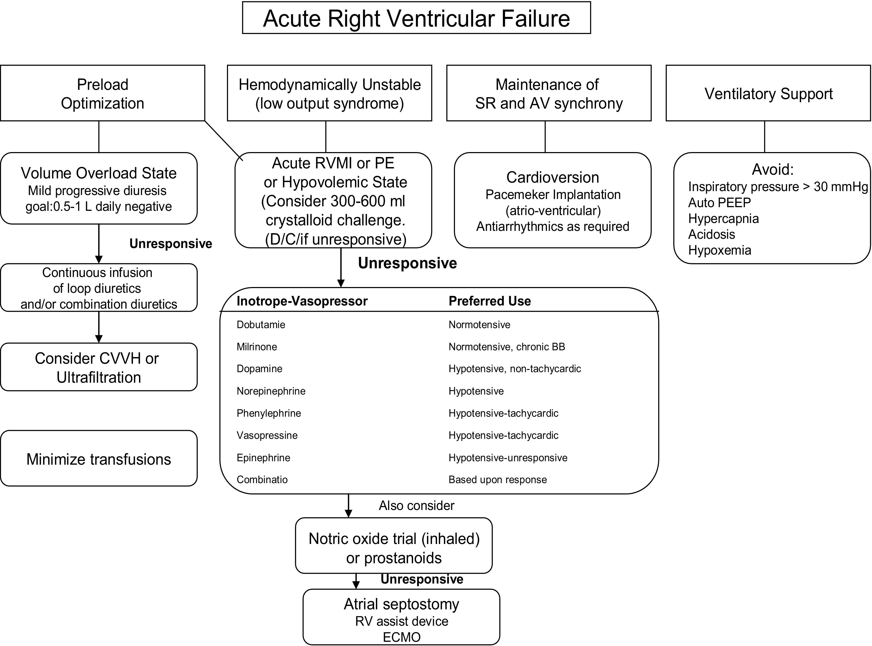
Figure 1
The Journal of Heart and Lung Transplantation 2010 29914-956DOI: (10.1016/j.healun.2010.05.034)
Copyright © 2010 International Society for Heart and Lung Transplantation Terms and Conditions
Notes:
Management of right ventricular dysfunction. AV, atrioventricular; CVVH, continuous venovenous hemofiltration; MI, myocardial infarction; PE, pulmonary embolism; PEEP, positive end-expiratory pressure; SR, sinus rhythm.
Adapted and reprinted with permission from Haddad F, et al.⁴⁷

