Slide 1
Revision of the 1996 Working Formulation for the Standardization of Nomenclature in the Diagnosis of Lung Rejection
Susan Stewart, FRCPath, Michael C. Fishbein, MD, Gregory I. Snell, MD, Gerald J. Berry, MD, Annette Boehler, MD, Margaret M. Burke, FRCPath, Alan Glanville, MD, F. Kate Gould, FRCPath, Cynthia Magro, MD, Charles C. Marboe, MD, Keith D. McNeil, FRACP, Elaine F. Reed, PhD, Nancy L. Reinsmoen, PhD, John P. Scott, MD, Sean M. Studer, MD, Henry D. Tazelaar, MD, John L. Wallwork, FRCS, Glen Westall, MD, Martin R. Zamora, MD, Adriana Zeevi, PhD, Samuel A. Yousem, MD
The Journal of Heart and Lung Transplantation
Volume 26 Issue 12 Pages 1229-1242 (December 2007)
DOI: 10.1016/j.healun.2007.10.017
Copyright © 2007 International Society for Heart and Lung Transplantation Terms and Conditions

Slide 2
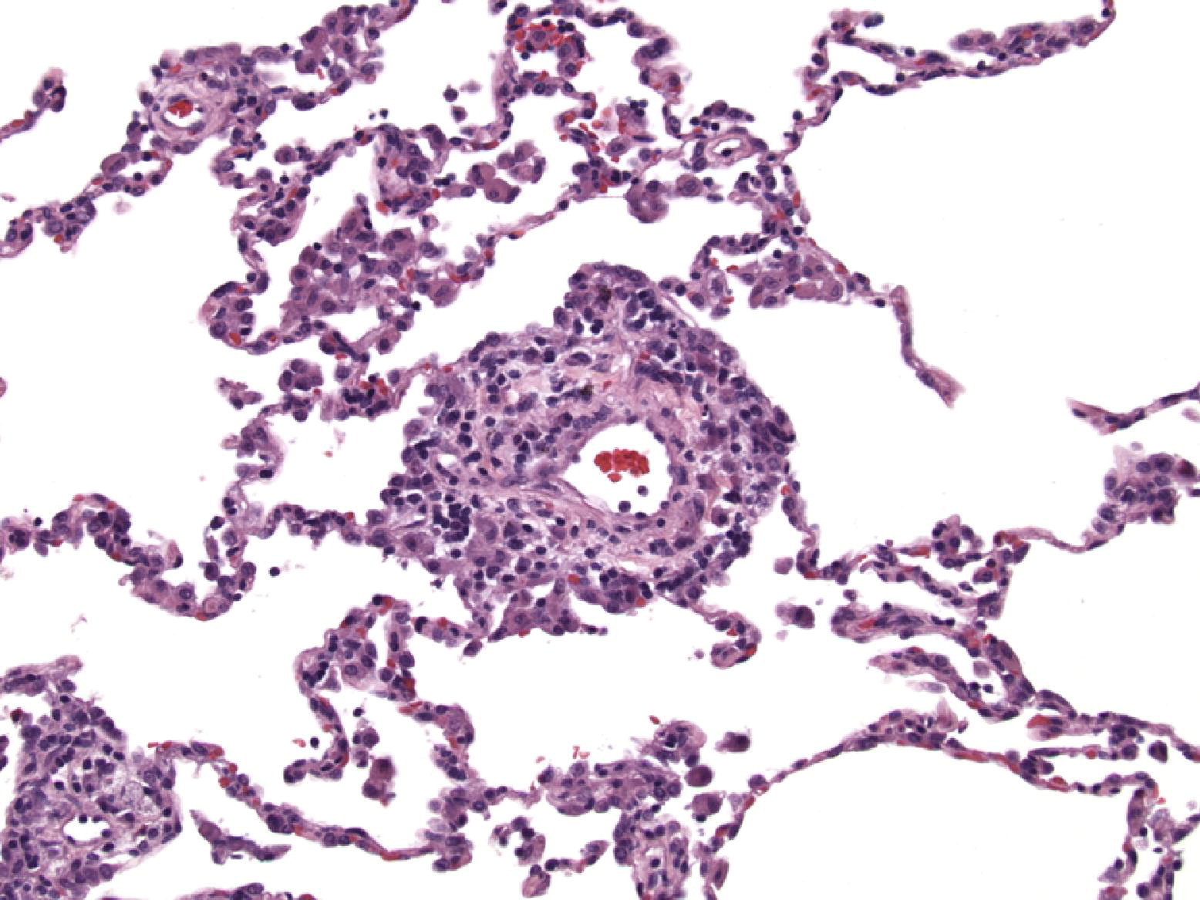
Figure 1
The Journal of Heart and Lung Transplantation 2007 261229-1242DOI: (10.1016/j.healun.2007.10.017)
Copyright © 2007 International Society for Heart and Lung Transplantation Terms and Conditions
Notes:
Minimal acute cellular rejection (A1). The characteristic feature of minimal acute cellular rejection is circumferential infiltration of the perivascular interstitium by mononuclear cell inflammatory infiltrate. This typically involves the small veins and consists of scattered mononuclear cells within loose perivascular connective tissue. No significant expansion of the perivascular interstitium or extension of mononuclear cells into adjacent alveolar septa is present. Haematoxylin and eosin (H&E).

Slide 3
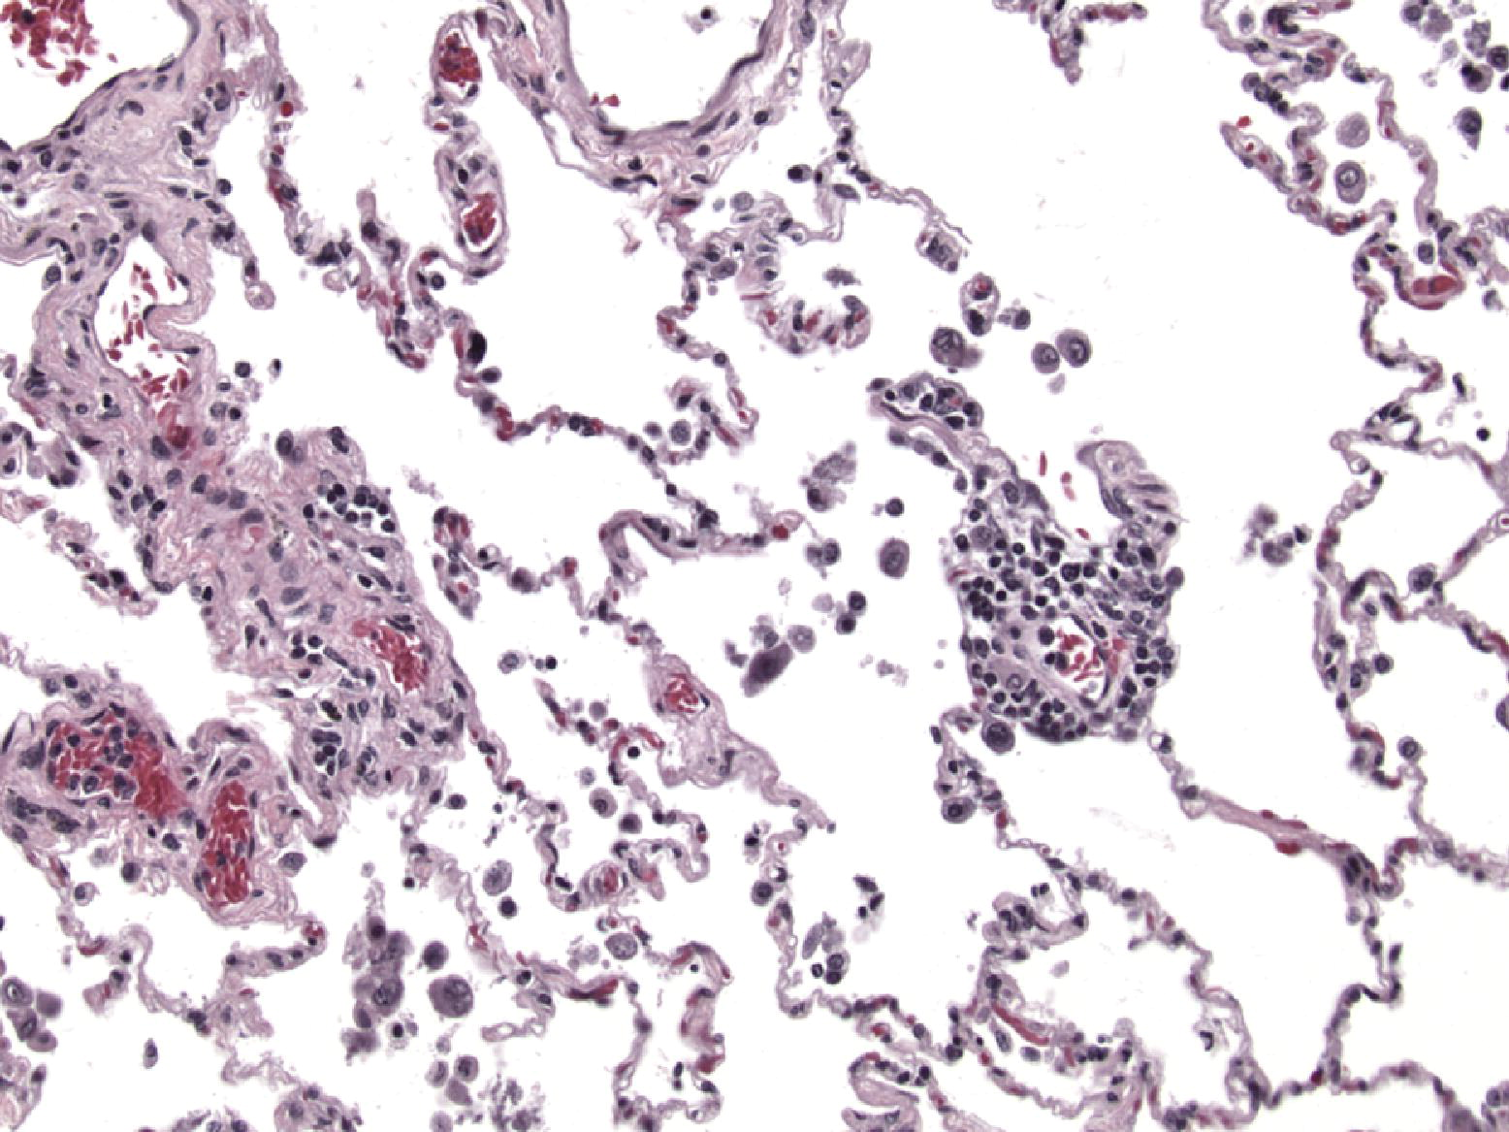
Figure 2
The Journal of Heart and Lung Transplantation 2007 261229-1242DOI: (10.1016/j.healun.2007.10.017)
Copyright © 2007 International Society for Heart and Lung Transplantation Terms and Conditions
Notes:
Minimal acute cellular rejection (A1). A sparse mononuclear cell infiltrate is present in the perivascular zones in this example of A1 minimal rejection at right. At left is a nonspecific mononuclear inflammatory infiltrate which fails to show the circumferential cuffing of vessels or the density of mononuclear cells that is sufficient for a diagnosis of minimal acute cellular rejection. H&E.

Slide 4
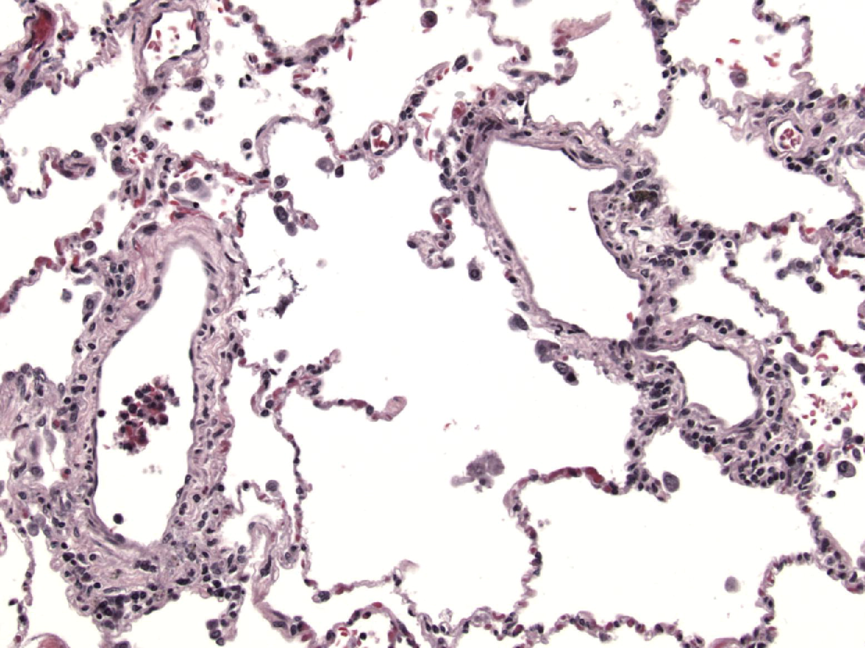
Figure 3
The Journal of Heart and Lung Transplantation 2007 261229-1242DOI: (10.1016/j.healun.2007.10.017)
Copyright © 2007 International Society for Heart and Lung Transplantation Terms and Conditions
Notes:
Minimal acute cellular rejection (A1). In this example of A1 rejection, the vessel at right displays a perivascular mononuclear infiltrate which in one segment of this vessel appears to be circumferential therefore warranting a diagnosis of minimal acute rejection. At left the vessel contains an ill-defined noncircumferential infiltrate of mononuclear cells of low intensity which would be regarded as a nonspecific morphologic finding. H&E.

Slide 5
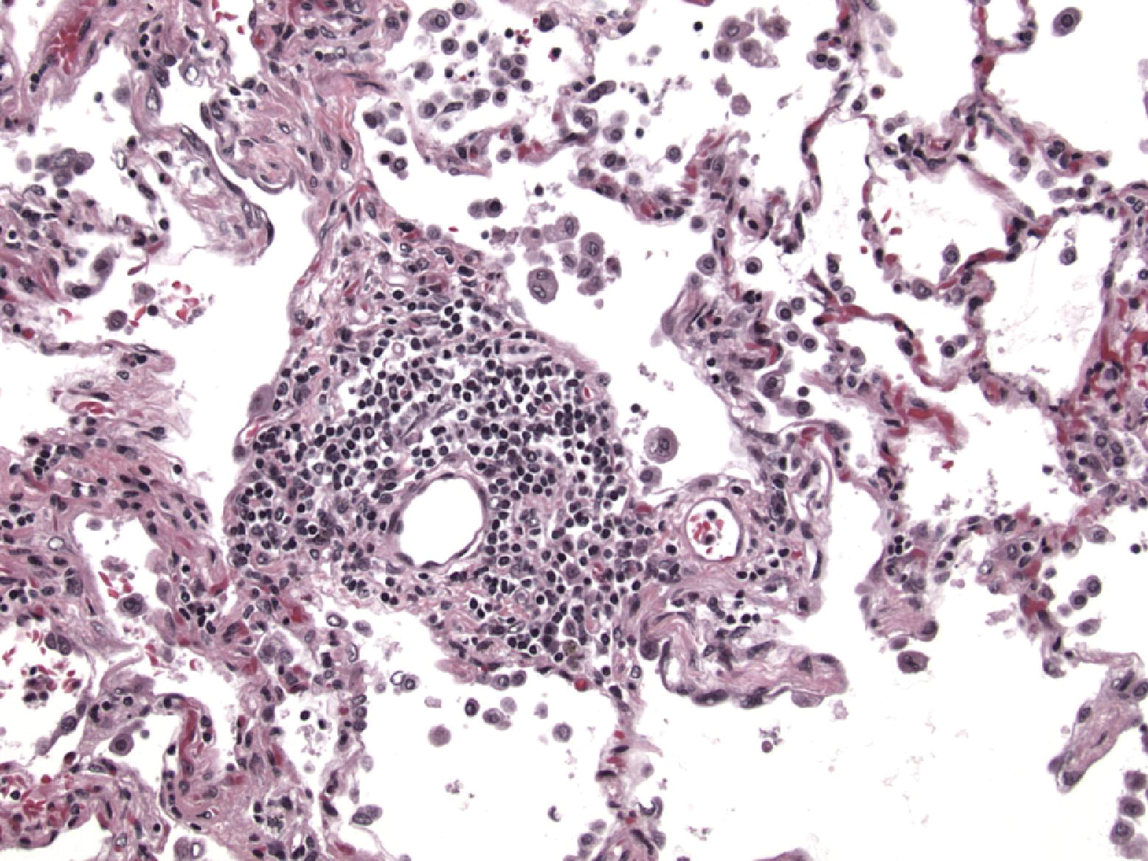
Figure 4
The Journal of Heart and Lung Transplantation 2007 261229-1242DOI: (10.1016/j.healun.2007.10.017)
Copyright © 2007 International Society for Heart and Lung Transplantation Terms and Conditions
Notes:
Mild acute cellular rejection (A2). In mild acute cellular rejection, the perivascular interstitium of small vessels, venules and arterioles, demonstrates significant circumferential expansion of the perivascular interstitium by mononuclear inflammatory infiltrate. The infiltrate consists largely of mononuclear cells with occasional activated lymphocytes and plasmacytoid lymphocytes. The mononuclear inflammatory infiltrate within the perivascular zones may be accompanied by alveolar macrophages. No infiltration of adjacent alveolar septa by the mononuclear infiltrate is present. H&E.

Slide 6
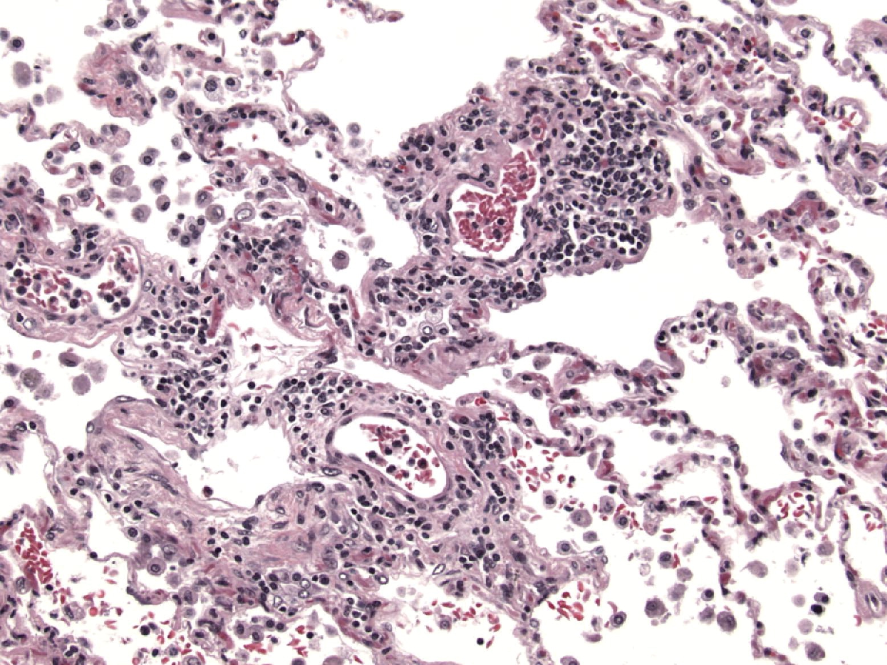
Figure 5
The Journal of Heart and Lung Transplantation 2007 261229-1242DOI: (10.1016/j.healun.2007.10.017)
Copyright © 2007 International Society for Heart and Lung Transplantation Terms and Conditions
Notes:
Mild acute cellular rejection (A2). In this example of mild acute cellular rejection, a tortuous small vessel in the lung parenchyma is cuffed by an inflammatory cell infiltrate which expands and tracks along the perivascular interstitium. The infiltrate remains associated with the perivascular interstitium without infiltration or expansion of adjacent alveolar septa by mononuclear cells. Subendothelial lymphocytic infiltration is also noted in upper right and such endothelialitis is a common finding in mild acute cellular rejection. H&E.

Slide 7
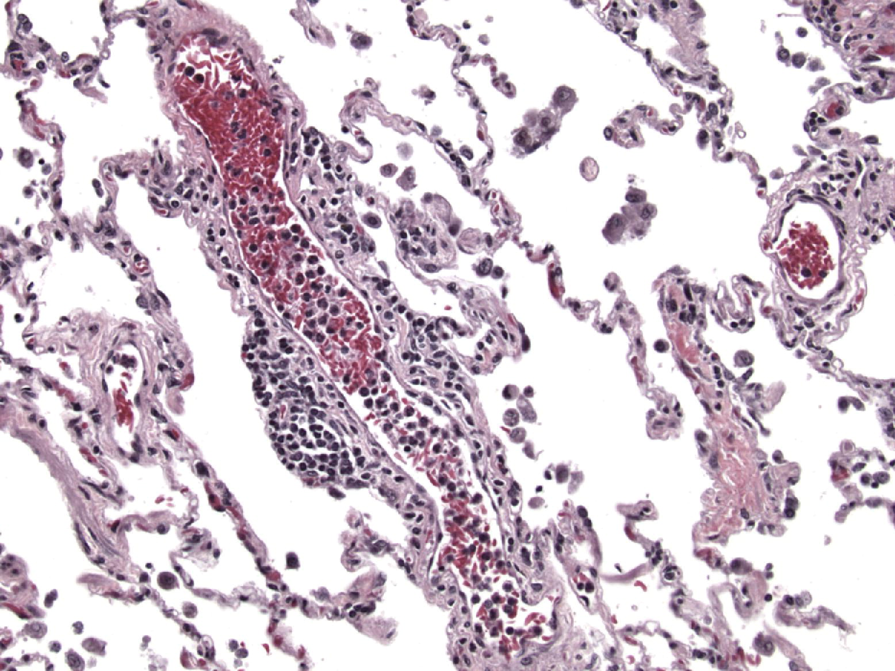
Figure 6
The Journal of Heart and Lung Transplantation 2007 261229-1242DOI: (10.1016/j.healun.2007.10.017)
Copyright © 2007 International Society for Heart and Lung Transplantation Terms and Conditions
Notes:
Borderline minimal-mild acute cellular rejection (A1-A2). In this example, a blood vessel is cut along its long axis. For the most part, the lymphoplasmacytic infiltrate is loosely distributed within the perivascular connective tissue. In only one focus is there expansion of the perivascular interstitium by the mononuclear infiltrate and therefore this case would be classified as mild acute cellular rejection even though the majority of this vessel shows minimal changes. H&E.

Slide 8
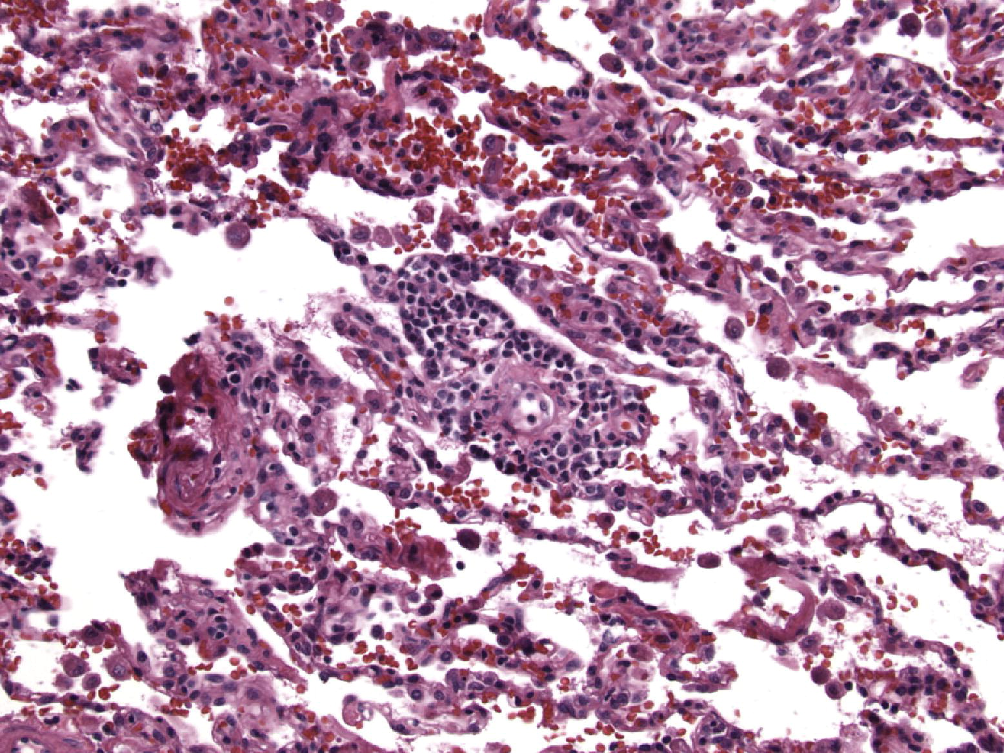
Figure 7
The Journal of Heart and Lung Transplantation 2007 261229-1242DOI: (10.1016/j.healun.2007.10.017)
Copyright © 2007 International Society for Heart and Lung Transplantation Terms and Conditions
Notes:
Borderline minimal-mild acute cellular rejection (A1-A2). This solitary perivascular infiltrate is associated with endothelial cell hyperplasia and expansion of the perivascular interstitium by mononuclear cells. The expansion, however, is rather slight and not pronounced and such a case would fall along the borderline of minimal-mild acute cellular rejection. H&E.

Slide 9
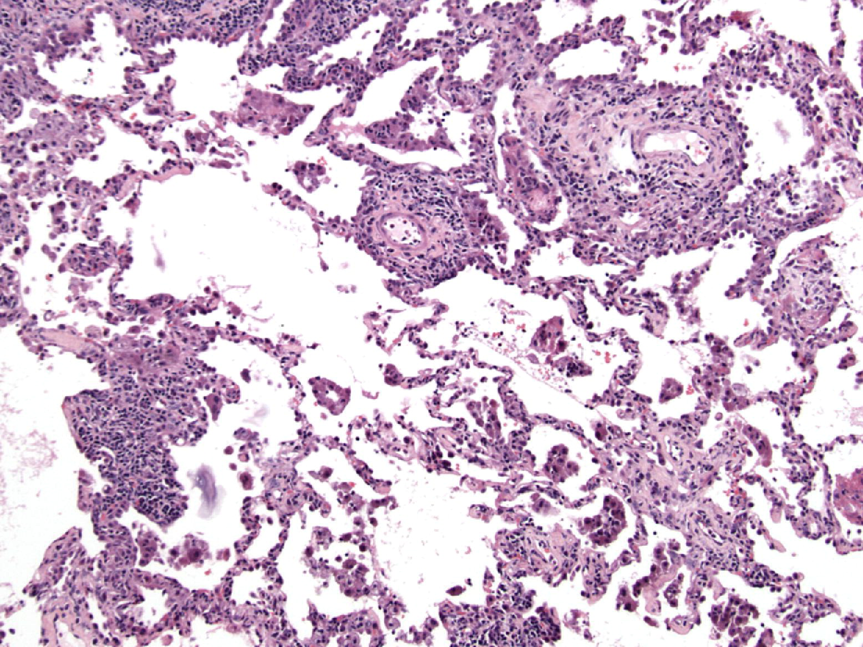
Figure 8
The Journal of Heart and Lung Transplantation 2007 261229-1242DOI: (10.1016/j.healun.2007.10.017)
Copyright © 2007 International Society for Heart and Lung Transplantation Terms and Conditions
Notes:
Moderate acute cellular rejection (A3). At scanning power, the perivascular mononuclear inflammatory infiltrate within the lung is easily identified. In addition, mononuclear cells are seen to percolate from the perivascular interstitium of small vessels into the alveolar septa where they are accompanied by alveolar pneumocyte hyperplasia. Mononuclear cells percolate into the perivascular airspaces where they are accompanied by a pronounced intraalveolar macrophage reaction. H&E.

Slide 10
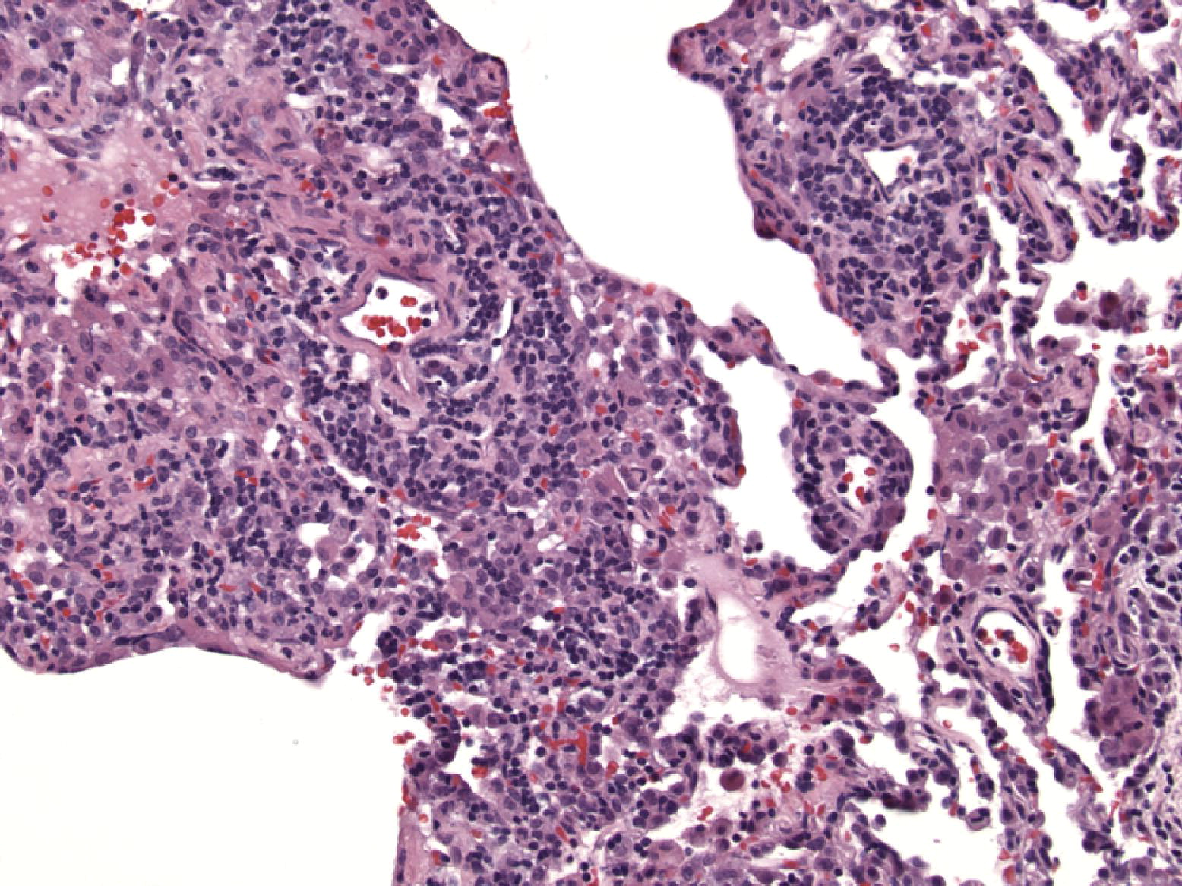
Figure 9
The Journal of Heart and Lung Transplantation 2007 261229-1242DOI: (10.1016/j.healun.2007.10.017)
Copyright © 2007 International Society for Heart and Lung Transplantation Terms and Conditions
Notes:
Moderate acute cellular rejection (A3). In this transbronchial biopsy, the lung parenchyma appears rather collapsed and atelectatic and yet, the perivascular mononuclear inflammatory infiltrate, with plasmacytoid lymphocytes and occasional eosinophils, expands the perivascular interstitium and extends into alveolar septa resulting in an “interstitial pneumonitis”. Alveolar pneumocytes are prominent and endothelialitis is readily identified. H&E.

Slide 11
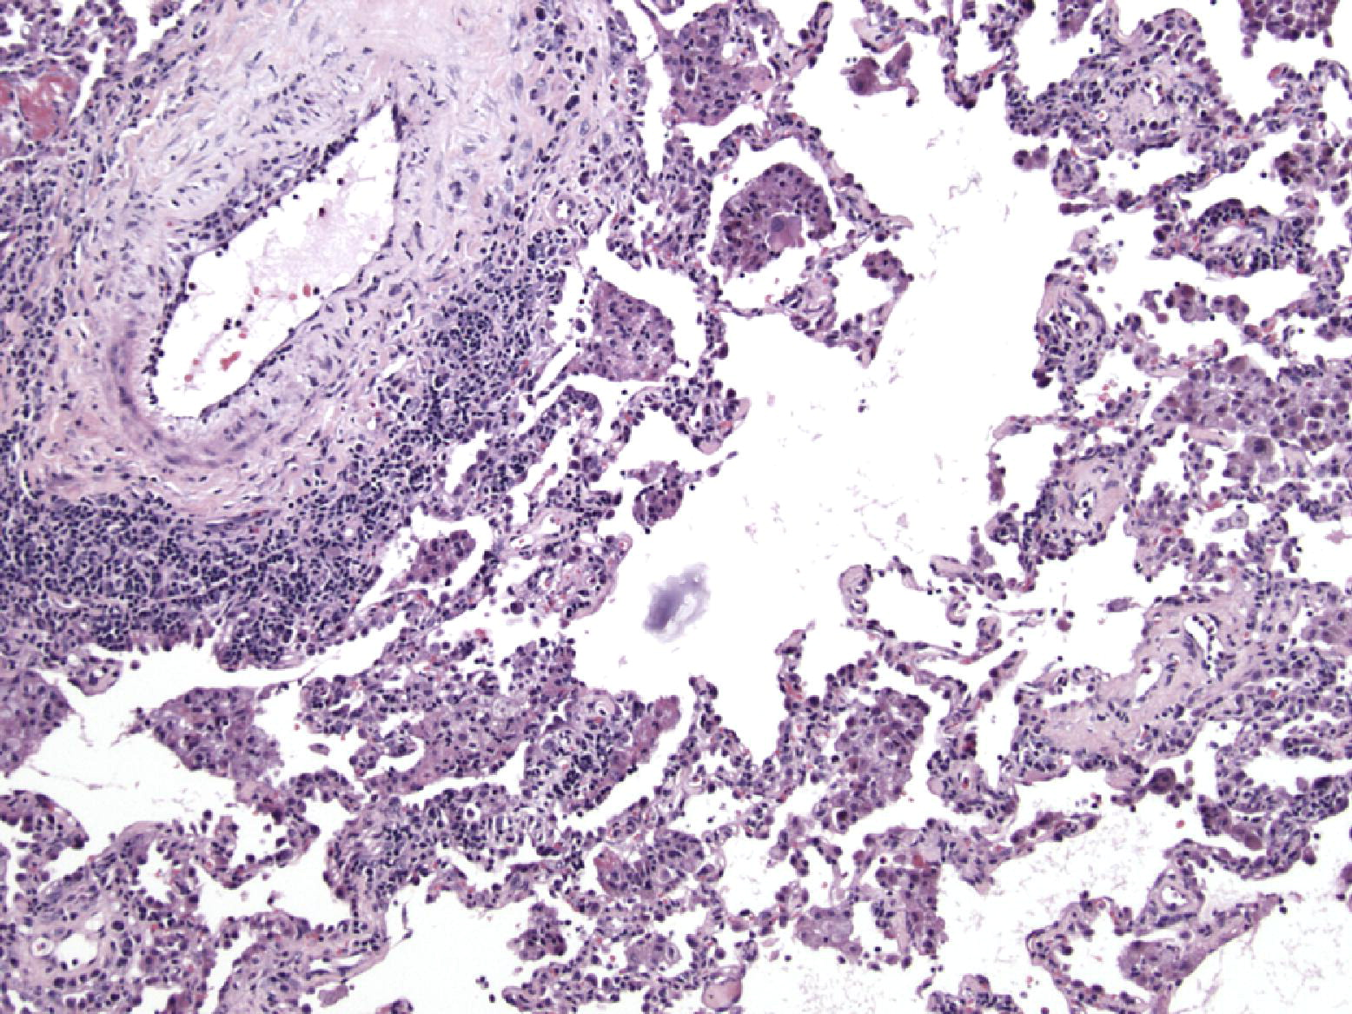
Figure 10
The Journal of Heart and Lung Transplantation 2007 261229-1242DOI: (10.1016/j.healun.2007.10.017)
Copyright © 2007 International Society for Heart and Lung Transplantation Terms and Conditions
Notes:
Moderate acute cellular rejection (A3). The characteristic feature of moderate acute cellular rejection is the expansion of the perivascular interstitium by mononuclear cells and the extension of the same cells into adjacent perivascular alveolar septa. Such cells may extend into the airspaces resulting in collections of macrophages and lymphocytes within alveoli. H&E.

Slide 12
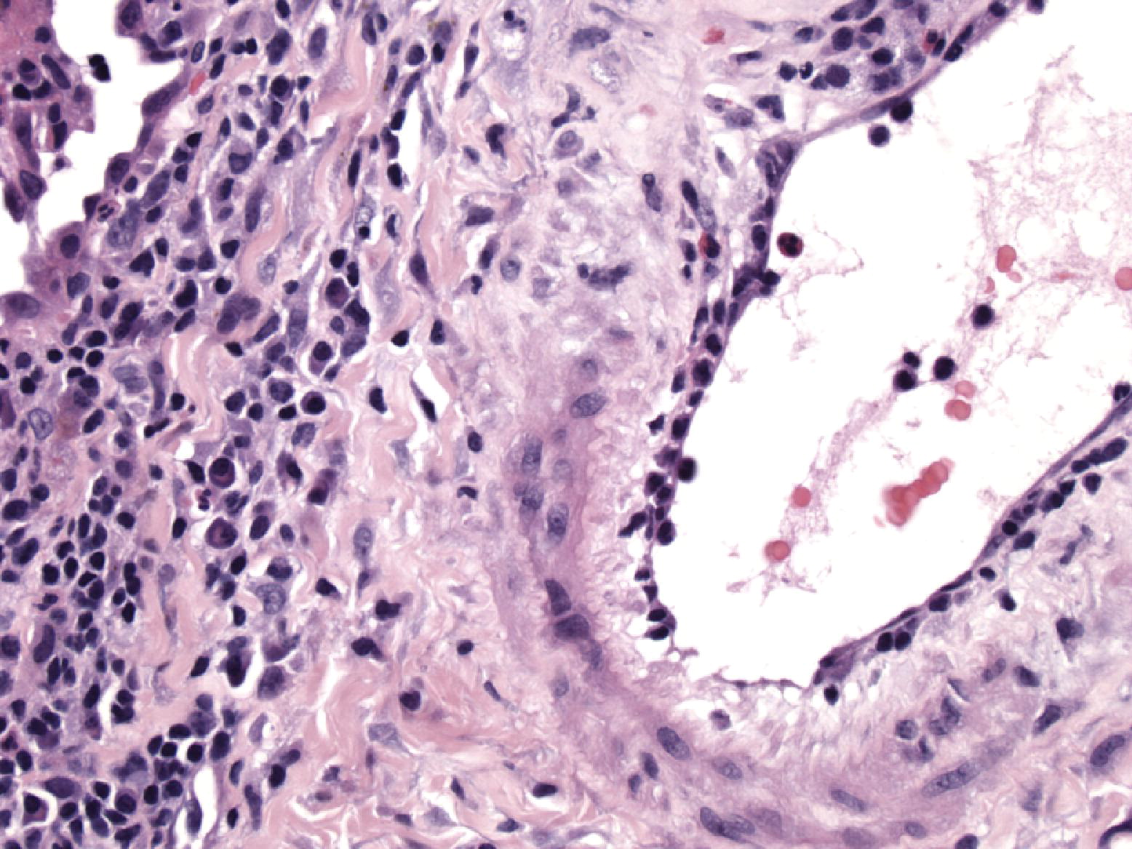
Figure 11
The Journal of Heart and Lung Transplantation 2007 261229-1242DOI: (10.1016/j.healun.2007.10.017)
Copyright © 2007 International Society for Heart and Lung Transplantation Terms and Conditions
Notes:
Moderate acute cellular rejection (A3). In almost all cases of moderate acute cellular rejection, subendothelial infiltrates of small round and plasmacytoid lymphocytes are characteristic, often accompanied by eosinophils i.e. endotheliitis or endothelialitis. H&E.

Slide 13
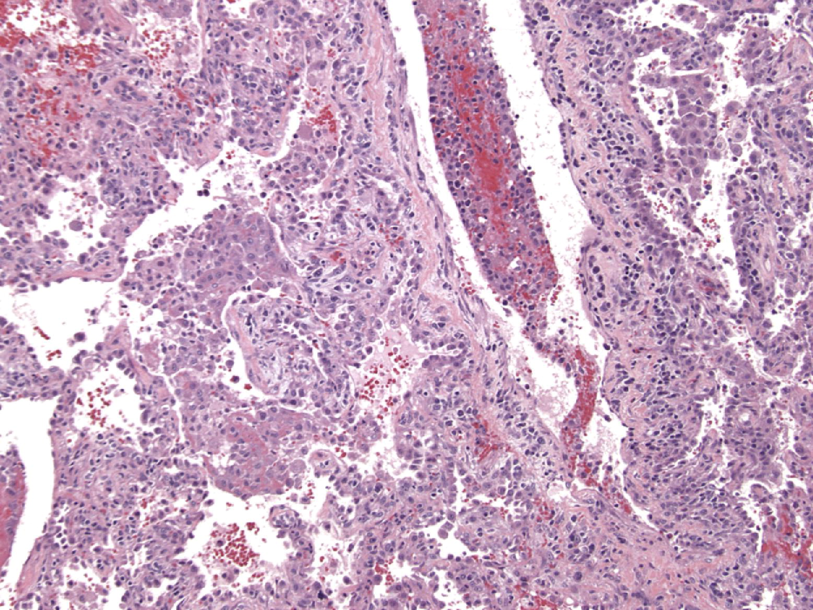
Figure 12
The Journal of Heart and Lung Transplantation 2007 261229-1242DOI: (10.1016/j.healun.2007.10.017)
Copyright © 2007 International Society for Heart and Lung Transplantation Terms and Conditions
Notes:
Severe acute cellular rejection (A4). At low magnification, the perivascular spaces and alveolar septa are expanded by a mononuclear inflammatory infiltrate, which paradoxically seems less intense than that seen in moderate acute cellular rejection. Percolation of mononuclear cells into the alveolar septa is readily identified and in severe rejection is accompanied by such pronounced alveolar pneumocyte injury that airspace fibrin and hyaline membranes form, with varying degrees of organization. This is accompanied by a nonspecific neutrophilic infiltrate. Such injury to the alveolar septa with fibrin exudation and neutrophil infiltration is characteristic of severe acute cellular rejection. Endothelialitis is almost uniformly seen in these cases. H&E.

Slide 14
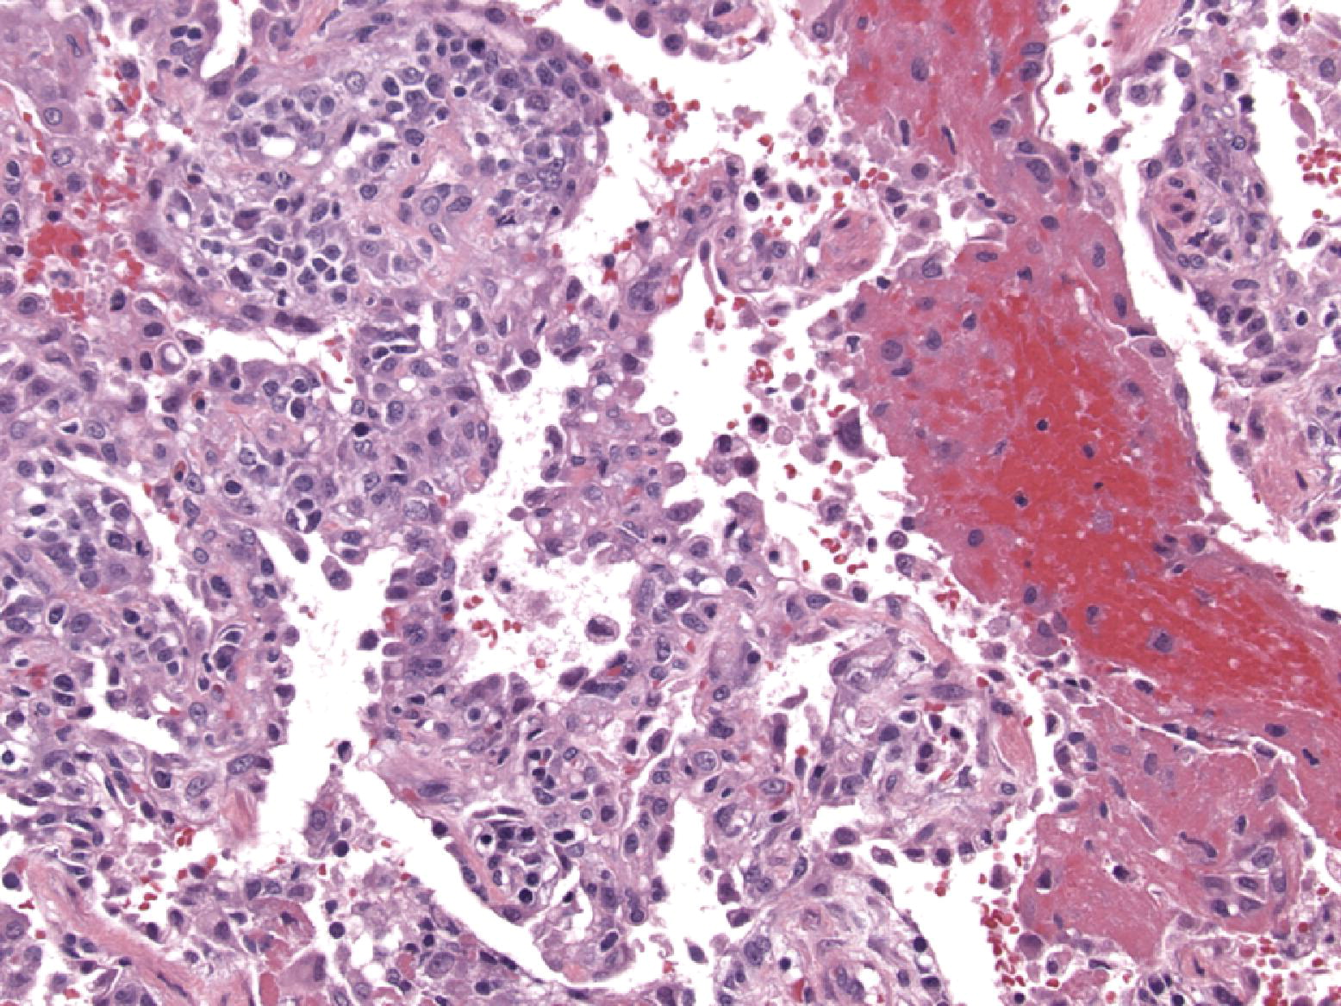
Figure 13
The Journal of Heart and Lung Transplantation 2007 261229-1242DOI: (10.1016/j.healun.2007.10.017)
Copyright © 2007 International Society for Heart and Lung Transplantation Terms and Conditions
Notes:
Severe acute cellular rejection (A4). In this example of severe acute rejection, perivascular mononuclear infiltrates are seen surrounding a small vessel at upper left and within alveolar septa. Injury to alveolar septa has resulted in hemorrhage and airspace fibrin undergoing varying degrees of organization. H&E.

Slide 15
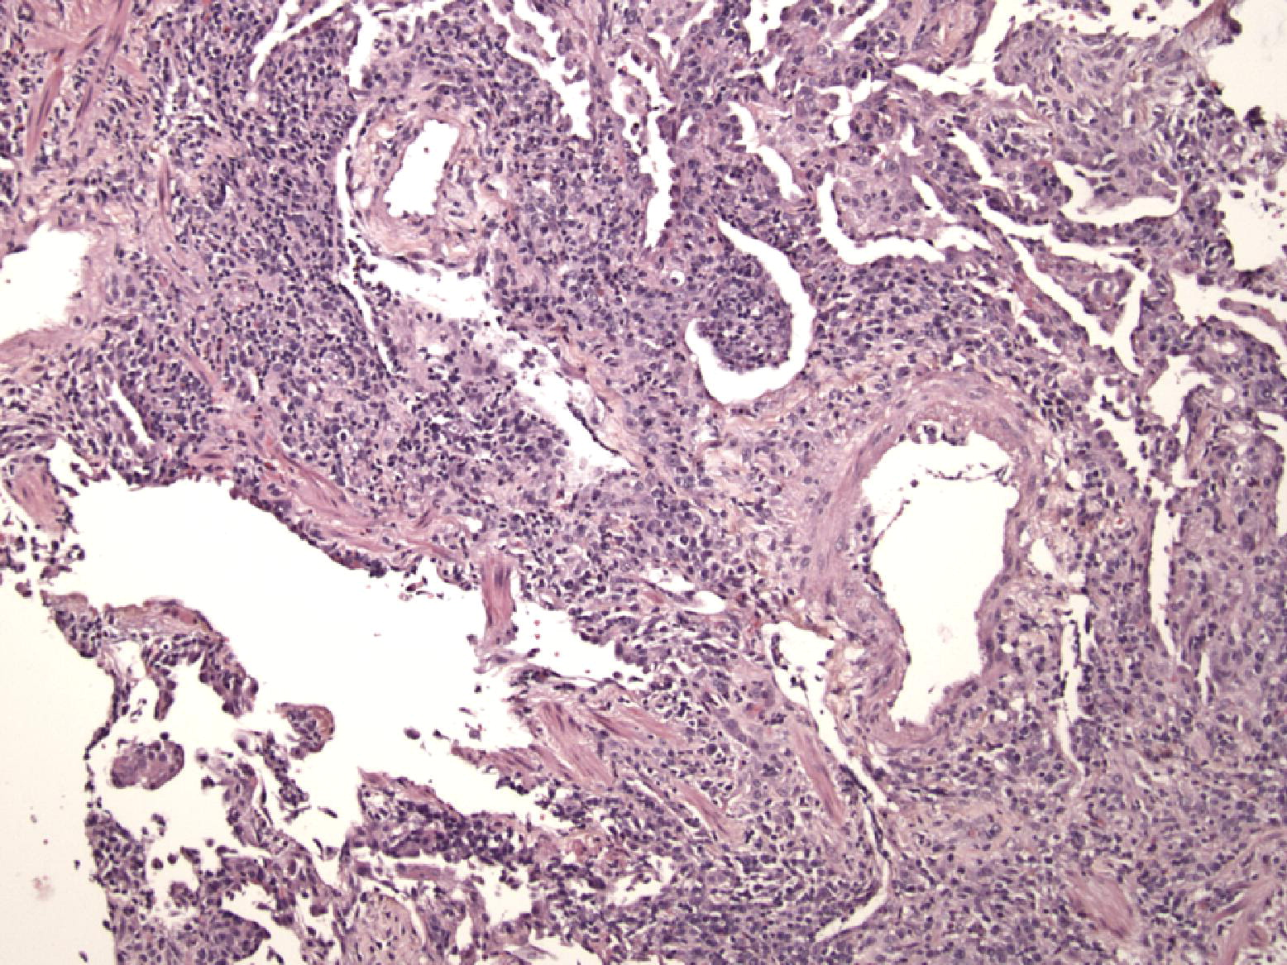
Figure 14
The Journal of Heart and Lung Transplantation 2007 261229-1242DOI: (10.1016/j.healun.2007.10.017)
Copyright © 2007 International Society for Heart and Lung Transplantation Terms and Conditions
Notes:
Severe acute cellular rejection (A4). In this example of severe acute cellular rejection two additional features are worthy of note. In addition to the perivascular and alveolar septal mononuclear infiltrate, there is significant injury to a small airway at lower left with an intense peribronchiolar mononuclear infiltrate. At upper right, airspace organization is noted with fibrin and hyaline membranes undergoing transition to granulation tissue. Such a finding can be a marker of the prior alveolar septal injury observed in moderate and severe acute rejection. H&E.

Slide 16
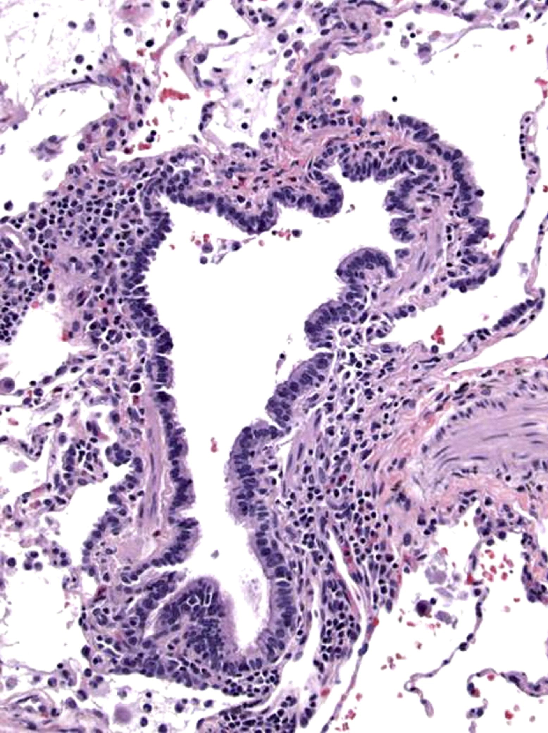
Figure 15
The Journal of Heart and Lung Transplantation 2007 261229-1242DOI: (10.1016/j.healun.2007.10.017)
Copyright © 2007 International Society for Heart and Lung Transplantation Terms and Conditions
Notes:
Low grade lymphocytic bronchiolitis (B1R). In this example the bronchiole shows a mild patchy peribronchiolar mononuclear cell infiltrate which spares the respiratory epithelium and is unassociated with epithelial injury. The infiltrate forms an incomplete circumferential band in places. There is no evidence of fibrosis in lymphocytic bronchiolitis in comparison with obliterative bronchiolitis. H&E.

Slide 17
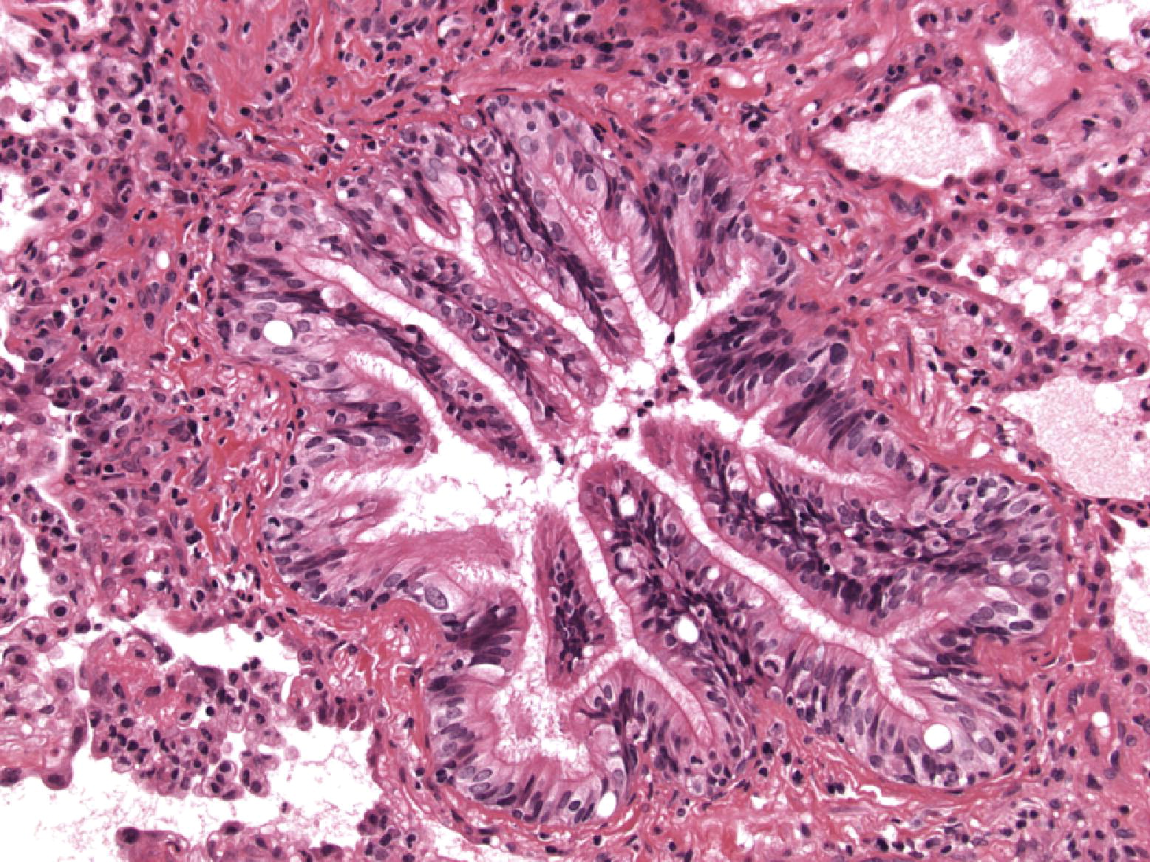
Figure 16
The Journal of Heart and Lung Transplantation 2007 261229-1242DOI: (10.1016/j.healun.2007.10.017)
Copyright © 2007 International Society for Heart and Lung Transplantation Terms and Conditions
Notes:
Low grade lymphocytic bronchiolitis (B1R). This terminal bronchiole shows epithelial hyperplasia and some epithelial undulation but is accompanied by a very sparse mononuclear inflammatory infiltrate which does not home to the basement membrane or injure the mucosal epithelium. H&E.

Slide 18
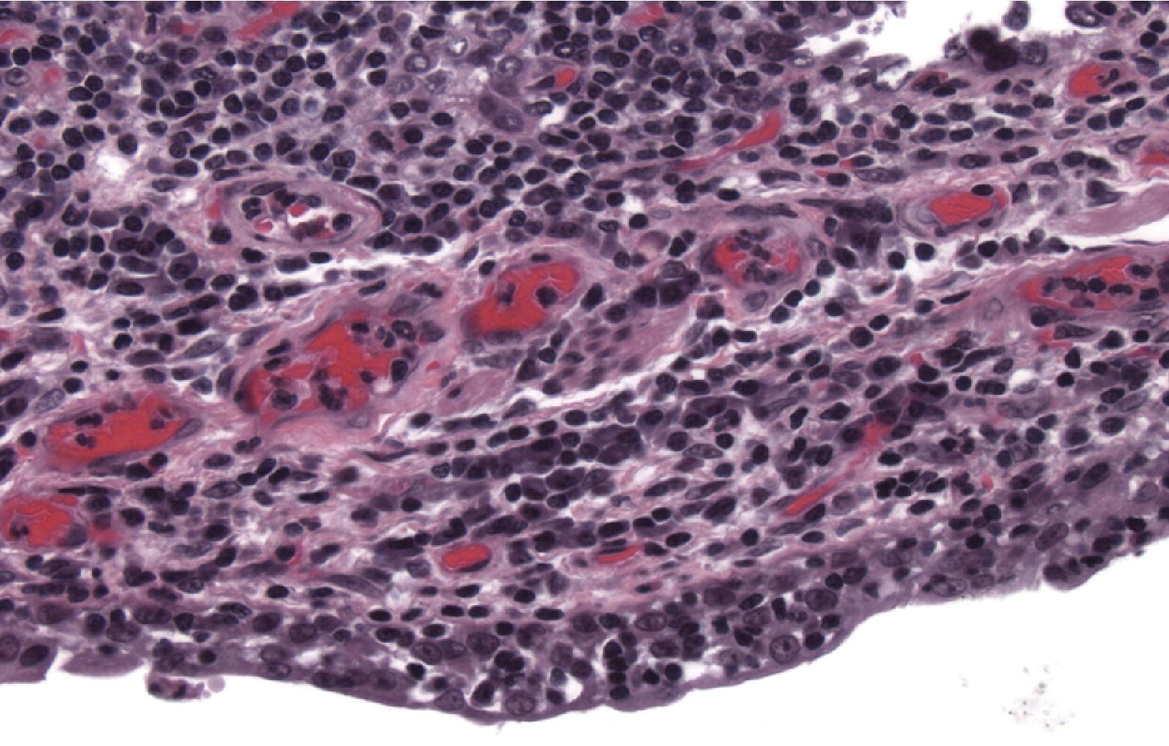
Figure 17
The Journal of Heart and Lung Transplantation 2007 261229-1242DOI: (10.1016/j.healun.2007.10.017)
Copyright © 2007 International Society for Heart and Lung Transplantation Terms and Conditions
Notes:
High grade lymphocytic bronchiolitis (B2R). In high grade lymphocytic bronchiolitis, in contrast to the low grade variant, mononuclear cells expand the submucosa and home to the epithelial basement membrane where they percolate through the basement membrane into the overlying respiratory epithelium. Epithelial cell necrosis and apoptosis is observed. H&E.

Slide 19
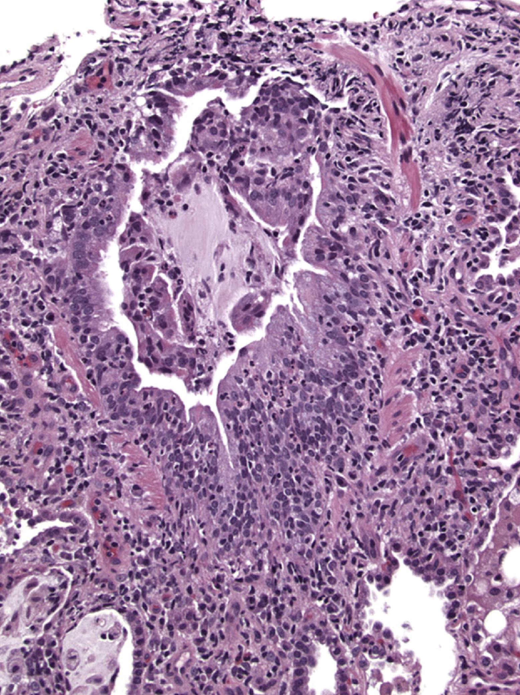
Figure 18
The Journal of Heart and Lung Transplantation 2007 261229-1242DOI: (10.1016/j.healun.2007.10.017)
Copyright © 2007 International Society for Heart and Lung Transplantation Terms and Conditions
Notes:
High grade lymphocytic bronchiolitis (B2R). This small bronchiole shows an intense mucosal and peribronchiolar mononuclear cell inflammatory infiltrate involving the epithelium with focal epithelial damage. Neutrophils are present in the epithelium and should not be confused with infectious bronchiolitis if correlation with microbiology is undertaken. H&E.

Slide 20
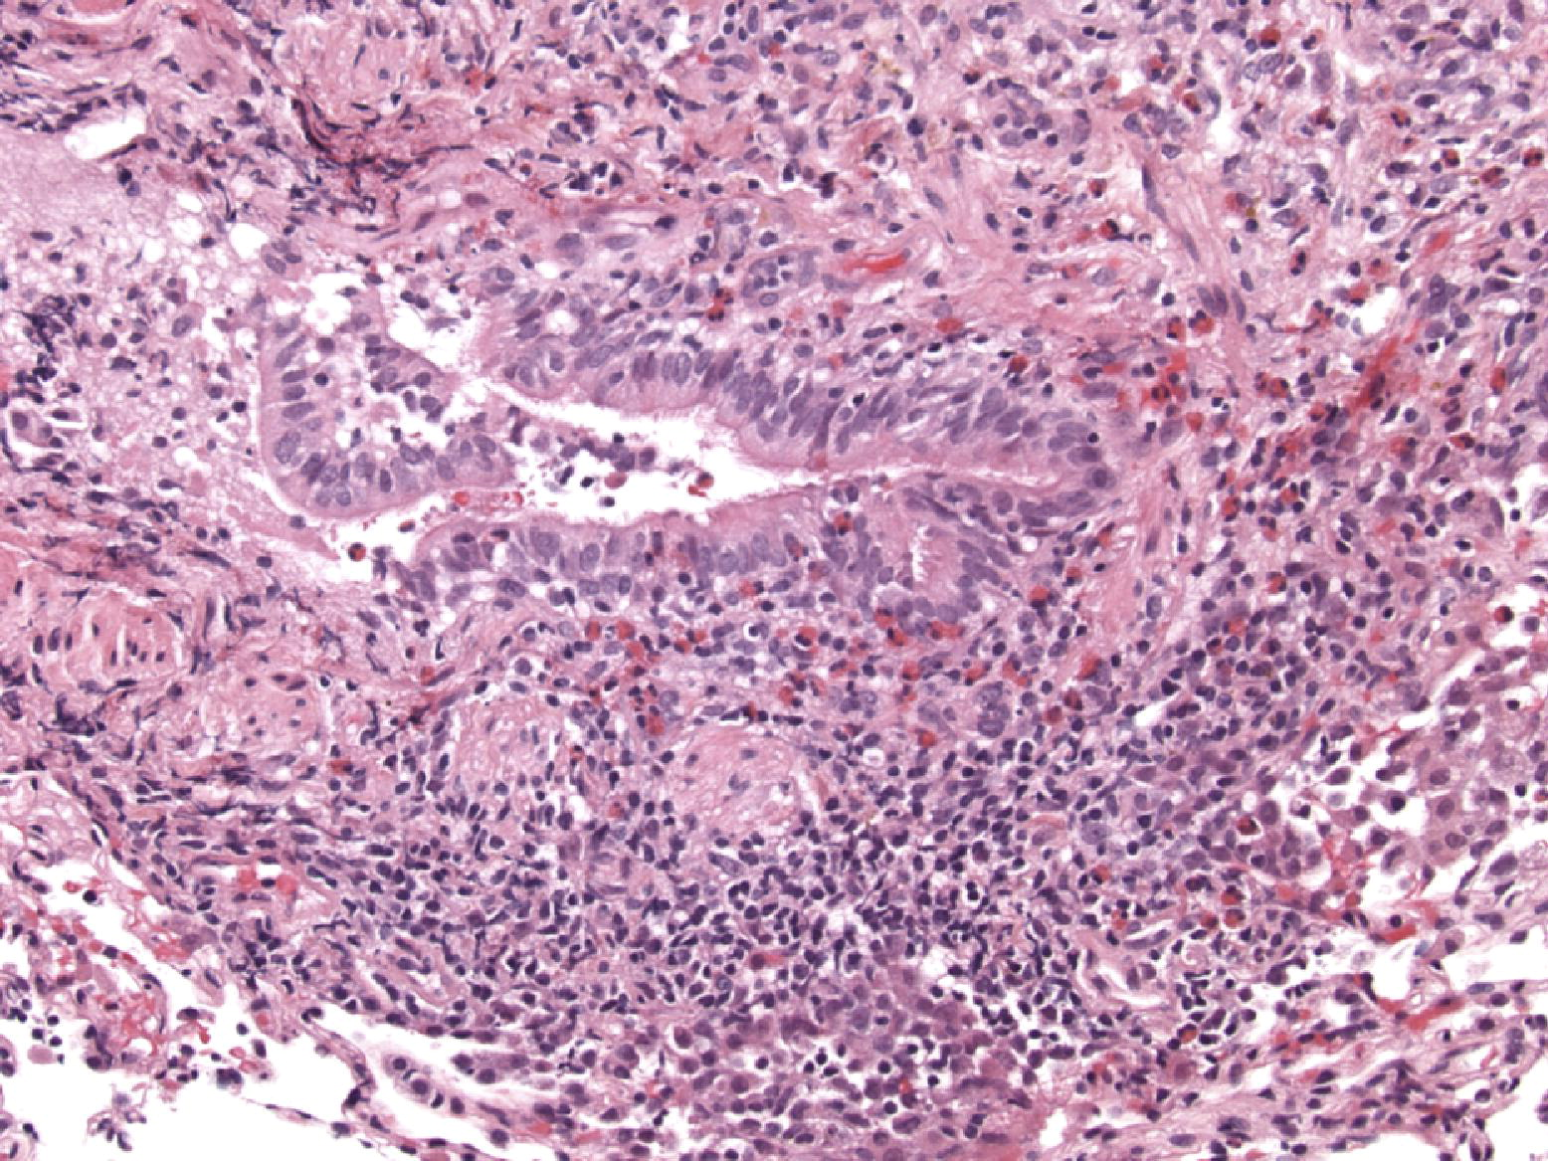
Figure 19
The Journal of Heart and Lung Transplantation 2007 261229-1242DOI: (10.1016/j.healun.2007.10.017)
Copyright © 2007 International Society for Heart and Lung Transplantation Terms and Conditions
Notes:
High grade lymphocytic bronchiolitis (B2R). In this example of a small bronchiole in a transbronchial biopsy, the mononuclear inflammatory cell infiltrate is accompanied by an intense eosinophilic infiltrate with eosinophils and lymphocytes traversing the epithelium accompanied by epithelial cell necrosis. Infection should be excluded as a cause of the eosinophilia. H&E.

Slide 21
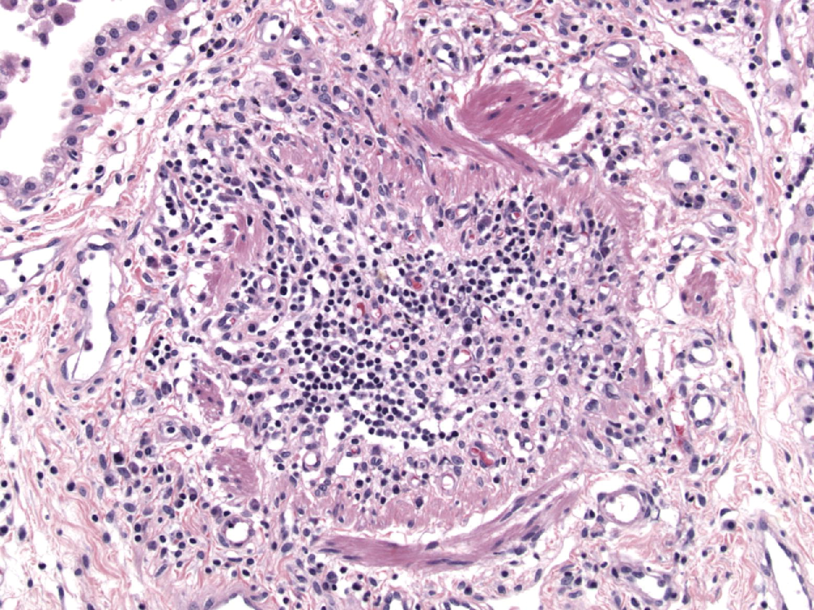
Figure 20
The Journal of Heart and Lung Transplantation 2007 261229-1242DOI: (10.1016/j.healun.2007.10.017)
Copyright © 2007 International Society for Heart and Lung Transplantation Terms and Conditions
Notes:
Obliterative bronchiolitis. In this example of obliterative bronchiolitis, the entire airway lumen has been obliterated by scar tissue and mononuclear cells, with the circumference of the small airways defined by an interrupted layer of smooth muscle bundles. H&E.

Slide 22
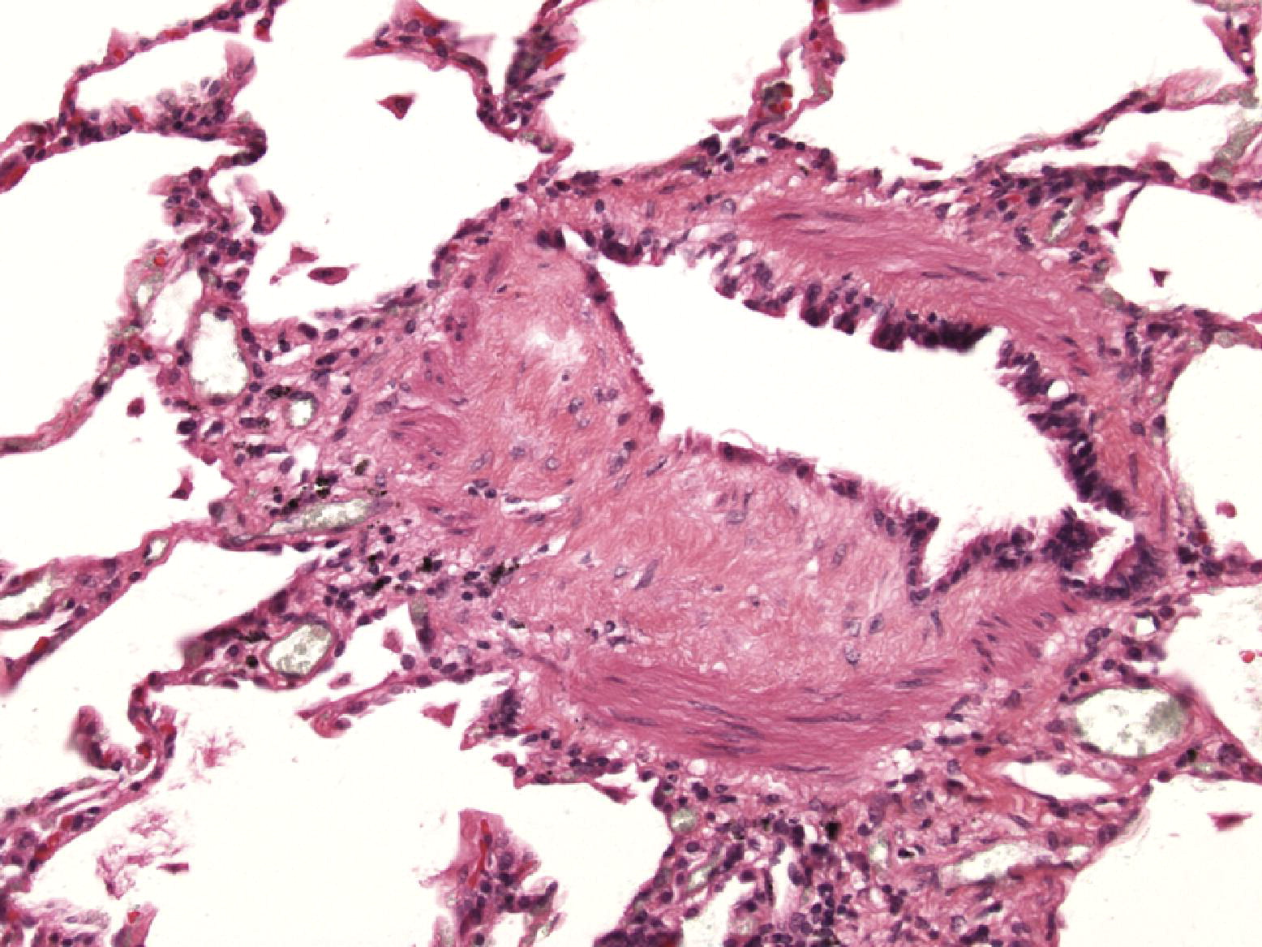
Figure 21
The Journal of Heart and Lung Transplantation 2007 261229-1242DOI: (10.1016/j.healun.2007.10.017)
Copyright © 2007 International Society for Heart and Lung Transplantation Terms and Conditions
Notes:
Obliterative bronchiolitis. This small bronchiole shows eccentric scarring of the submucosa of the small airway associated with an inconspicuous peribronchiolar mononuclear infiltrate. The overlying epithelium appears attenuated, while the lumen of the airway is distorted. Such partial occlusion of the small airways may be responsible for significant increases in airflow resistance. H&E.

Slide 23
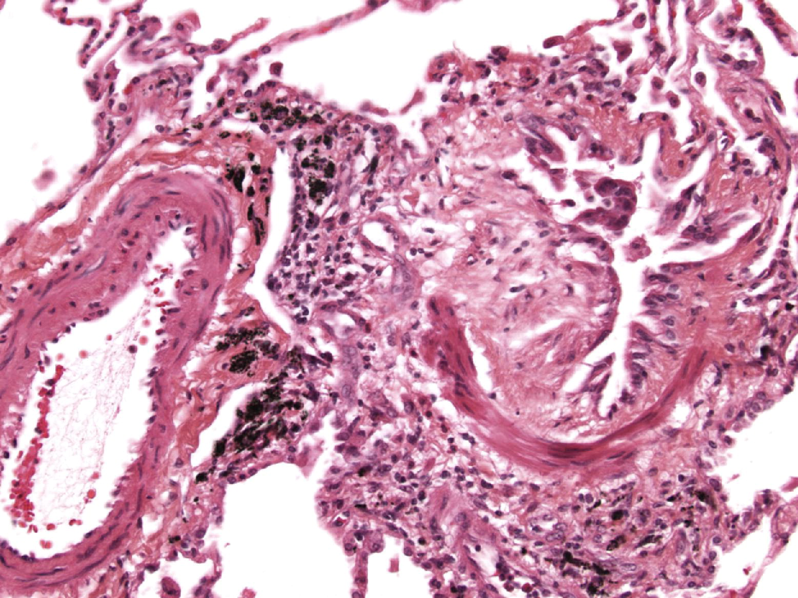
Figure 22
The Journal of Heart and Lung Transplantation 2007 261229-1242DOI: (10.1016/j.healun.2007.10.017)
Copyright © 2007 International Society for Heart and Lung Transplantation Terms and Conditions
Notes:
Obliterative bronchiolitis. In this transbronchial biopsy, an eccentric polypoid plaque of dense eosinophilic scar tissue is superimposed between attenuated respiratory epithelium and the smooth muscle wall of the airway. Such focal scarring of the airways is classified as obliterative bronchiolitis. H&E.

Slide 24
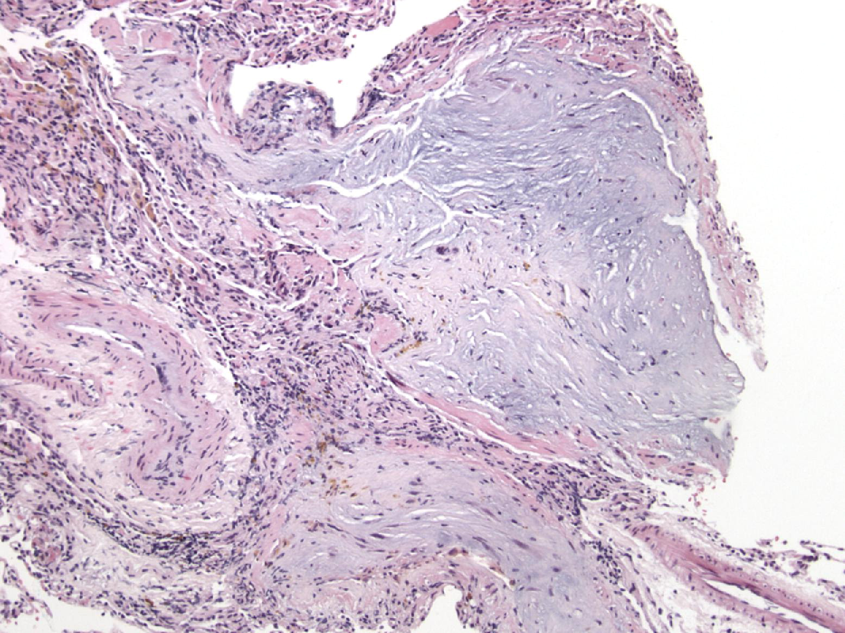
Figure 23
The Journal of Heart and Lung Transplantation 2007 261229-1242DOI: (10.1016/j.healun.2007.10.017)
Copyright © 2007 International Society for Heart and Lung Transplantation Terms and Conditions
Notes:
Obliterative bronchiolitis. In this distorted transbronchial biopsy, the scar tissue which is obliterating the airways has a loose myxoid quality but still shows dense lamellae of irreversible fibrous scar tissue in the airways. Once again the location of these scars adjacent to pulmonary arteries and the residual smooth muscle within the walls of these airways alert the pathologist to small airway disease. H&E.

Slide 25
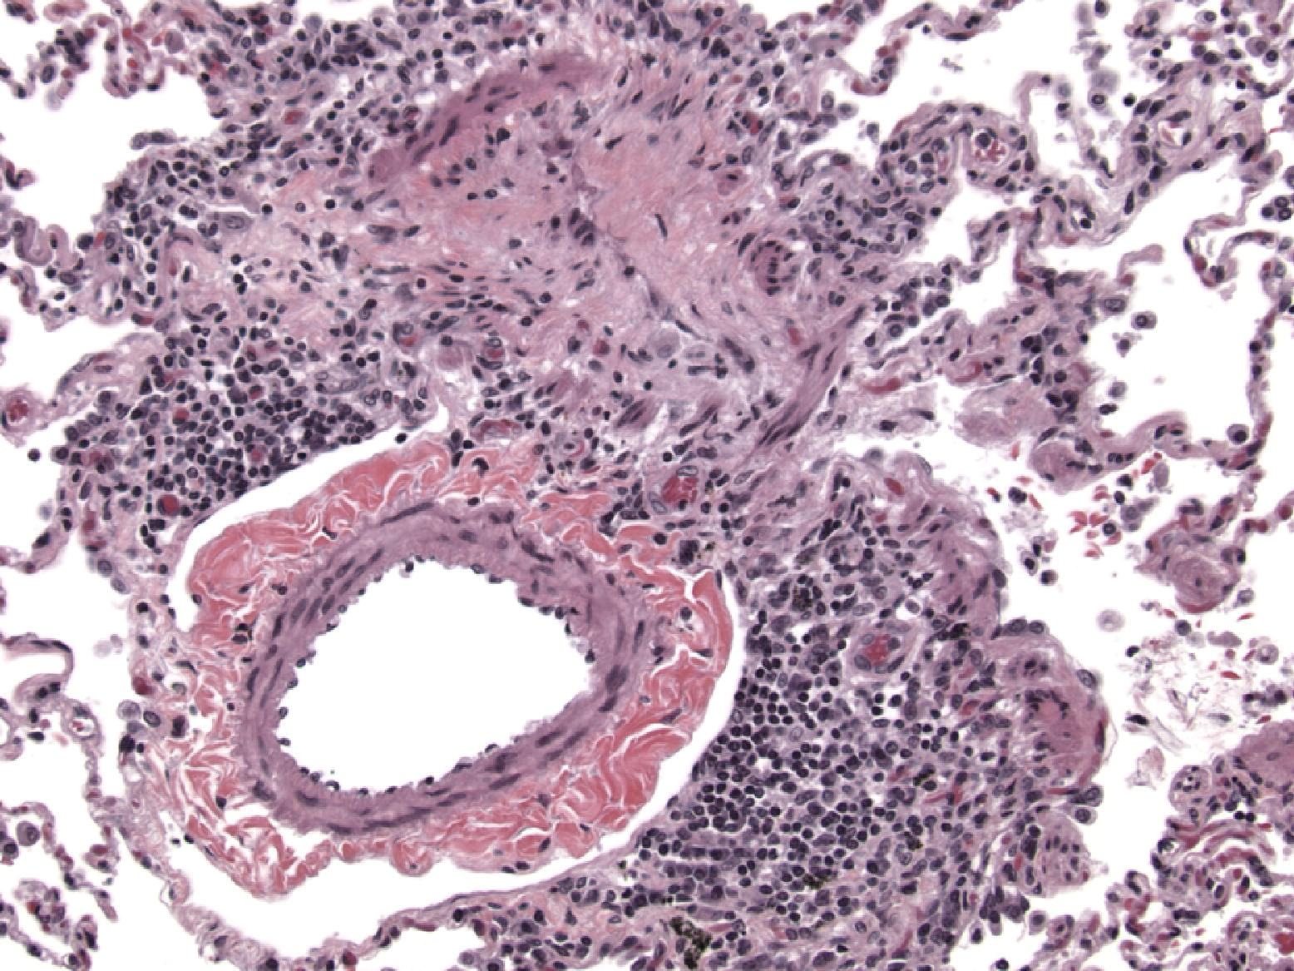
Figure 24
The Journal of Heart and Lung Transplantation 2007 261229-1242DOI: (10.1016/j.healun.2007.10.017)
Copyright © 2007 International Society for Heart and Lung Transplantation Terms and Conditions
Notes:
Obliterative bronchiolitis. The hint to underlying obliterative bronchiolitis in this case is the interrupted cords of smooth muscle forming a tubular structure associated with dense scar tissue in a position adjacent to a pulmonary artery. H&E.

Slide 26
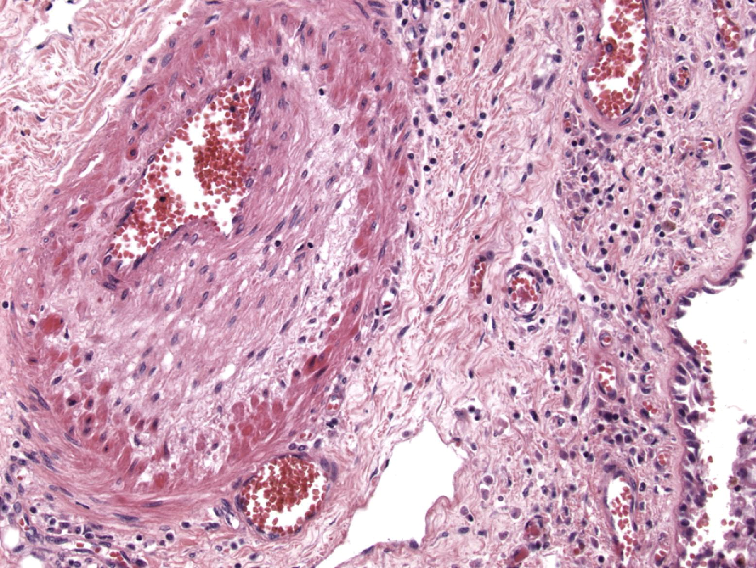
Figure 25
The Journal of Heart and Lung Transplantation 2007 261229-1242DOI: (10.1016/j.healun.2007.10.017)
Copyright © 2007 International Society for Heart and Lung Transplantation Terms and Conditions
Notes:
Graft atherosclerosis. In this example of accelerated vascular atherosclerosis due to alloreactive injury the pulmonary arteries adjacent to airways show fibro-intimal thickening of the subendothelial zones with atrophy of the media. H&E.

