Slide 1
Revision of the 1990 Working Formulation for the Standardization of Nomenclature in the Diagnosis of Heart Rejection
Susan Stewart, Gayle L. Winters, MD, Michael C. Fishbein, MD, Henry D. Tazelaar, MD, Jon Kobashigawa, MD, Jacki Abrams, MD, Claus B. Andersen, MD, DMSc, Annalisa Angelini, MD, Gerald J. Berry, MD, Margaret M. Burke, Anthony J. Demetris, MD, Elizabeth Hammond, MD, Silviu Itescu, MD, Charles C. Marboe, MD, Bruce McManus, MD, PhD, Elaine F. Reed, PhD, Nancy L. Reinsmoen, PhD, E. Rene Rodriguez, MD, Alan G. Rose, MD, Marlene Rose, PhD, MRCPath, Nicole Suciu-Focia, PhD, Adriana Zeevi, PhD, Margaret E. Billingham
The Journal of Heart and Lung Transplantation
Volume 24 Issue 11 Pages 1710-1720 (November 2005)
DOI: 10.1016/j.healun.2005.03.019
Copyright © 2005 International Society for Heart and Lung Transplantation Terms and Conditions

Slide 2
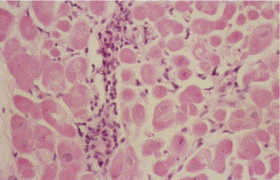
Figure 1
The Journal of Heart and Lung Transplantation 2005 241710-1720DOI: (10.1016/j.healun.2005.03.019)
Copyright © 2005 International Society for Heart and Lung Transplantation Terms and Conditions
Notes:
Myocardial biopsy showing acute cellular rejection with an inflammatory infiltrate composed of mainly lymphocytes in a perivascular distribution and not extending into interstitium or damaging myocytes. Hematoxylin and Eosin. (H&E)

Slide 3
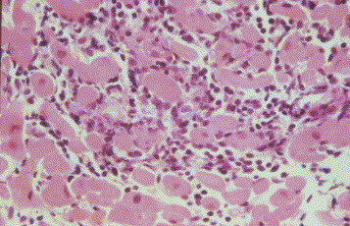
Figure 2
The Journal of Heart and Lung Transplantation 2005 241710-1720DOI: (10.1016/j.healun.2005.03.019)
Copyright © 2005 International Society for Heart and Lung Transplantation Terms and Conditions
Notes:
Myocyte damage characterized by encroachment of mononuclear cells at the perimeter of myocytes resulting in irregular, scalloped borders and distorting the cellular architecture. Several myocytes are surrounded by infiltrating cells. (H&E).

Slide 4
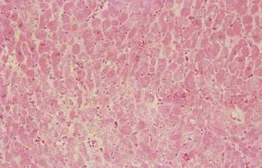
Figure 3
The Journal of Heart and Lung Transplantation 2005 241710-1720DOI: (10.1016/j.healun.2005.03.019)
Copyright © 2005 International Society for Heart and Lung Transplantation Terms and Conditions
Notes:
Grade 0 R: Normal endomyocardial biopsy showing no evidence of cellular infiltration. (H&E).

Slide 5
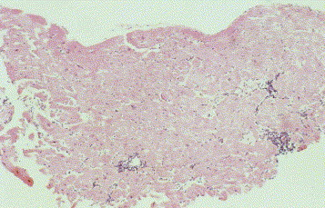
Figure 4
The Journal of Heart and Lung Transplantation 2005 241710-1720DOI: (10.1016/j.healun.2005.03.019)
Copyright © 2005 International Society for Heart and Lung Transplantation Terms and Conditions
Notes:
Grade 1 R: Low power view of endomyocardial biopsy showing three focal, perivascular infiltrates without myocyte damage. Previously Grade 1A (H&E).

Slide 6
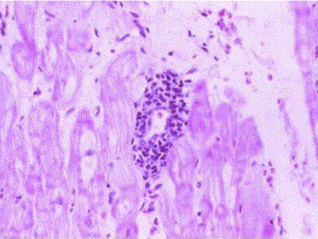
Figure 5
The Journal of Heart and Lung Transplantation 2005 241710-1720DOI: (10.1016/j.healun.2005.03.019)
Copyright © 2005 International Society for Heart and Lung Transplantation Terms and Conditions
Notes:
Grade 1 R: Higher power view of focal, perivascular mononuclear cell infiltrate without myocyte encroachment or damage. Previously Grade 1A. (H&E).

Slide 7
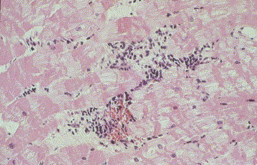
Figure 6
The Journal of Heart and Lung Transplantation 2005 241710-1720DOI: (10.1016/j.healun.2005.03.019)
Copyright © 2005 International Society for Heart and Lung Transplantation Terms and Conditions
Notes:
Grade 1 R: Both perivascular and interstitial infiltrates are present but without definite evidence of myocyte damage. Previously Grade 1A (H&E).

Slide 8
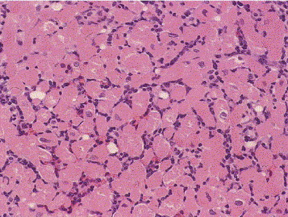
Figure 7
The Journal of Heart and Lung Transplantation 2005 241710-1720DOI: (10.1016/j.healun.2005.03.019)
Copyright © 2005 International Society for Heart and Lung Transplantation Terms and Conditions
Notes:
Grade 1 R: Diffuse mononuclear cell infiltrate with an interstitial pattern of lymphocytes between and around myocytes without associated myocyte damage. Previously Grade 1B. (H&E).

Slide 9
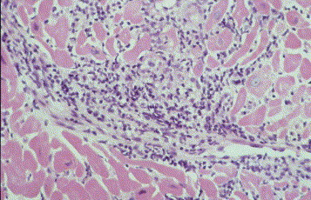
Figure 8
The Journal of Heart and Lung Transplantation 2005 241710-1720DOI: (10.1016/j.healun.2005.03.019)
Copyright © 2005 International Society for Heart and Lung Transplantation Terms and Conditions
Notes:
Grade 1 R: High power view of a mononuclear infiltrate extending from a perivascular position into adjacent myocardium with damage to myocytes and distortion of architecture. This is a single focus in the biopsy series and therefore is included in the revised mild grade of acute rejection, previously described as Grade 2. (H&E).

Slide 10
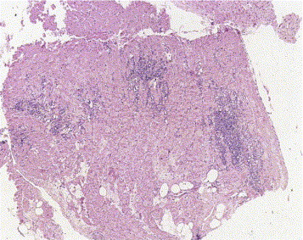
Figure 9
The Journal of Heart and Lung Transplantation 2005 241710-1720DOI: (10.1016/j.healun.2005.03.019)
Copyright © 2005 International Society for Heart and Lung Transplantation Terms and Conditions
Notes:
Grade 2 R: Low power view showing three foci of damaging mononuclear cell infiltrate with normal myocardium intervening. Prevously Grade 3A. (H&E).

Slide 11
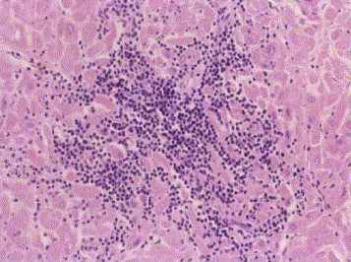
Figure 10
The Journal of Heart and Lung Transplantation 2005 241710-1720DOI: (10.1016/j.healun.2005.03.019)
Copyright © 2005 International Society for Heart and Lung Transplantation Terms and Conditions
Notes:
Grade 2 R: Higher power view of one focus of figure 9 damaging infiltrate with myocyte damage and architectural distortion (a “space occupying lesion”). (H&E).

Slide 12
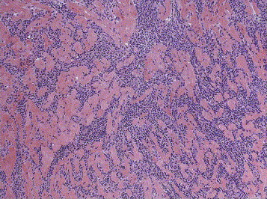
Figure 11
The Journal of Heart and Lung Transplantation 2005 241710-1720DOI: (10.1016/j.healun.2005.03.019)
Copyright © 2005 International Society for Heart and Lung Transplantation Terms and Conditions
Notes:
Grade 3 R: Diffuse damaging infiltrates with encroachment of myocytes and disruption of normal architecture. This contrasts with the non-damaging infiltrates of figure 7. Prevously Grade 3B. (H&E).

Slide 13
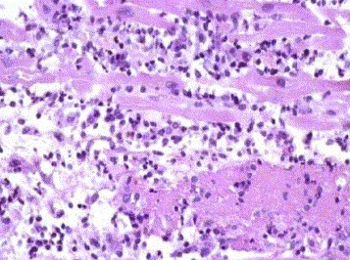
Figure 12
The Journal of Heart and Lung Transplantation 2005 241710-1720DOI: (10.1016/j.healun.2005.03.019)
Copyright © 2005 International Society for Heart and Lung Transplantation Terms and Conditions
Notes:
Grade 3 R: Severe acute rejection with widespread myocyte damage and some necrosis. The diffuse infiltrate includes polymorphs as well as lymphocytes, macrophages and plasma cells. Previously Grade 4. (H&E).

Slide 14
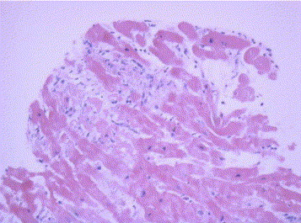
Figure 13
The Journal of Heart and Lung Transplantation 2005 241710-1720DOI: (10.1016/j.healun.2005.03.019)
Copyright © 2005 International Society for Heart and Lung Transplantation Terms and Conditions
Notes:
Peritransplant injury showing a focus of ischemic injury with myocytolysis and vacuolization. Note the relative lack of infiltrating inflammatory cells compared with acute cellular rejection. Macrophages are present. (H&E).

Slide 15
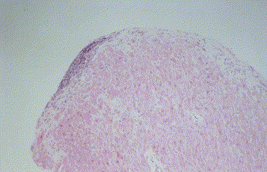
Figure 14
The Journal of Heart and Lung Transplantation 2005 241710-1720DOI: (10.1016/j.healun.2005.03.019)
Copyright © 2005 International Society for Heart and Lung Transplantation Terms and Conditions
Notes:
Low power view of non-encroaching endocardial infiltrate or Quilty lesion with normal underlying myocardium. (H&E).

Slide 16
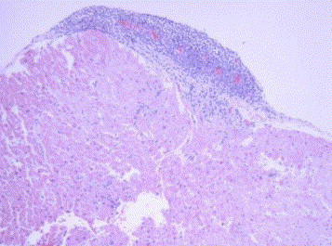
Figure 15
The Journal of Heart and Lung Transplantation 2005 241710-1720DOI: (10.1016/j.healun.2005.03.019)
Copyright © 2005 International Society for Heart and Lung Transplantation Terms and Conditions
Notes:
Higher power view of another area of the same biopsy as figure 14, showing some superficial encroachment of the endocardial lesion into underlying myocardium. Note the prominent vascularity of this endocardial infiltrate which can be a very useful feature for distinguishing tangentially cut infiltrates from foci of acute cellular rejection. (H&E).

Slide 17
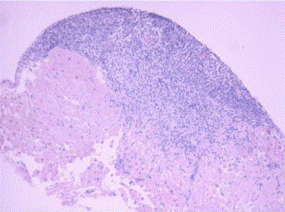
Figure 16
The Journal of Heart and Lung Transplantation 2005 241710-1720DOI: (10.1016/j.healun.2005.03.019)
Copyright © 2005 International Society for Heart and Lung Transplantation Terms and Conditions
Notes:
A deeper section of the biopsy in figure 15 showing much greater encroachment into myocardium and less vascularity. (H&E).

Slide 18
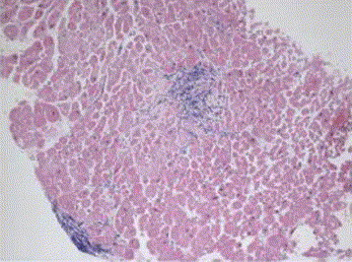
Figure 17
The Journal of Heart and Lung Transplantation 2005 241710-1720DOI: (10.1016/j.healun.2005.03.019)
Copyright © 2005 International Society for Heart and Lung Transplantation Terms and Conditions
Notes:
Endomyocardial biopsy showing a small endocardial infiltrate and focus of deeper intramyocardial cellular infiltration which raises the possibility of acute cellular rejection until deeper sections are examined. (H&E).

Slide 19
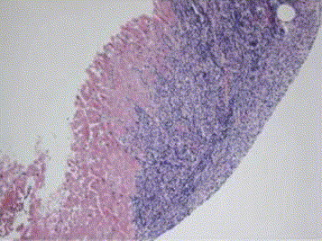
Figure 18
The Journal of Heart and Lung Transplantation 2005 241710-1720DOI: (10.1016/j.healun.2005.03.019)
Copyright © 2005 International Society for Heart and Lung Transplantation Terms and Conditions
Notes:
Deeper section of figure 17 clearly shows extension of the surface endocardial infiltrate into myocardium confirming the correct diagnosis of Quilty lesion rather than acute cellular rejection. (H&E).

Slide 20
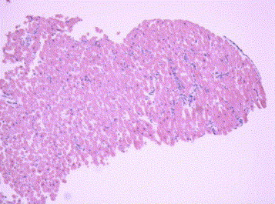
Figure 19
The Journal of Heart and Lung Transplantation 2005 241710-1720DOI: (10.1016/j.healun.2005.03.019)
Copyright © 2005 International Society for Heart and Lung Transplantation Terms and Conditions
Notes:
Antibody mediated rejection (AMR 1). Low power view of endomyocardial biopsy with scattered cellular infiltrates and intervening normal tissue. (H&E).

Slide 21
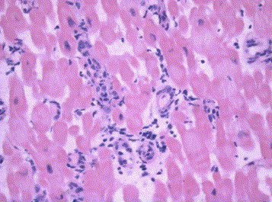
Figure 20
The Journal of Heart and Lung Transplantation 2005 241710-1720DOI: (10.1016/j.healun.2005.03.019)
Copyright © 2005 International Society for Heart and Lung Transplantation Terms and Conditions
Notes:
AMR 1. Higher power view shows that the cellular infiltrates are within vessels and include polymorphs. Endothelial cell swelling is present. The increased cellularity seen at low power is due to the presence of these intravascular cells and not perivascular inflammation. Compare with figures 1 and 5. (H&E).

Slide 22
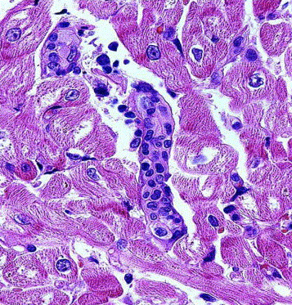
Figure 21
The Journal of Heart and Lung Transplantation 2005 241710-1720DOI: (10.1016/j.healun.2005.03.019)
Copyright © 2005 International Society for Heart and Lung Transplantation Terms and Conditions
Notes:
AMR 1. High power view confirms the intravascular location of the cells which have the appearance of macrophages and illustrates the endothelial cell swelling. (H&E).

Slide 23
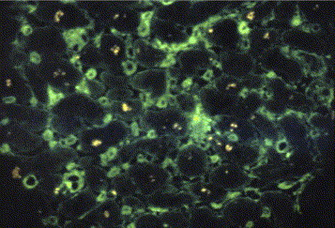
Figure 22
The Journal of Heart and Lung Transplantation 2005 241710-1720DOI: (10.1016/j.healun.2005.03.019)
Copyright © 2005 International Society for Heart and Lung Transplantation Terms and Conditions
Notes:
AMR 1. Immunofluorescence positivity for IgG clearly shown in and around capillaries.

Slide 24
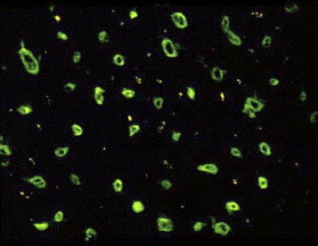
Figure 23
The Journal of Heart and Lung Transplantation 2005 241710-1720DOI: (10.1016/j.healun.2005.03.019)
Copyright © 2005 International Society for Heart and Lung Transplantation Terms and Conditions
Notes:
AMR 1. Immunofluorescence positivity for C4d in capillaries with characteristic “doughnut” appearance.

Slide 25
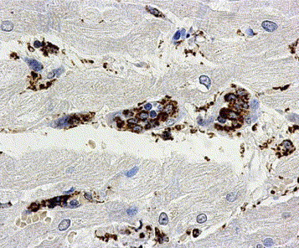
Figure 24
The Journal of Heart and Lung Transplantation 2005 241710-1720DOI: (10.1016/j.healun.2005.03.019)
Copyright © 2005 International Society for Heart and Lung Transplantation Terms and Conditions
Notes:
AMR 1. Immunoperoxidase staining is strongly positive for CD68, confirming the intravascular cells to be macrophages.

Slide 26
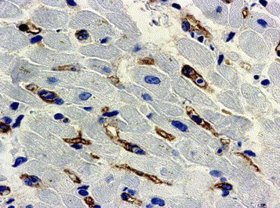
Figure 25
The Journal of Heart and Lung Transplantation 2005 241710-1720DOI: (10.1016/j.healun.2005.03.019)
Copyright © 2005 International Society for Heart and Lung Transplantation Terms and Conditions
Notes:
AMR 1. Immunoperoxidase staining is strongly positive for C4d in capillaries allowing a diagnosis of AMR to be made in the appropriate context. (see text).

